Slide 1
Macro-class Selection for Hierarchical k-NN Classification of Inertial Sensor Data
Corey McCall, Kishore Reddy, and Mubarak Shah University of Central Florida

Slide 2
Problem
Automatic construction of a hierarchical classifier for action recognition in pervasive systems.

Slide 3
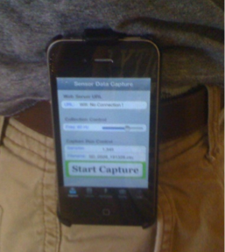
Datasets
Smartphone Dataset
Exercise sequence recorded with smartphone IMU.
13 features across each DoF of each sensor.
125 candidate features per IMU.

Slide 4
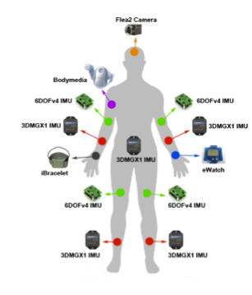
Datasets
CMU-MMAC Dataset
Cooking sequences recorded with 5 IMUs.
525 potential features

Slide 5
Datasets

Slide 6
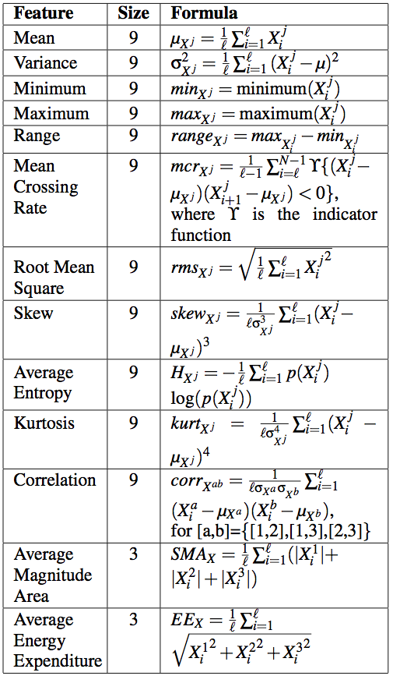
Features

Slide 7
Motivation
The difficulty and cost of classification generally increases with the number of classes.
Goal: Hierarchical classification for accurate and efficient action recognition.
How to build hierarchy? (macro-class selection)
Which features to use at each level? (feature selection)
?

Slide 8
Motivation

Slide 9
The Algorithm
Summary of Training Procedure
Select features and macro-classes for top level of hierarchy.
Train k-NN to classify each training sample into a macro-class.
Select a specialized feature set for each macro-class.
Train k-NN on each macro-with specialized feature set.

Slide 10
The Algorithm
Summary of Testing Procedure
Classify test sample into a macro-class.
Classify test sample on macro-class using specialized features.

Slide 11
The Algorithm

Slide 12
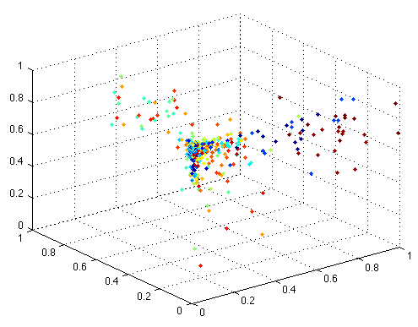
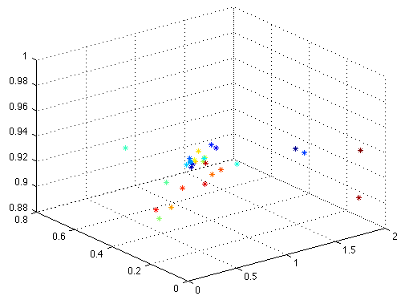
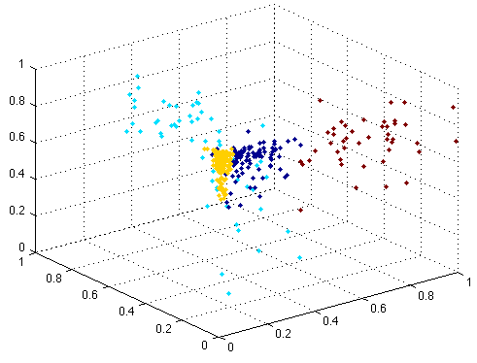
The Algorithm
A Greedy Approach based on k-NN
For each potential feature set:
Calculate each class’s mean
Cluster means with special k-means
Use 1-NN to assign class to macro-class
Score feature/macro-class selection

Slide 13
The Algorithm
Macro-class selection example
Training examples in potential feature set
Center of each class

Slide 14
The Algorithm
A: [4 5 12 17 22 23]
B: [13 14 15 21 24 25]
C: [2 3 7 8 9 10 11 16 18 19 20 26 27] D: [1 6 28 29]
Classification Results:
Classifier A 97.9% Classifier B 86.5% Classifier C 63.3% Classifier D 66.0% TOTAL: 71.1%
(Single Classifier): 62.2%
Training examples placed in macro-classes

Slide 15
The Algorithm
Macro-class Scoring
First, optimize for high training accuracy using θ.
After threshold, optimize for better distribution using Φ.

Slide 16
The Algorithm (Details)
Compute candidate feature set C of potential features f_{i}
Scale C to [0,1]
Initialize selected feature set S to empty
Iterate while score increases or C is empty: For all f_{i} in C Calculate mean of each class of features in S U f_{i} Perform k-means on class means to get cluster centers Assign each data example in training set to a bin using 1-NN Assign each class to a bin based on popularity Determine a score based on accuracy threshold Add feature with best score S and remove from C.

Slide 17
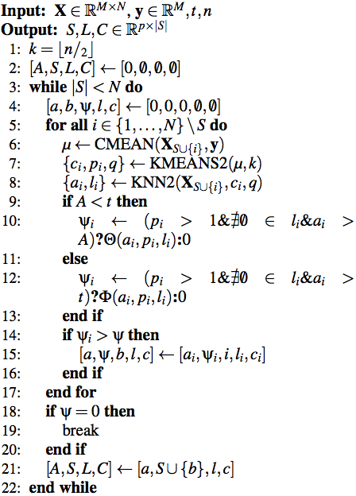
The Algorithm (Details)

Slide 18
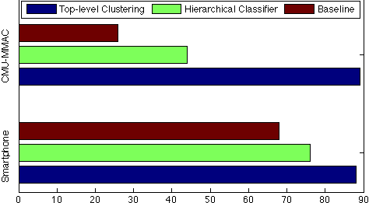
Experimental Results
CMU-MMAC: 69% improvement
Smartphone: 12% improvement

Slide 19
Experimental Results
1. Close Fridge | 16. Read Box
2. Crack Egg | 17. Spray Pam
3. Open Box | 18. Stir Bowl
4. Open Cupboard1 | 19. Stir Egg
5. Open Cupboard2 | 20.Switch On
6. Open Fridge | 21. Take Pan
7. Pour Bowl in Pan | 22. Take Egg
8. Pour Bag in Bowl | 23. Take Fork
9. Pour Oil in Bowl | 24. Take Oil
10. Pour Oil in Cup | 25. Take Pam
11. Pour Water in Bowl | 26. Twist Off Cap
12. Pour Water in Cup | 27. Twist On Cap
13. Put Pan in Oven | 28. Walk to Counter
14. Put Oil in Cupboard3 | 29. Walk to Fridge
15. Put Pam in Cupboard3
CMU-MMAC Dataset

Slide 20
Experimental Results
Smartphone Dataset
1. Biking | 6. Running
2. Climbing | 7. Standing
3. Descending | 8. Treadmill Walking
4. Exercise Biking | 9. Walking
5. Jump Roping

Slide 21
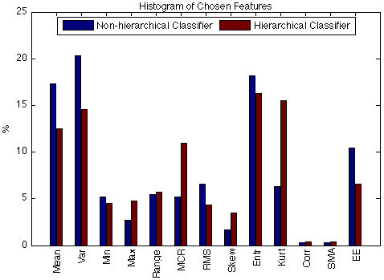
Experimental Results
Std. Dev. Non-Hierarchical: 6.8
Std. Dev. Hierarchical: 5.6

Slide 22
Conclusion
Constructed hierarchical classifier shows significant improvement over baseline.
Final results on CMU-MMAC dataset: 44%
Lower than (Fisher and Reddy, 2011)
Very High top-level clustering accuracy (~90%)
Large improvement because of many confusing classes.
Final results on Smartphone dataset: 76%

Slide 23
Summary of Contributions
First algorithm to automatically select features and macro-classes.
Can be used in conjunction with more complex feature selection and classification algorithms as the top-level of hierarchy.
Smartphone dataset, UCF Computer Vision Lab, 2011: http://vision.eecs.ucf.edu/data/SmartPhone

