Slide 1
GMCP-Tracker: Global Multi-object Tracking Using Generalized Minimum Clique Graphs
UCF
Computer Vision Lab
Amir R. Zamir, Afshin Dehghan, Mubarak Shah
UCF Computer Vision lab

Slide 2
Tracking Problem:
UCF
Computer Vision Lab

Slide 3
Data Association:
UCF
Computer Vision Lab
Temporally Local!

Slide 4
Data Association:
UCF
Computer Vision Lab
Temporally Local!
Temporally Global!

Slide 5
GMCP Tracker:
UCF
Computer Vision Lab

Slide 6
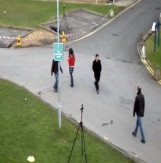
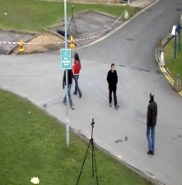
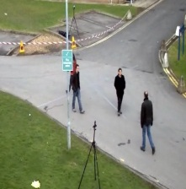
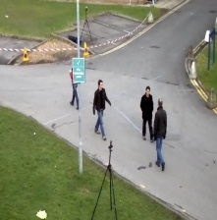
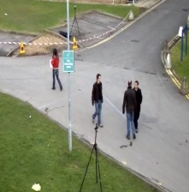
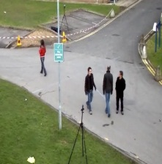
Finding Tracklets using GMCP
UCF
Computer Vision Lab
We define graph $G=(V,E,w)$:
Frame 1
Frame 2
Frame 3
Frame 4
Frame 5
Frame 6

Slide 7
Finding Tracklets using GMCP
UCF
Computer Vision Lab
We define graph $G=(V,E,w)$:
Frame 1
Frame 2
Frame 3
$$v_{1}^{1}$$
$$v_{2}^{1}$$
$$v_{1}^{2}$$
$$v_{2}^{2}$$
$$v_{1}^{3}$$
$$v_{2}^{3}$$
$$v_{3}^{1}$$
$$v_{3}^{2}$$
$$v_{3}^{3}$$
$$v_{1}^{5}$$
$$v_{1}^{4}$$
$$v_{2}^{4}$$
$$v_{2}^{5}$$
$$v_{1}^{6}$$
$$v_{2}^{6}$$
$$v_{3}^{5}$$
$$v_{3}^{6}$$
$$v_{3}^{4}$$
Frame 4
Frame 5
Frame 6

Slide 8
Finding Tracklets using GMCP
UCF
Computer Vision Lab
We define graph $G=(V,E,w)$:
Frame 1
Frame 2
Frame 3
$$C_{1}^{}$$
$$v_{1}^{1}$$
$$v_{2}^{1}$$
$$C_{2}^{}$$
$$v_{1}^{2}$$
$$v_{2}^{2}$$
$$C_{3}^{}$$
$$v_{1}^{3}$$
$$v_{2}^{3}$$
$$v_{3}^{1}$$
$$v_{3}^{2}$$
$$v_{3}^{3}$$
$$C_{4}^{}$$
$$C_{5}^{}$$
$$v_{1}^{5}$$
$$C_{6}^{}$$
$$v_{1}^{4}$$
$$v_{2}^{4}$$
$$v_{2}^{5}$$
$$v_{1}^{6}$$
$$v_{2}^{6}$$
$$v_{3}^{5}$$
$$v_{3}^{6}$$
$$v_{3}^{4}$$
Frame 4
Frame 5
Frame 6

Slide 9
Finding Tracklets using GMCP
UCF
Computer Vision Lab
$Input graph G shown in yellow edges$
Frame 1
Frame 2
Frame 3
Frame 4
Frame 5
Frame 6

Slide 10
Finding Tracklets using GMCP
UCF
Computer Vision Lab
$Input graph G shown in yellow edges$
Frame 1
Frame 2
Frame 3
Frame 4
Frame 5
Frame 6
$Goal:Find the subgraph {G_{s}=(V_{s},E_{s},w_{s})}_{} where one node out of each cluster is selected.$
$G_{s} detemines the tracklet of one person.$

Slide 11
Finding Tracklets using GMCP
UCF
Computer Vision Lab
$a feasible G_{s} shown in orange:$
Frame 1
Frame 2
Frame 3
Frame 1
Frame 2
Frame 3
Frame 2
Frame 5
Frame 6
Frame 4
Frame 5
Frame 6
Frame 4
Frame 5
Frame 6
$G_{s} determines the tracklet of one person.$

Slide 12
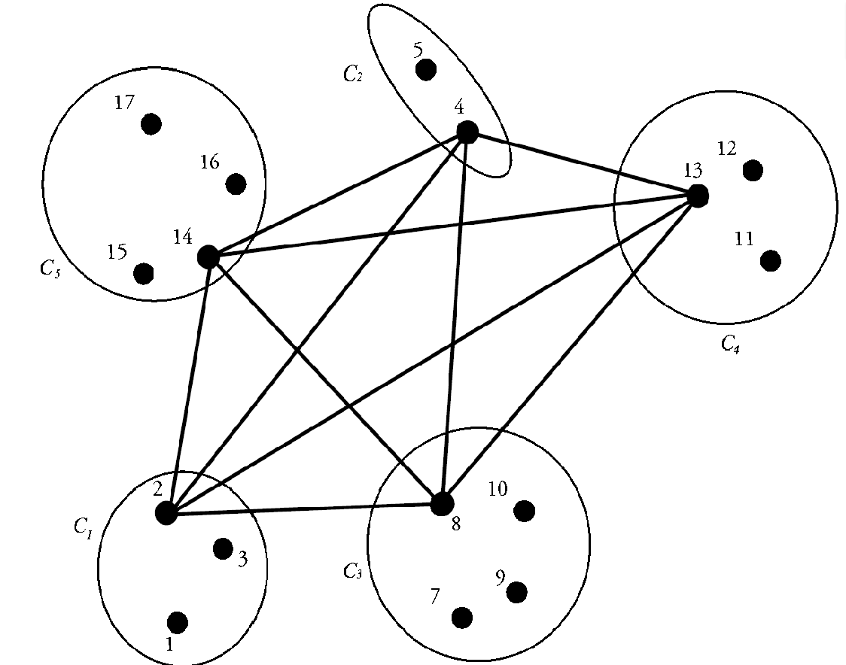
Generalized Minimum Clique Problem
UCF
Computer Vision Lab
$V_{s} (one node out of each cluster)$ is shown.
In our tracking framework:

Slide 13
Finding Tracklets using GMCP
UCF
Computer Vision Lab
$a feasible G_{s} shown in orange:$
Frame 1
Frame 2
Frame 3
Frame 1
Frame 2
Frame 3
Frame 2
Frame 5
Frame 6
Frame 4
Frame 5
Frame 6
Frame 4
Frame 5
Frame 6
$G_{s} determines the tracklet of one person.$

Slide 14
Finding Tracklets using GMCP
UCF
Computer Vision Lab
$V_{s} determines the tracklet of one person.$
Frame 1
Frame 2
Frame 3
Frame 1
Frame 2
Frame 3
Frame 2
Frame 5
Frame 6
Frame 4
Frame 5
Frame 6
Frame 4
Frame 5
Frame 6
Appearance
Motion

Slide 15
Finding Tracklets
UCF
Computer Vision Lab
Tracklet-global motion cost model:

Slide 16
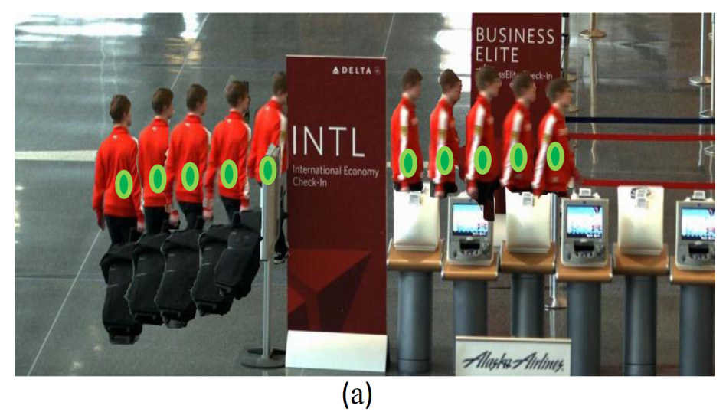
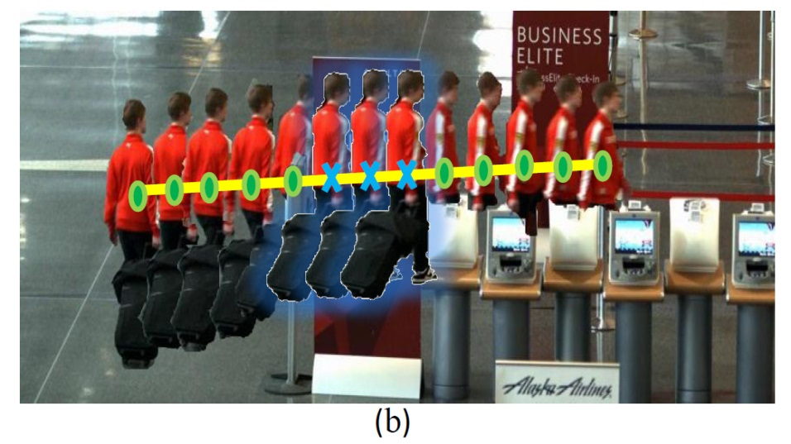
Finding Tracklets using GMCP
UCF
Computer Vision Lab
Occlusion Handling:
What if one person is not detected in some frames?
We put a hypothetical node in each cluster for such cases.
The appearance and location features of the hypothetical node are calculated at each iteration using $V_{s}$ and constant velocity model:

Slide 17
Finding Tracklets using GMCP
UCF
Computer Vision Lab
Occlusion Handling:
Frame 1
Frame 2
Frame 3
Frame 4
Frame 5
Frame 6
Hypothetical Nodes added.

Slide 18
How to solve GMCP?
UCF
Computer Vision Lab
GMCP is a NP-hard problem.
Local Search optimization method:
A Metaheuristic method based on moving from one solution to another by making local changes.
We use Tabu search which is a variation of local search.
It discourages using repeatedly used elements to avoid becoming stuck in suboptimal regions.
Using non-optimized Matlab code, on Quadcore 2.4 GHz machine: average processing time of 4.4 seconds per frame.

Slide 19
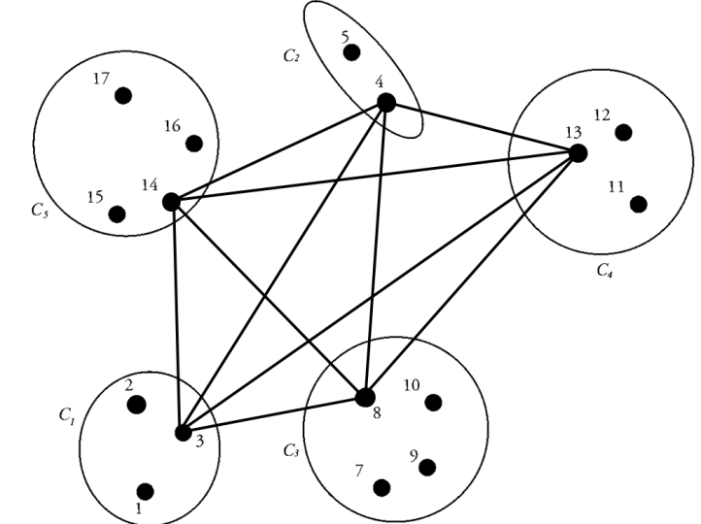
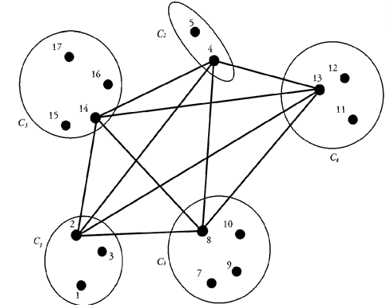
Local Search
UCF
Computer Vision Lab
Neighbor solutions:
Two solutions are neighbors if they are identical except in one element.
For GMCP, Two solutions are neighbor if they are identical except in the element of one cluster.
Two neighbor GMCP solutions:
V_{s}=[3,4,8,13,14]
V_{s}=[2,4,8,13,14]

Slide 20
Local Search
UCF
Computer Vision Lab
Algorithm:
Begin with an initial solution. Mark it as current solution.
Find all neighbor solutions to the current solution.
If a neighbor solution induces a lower cost:
Replace current solution with that neighbor and goto 2.
Otherwise:
Return current solution as the final solution.
End.
We use Tabu search which is a variation of local search.
It discourages using repeatedly used elements to avoid becoming stuck in suboptimal regions.
Using non-optimized Matlab code, on Quadcore 2.4 GHz machine: average processing time of 4.4 seconds per frame.

Slide 21
Finding Tracklets
UCF
Computer Vision Lab
Optimization Function:
Illustration of optimizing the cost function for a sample segment:
Town Center Sequence
Frames 351-400

Slide 22
Process of Finding Tracklets in one Segment
UCF
Computer Vision Lab

Slide 23
Process of Finding Tracklets in one Segment

Slide 24
Resultant Tracklets in one Segment
UCF
Computer Vision Lab

Slide 25
Tracklets in all segment of video
UCF
Computer Vision Lab
Now: Merging tracklets into full trajectories
Now: Merging tracklets into full trajectories!

Slide 26
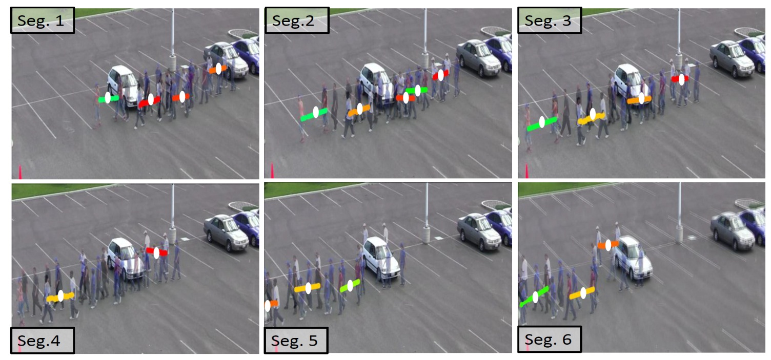
Tracklet Merging
UCF
Computer Vision Lab
Another data association problem!
We use GMCP-based framework again.
Each traklet represented by one node in $G^{′}$
Appearance feature: average of appearance feature of detections
Location feature: Middle point of the tracklet

Slide 27
Tracklet Merging
UCF
Computer Vision Lab
Modeling the movement of people in long term is difficult:
The motion model is piecewise and not global
Hypothetical node’s spatial location prediction is piecewise:

Slide 28
Tracklet Merging
UCF
Computer Vision Lab

Slide 29
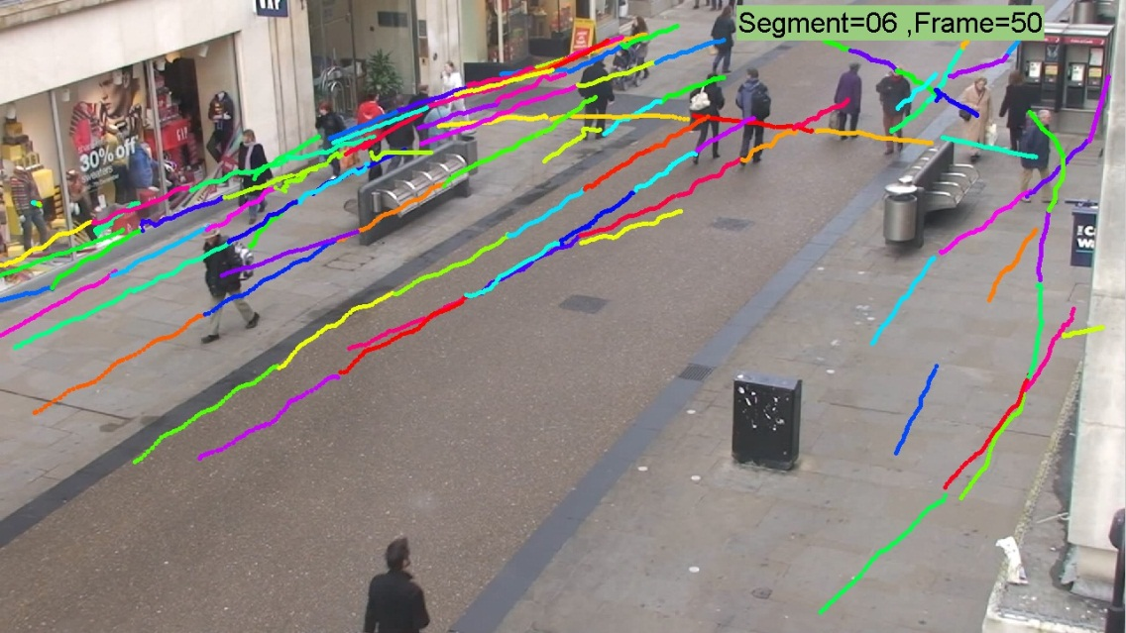
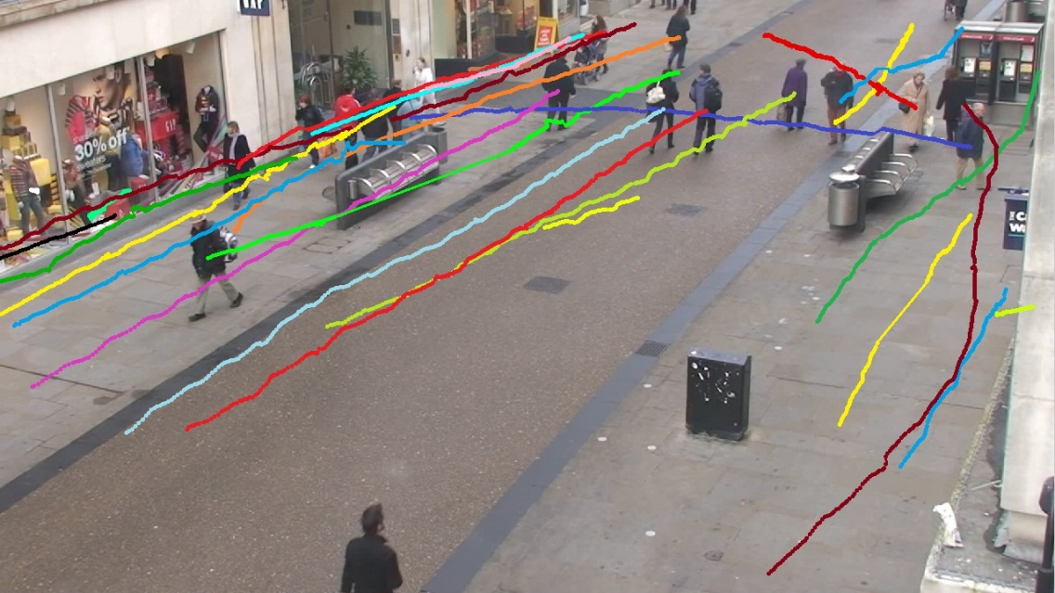
Merging Results
UCF
Computer Vision Lab
Tracklets
Trajectories

Slide 30
Tracking Results
UCF
Computer Vision Lab

Slide 31
PETS2009-S2L1 Results
UCF
Computer Vision Lab

Slide 32
PETS2009-S2L1 Results
UCF
Computer Vision Lab
[2] Andriyenko CVPR2011 [17]: Berclaz (KSP) [18]: Shitrit ICCV11

Slide 33
TUD Crossing Results
UCF
Computer Vision Lab
Andriyenko and Schindler
GMCP-Tracker
Andriyenko, A., Schindler, K.: Multi-target tracking by continuous energy minimization. CVPR2011

Slide 34
Parking Lot
UCF
Computer Vision Lab
Parking Lot Sequence:
1000 frames
14 pedestrians
Parallel and close movements
Similar appearances

Slide 35
Parking Lot Results
UCF
Computer Vision Lab

Slide 36
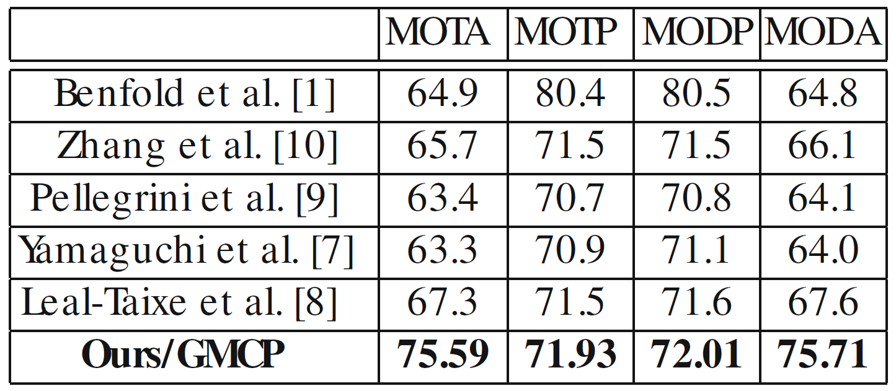
Quantitative Results
UCF
Computer Vision Lab
Town Center Sequence:
CLEARMOT: Bernardin, K., Stiefelhagen, R.: Evaluating multiple object tracking performance: The clearmot metrics. In: EURASIP JIVP. (2008)

Slide 37
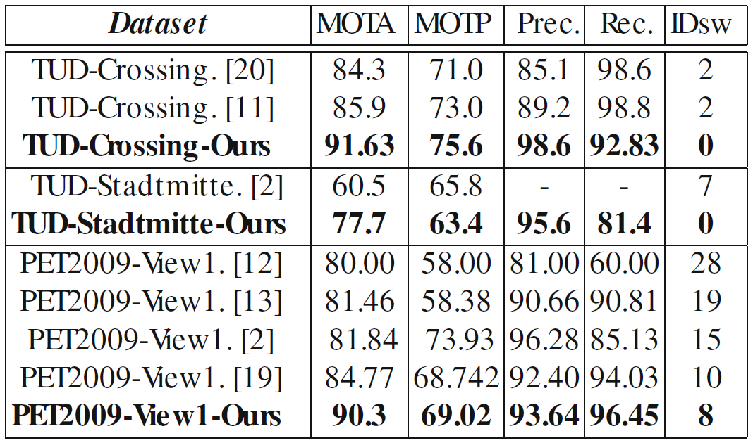
Quantitative Results
UCF
Computer Vision Lab
TUD-Crossing, Stadmitte, PET2009 S2L1:

Slide 38
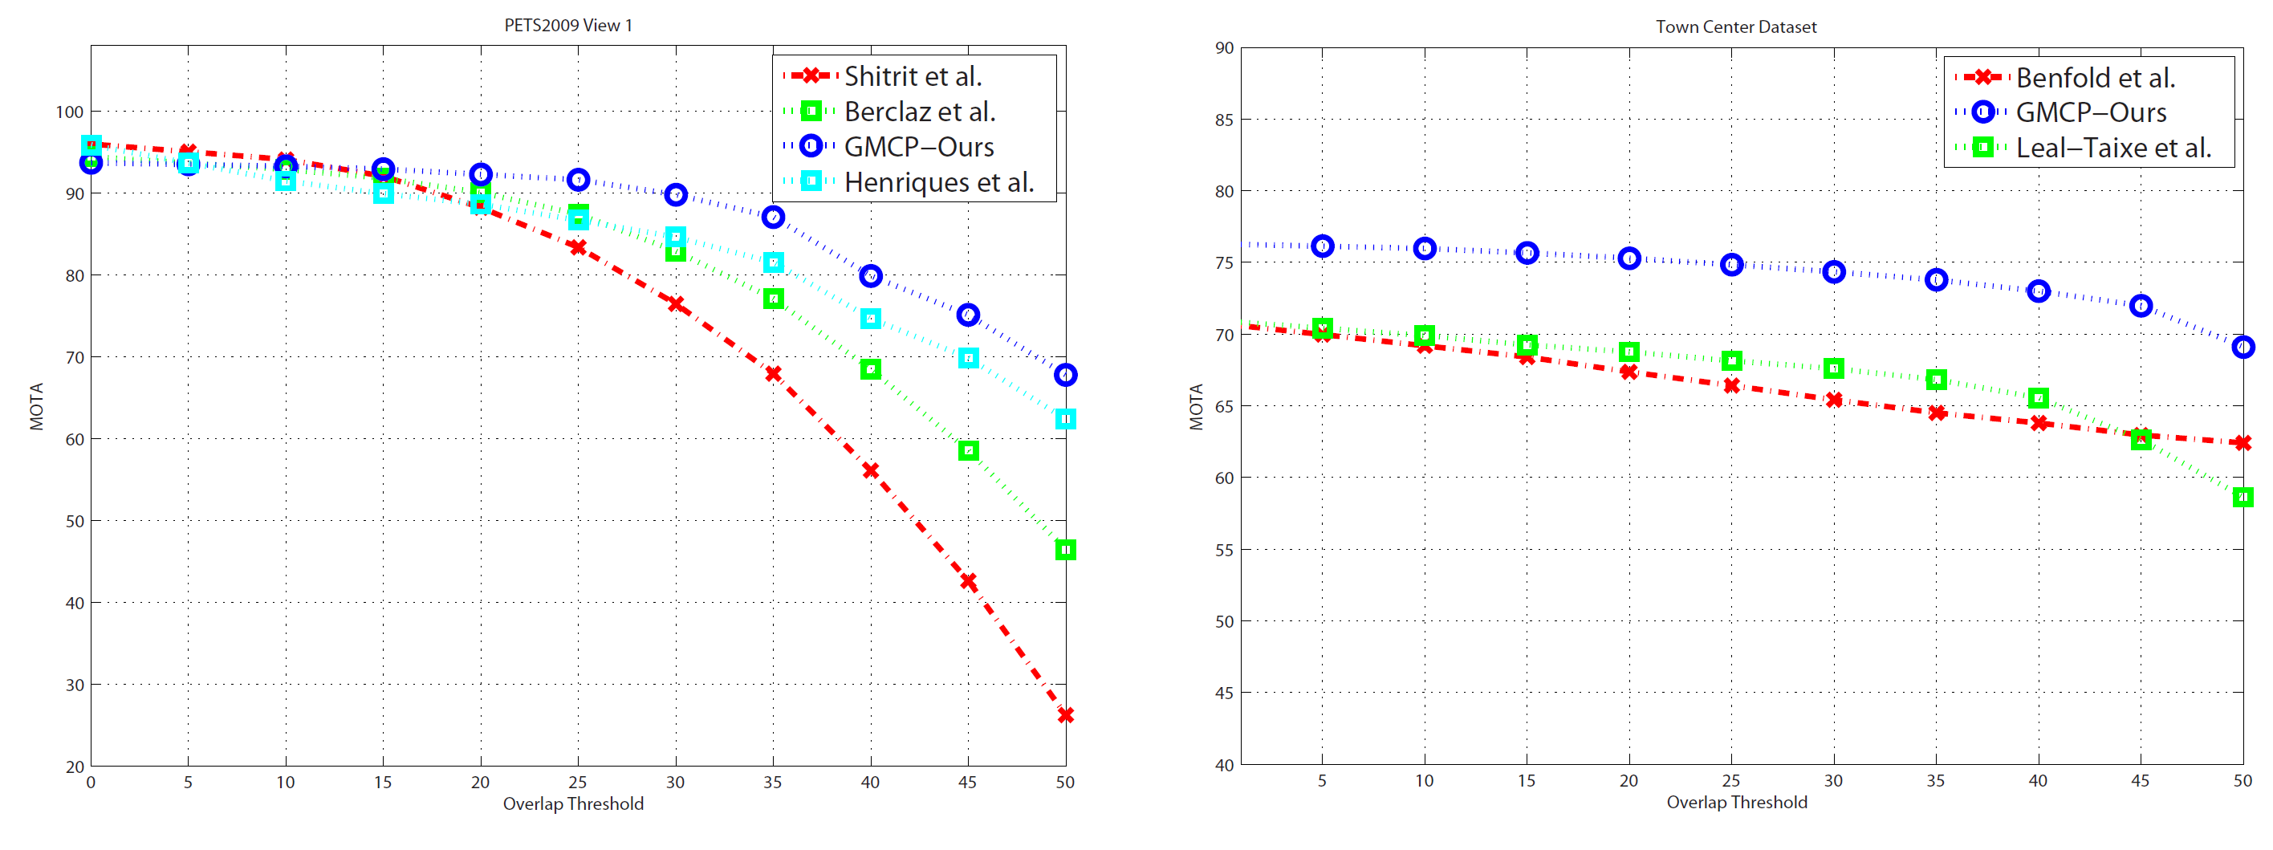
Quantitative Results
UCF
Computer Vision Lab
Different overlap thresholds for CLEARMOT metrics:
CLEARMOT: Bernardin, K., Stiefelhagen, R.: Evaluating multiple object tracking performance: The clearmot metrics. In: EURASIP JIVP. (2008)

Slide 39
Quantitative Results
UCF
Computer Vision Lab
Parking Lot Seq.
Town Center Seq.
TUD Crossing
TUD Stadtmitte
PETS2009 S2L1

Slide 40
GMCP-Tracker: Global Multi-object Tracking Using Generalized Minimum Clique Graphs
UCF
Computer Vision Lab
Thank You!
Amir R. Zamir, Afshin Dehghan, Mubarak Shah
UCF Computer Vision lab

