Slide 1
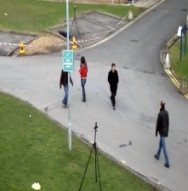
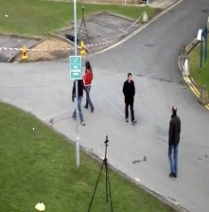
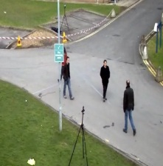
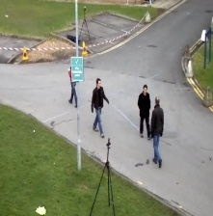
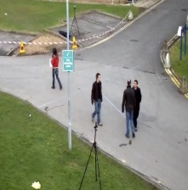
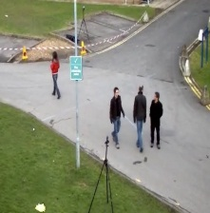
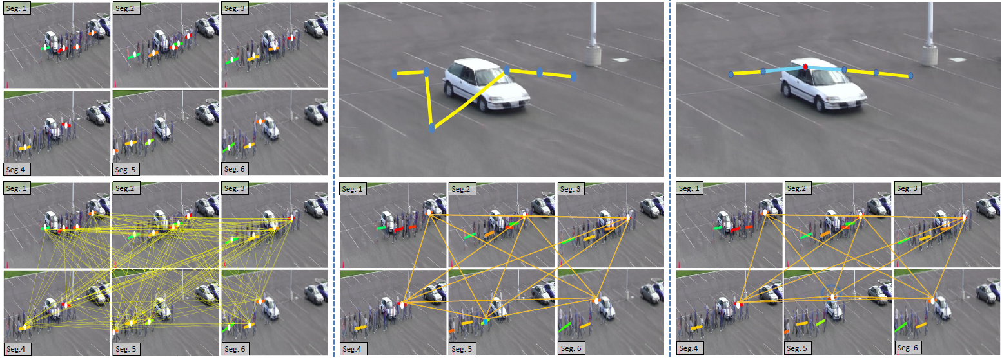
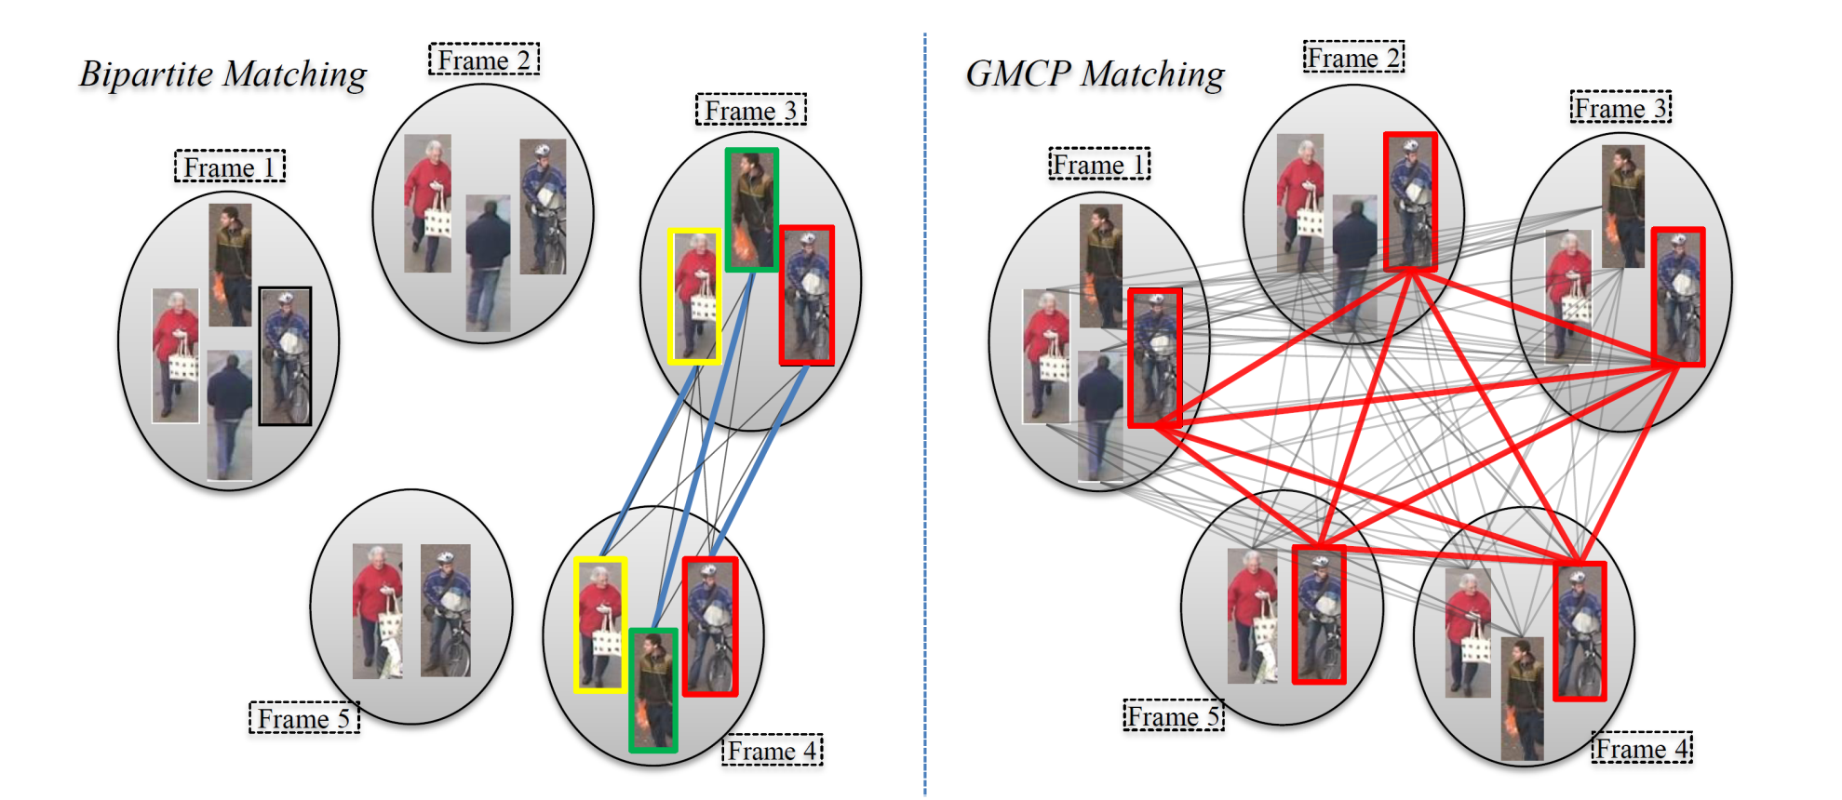
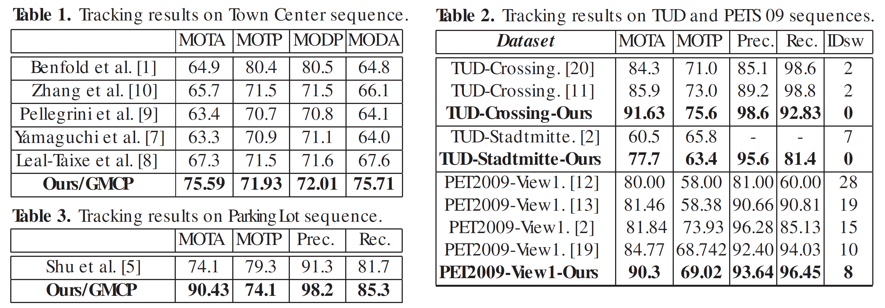
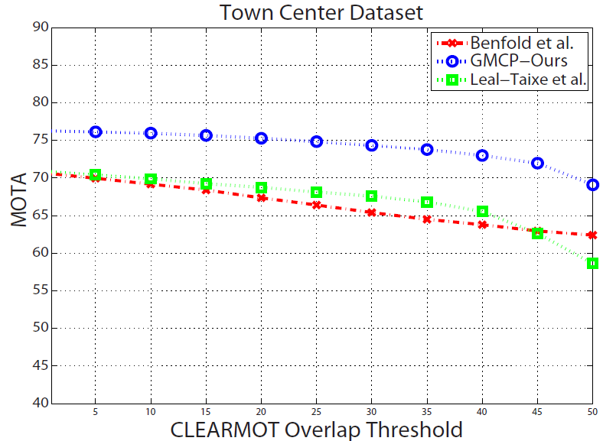
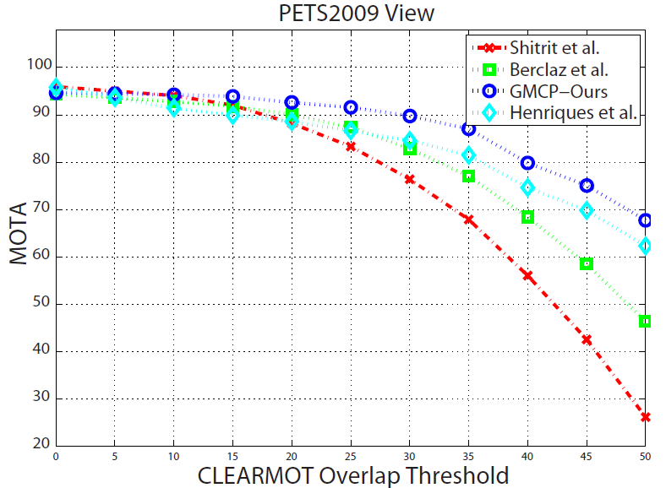
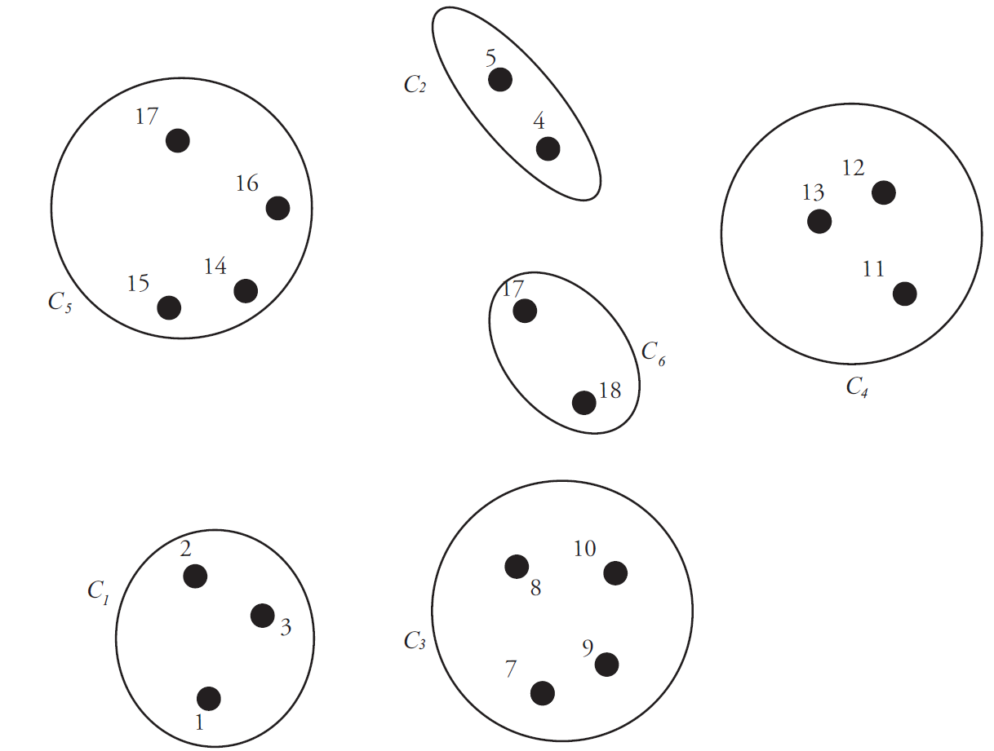
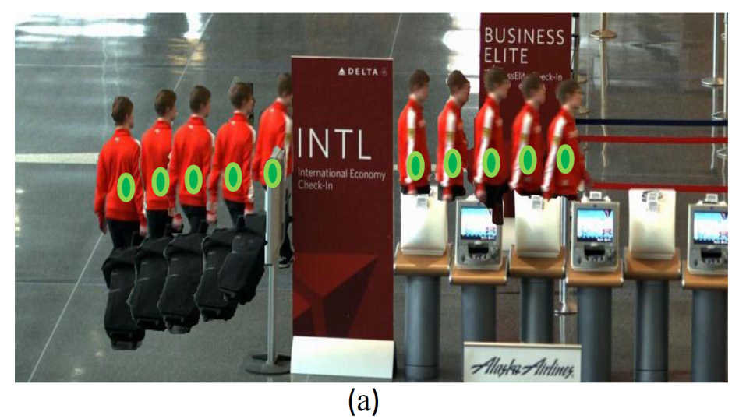
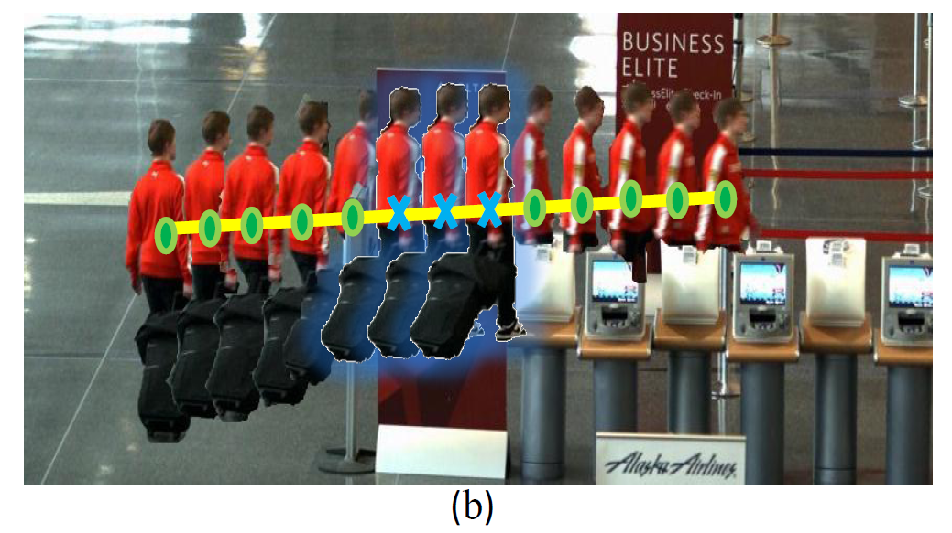
GMCP-Tracker: Global Multi-object Tracking Using
Generalized Minimum Clique Graphs Amir Roshan Zamir, Afshin Dehghan, Mubarak Shah ({aroshan| adehghan | shah @cs.ucf.edu} , University of Central Florida)
UCF
Trajectories
ECCV ‘12
Problem:
Tracking by Detection
Key Contributions:
A new tool in Computer Vision:
Generalized Minimum Clique Problem (GMCP):
Typically useful where there are multiple possibilities for some subproblems, as well as a global criterion to satisfy.
GMCP utilized for computing tracklets and trajectories.
A new temporally global approach to Data Association
A new tracklet-global motion cost model.
Shifting approximation from Time Domain to Object Domain:
Finding tracklets/trajectories in a temporally global way.
Finding the tracklet/trajectory of one object at a time (greedy).
4. Finding Tracklets Using GMCP:
Found Tracklets in Different Segments:
Input Detections
Frame 1
$$v_{1}^{1}$$
Frame 2
$$v_{1}^{2}$$
Frame 3
$$C_{1}^{}$$
$$v_{2}^{1}$$
$$C_{2}^{}$$
$$v_{2}^{2}$$
$$v_{3}^{2}$$
$$C_{3}^{}$$
$$v_{1}^{3}$$
$$v_{2}^{3}$$
$$v_{3}^{3}$$
$$v_{3}^{1}$$
$$C_{4}^{}$$
$$v_{1}^{4}$$
$$v_{2}^{4}$$
$$C_{5}^{}$$
$$v_{1}^{5}$$
$$v_{2}^{5}$$
$$v_{3}^{5}$$
$$C_{6}^{}$$
$$v_{4}^{6}$$
$$v_{1}^{6}$$
$$v_{2}^{6}$$
$$v_{3}^{6}$$
$$v_{3}^{4}$$
Merging Tracklets into Trajectories:
Frame 4
Frame 5
Frame 6
Occlusion Handling using HN$′$
Frame 1
Frame 2
Frame 3
Input Tracklets
Minimum Clique ${\hat{V}}_{s}′$
Input Graph G
Tracklet-global Motion Cost Model
Bipartite Matching vs. GMCP
2. Block Diagram:
Frame 4
Frame 5
Frame 6
Frame 1
Frame 2
Frame 3
Experimental Results
Minimum Clique ${\hat{V}}_{s}$
Frame 1
Frame 2
Frame 3
Frame 2
3. Generalized Minimum Clique Problem (GMCP):
Frame 5
Input to GMCP
Generalized Minimum Clique
Frame 4
Frame 5
Frame 6
Frame 4
Frame 5
Frame 6
Occlusion Handling Using HN
Frame 1
Frame 2
Frame 3
Occlusion Handling Using Hypothetical Nodes:
Project Page: http://vision.eecs.ucf.edu/ projects/GMCP-Tracker/
$${G=(V,E,w)}_{ }$$
$${G_{s}=(V_{s},E_{s},w_{s})}_{ }$$
Project Page
Definition:
(nodes≡detections) (clusters≡frames) (GMCP solution=tracklet of one Object)
YouTube
Frame 4
Frame 5
Frame 6

