Slide 1
Geometry Based Human Detection in UAV Imagery
Vladimir Reilly
Berkan Solmaz
Mubarak Shah
ECCV-2010

Slide 2
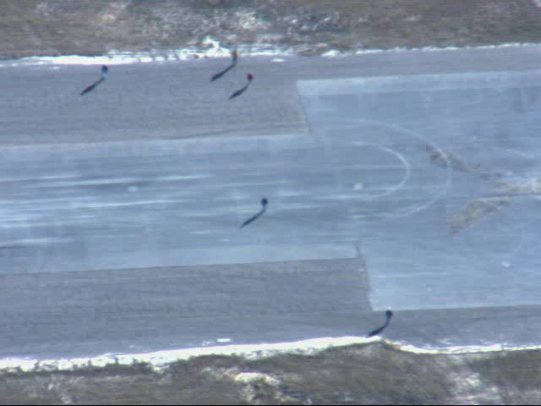
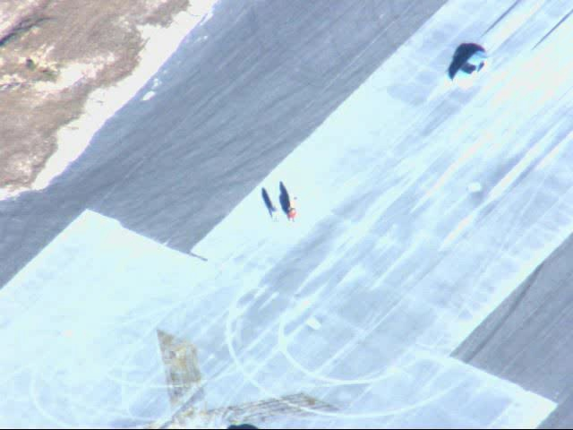
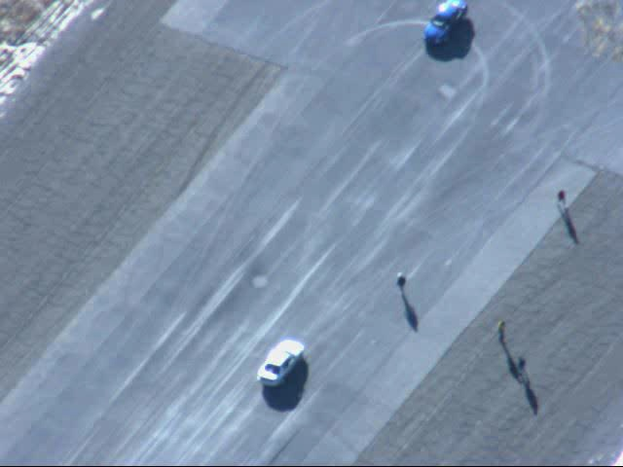
Problem
Goal: Detect Humans

Slide 3
Previous Work
Navneet Dalal and Bill Triggs “Histograms of Oriented Gradients for Human Detection” CVPR05

Slide 4
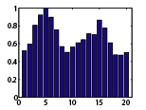
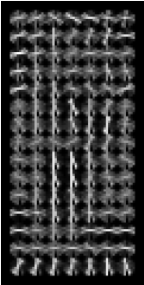
Related Work
Obtain Gradient Orientations
Concatenate
SVM Classification

Slide 5
Related Work
6
2
6
4.6875% Height
8.3% Height
2
9.375% Width
14.28% Width
128
24
64
14

Slide 6
Assumptions
The person is standing upright perpendicular to the ground plane.
The person is casting a shadow.
There is a geometric relationship between person's height and the length of their shadow.

Slide 7
Our Approach
Derive constraints from the metadata
  Orientation of human in frame
  Orientation of shadow in frame
Combine the two
  Obtain Human Candidates
Classify each candidate

Slide 8
Our World
Latitude, Longitude, Time
  Sun Azimuth
  Elevation
  Use to compute
  Use to compute
Zw
Yw
Xw
Notes:
S(arrow) projection of sun vector on the gorund

Slide 9
Our World
Latitude, Longitude, Time
  Sun Azimuth
  Elevation
  Use to compute
  Use to compute
Zw
Yw
Xw
Notes:
S(arrow) projection of sun vector on the gorund

Slide 10
Deriving Constraints (shadow)
We have two vectors
Angle between them
  The vectors are in world coordinates
  We need these vectors in image coordinates
Z
N
E
Notes:
N is true north.

Slide 11
Deriving Constraints (shadow)
Need
  Orthorectify the image
    Image angles become equal to world angles
  Align orthorectified image with world coordiantes
    North and East directions
Metadata based orthorectification accomplishes both

Slide 12
Ortho Rectification
Z_{uav}
Z_{cam}
Y_{cam}
Metadata
  Sensor Parameters
    Sensor Elevation
    Sensor Azimuth
    Sensor Roll
  Aircraft Parameters
    Latitude Longitude
    Heading, Pitch, Yaw, Roll
Y_{uav}
X_{cam}
X_{uav}
Z
N
E

Slide 13
Ortho Rectification
Use metadata parameters
  Obtain Sensor Model
  Place Image Plane In world
  Ray Trace to groundplane
Z
N
E

Slide 14
Ortho Rectification
Use metadata parameters
  Obtain Sensor Model
  Place Image Plane In world
  Ray Trace to groundplane
Z
N
E

Slide 15
Deriving Constraints (shadow)
Need
  Orthorectify the image
    Image angles become equal to world angles
  Align orthorectified image with world coordinates
    North and East directions
Metadata based orthorectification accomplishes both

Slide 16
Ortho Rectification
For all points in image
We have world coordinates
Compute Homography
  From Image and Ground Plane

Slide 17
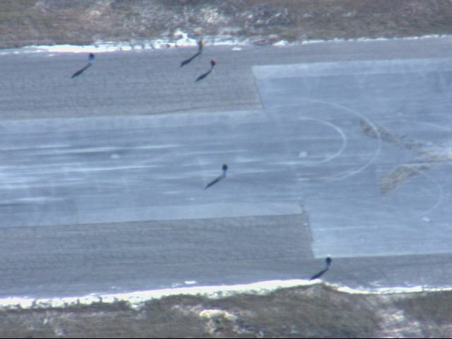
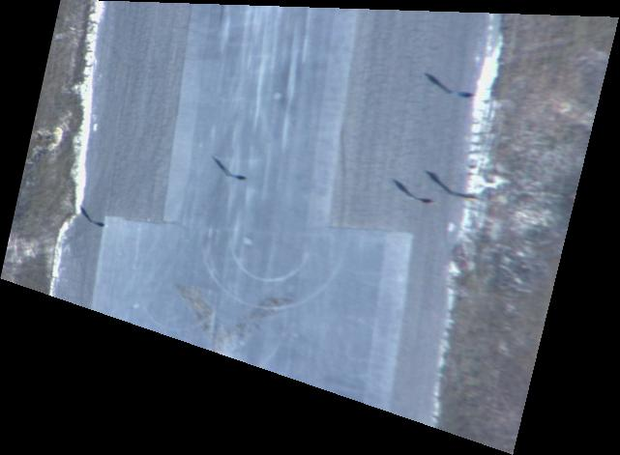
Ortho Rectification
Apply To original Frame
Original Frame
Ortho Rectified Frame
Notes:
Ortho rectification sensor aligns image with world coordinate

Slide 18
Sun Vector in Original Image
Original Frame
Ortho Rectified Frame
Notes:
Y-axis becomes north, orthorectified image aligns it with world coordinate system.

Slide 19
Obtaining Normal Vector
After Obtaining
Let
Obtain
Generate Second Sensor
Obtain
Obtain
Obtain
Projected k
Z
N
E

Slide 20
Obtaining Normal Vector
After Obtaining
Let
Obtain
Generate Second Sensor
Obtain
Obtain
Obtain
Projected k
Z
N
E

Slide 21
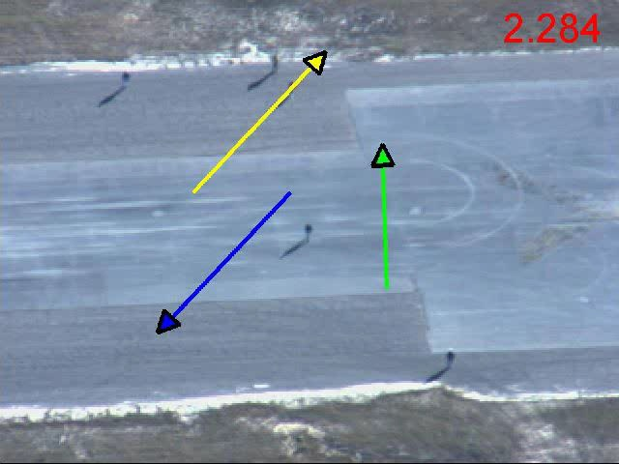
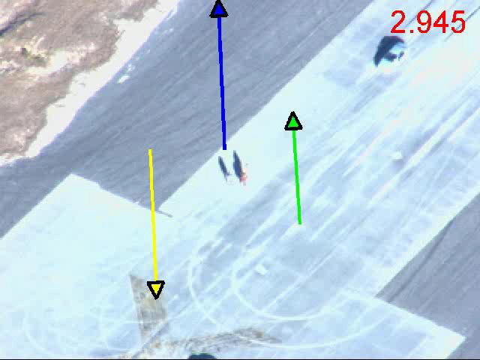
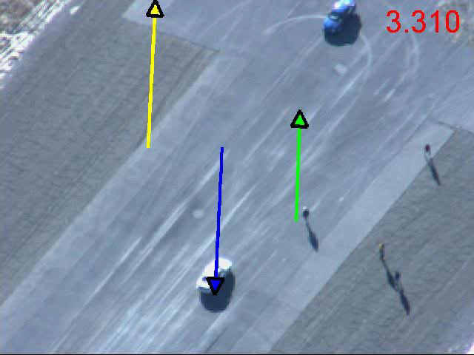
Results
Yellow: Sun
Blue : Shadow
Green : Normal

Slide 22
Shadow Normal Ratio
2.284
Original Frame
Notes:
Ratio of shadow and normal , ratio of height of person, and its shadow..
Obtain ratio from meta data…fix them in the world..
People are of the same height..
Ratio of shadow and normal , ratio of height of person, and its shadow..
Obtain ratio from meta data…fix them in the world..
People are of the same height..
Projected normal to the ground plane.

Slide 23
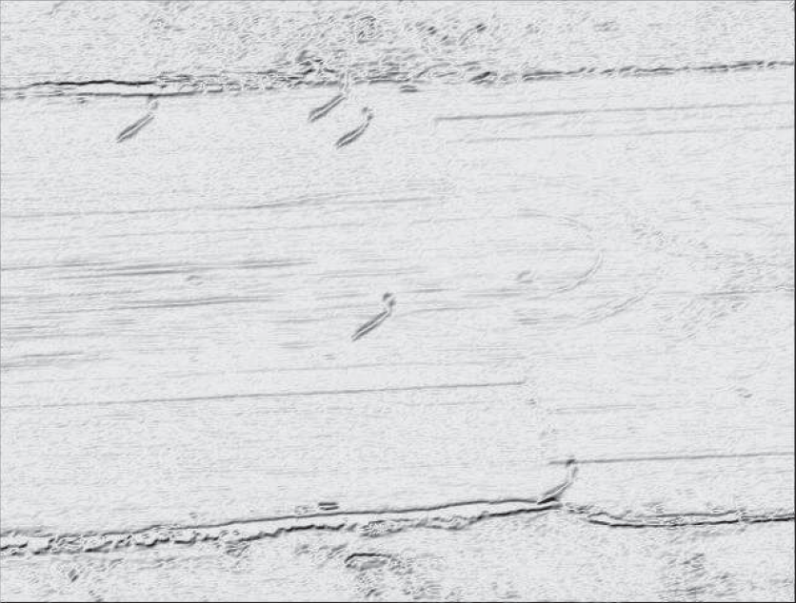
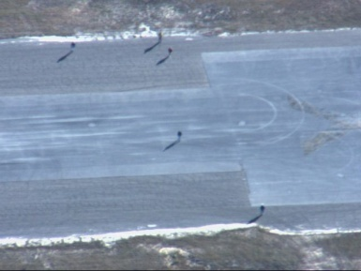
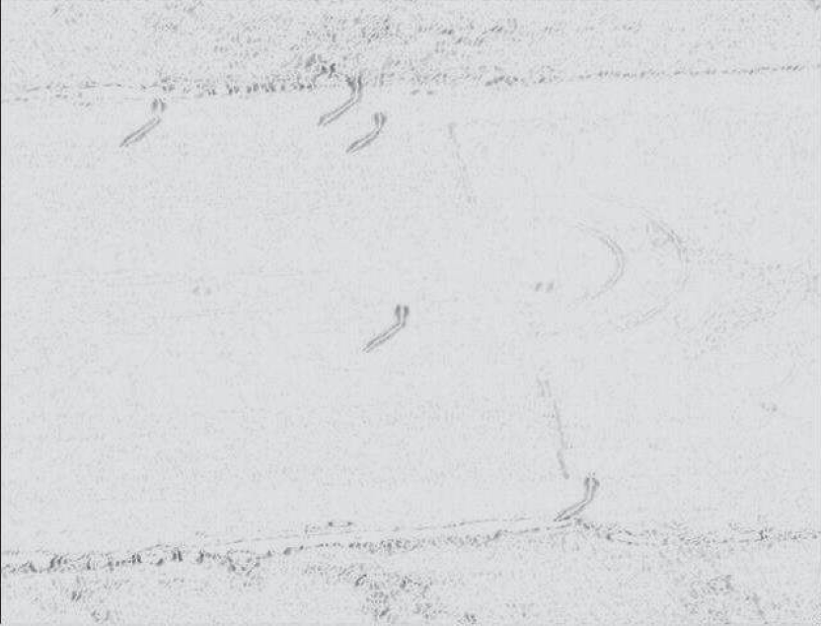
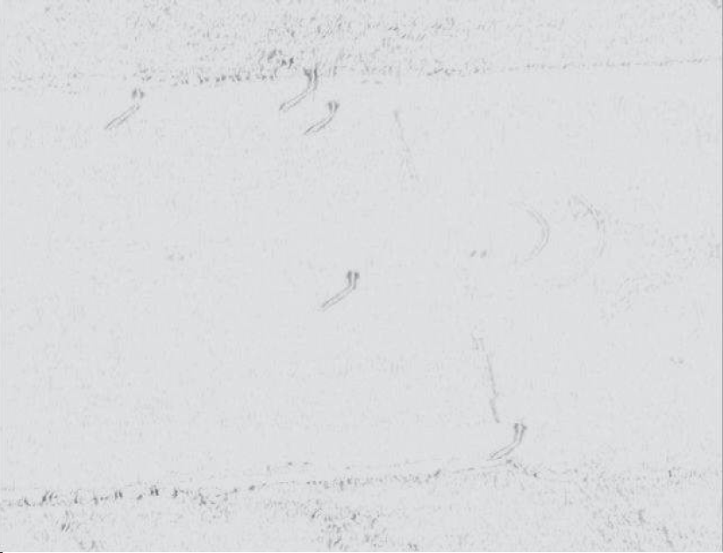
Detecting Out of Plane Objects
Erode in Shadow Direction
Compute Gradient in Shadow Direction
Compute Gradient in Normal Direction
Erode in Normal Direction
Notes:
Take the minimum…length of s’
Gradient in different directions

Slide 24
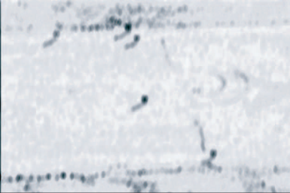
Detecting Out of Plane Objects
Blur In Shadow Direction
Threshold
Blur In Normal Direction
Threshold
Notes:
Blur to get blob, get better blobs..average

Slide 25
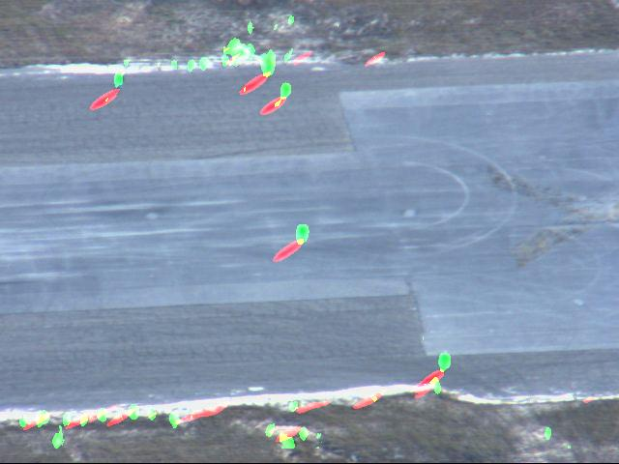
Detecting Out of Plane Objects
Red: Shadow Blobs
Green: Normal Blobs

Slide 26
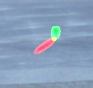
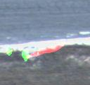
Object Shadow Configuration
A valid configuration of human and shadow blobs
should results in an intersection of the rays.
Notes:
S’.. Sun, it is shadow..

Slide 27
Object Shadow Sizes
Does axis ratio conform to

Slide 28
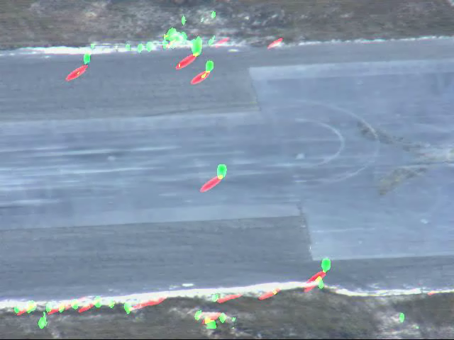
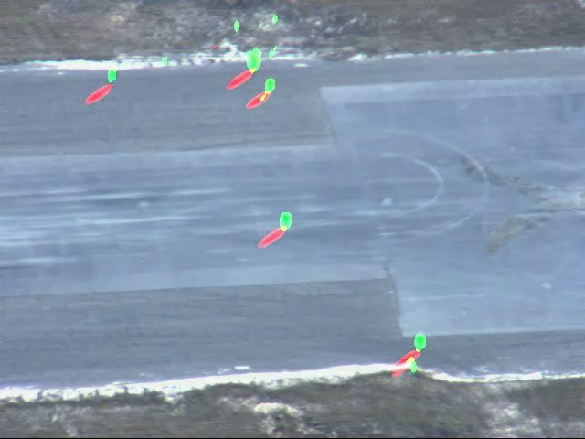
Clip008
Refined
Notes:
Shadow

Slide 29
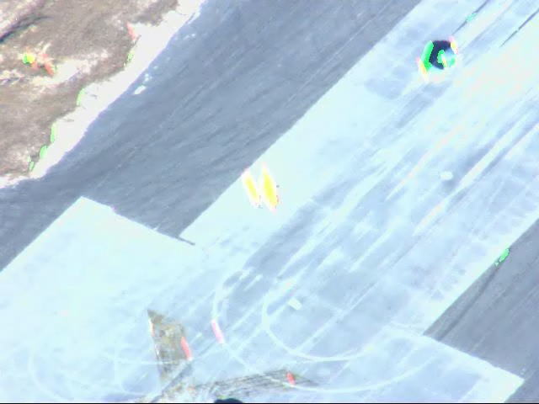
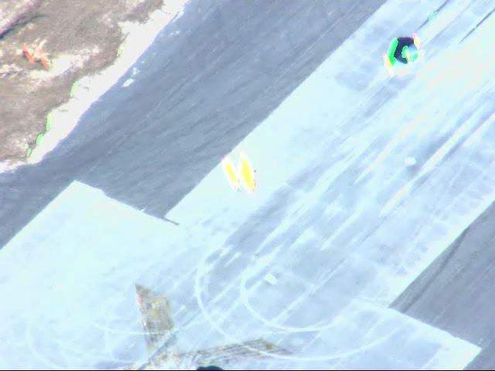
Clip009
Refined
Notes:
Yello: orientation of shadow and person are the same.. Depending on where you take a picture from.

Slide 30
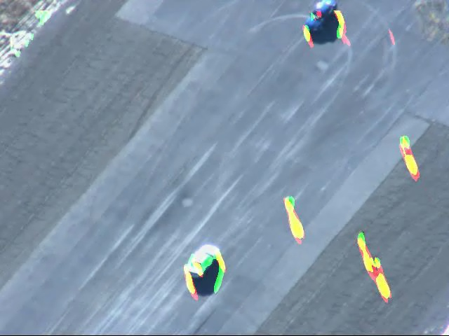
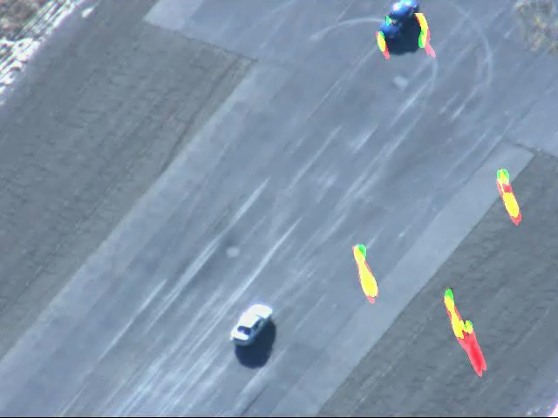
Clip010
Refined

Slide 31
Classifying Human Candidates
LL₁₁ | LL₁₂ | …
Apply wavelet transform
Vectorize and Concatenate
Train SVM
LH₁₁ | LH₁₂ | …
HL₁₁ | HL₁₂ | …
HH₁₁ | HH₁₂ | …
SVM

Slide 32
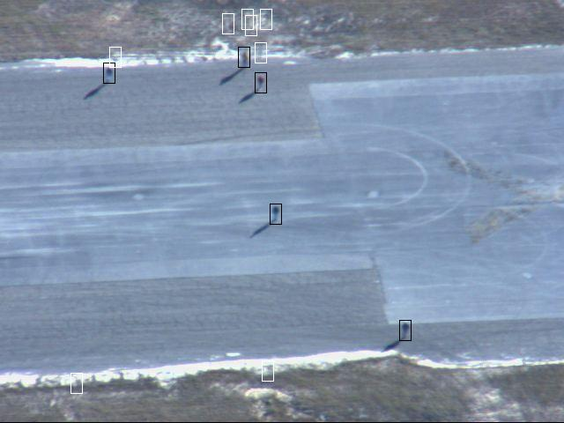
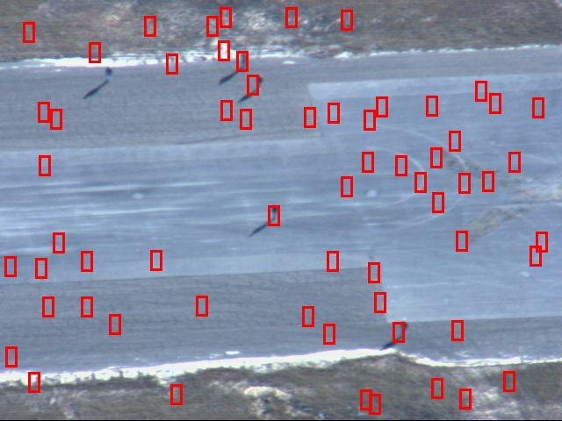
Qualitative Results
Black: Final Detections
Red: Full Frame HOG
Yellow: Rejected Candidates

Slide 33
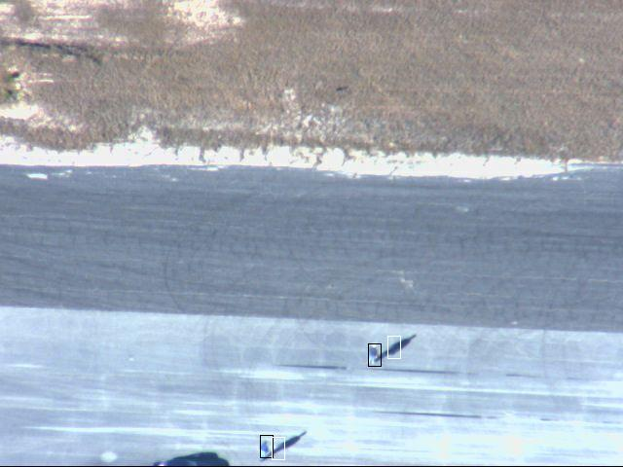
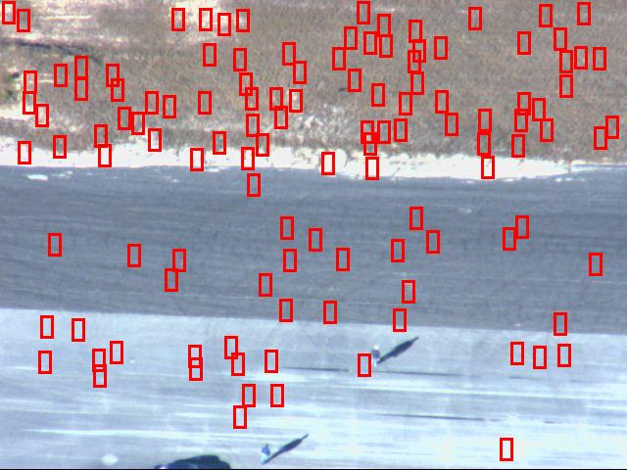
Qualitative Results
Black: Final Detections
Red: Full Frame HOG
Yellow: Rejected Candidates

Slide 34
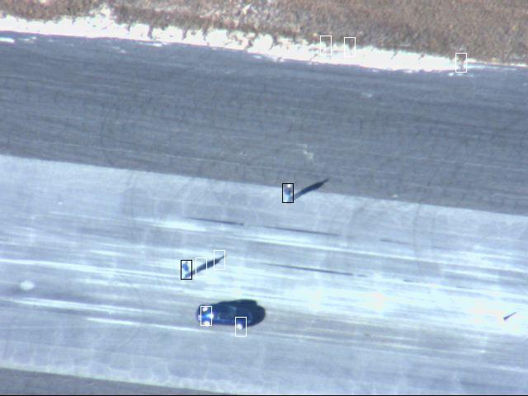
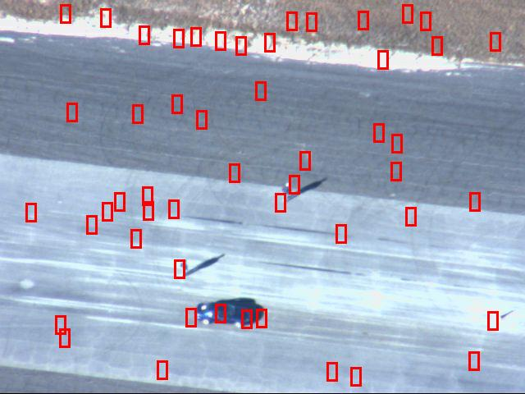
Qualitative Results
Black: Final Detections
Red: Full Frame HOG
Yellow: Rejected Candidates

Slide 35
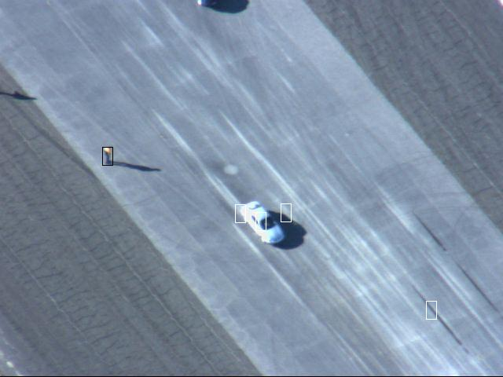
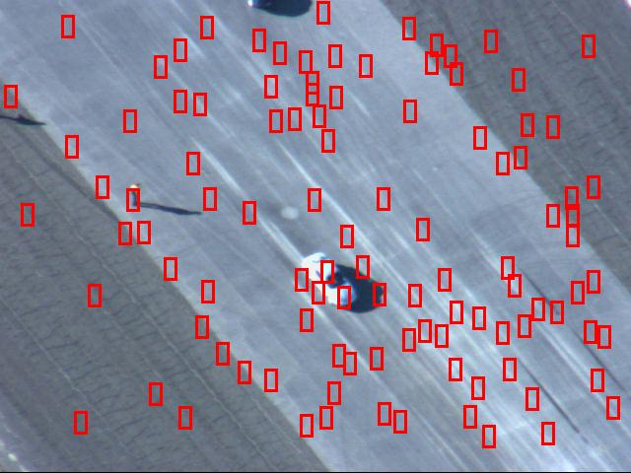
Qualitative Results
Black: Final Detections
Red: Full Frame HOG
Yellow: Rejected Candidates

Slide 36
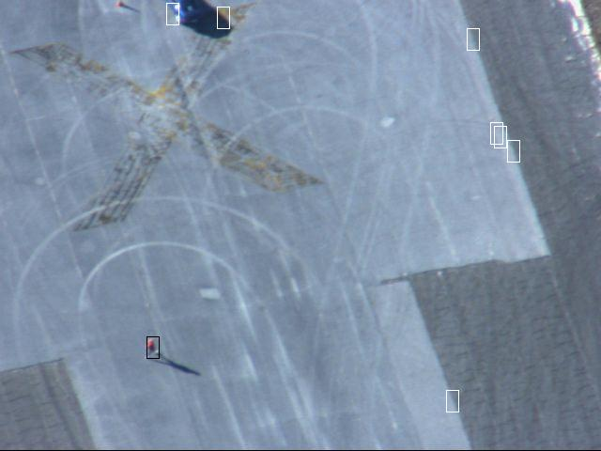
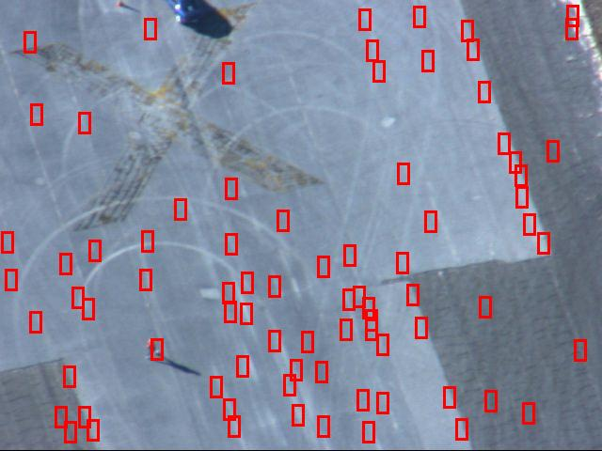
Qualitative Results
Black: Final Detections
Red: Full Frame HOG
Yellow: Rejected Candidates

Slide 37
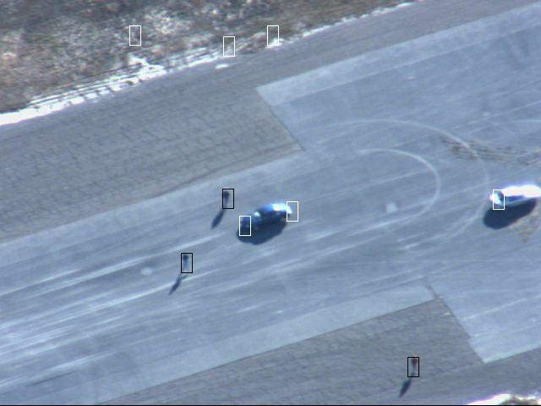
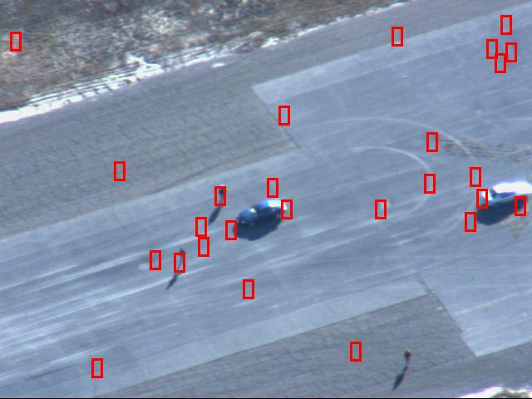
Qualitative Results
Black: Final Detections
Red: Full Frame HOG
Yellow: Rejected Candidates

Slide 38
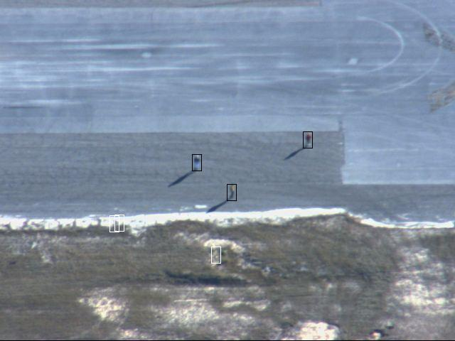
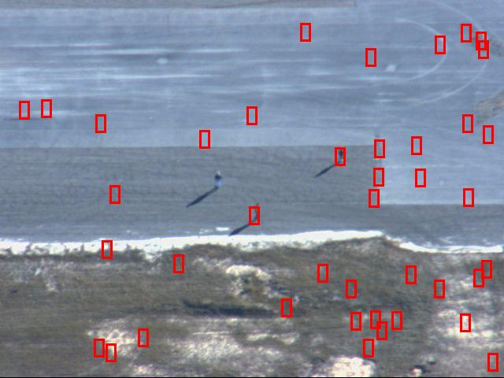
Qualitative Results
Black: Final Detections
Red: Full Frame HOG
Yellow: Rejected Candidates

Slide 39
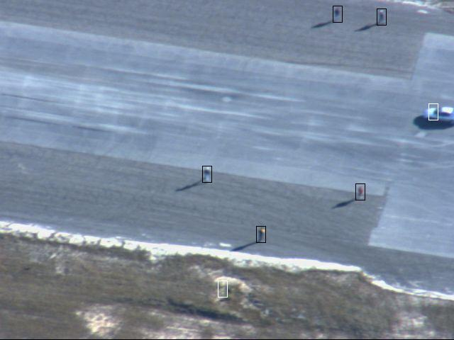
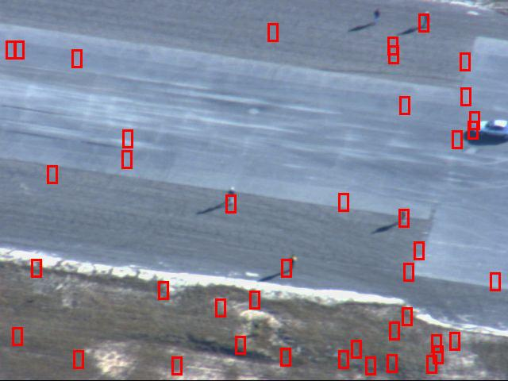
Qualitative Results
Black: Final Detections
Red: Full Frame HOG
Yellow: Rejected Candidates

Slide 40
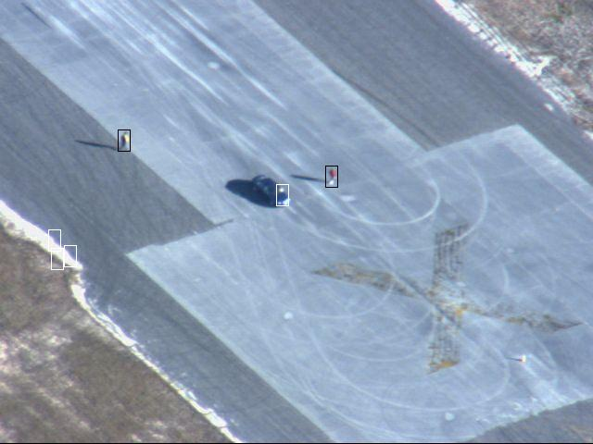
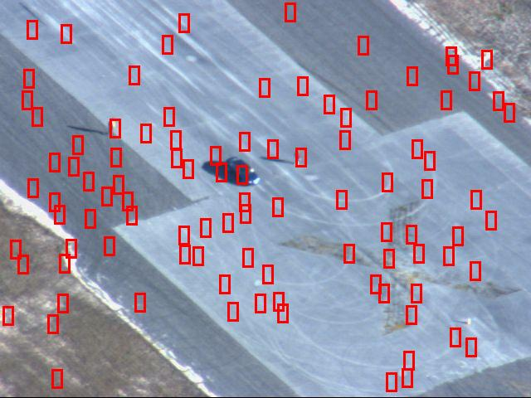
Qualitative Results
Black: Final Detections
Red: Full Frame HOG
Yellow: Rejected Candidates

Slide 41
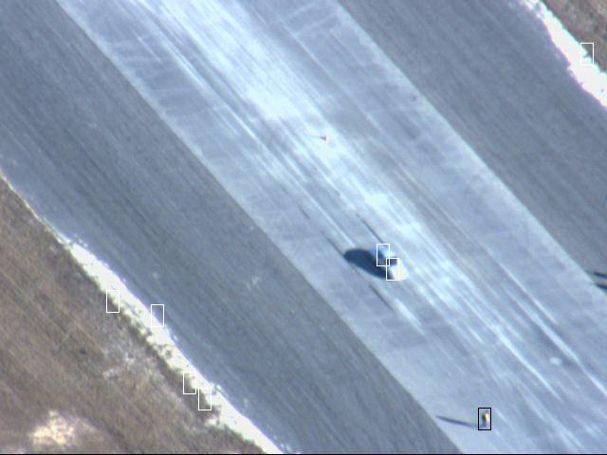
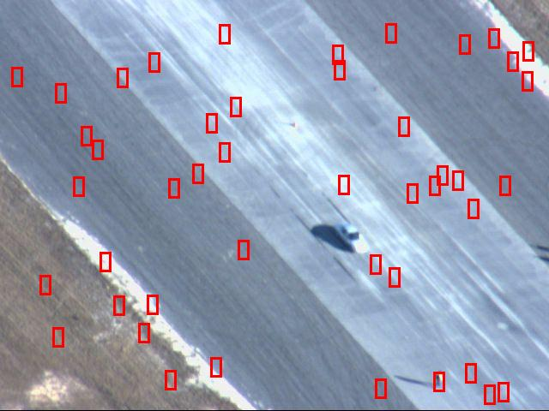
Qualitative Results
Red: Full Frame HOG
Black: Final Detections
Yellow: Rejected Candidates

Slide 42
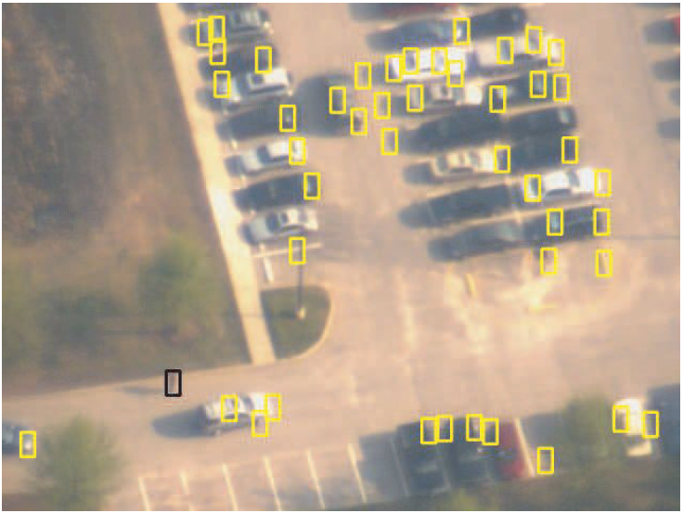
Qualitative Results
Black: Final Detections
Red: Full Frame HOG
Yellow: Rejected Candidates

Slide 43
Qualitative Results
Black: Final Detections
Red: Full Frame HOG
Yellow: Rejected Candidates

Slide 44
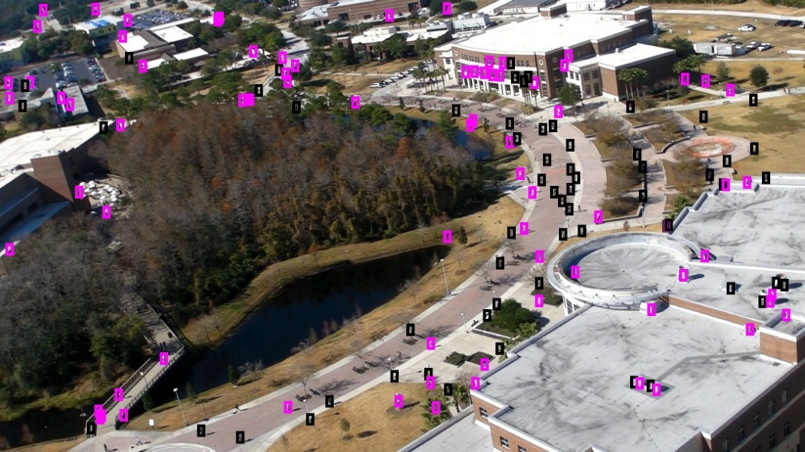
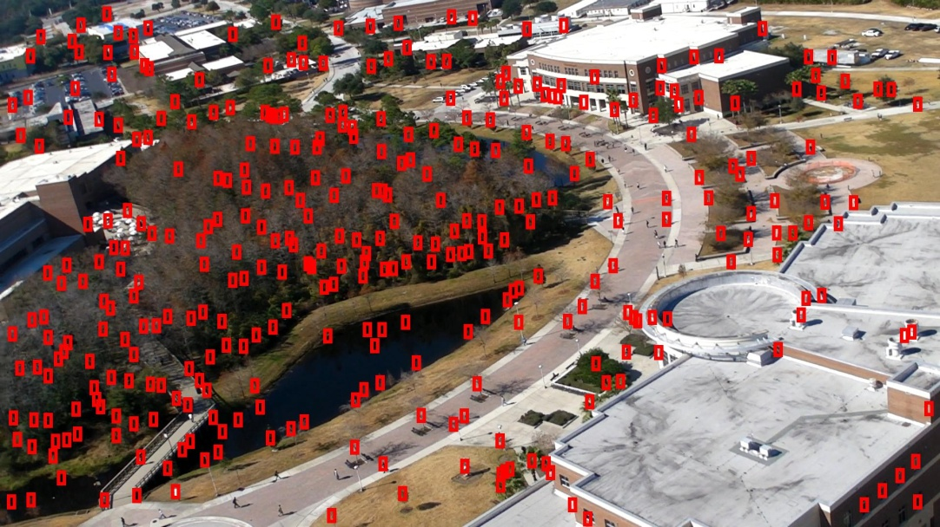
Qualitative Results
Black: Final Detections
Red: Full Frame HOG
Yellow: Rejected Candidates

Slide 45
Quantitative Results: SVM Training
2099 Positive
2217 Negative Examples
RBF Kernel
Sequence 1
Sequence 2
Sequence 3
Video | Frames | TotalPeople
Clip 008 | 1191 | 4892
Clip 009 | 1006 | 2000
Clip 010 | 823 | 3098

Slide 46
Quantitative Results
2099 Positive
2217 Negative Examples
RBF Kernel
Sequence 1
Sequence 2
Sequence 3
Video | Frames | TotalPeople
Clip 008 | 1191 | 4892
Clip 009 | 1006 | 2000
Clip 010 | 823 | 3098
Timing
Full Frame HOG Several Hours
Proposed Method Six Seconds
Notes:
Our Geometry based method with shadow, object-shadow relationship re-
finement, and centroid localization is shown in red. Yellow curves are for our geometry
based method without the use of object-shadow relationship refinement, or centroid
localization. A standard full frame detector (HOG) is shown in blue. Green shows re-
sults obtained from classifying blobs obtained through registration, motion, detection,
and tracking, similar to [8]. Black curves are for our modified implementation of [9],
which uses Harris corner tracks.

Slide 47
Qualitative Results vs Motion
Stationary Human
Shadow and human
Two humans and Shadow
Motion
Geometry Constrained
Notes:
Shadow is part of the motion blob..
Two people merge..

Slide 48
What do you in absence of metadata ?

Slide 49
Detecting Out of Plane Objects
Erode in Shadow Direction
Compute Gradient in Shadow Direction
Compute Gradient in Normal Direction
Erode in Normal Direction
Notes:
Take the minimum…length of s’
Gradient in different directions

Slide 50
Detecting Out of Plane Objects
Blur In Shadow Direction
Threshold
Blur In Normal Direction
Threshold
Notes:
Blur to get blob, get better blobs..average

Slide 51
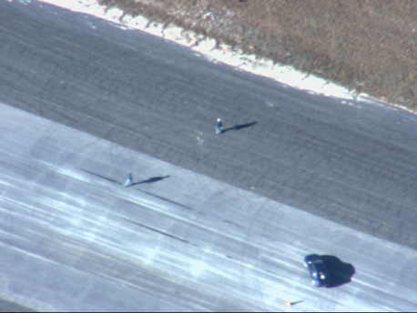
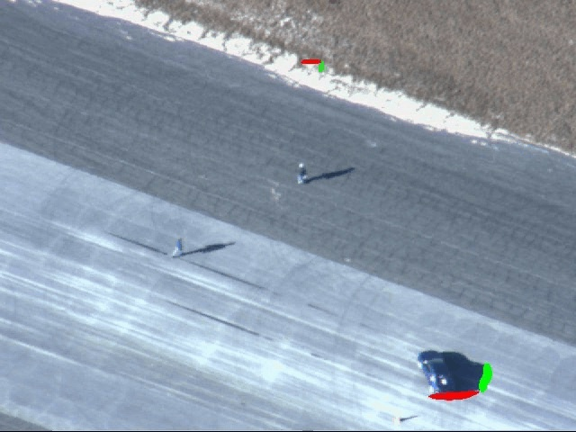



No metadata available
Apply Candidate Detector for different orientations of shadow
0-50
55-95
100-175
180-215
220-230
235-275
280-355
Notes:
It is one angle in the image, verticle in y axis..
One person is detected in certain range 55-95, 180-215, 235-275..
For the second person if the range overlaps with the first, you can find the potential sun angle.

Slide 52
No metadata available
0-50
55-95
100-175
180-215
220-230
235-275
280-355
55 60 … 90 95
180 185 … 210 215
235 240 … 270 275
1 1 … 1 1
0 0 … 0 0
1 1 … 1 1
0 45 90 135 180 225 270 315 355
LCCS
180 … 225
Notes:
O is overlap…. At least two verticle project….

Slide 53
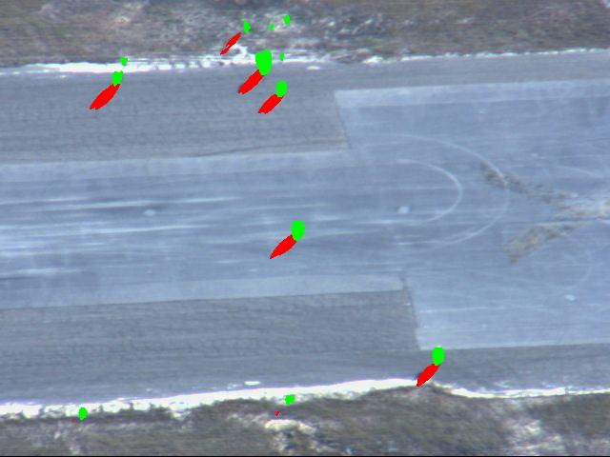

Qualitative Results
Meta
Auto
35˚
46.7˚

