Slide 1
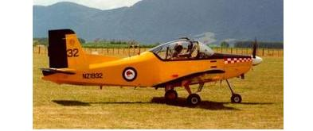
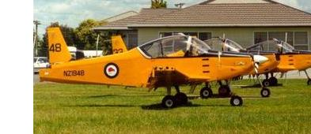
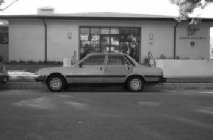
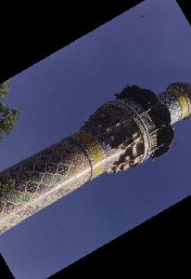
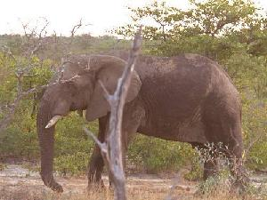
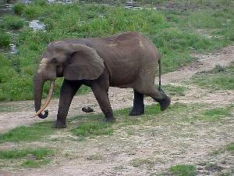
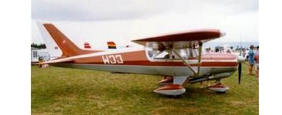
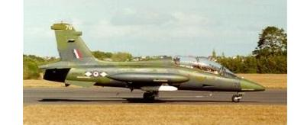
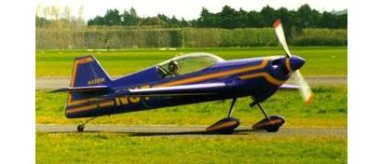
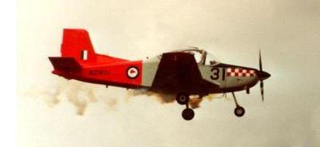
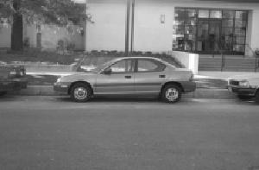
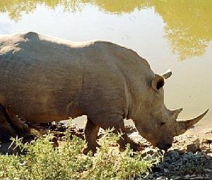
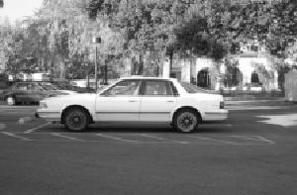
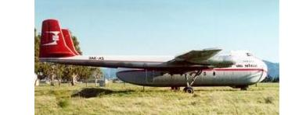
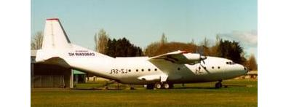
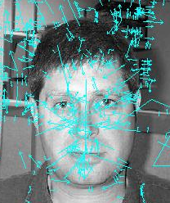
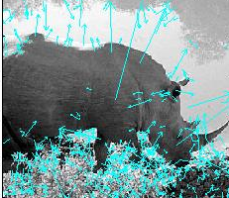
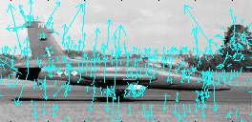
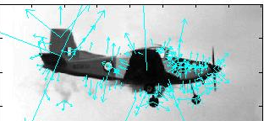
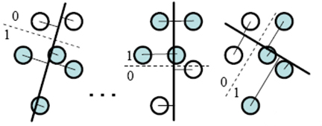
Learning Visual Bits with Direct Feature Selection
Joel Jurik¹ and Rahul Sukthankar^{2,3}
¹University of Central Florida ²Intel Research Pittsburgh ³Robotics Institute, Carnegie Mellon
4. Using GentleBoost, construct a sequence of visual bits that represent an image at a much higher level than SIFT.
5. Train SVM using the aggregates of the visual bits
1
1
0
1
1
1
5
0
0
0
1
1
0
2
1
1
1
1
1
0
5
Introduction
0
1
1
1
0
0
3
Testing Parameters
Problem: Popular object recognition systems separate the processes of codebook generation and classifier training.
Solution: Unify the processes into a single framework by proposing a new way to learn visual bits using direct feature selection to avoid the complicated optimization framework from [1].
100 testing images (100 positive, 100 negative)
Distinguish between airplane and non-airplane images
Support Vector Machine
Model
6. Repeat for multiple categories
sheep? ✗
bus? ✓
cat? ✗
bicycle? ✓
car? ✓
cow? ✗
dog? ✗
horse? ✗
mbike? ✓
person? ✓
Figure 6: Training using visual bits.
Figure 8: Examples of images used.
Results
Figure 1: Object recognition.
Process
1. Image representation using SIFT descriptors [2].
System | Accuracy
Visual Bits | 89%
K-means | 86%
2. Randomly generate weights using a uniform distribution from -1000 to +1000 with 128 dimensions (the same as SIFT).
3. We find the linear projection using these weights and descriptors, and find the best projection and threshold using the GentleBoost algorithm [3].
Figure 2: Examples of SIFT descriptors.
Figure 7: Training using visual bits.
Table 1: Results.
Training Parameters
…
Visual bits system parameters
Weight distribution: Uniform [-1000,+1000]
Number of weights: 10,000
Rounds of boosting: 200
K-means parameters
Number of cluster centers: 1000
Other parameters
200 training images (100 positive, 100 negative)
Systems use SIFT and SVM during training
References
-201.0
61.7
-50.0
-113.0
1
2
3
128
[1] L. Yang, R. Jin, R. Sukthankar, F. Jurie: Unifying Discriminative Visual Codebook Generation with Classifier Training for Object Category Recognition, CVPR 2008
[2] D. G. Lowe: Distinctive Image Features from Scale-Invariant Keypoints, IJCV 2004
[3] J. Friedman, J., Hastie, T., Tibshirani, R.: Additive Logistic Regression: A Statistical View Of Boosting, Annals of Statistics, Vol. 28, 1998.
[4] P. Viola, M. Jones: Robust Real-time Object Recognition, IJCV 2001
Figure 3: Example of direct feature selection.
-201.0
61.7
-50.0
…
-113.0
.0569
.0118
.0079
…
0
305.4
1
2
3
128
1
2
3
128
Figure 4: Find projection using
weights and SIFT descriptors.
Figure 5: Find best projection and threshold to assign visual bit to either 1 or 0.

Slide 2
Learning Visual Bits with Direct Feature Selection
Joel Jurik¹ and Rahul Sukthankar^{2,3}
¹University of Central Florida ²Intel Research Pittsburgh ³Robotics Institute, Carnegie Mellon
4. Using GentleBoost, construct a sequence of visual bits that represent an image at a much higher level than SIFT.
5. Train SVM using the aggregates of the visual bits
1
1
0
1
1
1
5
0
0
0
1
1
0
2
1
1
1
1
1
0
5
Motivation
0
1
1
1
0
0
3
Testing Parameters
We use an object recognition system that solves the problem of separating the processes of codebook generation and classifier training by unifying them into a single framework. We propose a new way to learn visual bits using direct feature selection to avoid the complicated optimization framework from [1].
100 testing images (100 positive, 100 negative)
Distinguish between airplane and non-airplane images
Support Vector Machine
Model
6. Repeat for multiple categories
sheep? ✗
bus? ✓
cat? ✗
bicycle? ✓
car? ✓
cow? ✗
dog? ✗
horse? ✗
mbike? ✓
person? ✓
Figure 5: Training using visual bits.
Figure 7: Examples of images used.
Results
Figure 1: Object recognition.
Process
1. Image representation using SIFT descriptors [2].
System | Accuracy
Visual Bits | 89%
K-means | 86%
2. Randomly generate weights using a uniform distribution from -1000 to +1000 with 128 dimensions (the same as SIFT).
3. We then find the linear projection using these weights and descriptors, and find the best projection and threshold using the GentleBoost algorithm [3].
Figure 2: Examples of SIFT features.
Figure 6: Training using visual bits.
Table 1: Results.
Training Parameters
…
Visual bits system parameters
Weight distribution: Uniform [-1000,+1000]
Number of weights: 10,000
Rounds of boosting: 200
K-means parameters
Number of cluster centers: 1000
Other parameters
200 training images (100 positive, 100 negative)
Systems use SIFT and SVM during training
References
-1000
54
976
-241
[1] L. Yang, R. Jin, R. Sukthankar, F. Jurie: Unifying Discriminative Visual Codebook Generation with Classifier Training for Object Category Recognition, CVPR 2008
[2] D. G. Lowe: Distinctive Image Features from Scale-Invariant Keypoints, IJCV 2004
[3] J. Friedman, J., Hastie, T., Tibshirani, R.: Additive Logistic Regression: A Statistical View Of Boosting, Annals of Statistics, Vol. 28, 1998.
[4] P. Viola, M. Jones: Robust Real-time Object Recognition, IJCV 2001
1
2
3
128
Figure 3: Example of direct feature selection.
Figure 4: Finding the linear projections and thresholds.

Slide 3
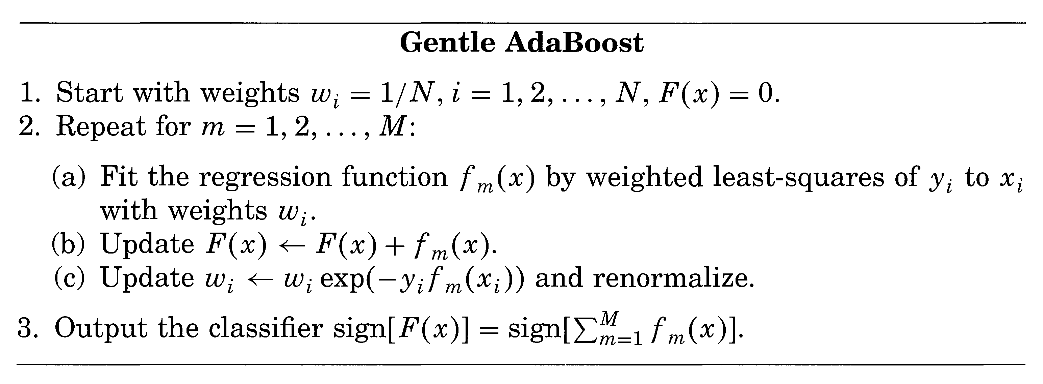
Learning Visual Bits with Direct Feature Selection
Joel Jurik¹ and Dr. Rahul Sukthankar^{2,3}
¹University of Central Florida ²Intel Research Pittsburgh ³Robotics Institute, Carnegie Mellon
Abstract
Using GentleBoost, we are able to construct a sequence of visual bits that represent an image at a much higher level than SIFT. We take the aggregates of visual bits to train the SVM, which will create a model used for testing.
Testing Parameters
Popular object category recognition systems currently use an approach that represents images by a bag of visual words. However, these systems can be improved in two ways using the framework of visual bits [1]. First, instead of representing each image feature by a single visual word, each feature is represented by a sequence of visual bits. Second, instead of separating the processes of codebook generation and classifier training, we unify them into a single framework. We propose a new way to learn visual bits using direct feature selection to avoid the complicated optimization framework from [1]. Our results confirm that visual bits outperform the bag of words model on object category recognition.
For testing, we use a separate set of images from the training set that consists of 100 images, where 50 are positive and 50 are negative. The task at hand is to distinguish between an airplane and non-airplane images.
0
1
0
1
0
0
1
0
0
1
0
1
0
1
0
0
0
1
1
1
0
1
1
1
Support Vector Machine
Model
Results
Figure 3: Training using visual bits
System | Accuracy
Visual Bits | 89%
K-means | 86%
Training Parameters
For training the visual bits system, we use the following parameters:
Weight distribution: Uniform [-1000,+1000]
Number of weights: 10,000
Rounds of boosting: 200
We compare our performance, against a baseline object category recognition that uses k-means + SVM with the following parameter:
Number of clusters: 1000
Each system uses the same 200 training images, in which 100 are positive, and 100 are negative. The positive images are of airplanes, and the negative images can be rhinos, cars, elephants, faces, or minarets. SIFT is used for image representation, and SVM is used during training.
Figure 5: Results. Visual Bits system shows improvement upon standard clustering approaches
Explanation
As you can see, the visual bits system outperforms the object recognition system using k-means clustering with the task of distinguishing between airplane and non-airplane images. Object category recognition using multiple categories using visual bits is currently being implemented.
For image representation , we use SIFT [2].
Once the SIFT descriptors for all images have been obtained, we randomly generate weights using a uniform distribution from -1000 to +1000 with 128 dimensions (the same as SIFT). We then find the linear projection using these weights and descriptors, and find the best projection and threshold using the GentleBoost algorithm [3]:
Figure 1: Examples of SIFT features
References
[1] L. Yang, R. Jin, R. Sukthankar, F. Jurie: Unifying Discriminative Visual Codebook Generation with Classifier Training for Object Category Recognition, CVPR 2008
[2] D. G. Lowe: Distinctive Image Features from Scale-Invariant Keypoints, IJCV 2004
[3] J. Friedman, J., Hastie, T., Tibshirani, R.: Additive Logistic Regression: A Statistical View Of Boosting, Annals of Statistics, Vol. 28, 1998.
[4] P. Viola, M. Jones: Robust Real-time Object Recognition, IJCV 2001
Figure 2: GentleBoost algorithm
Figure 4: Examples of images used.

