Slide 1
REU: Week Two
Clustering, Bag of Words, and Image Detection

Slide 2
Clustering
Useful for grouping data
Related pixels in an image
Done based on color intensity and location
Utilized K-means

Slide 3
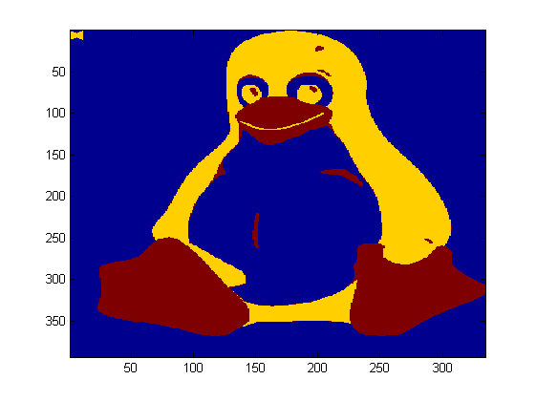
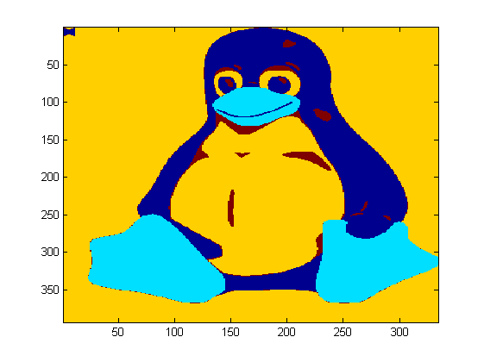
Clustering
CoLOR oNLY
Color And weighted Location

Slide 4
Generating the Codebook
Generate Feature Descriptors as we did last week.
Generated by applying multiple Gaussian derivatives at random points in the images.
Then cluster using k-means.

Slide 5
Bag of Words
Next generate the bag of words representations of images at set intervals.
I chose every spacing of 13 pixels.
From here find it’s the clustered center these words are closest to for the image and this will give us a histogram.

Slide 6
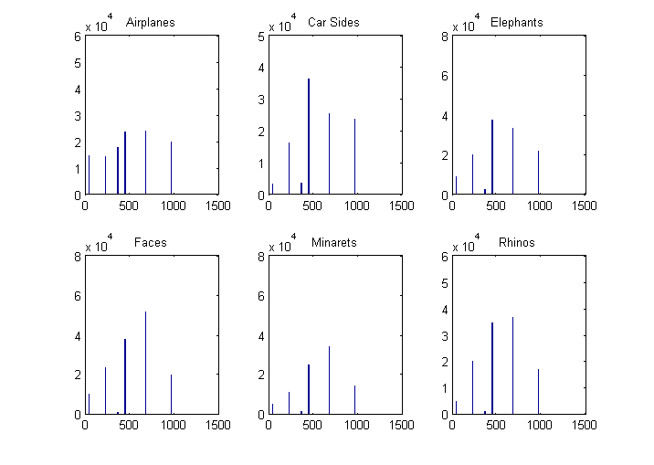
Histograms

Slide 7
Image Detection
Then run the histograms through logistic regression to get the proper weights.
Following this get more feature data from images and apply the weights and squashing function.
Then apply a threshold to determine detections.

Slide 8
Confusion Matrix
Actual→ Predictedv | Airplanes | Car Sides | Elephants | Faces | Minarets | Rhinos
Airplanes | .75 | 0 | .25 | 0 | .0588 | 0
Car Sides | .25 | 1 | .25 | 1 | 0 | .4167
Elephants | 0 | 0 | 0 | 0 | 0 | 0
Faces | 0 | 0 | 0 | 0 | 0 | .1667
Minarets | 0 | 0 | .375 | 0 | .9412 | .25
Rhinos | 0 | 0 | .125 | 0 | 0 | .1667
*threshold of .5

Slide 9
Project Thoughts
Anomalous behavior in video.
Tracking of objects through occlusions based on predicted trajectory.
TRECVID
Scene Recognition in Movies
Notes:
Tracking through occlusion imron?
Scene recog. ramin

