Slide 1
REU: Week 4

Slide 2
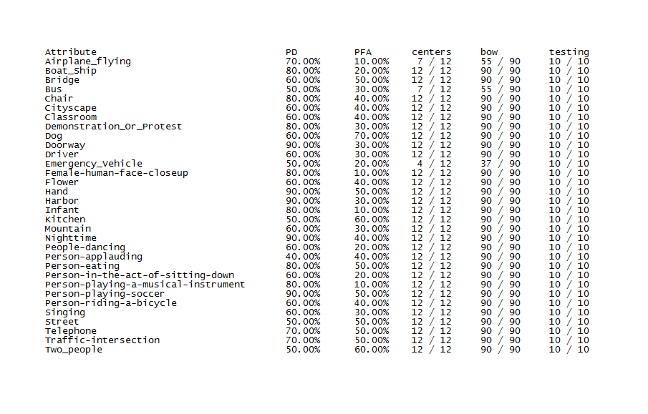
Preliminary Results

Slide 3
SIFT
Read Distinctive Image Features from Scale-Invariant Keypoints by Lowe
Dr. Tappen also gave a presentation on SIFT.
Helped clarify, what is going on “under the hood.”
Notes:
Scale can be an issue, but is not as much of an issue as orientation. Now realize what the ovals are doing in images presented from before. They highlight the size or scale of the edges present. (Larger for flatter, uniform areas) Really found the orientation fix interesting. Makes sense that one could determine the orientation of an image. Done by weighting the gradient magnitude with a Gaussian window. These are then accumulated into histograms that summarize these patches which gives an overall orientation to look at.

Slide 4
SIFT (cont.)
TRECVID utilizes SIFT.
Starting this weekend, I will be testing the various parameters of our feature descriptor executable.
I will start by comparing Harris-Laplace and dense-sampling.
Notes:
Time consuming to generate all the descriptors so I will be generating the descriptors for 1 category and testing them. If the results are promising then we would generate for all the categories.

Slide 5
Generalization
Logistic Regression is currently our method of training.
A problem is it could fire too much on a particular bin.
Correct this with a sort of penalty addition to our logistic regression code.
Notes:
A particular bin or weight can become very large giving a large bias to that particular term. This helps to correct the bias. Write out equation on board.

Slide 6
Generalization (cont.)
How to weight it?
The goal is to determine the best lambda experimentally.
Spent quite a bit of time on this last night. (getting some errors)
This will increase the error in training, but decrease testing error.

Slide 7
Next Week
Generate some valid results with generalization.
Work on our SIFT executable trying to get better results.

