Slide 1
REU: Week 5

Slide 2
This Week
Comparison of Detectors
Dense-Sampling vs. Harris-Laplace
Regularization
High-Level Feature List Released
New Ideas

Slide 3
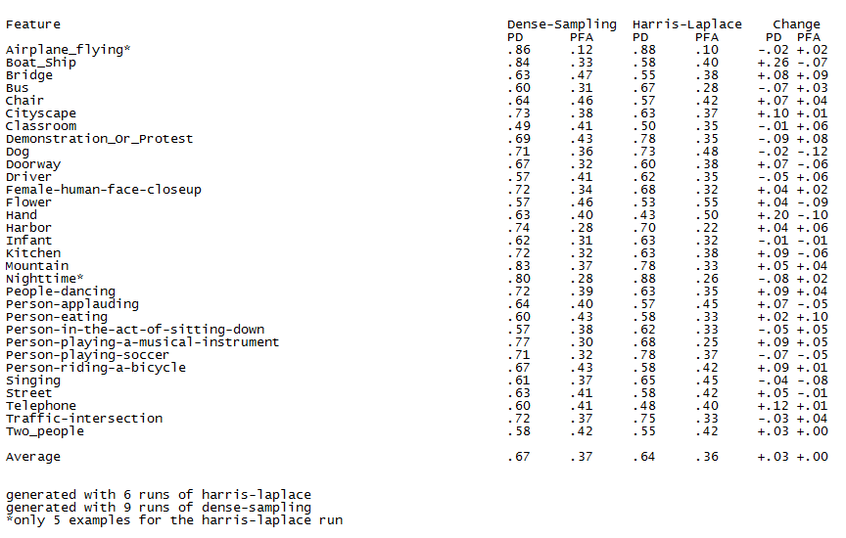
Dense Sampling vs. Harris-Laplace

Slide 4
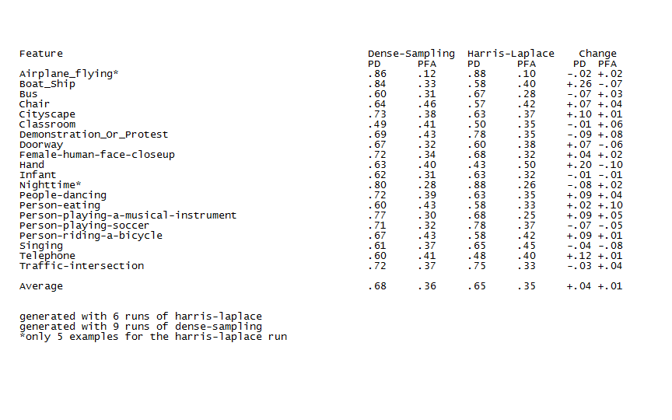
Dense Sampling vs. Harris-Laplace

Slide 5
Analysis
Results are mixed.
Not really clear which is better overall.
Fewer False Positives and Detections with Harris-Laplace
Possible Solutions
Combine the detectors
Utilize optimal detector for concept

Slide 6
Regularization
Recap
Preliminary Results
For logistic regression there was not a drastic change.
Thanks to Ben we know that SVM performs better than Logistic-Regression.
Will need to apply it to the SVM now.
Notes:
Adds a cost to the method so that it doesn’t overtrain on a particular bin or theta value.

Slide 7
New Ideas
Utilize individual detectors for concepts.
Motion
Analyze audio
Can extract audio from video using mplayer.
Analysis with sptool in matlab?
Just need the data.
Read past TRECVID papers.
Inspiration at CVPR ’09

