Slide 1
REU: Week 7
TRECVID
Sean McMillan

Slide 2
Key Frame Extraction
Two Problems
Shot Boundary Detection
Key Frame Extraction
Adaptive Key Frame Extraction Using Unsupervised Clustering, Zhuang et al. ICIP '98

Slide 3
Shot Boundary Detection
Shot – set of frames that compose a segment of a video
Detection of these allows us to find the major changes in the video.
Convert frames from rgb to hsv colorspace.
Check the histogram intersections between two adjacent frames.
Possibly provided to us.

Slide 4
Key Frame Extraction
Shot = {f₁, … , f_{N}}
f₁ → centroid of 1st cluster
If no more frames, done.
Find the histogram intersection of f_{i} and each cluster centroid.
Take the largest intersection and compare to a threshold, if it is less than the threshold add another cluster with f_{i} as its centroid otherwise add to the cluster it was closest too and adjust the centroid

Slide 5
Key Frame Extraction (Cont.)
Check for clusters with more than the statistical average number of frames.(The number of frames divided by the number of clusters.)
These become key clusters and a representative frame becomes a key frame.

Slide 6
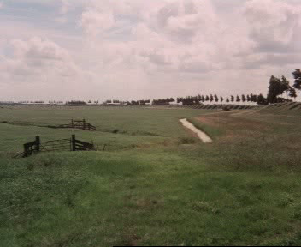
Results
A short clip on the right of an actual video from TRECVID.

Slide 7
Results
60 sec. clip processed in 37 sec.
1501 frames cut down to 10 key frames.

Slide 8
Analysis
Still tweaking it a bit.
Not selecting last frame as a boundary.
Probably should include shot boundary frames in addition to those found clustering.

Slide 9
Moving Forward
Full System should be ready early next week.
Scoring of detector by TRECVID standards.
Possible implementation of voting on descriptors.

