Slide 1
REU: Week 8

Slide 2
Layout
Update
Moving Forward

Slide 3
Key Frame Extraction
Works well, applying to all data so we can do a full run.

Slide 4
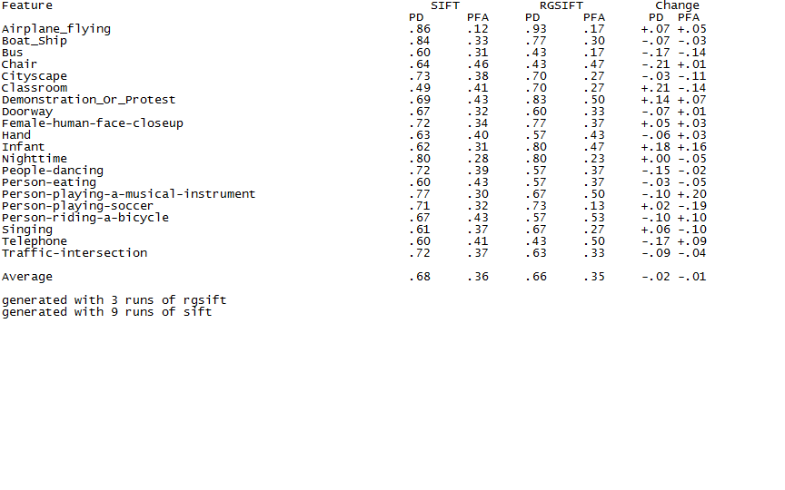
RGSIFT vs. SIFT

Slide 5
Analysis
RGSIFT performs significantly better in some categories, but overall worse.
Based on this and several papers, I will start working on a fusion method to utilize multiple detectors.
Should be more robust as we can utilize detectors that are complementary.
Notes:
Complementary in the sense that the invariances complement each other. Rgsift is shift and scale invariant, but not color intensity invariant.
By fusion I mean a method through which multiple detectors are used and averaged before going into the svm.

Slide 6
Moving Forward
Closer to a full run.
Early fusion method.
Also look at GIST descriptors.
Preliminary results from a Naveed show promise.

