Slide 1
REU Report Meeting Week 2
Patrick Hynes

Slide 2
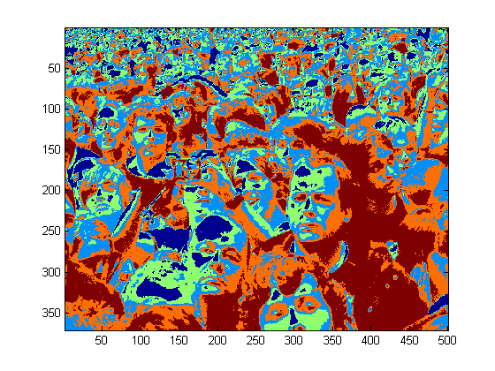
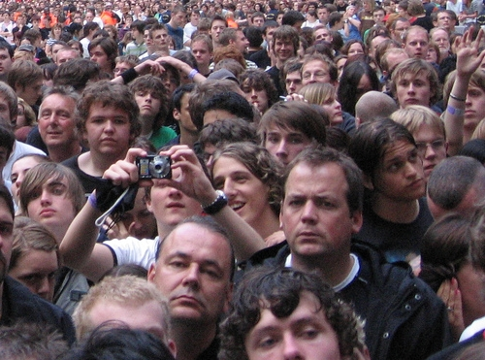
K - Means

Slide 3
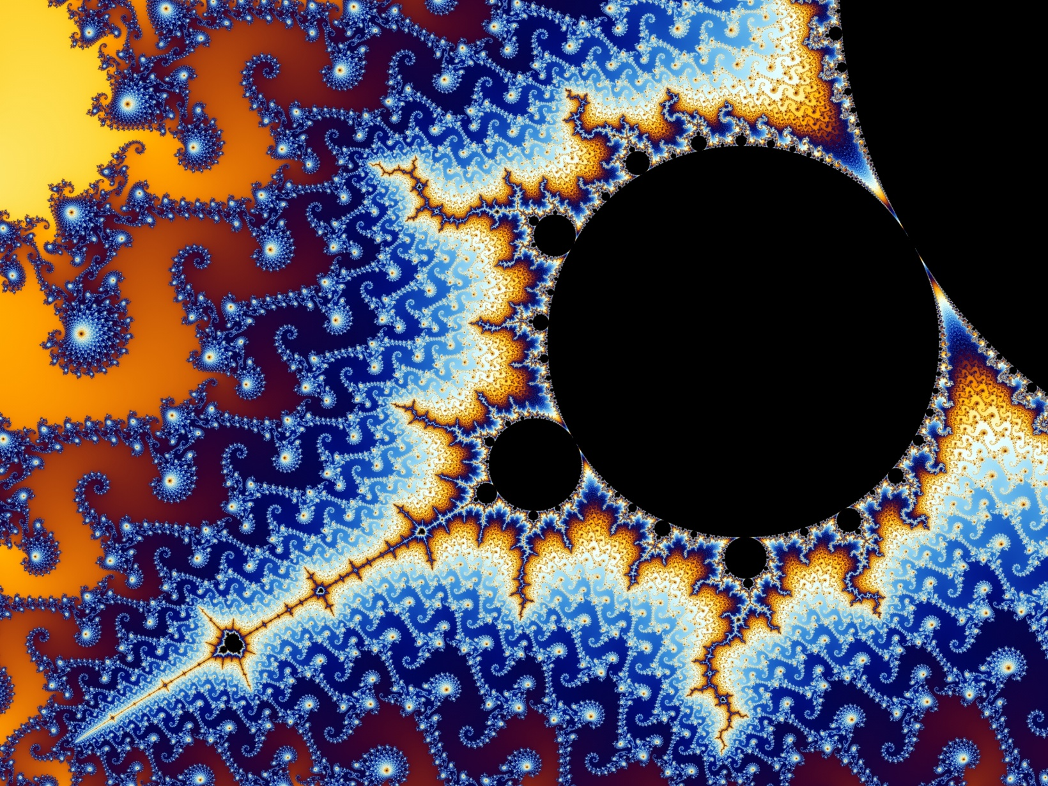
K - Means

Slide 4
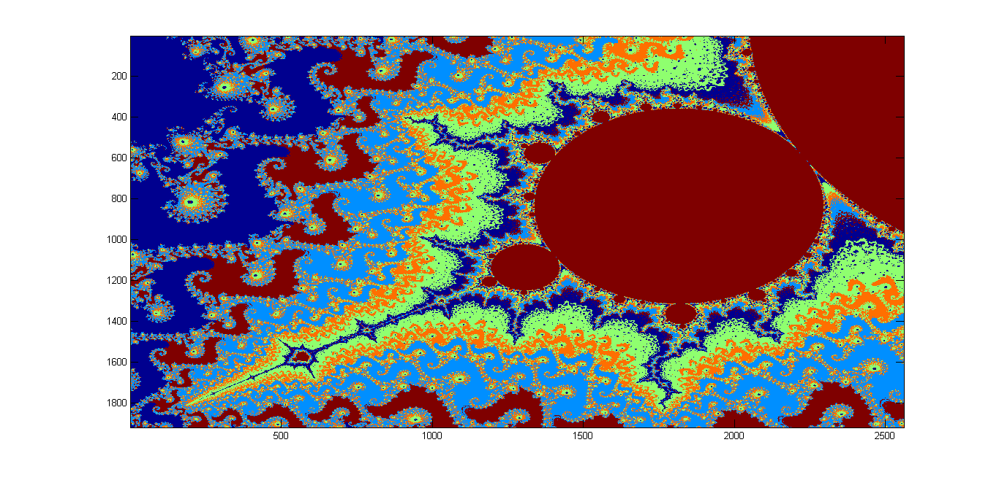
K - Means

Slide 5
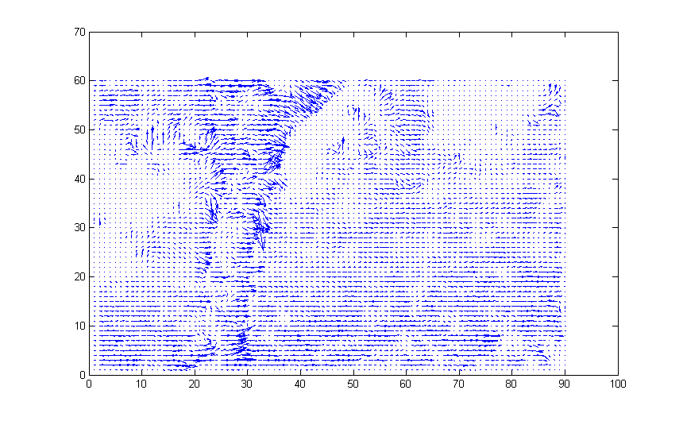
Optical Flow

Slide 6
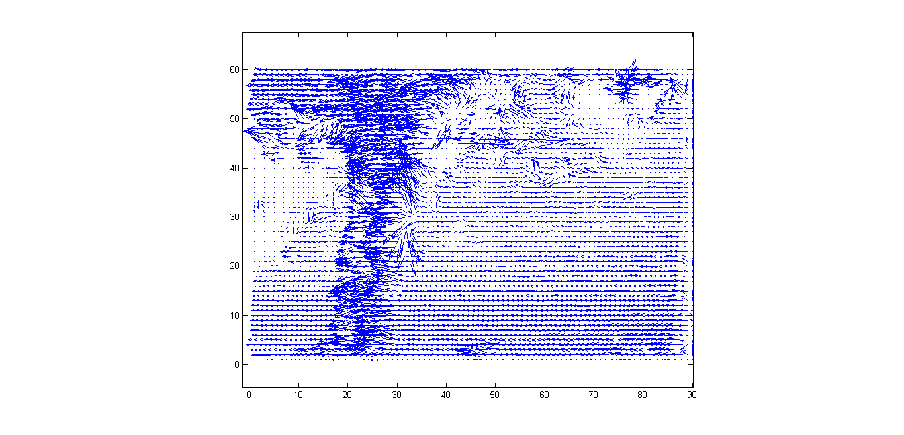
Optical Flow

Slide 7
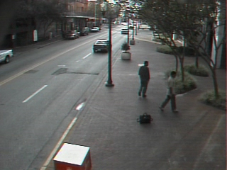
Background removal

Slide 8
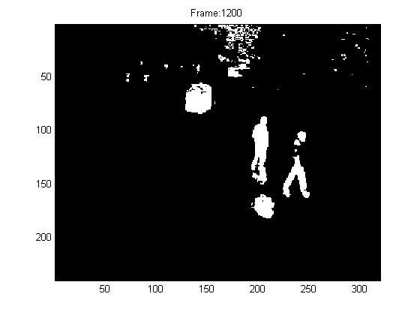
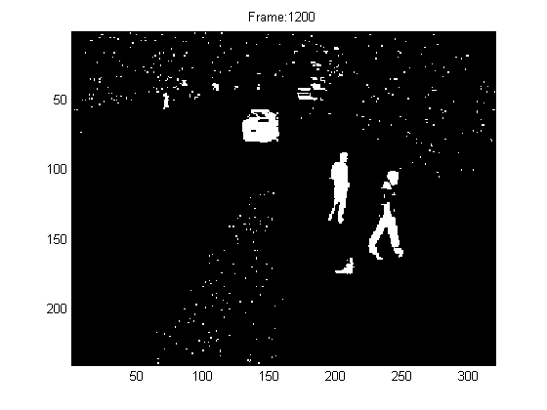
Background Removal
Median
Single Gaussian Distribution

Slide 9
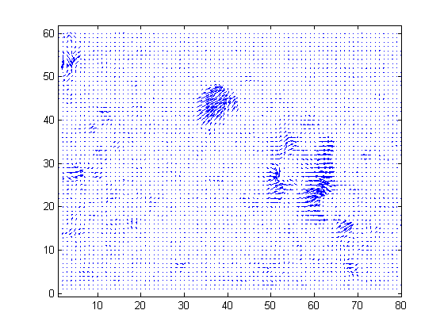
Optical Flow for Video Frame

Slide 10
Project Topics
One-Shot recognition
Facebook Project
3D from phone
LaViola’s Depth to Skeletal Structure

