Slide 1
REU Report Meeting Week 4
Patrick Hynes

Slide 2
Topic
One shot recognition
  Extending to Action recognition

Slide 3
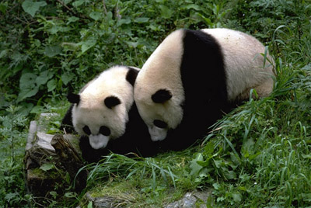
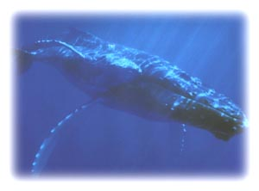
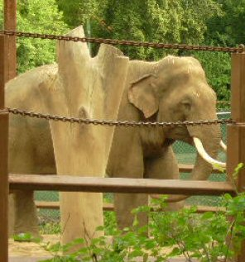
Animals with Attributes

Slide 4
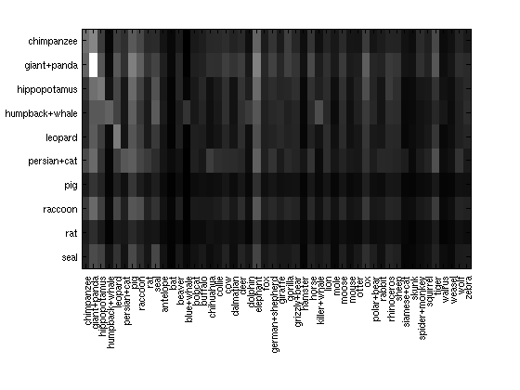

Slide 5
Caltech 101 Experiments
Goal, compare results to Fei-fei,Fergus, Perona
All 101 Categories
Training set of 3,6,15 examples per class
Testing set of 50 examples per class

Slide 6
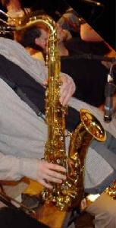
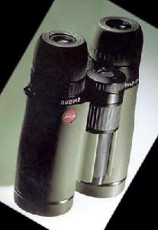
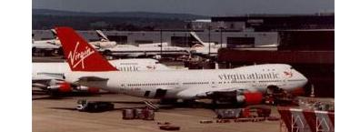
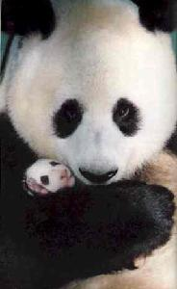
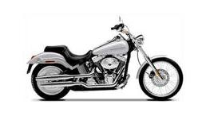

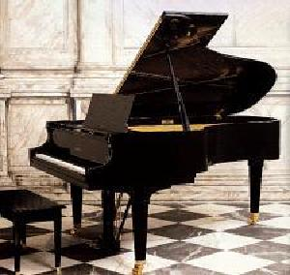
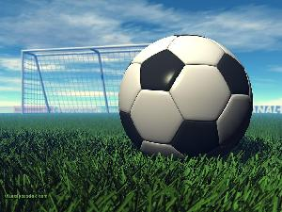
Caltech 101 Images

Slide 7
Some Results
Working with Antonio to compare our results
His code is using the same examples repeatedly, mine is choosing examples from each category randomly

Slide 8
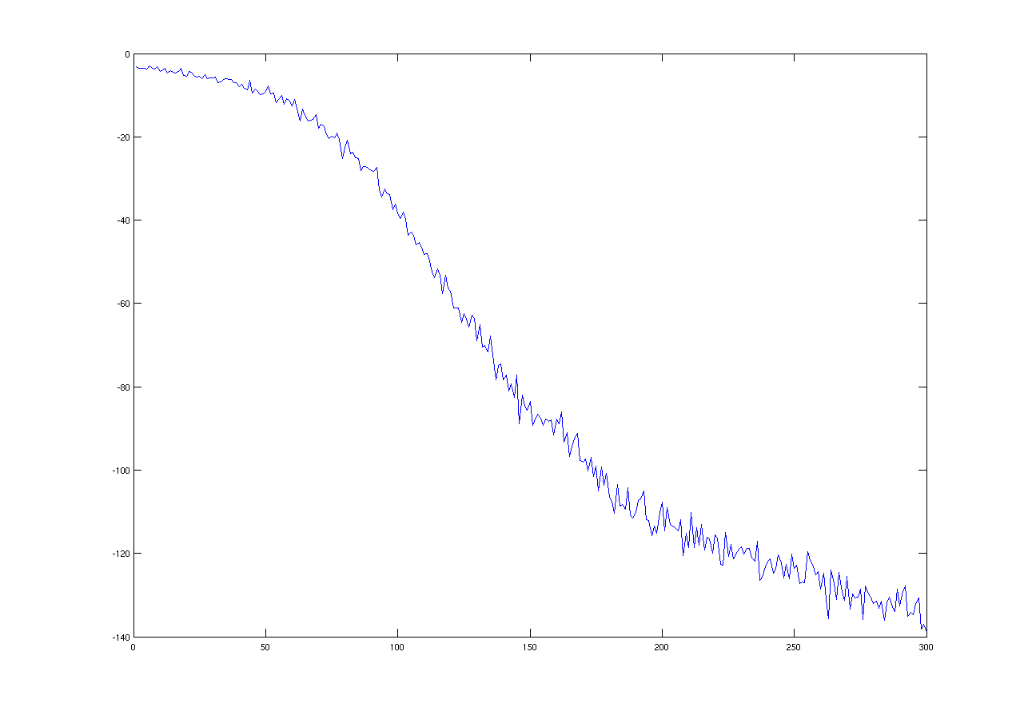
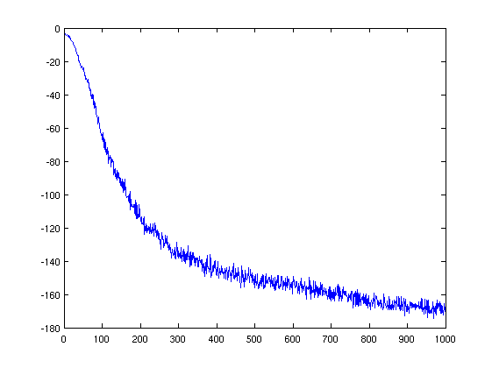
Some Results
Optimization Function

Slide 9
Some Results
Using PCA with 3 training examples
3 training examples over 300 optimization iterations, 1 microset 8.21% mean accuracy
Using PCA over training and testing examples
3 examples 1000 iter. 1microset 8.52% mean accuracy
3 examples 600 iter. 10 microsets 9.28%
6 examples 300 iter. 1 microset 10.37%

Slide 10
Areas to test and improve
Experimenting with
  different PCA data
  number of microsets
  Proper number of iterations for optimization
  Increased one-shot repetitions in checking accuracy
  Averaging results from various data

