Slide 1
REU Report Meeting Week 6
Patrick Hynes

Slide 2
Topic
One shot recognition

Slide 3
Experiment Goal
Train on Caltech 256 categories
30607 Images
Test one-shot on Caltech 101
9146 Images

Slide 4
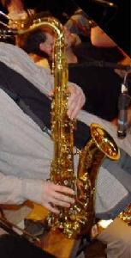
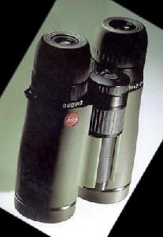

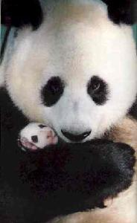
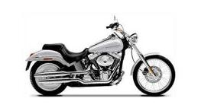
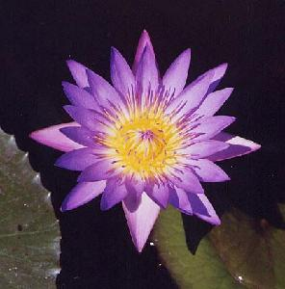
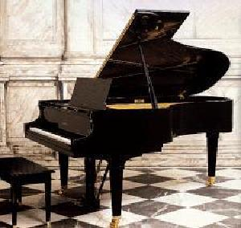

Caltech 101 Images

Slide 5
Procedure
Normalize features and perform Principle Component Analysis on 226 unique categories of Caltech 256
Train Classifier on the 500 features generated
Using the previous PCA, transform Caltech 101 features
Perform a one-shot learning task

Slide 6
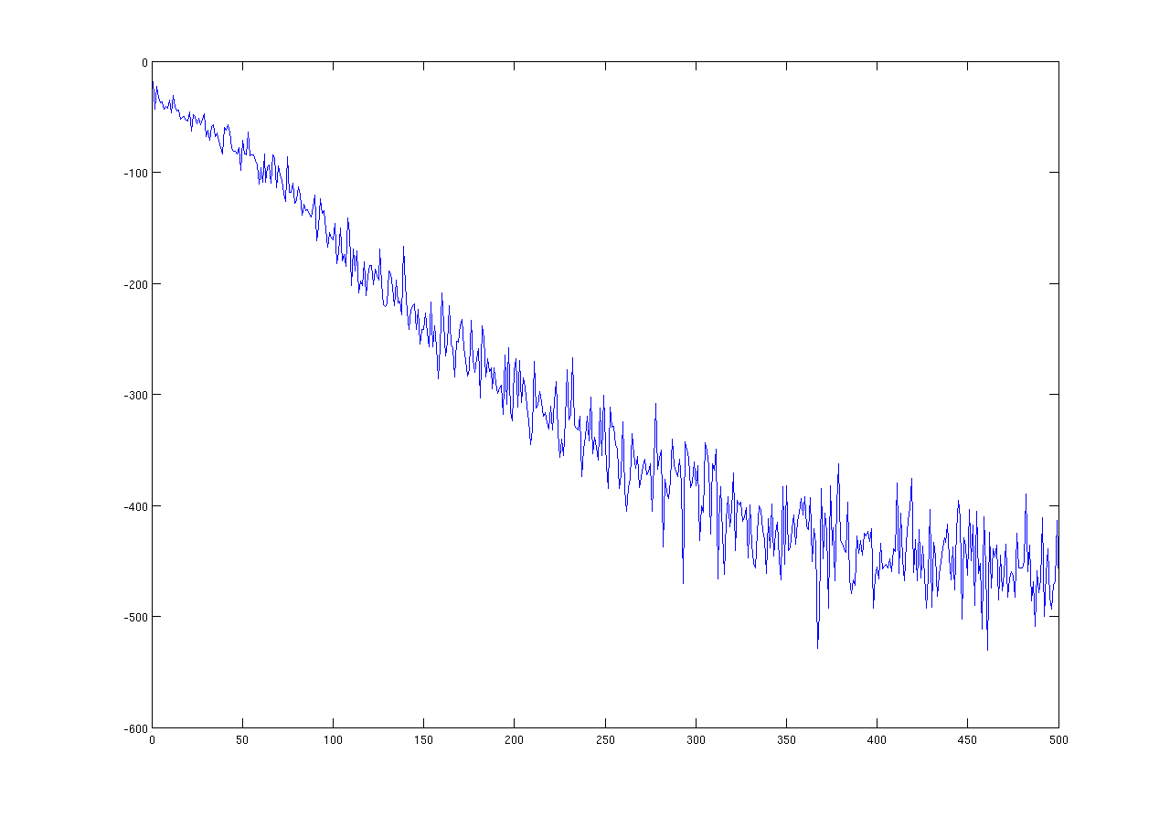
Some Results
500 iterations, 0.01 Step, 1 test, 10 train

Slide 7
Some Results
Results consistently in approximately 7-9% mean accuracy range
Optimization weakly affecting output

Slide 8
Areas to test and improve
Suspect there is most likely some error with current implementation of the final one-shot classification task
Also in question, optimization dimension reduction

