Slide 1
REU Report Meeting Week 7
Patrick Hynes

Slide 2
Outline – One Shot
Recent results Caltech experiments
  Experiments, changes
Moving forward
  YouTube Dataset
  One Shot action recognition

Slide 3
Some Results
Trained on Caltech 256
One Shot on Caltech 101
Num. Train Examples | Our Method | Fei-Fei, et all
1 | 9.73% | ----
3 | 11.00% | 10.4%
6 | 14.73% | 13.9%
15 | 20.14% | 17.7%

Slide 4
Results - Baseline
Trained on Caltech 101
Trained on Caltech 101
Num. Training Examples | Our Method
1 | 37.11%
3 | 41.71%
6 | 50.66%
15 | 57.81%

Slide 5
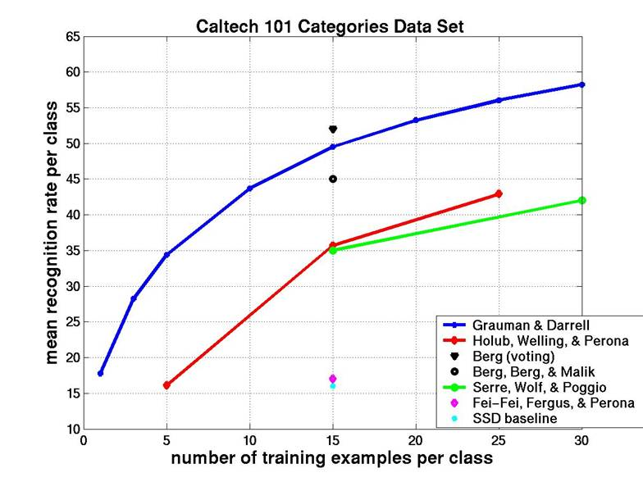
Road Block

Slide 6
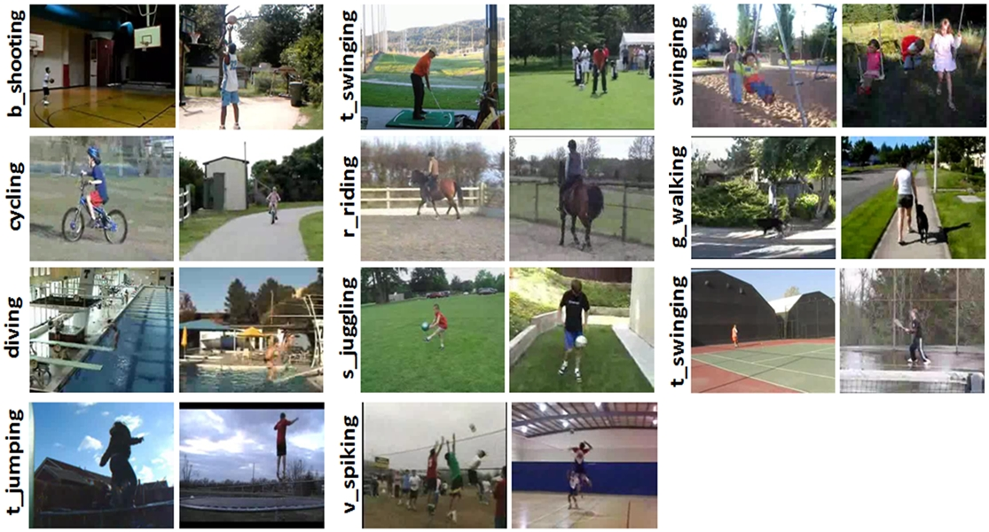
YouTube Dataset
11 Categories, 100 Videos each

Slide 7
Method
Features consisting Bag of Word Histograms for each image
Designate 5 classes for training
Perform One Shot training for remaining classes

