Slide 1
REU Report Meeting Week 8
Patrick Hynes

Slide 2
Outline – One Shot
This Week’s Results
YouTube Dataset
Next Steps

Slide 3
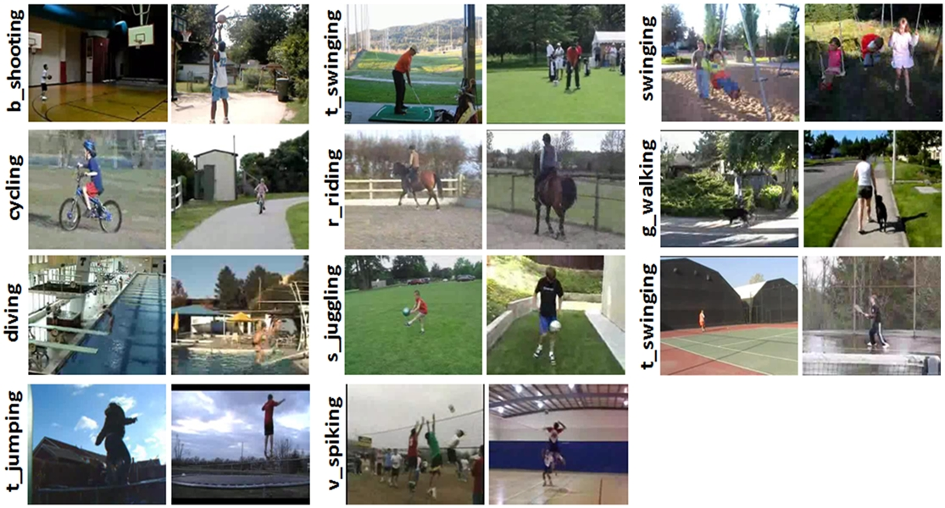
YouTube Dataset
11 Categories, 100 Videos each

Slide 4
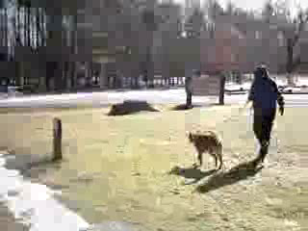
Video from Dataset

Slide 5
Method
Features consisting Bag of Word Histograms for each image
Designate 5 classes for training
Perform One Shot training for remaining classes

Slide 6
5 Train , 6 Test
Dimension Reduction | 1 Shot | 3 Shot | 6 Shot | 15 Shot
PCA | 20.04 | 20.41 | 21.71 | 23.66
Fast SVD | 27.42 | 29.04 | 33.05 | 36.21
Fast SVD | 29.26 | --- | 34.59 | ---
Fast SVD | 32.83 | --- | 38.16 | ---
Fast SVD | 27.60 | --- | 31.18 | ---
Fast SVD | 32.03 | --- | 37.58 | ---
Fast SVD | 33.90 | --- | 38.52 | ---

Slide 7
Try something different
Training Classes | Testing Classes | Dimension Reduction | 1 Shot | 3 Shot | 6 Shot | 15 Shot
11 | 11 | PCA | 85.40 | --- | --- | 92.81
11 | 11 | Fast SVD | 81.68 | 89.04 | 91.69 | 93.24
5 | 6 | PCA | 20.04 | 20.41 | 21.71 | 23.66
5 | 6 | Fast SVD | 27.42 | 29.04 | 33.05 | 36.21
1 | 10 | PCA | 16.73 | 18.00 | 20.05 | 22.04
1 | 10 | Fast SVD | 15.05 | 15.71 | 17.97 | 20.27
1 | 11 | PCA | 19.28 | 20.00 | 21.10 | 22.44
1 | 11 | Fast SVD | 13.86 | 14.21 | 15.71 | 18.17

Slide 8
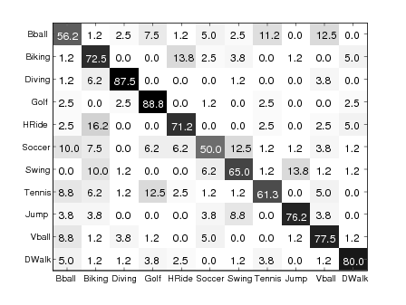
Shah’s Group Results Overall 71.5%
Leave-One-Out Cross Validation

Slide 9
Can we compare more directly
Train and Test Using all Classes, but separate examples
Train Examples | Test Examples | Dimension Reduction | 1 Shot | 15 Shot
75 | 25 | PCA | 59.57 | 68.15
75 | 25 | SVDS | 63.64 | 72.68
75 | 25 | Fast SVD | 69.85 | 79.80
50 | 50 | Fast SVD | 66.80 | 71.26
25 | 75 | Fast SVD | 61.68 | 64.07

Slide 10
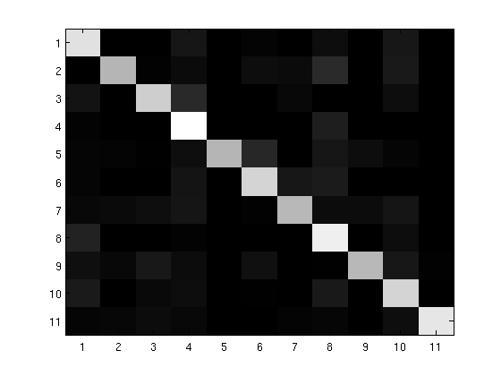
72-25 SVDS 15 shot

Slide 11
Cross Validation
Comparison Results look promising
Test and Train on All Classes
Train on 90 examples
Test on remaining 10
1 shot, 15 shot
Average 10 runs, using different 10 test examples for each run

Slide 12
Cross Validation Results
Testing examples pulled in order
Testing examples pulled randomly
 | 1 Shot Mean | 15 Shot Mean
90-10 Fast SVD | 54.03 | 63.38
 | 1 Shot Mean | 15 Shot Mean
90-10 Fast SVD | 64.57 | 75.91

Slide 13
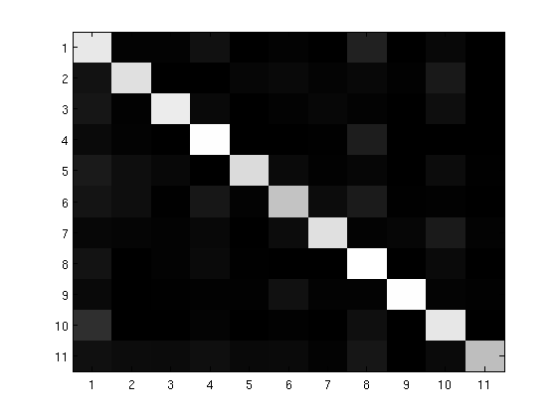
Cross Validation Confusion Matrix

Slide 14
Next Steps
Try different Cross Validation Schemes
Switch Dimension Reduction
PCA over weekend, will take two days
Change number of examples
Vary training classes
Return to Caltech Experiments
Adapt SVDS, Fast SVD see how these results compare to the PCA we were using
Can some of these results inform how we do pure one-shot?

