Slide 1
REU Report Meeting Week 9
Patrick Hynes

Slide 2
Outline – One Shot
Recap
This Week’s Results
YouTube Dataset
Caltech
Next Steps

Slide 3
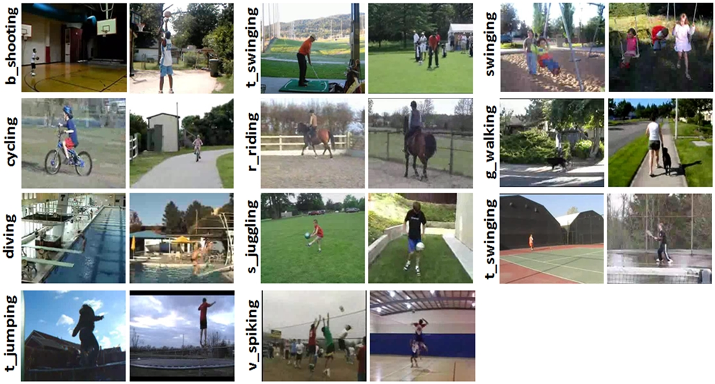
YouTube Dataset
11 Categories, 100 Videos each

Slide 4
Methods
One-Shot Learning of Classes
Leave-One-Out Cross Validation

Slide 5
5 Train , 6 Test
Dimension Reduction | 1 Shot | 3 Shot | 6 Shot | 15 Shot
PCA | 20.04 | 20.41 | 21.71 | 23.66
Fast SVD | 27.42 | 29.04 | 33.05 | 36.21
Fast SVD | 29.26 | --- | 34.59 | ---
Fast SVD | 32.83 | --- | 38.16 | ---
Fast SVD | 27.60 | --- | 31.18 | ---
Fast SVD | 32.03 | --- | 37.58 | ---
Fast SVD | 33.90 | --- | 38.52 | ---

Slide 6
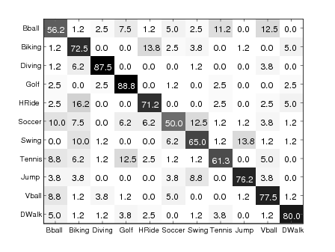
“Videos in wild” Results Overall 71.5%
Leave-One-Out Cross Validation

Slide 7
Baseline
How well could we do, training on everything?
Training Classes | Testing Classes | Dimension Reduction | 1 Shot | 3 Shot | 6 Shot | 15 Shot
11 | 11 | PCA | 85.40 | --- | --- | 92.81
11 | 11 | Fast SVD | 81.68 | 89.04 | 91.69 | 93.24

Slide 8
Can we compare more directly
Train and Test Using all Classes, but separate examples pulled randomly
Train Examples | Test Examples | Dimension Reduction | 1 Shot | 15 Shot
75 | 25 | PCA | 59.57 | 68.15
75 | 25 | SVDS | 63.64 | 72.68
75 | 25 | Fast SVD | 69.85 | 79.80
50 | 50 | Fast SVD | 66.80 | 71.26
25 | 75 | Fast SVD | 61.68 | 64.07

Slide 9
Cross Validation Results
Testing examples pulled in order
Testing examples pulled randomly
 | 1 Shot Mean | 15 Shot Mean
90-10 Fast SVD | 54.03 | 63.38
 | 1 Shot Mean | 15 Shot Mean
90-10 Fast SVD | 64.57 | 75.91

Slide 10
Person by Person Cross Validation
“96-4”
Neighbors | Optimization 3 sets, 1 train, 10 test
1 ‘shot’ | 50.85
15 ‘shot | 59.70
25 ‘shot’ | 60.14
96 ‘shot’ | 61.28

Slide 11
Conclusions
Method is heavily disturbed by these different videos
Results show some possible inconsistencies that may need to be explored

Slide 12
Caltech Experiments
Try different dimension reductions strategy
Anthony will have additional results on his Caltech experiments

Slide 13
Recall
Trained on Caltech 256
One Shot on Caltech 101
Neighbors | Our Method | Fei-Fei, et all | Grauman and Darrell
1 | 9.73% | ---- | 17.5%
3 | 11.00% | 10.4% | 28%
6 | 14.73% | 13.9% | ----

Slide 14
FastSVD vs. PCA
Training on 256, Testing 101
FastSVD doesn’t give a similar benefit in this instance
Neighbors | PCA | FastSVD
1 | 9.73% | 5.40%
3 | 11.00% | 5.97%
6 | 14.73% | 7.36%

Slide 15
Next Steps
Can we do better at recognizing an action in a very different video?
Reevaluate features
How can we improve on our one shot results and use that knowledge to help answer the first question?
Run additional one-shot experiments
Continue one-shot experiments with the Caltech datasets.

