Slide 1
Project Presentation – Week 1
By Joshua Michalczak, May 21, 2010
Presentationfor UCF Computer Vision REU

Slide 2
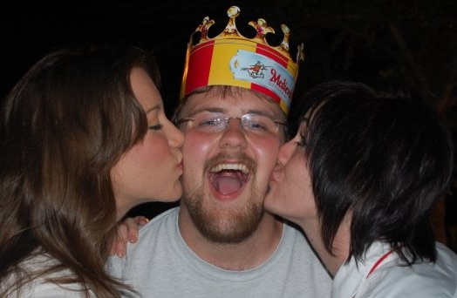
About Me
Born in Orlando; live in Orlando
Senior at UCF (graduate May 2011)
Computer Science Major
Good at Programming
Member of UCF Programming Team
OK at Math
Statistics 2; Calculus 3

Slide 3
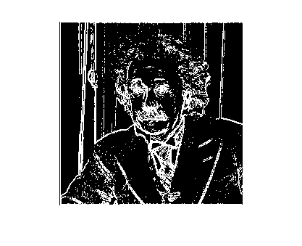
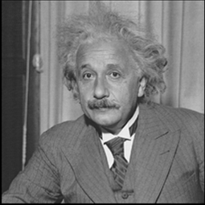
Gradient Edge Detection
Original
25% Edge detection

Slide 4
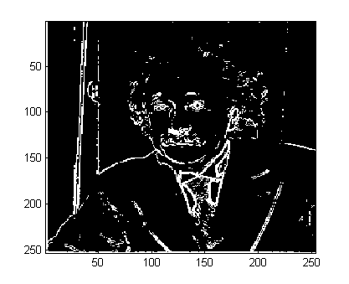
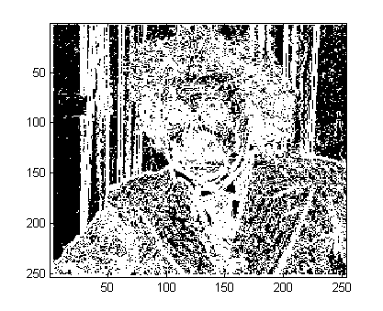
Gradient Edge Detection
10%
25%
50%

Slide 5
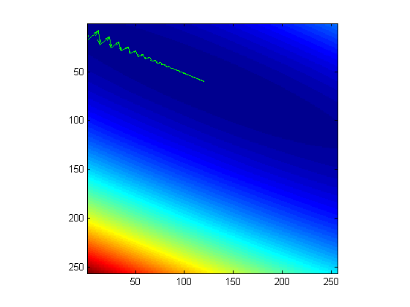
Gradient Descent

Slide 6
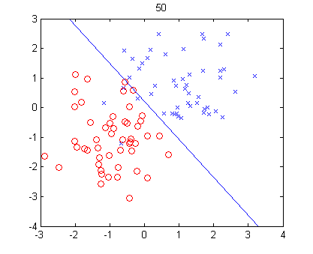
Logistic Regression
L:1.550827e+001

