Slide 1
Project Presentation – Week 2
By: Joshua Michalczak, 28 May 2010
For: Computer Vision R.E.U. at University of Central Florida

Slide 2
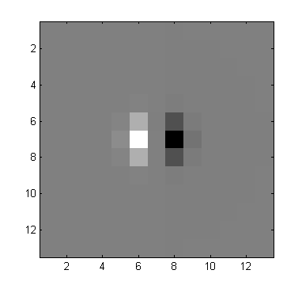
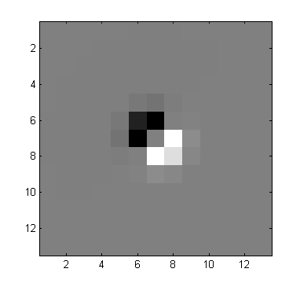
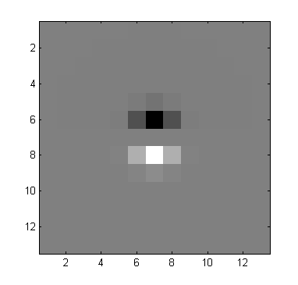
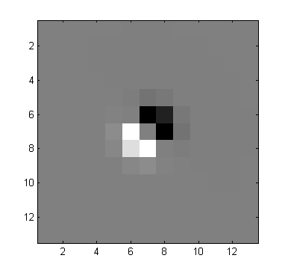
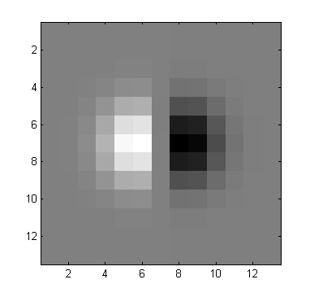
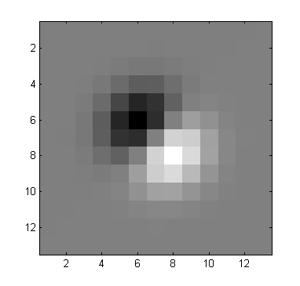
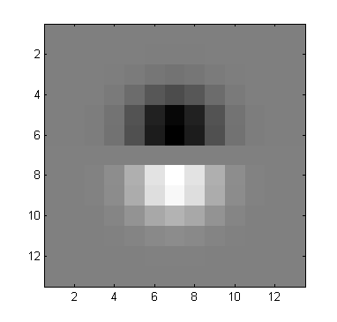
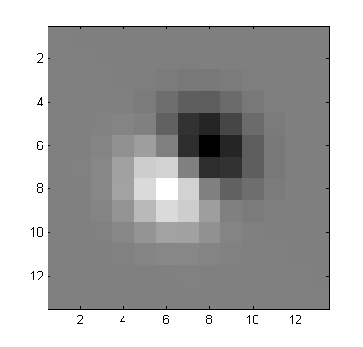
Learned Edge Detection - Filters

Slide 3
Learned Edge Detection - RoC
False alarm = 10%, Detection = 63.5%, Threshold = ~62.0%
False alarm = 30.3%, Detection = 90%, Threshold = ~32.6%

Slide 4
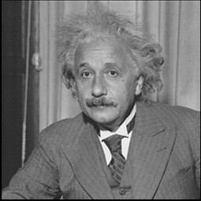
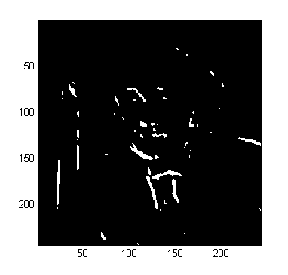
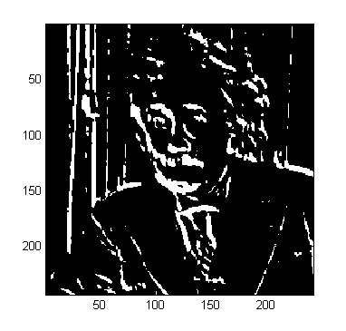
Learned Edge Detection
False alarm = 10%, Detection = 63.5%, Threshold = ~62.0%
False alarm = 30.3%, Detection = 90%, Threshold = ~32.6%

Slide 5
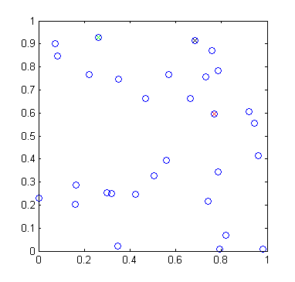
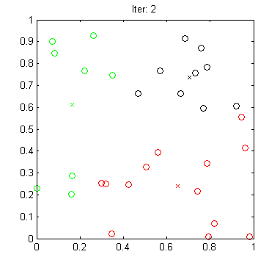
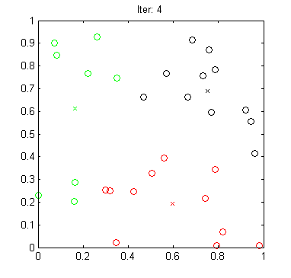
Clustering via K-Means

Slide 6
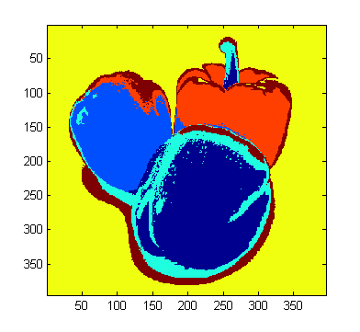
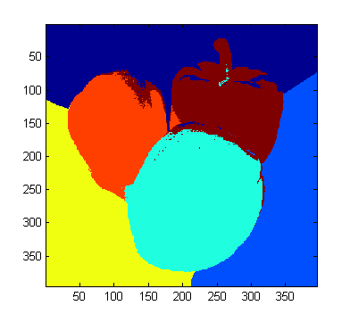
Clustering via K-Means
6 cluster centers,
without location weight
6 cluster centers,
with location weight

Slide 7
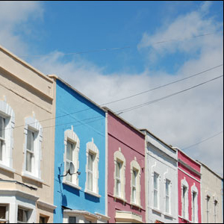
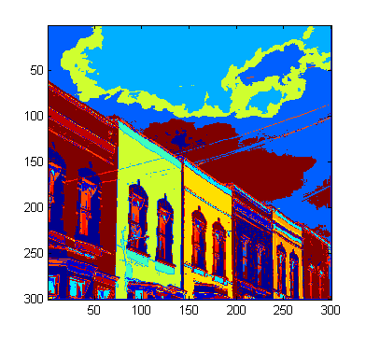
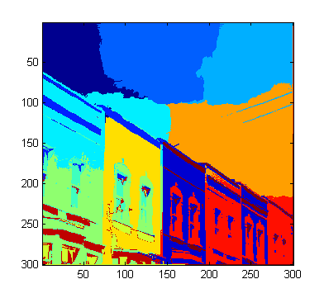
Clustering via K-Means
15 cluster centers,
without location weight
15 cluster centers,
with location weight

Slide 8
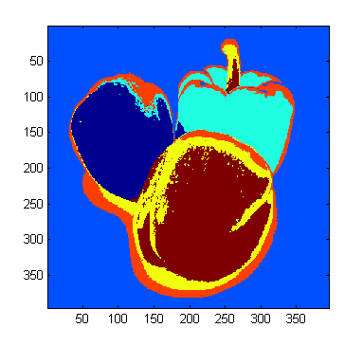
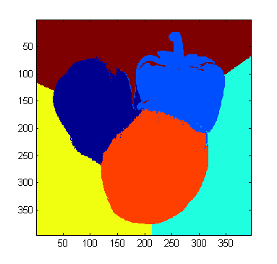
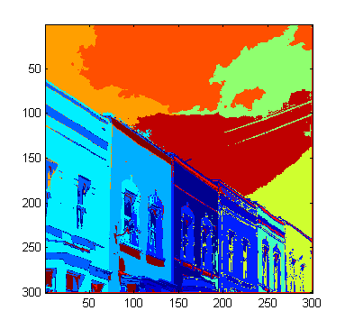
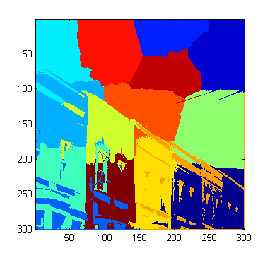
Clustering via K-Means (Color weight vs. Location weight)
Higher color weight
Equal weights
Higher location weights

Slide 9
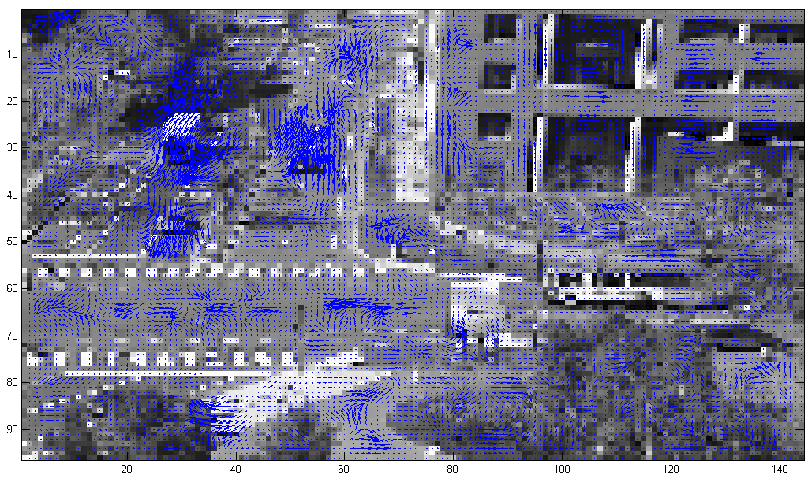
Optical Flow Results - Initial (levels: 3, win: 3, iter:3)
“Blob” of flow?
Noise?

Slide 10
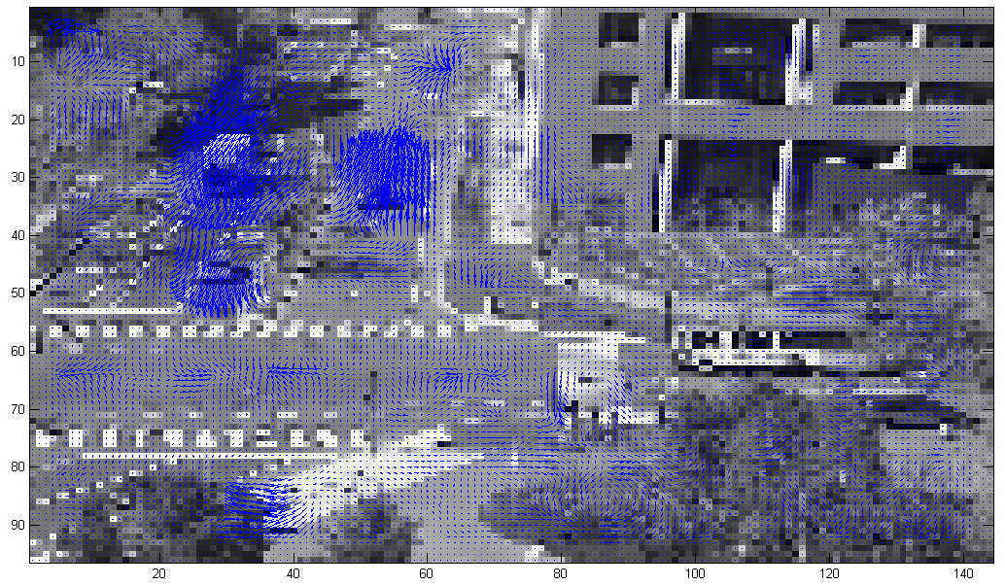
Optical Flow Results – Larger Win (levels: 3, win: 5, iter:3)
Bigger “blobs”
Less noise

Slide 11
Optical Flow Results – More iter (levels: 3, win: 3, iter:20)
Shrinks “blobs”
Better alignment
Vector magnitudes reduced
Lessens noise

Slide 12
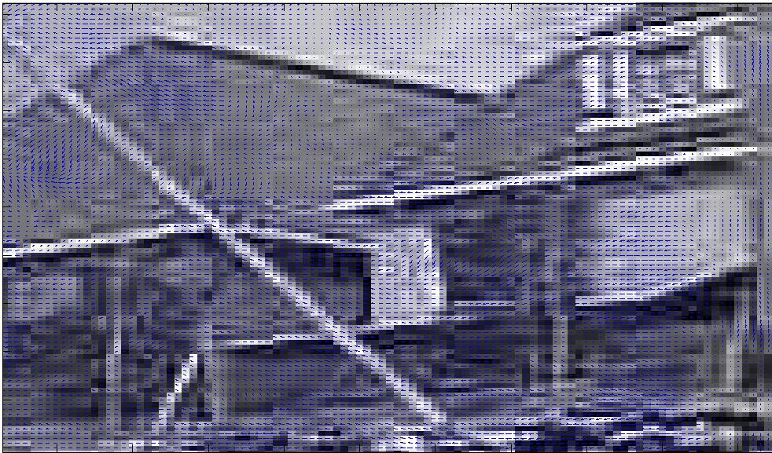
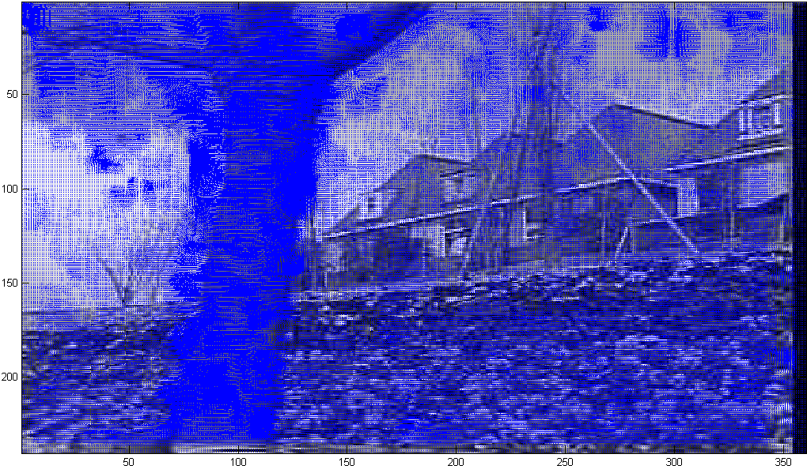
Optical Flow Results – Second test set (2, 3, 3)

Slide 13
Optical Flow Results - Thoughts
Larger windows
Reduce noise (+)
Increase “blob” size (-)
More iterations
“blobs” better modeled (+)
Computationally expensive (-)
Changes vector magnitudes (More accurate?)
Levels
Each scene/scenario seems to have an ideal pyramid count.
Inappropriate level size greatly affects the resulting flow adversely.

Slide 14
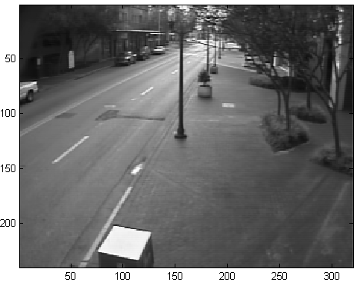
Background Subtraction - Median
Briefcase shadow

Slide 15
Background Subtraction – Single Gaussian
Standing shadows

Slide 16
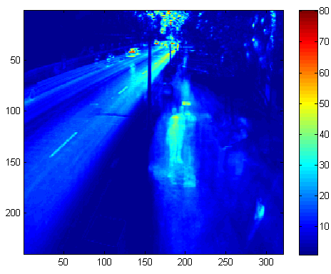
Background Subtraction – Standard Deviation

Slide 17
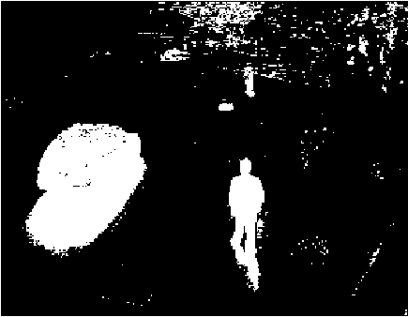
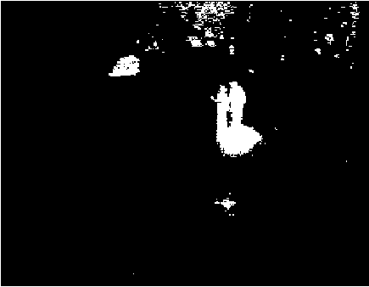
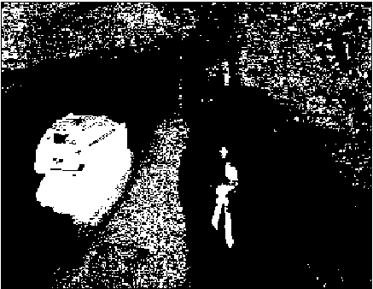
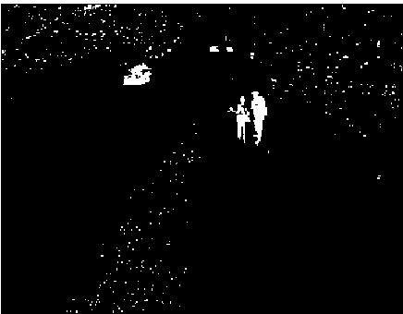
Background Subtraction – Comparing Results
Median
(10 dist.)
Frame 152
Frame 670
Gaussian
(-2 < z > 2)

Slide 18
Topics I’m Interested in
3D
Creation of 3D Data
Shape/Depth from X
Stereo
Working with 3D
SLAM
Interpreting Structure
Augmented Reality
4
5
1
3
2*

Slide 19
SLAM - Simultaneous localization and mapping
Likes: Problem well defined
Plethora of research – good ideas and algorithms
Could be coupled with machine learning for other tasks?
Idea: Could aide in the accuracy of Dr. Lobo’s 4-camera device? Extend uses in market?
When coupled together, localization and mapping correct errors in each-other.

Slide 20
Augmented Reality
Likes: Combining 3D interpretation with applications
Dislikes: Seems to have moved away from research and more into application fields
Most papers were system specific or discussed a use of AR rather than AR itself
Idea: Coupling “Where am I” with AR
Sort of already done though, see Layar app for Android phones

Slide 21
Interpreting Structure
Likes: Couples 3D field with Machine Learning field
Useful base for other work; see Depth-map To Skeleton project
Dislikes: Too broad of a problem
Would prefer focused project to ensure good results from REU program
Also, not sure of project ideas other than DTS project….

Slide 22
Creation of 3D Data
Likes: Low-level
I tend to gravitate to “fundamental problems”
Again, building a framework for other work
Dislikes: Dead field?
Most techniques are well researched
New technology automagically grabs reliant depth; stereo and 3D cameras
Again, not sure on project topics other than depth from defocus

