Slide 1
Project Presentation – Week 4
By: Joshua Michalczak, 10 June 2010
For: Computer Vision R.E.U. at University of Central Florida

Slide 2
Topic Overview
Structure from motion
Derive a scene’s 3D nature from a series of 2D observations
Use changes in object locations to derive depth
2 main methods of achieving SfM:
From object flow, think 4 camera device
From planar homography, think Photosynth

Slide 3
Topic Overview
Exploring uses of SfM
4 camera device aware of environment structure
Segmenting object movement from environment movement for better global flow
SLAM techniques
Papers:
Single Camera SfM w/ automatic baseline selection
MonoSLAM
FastSLAM

Slide 4
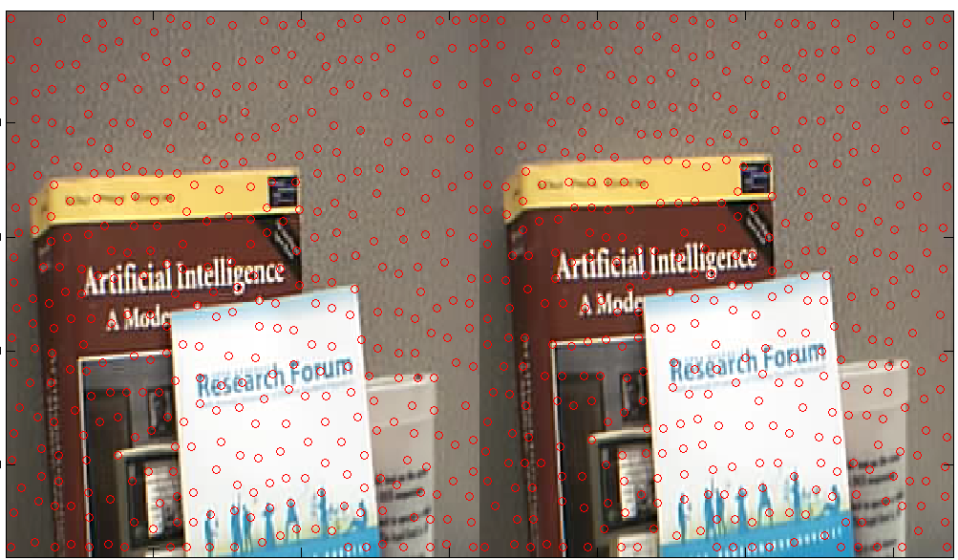
Results so far: KLT Feature Detection

Slide 5
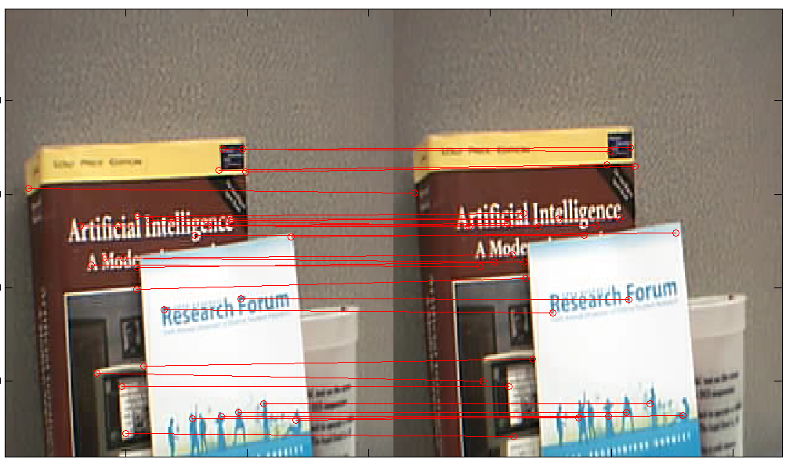
Results so far: KLT Feature Matching - Flow

Slide 6
Results so far: KLT Feature Matching - Diff²

Slide 7
Results so far: KLT Feature Matching - Diff² (2)

Slide 8
Future work
CVPR 2010:
Tutorial on 3D shape reconstruction Monday morning
Shape-from-X program
Continue to implement Single-Camera SfM
RANSAC for better matching results
Derive camera location based on correspondance

