Slide 1
Project Presentation – Week 6
Joshua Michalczak
For UCF REU in Computer Vision, Summer 2010

Slide 2
Recap – What I’m doing
‘Structure from Motion’ (SfM)
Recovery of pixel depth by viewing that point from different locations
Typical applications: 3D reconstruction
Exploring new uses?
Detecting occlusion of environment, etc

Slide 3
Where was I?
Week 4 Meeting
During CVPR
Feature point detection
Matching of features across different frames
Robust estimation of Fundamental Matrix (F) using RANSAC

Slide 4
The F-Matrix
DEMO

Slide 5
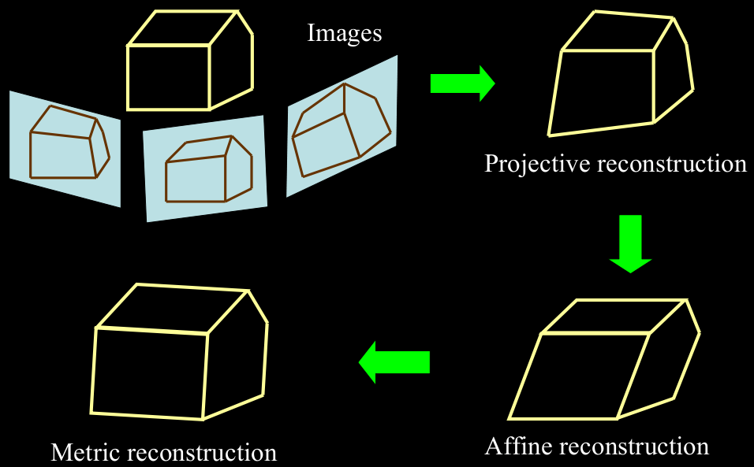
Where am I now?
Can triangulate to ‘Projective’ accuracy
Can “upgrade” the ‘projective’ reconstruction to an ‘affine’ reconstruction

Slide 6
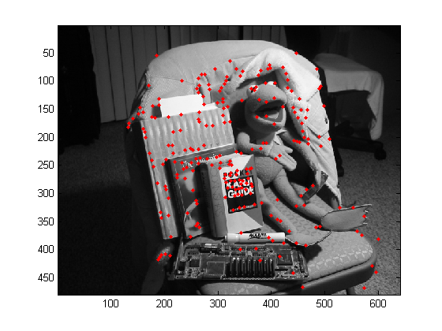
Affine Reconstruction?
What we expect: projecting 3D points to image matches original feature point locations (correct for 1st view)

Slide 7
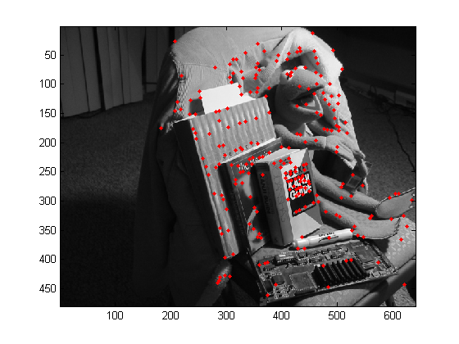
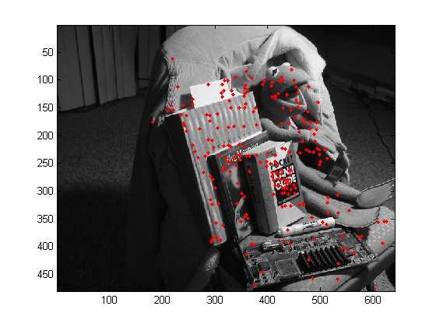
Affine Reconstruction?
What’s wrong: Doing the same thing for the 2nd view does not yield correct locations. Incorrect by an affine transformation.

Slide 8
Goal for next week
Complete ‘Metric’ reconstruction
Port code out of Matlab for real-time demonstration

