Slide 1
Project Presentation – Week 7
Joshua Michalczak
For UCF REU in Computer Vision, Summer 2010

Slide 2
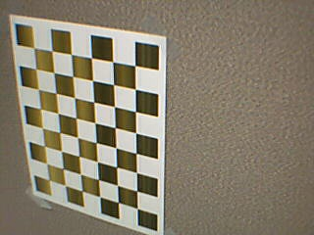
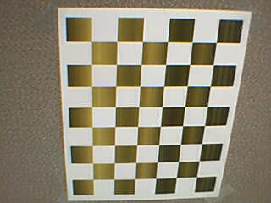
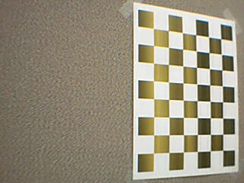
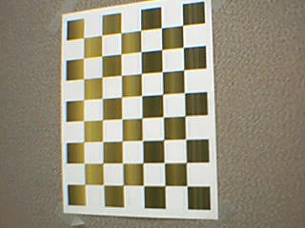
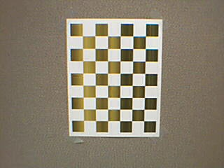
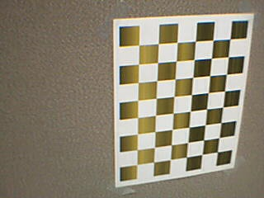
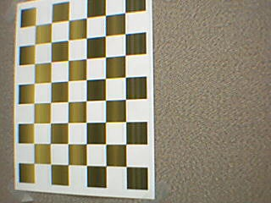
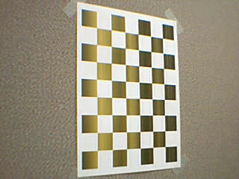
Changes
Assuming camera is calibrated
Could possibly switch back later…
… but for now makes metric reconstruction easier

Slide 3
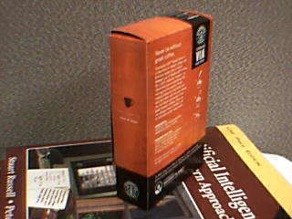
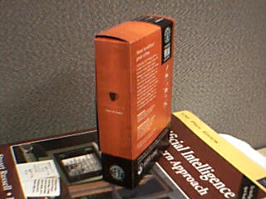
Metric Reconstruction
Calculate initial matches
RANSAC outliers
Correct points using camera calibration
Calculate essential matrix
Rotation + translation
Calculate 3D structure

Slide 4
SUPER AWESOME DEMO TIME

Slide 5
Thoughts on initial results
Needs dense matching
Ideally, epilines are horizontal across both images
Problem, my current implementation is off by up to 10 scan-lines (limits search but not ideal)

Slide 6
Goals
Dense matching
Better recitfication?
Adding a 3rd (or 4th, 5th, etc…) frame and calculating it’s pose / adding it’s 3D info
Porting to a real-time capable language
Comparison with “Instantaneous Model”
Detection of objects which are not “moving with the environment”

