Slide 1
Project Presentation – Week 9
Joshua Michalczak
For UCF REU in Computer Vision, Summer 2010

Slide 2
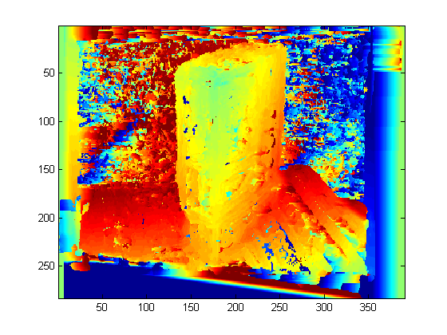
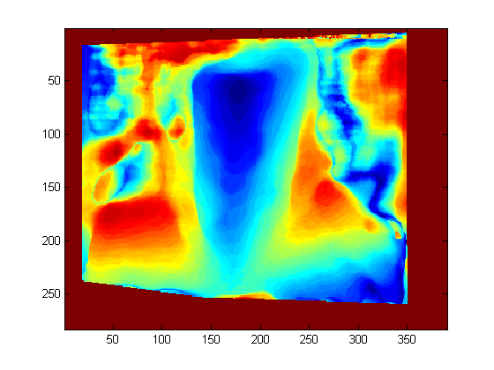
Last Week
Fix’d Rectification
Homebrew Disparity Mapping
Matlab code

Slide 3
This Week
Rebuilding Matlab pipeline in C#
Using “Emgu CV” to map opencv (C++) to C#
Lots of things nice; easy (for example, GUI)
A few things not so much; managed memory (C#) sometimes doesn’t like working with unmanaged memory (C++)

Slide 4
This Week
Currently able to…
… single camera …
… calibrate camera
… find fundamental matrix between two views
… rectify images and find disparity using SGBM
… stereo rig …
… calibrate cameras individually
… BUG: can’t calibrate rig because EmguCV undistort code is broken
Fixed in a current SVN revision; downloaded and building
… rectify images and find disparity using SGBM

Slide 5
Results (No pictures ☹)
Single camera
Fundamental matrix sometimes fails
“Critical Movement”
Mixed Quality in disparity maps
Mostly “nonsense”, sometimes “good”; parameters?
Stereo rig
Expect better quality
Pre-runtime calibration
3D points at time t rather than a combo of t and t+1

Slide 6
Quick Question for Everyone
What is my topic on?
“3D”? “Structure from Motion”? “I have no idea”?
Structure from Motion is only a step in a pipeline
I’m working on leveraging 3D scene information to detect objects which are moving relative to the scene
Previous work mostly flow based
Scene-to-Camera & Object-to-Camera movement, not necessarily representative of Scene-to-Object

Slide 7
Thoughts on how to do so
Determine the “Empty Volume”
When we recover a 3D surface from a camera, we can make assumptions that the space between the surface and the camera center is empty
We can recover the volume of each reconstruction and it’s location relative to the world; volumes can be merged into a single solid
Objects which “puncture” the solid (within some threshold) must have done so through movement

Slide 8
Thoughts on how to do so
“Scene Flow”
Develop correspondences between 3D points at time t1 and t2 using mixture of information (photo consistency, camera/rig locations, etc)
Points which are matched can be tracked in 3D coordinates; movement within some threshold (or outside some distribution) can be marked vs. noise-induced false movement

Slide 9
Thoughts on how to do so
“Object Distributions”
Segment 3D reconstruction into objects
Model an object as a centroid (mean of object points) and a standard deviation in each cardinal direction
Objects which move will show increasingly larger deviations over time as well as a moving centroid; objects where these properties cross a threshold can be marked for movement

