Slide 1
SIFT Algorithm
Scale-invariant feature transform
Extracts features that are robust to changes in image scale, noise, illumination, and local geometric distortion

Slide 2
University of British Columbia
David Lowe’s patented method
Demo Software: SIFT Keypoint Detector
Supports Windows and Linux

Slide 3
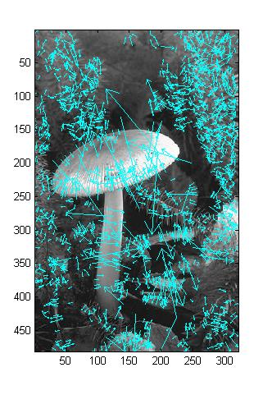
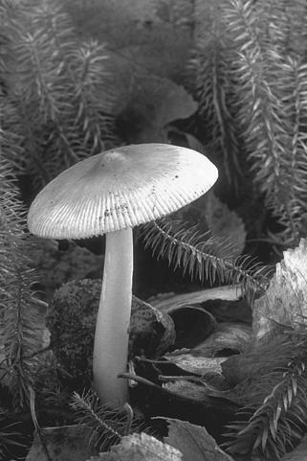
UBC’s Key Interest Points
Key locations are defined as maxima and minima of the result of
difference of Gaussians function applied in scale-space to a series of smoothed
and resampled images.

Slide 4
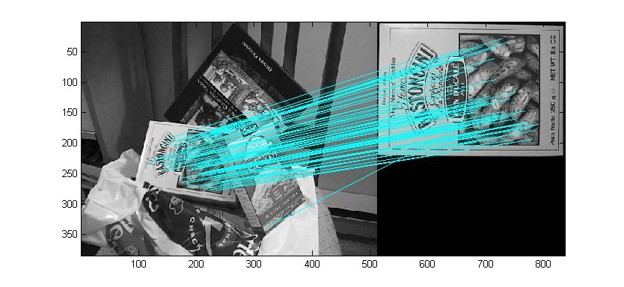
Matching Key Points

Slide 5
VLFeat
Open source library with popular algorithms including SIFT, MSER, k-means, hierarchical k-means, agglomerative information bottleneck, and quick shift.
Written in C for efficiency and compatibility, with interfaces in MATLAB for ease of use and detailed documentation throughout. It supports Windows, Mac OS X, and Linux.

Slide 6
VLFeat
Key point is a disk of center f(1:2), scale f(3) and orientation f(4) .
Descriptors are a green grid centered on the key point.

Slide 7
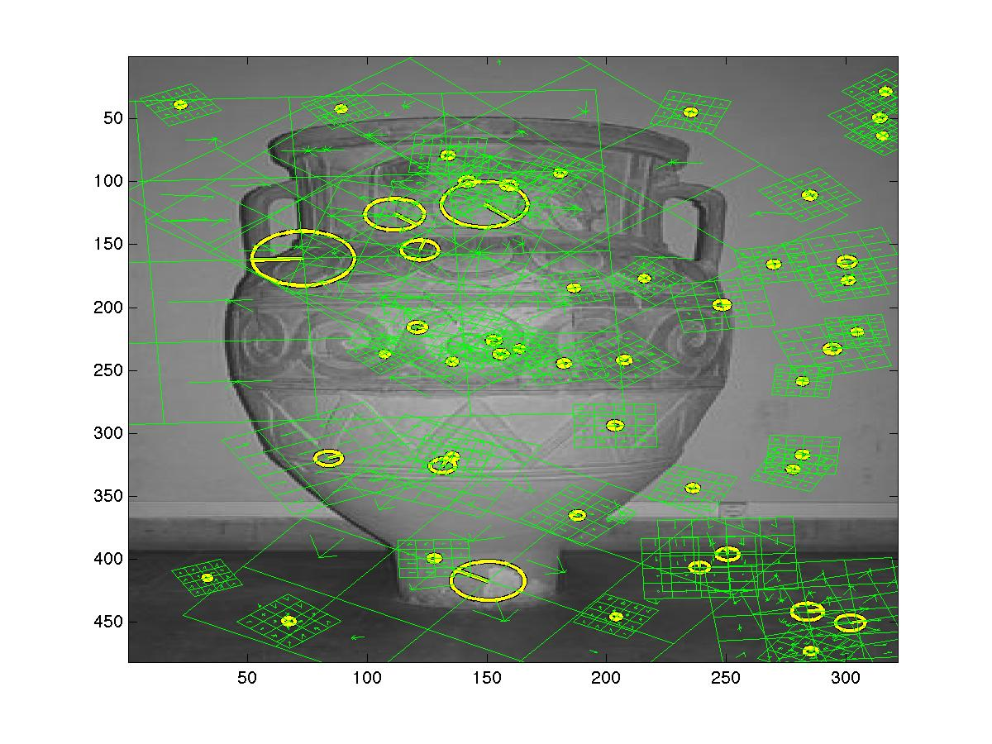
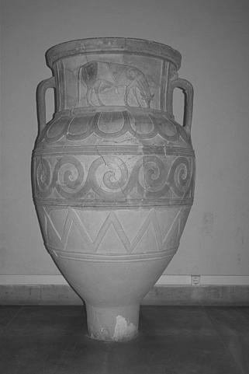
VLFeat’s Key Points and Descriptor

Slide 8
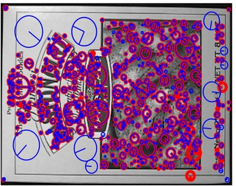
UBC vs VLFeat
VLFeat = Blue UBC SIFT = Red Most key points match exactly.

