Slide 1
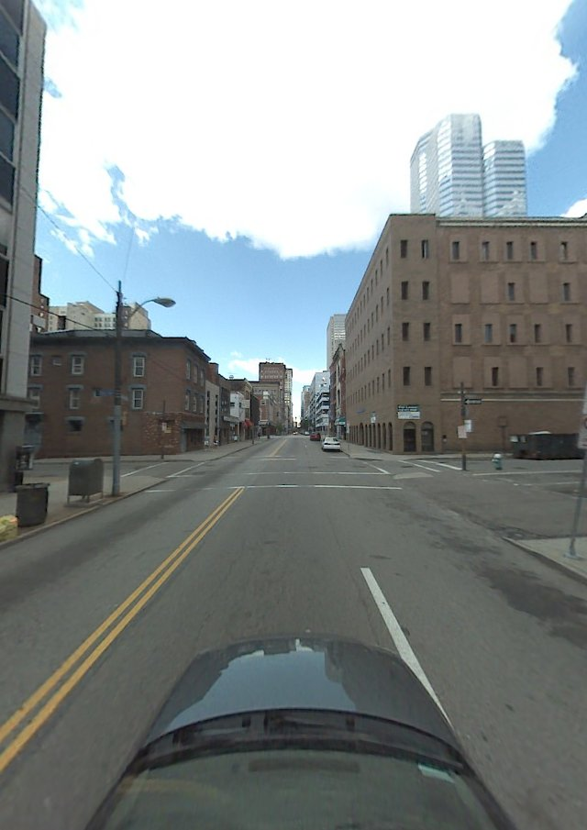
Improving Interest Point Detection for Geolocating Objects
Trying other methods
ASIFT
MSER

Slide 2
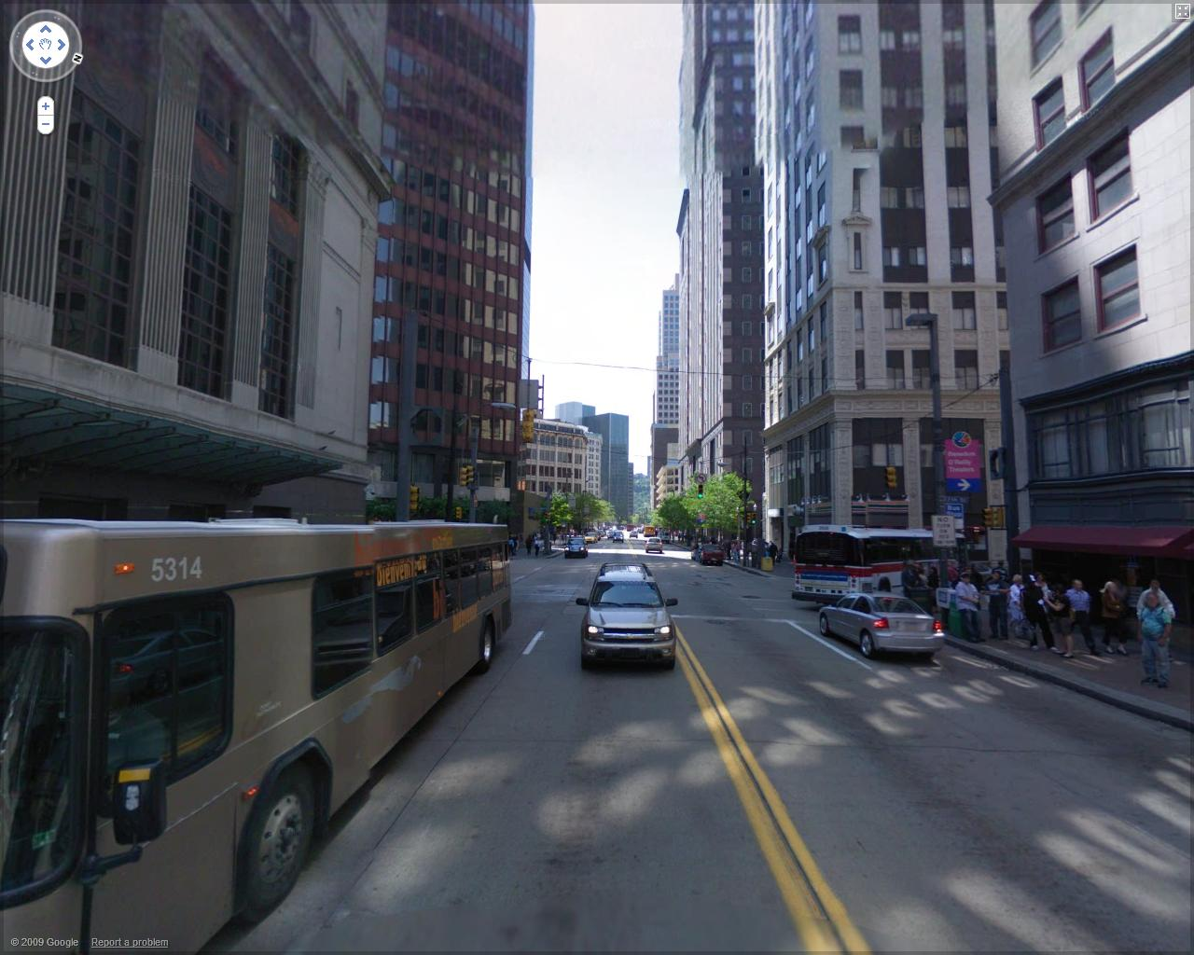

Slide 3
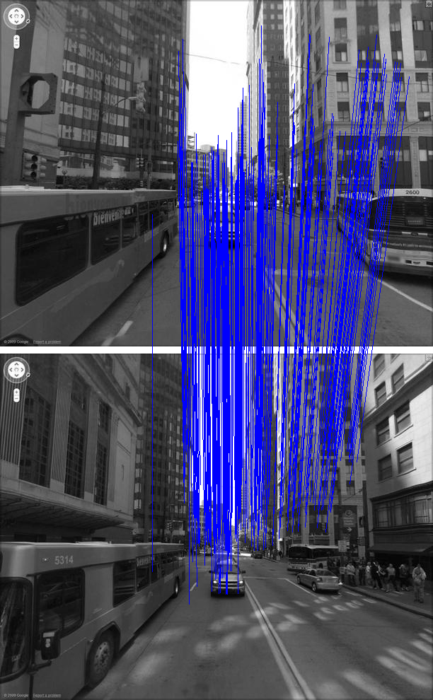

Slide 4
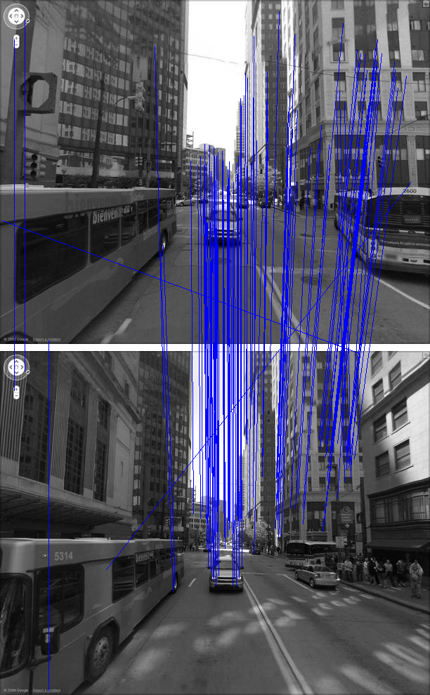

Slide 8
Geolocating and Matching Video
Given a Video: Tasks (in order)
Detecting scene changes - block motion estimation error over each frame and detecting frames for which this sum exceeds a certain threshold
Selecting Optimal Frames
Determine search radius
Find Trajectory
Match Trajectory

