Slide 1
Geolocating Video
Neil Gealy

Slide 2
Show video

Slide 3
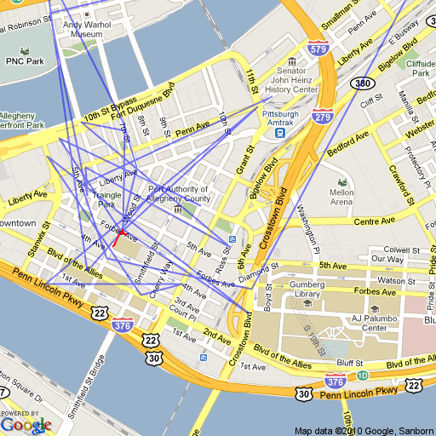
Ground Truth (red) Query Frames (blue)

Slide 4
Removed bad matches by Clustering
Chose a radius and a threshold
Checked to see how many other points were located within the radius and compared it to the threshold
Did consecutive clustering in this manner
First with a high radius and threshold to find the large cluster
Second with low radius and threshold to refine the trajectory

Slide 5
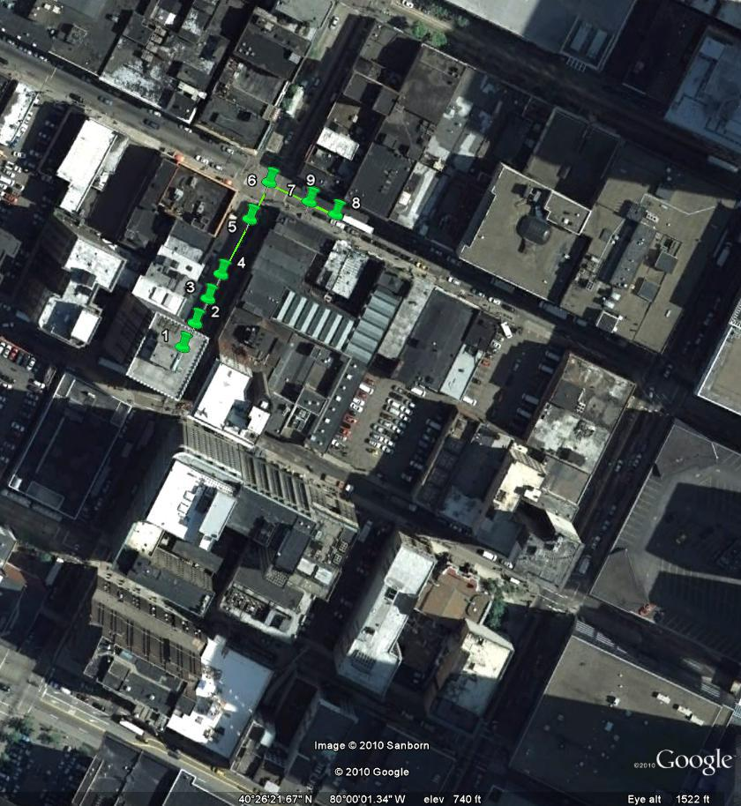
Ground Truth

Slide 6
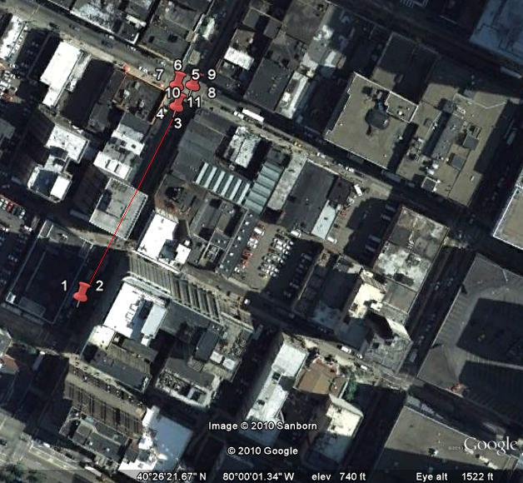
Calculated Trajectory w/ Clustering

Slide 7
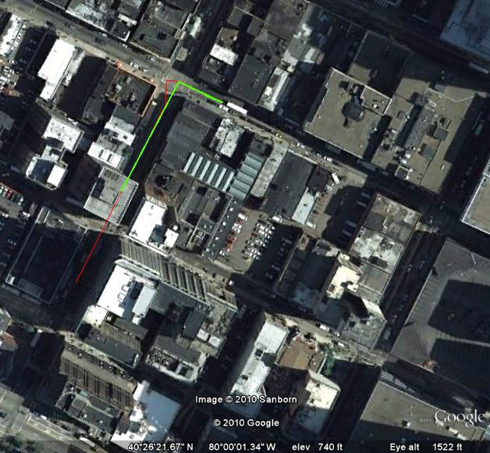
Ground Truth (green) Calculated Trajectory (red)

Slide 8
Next Steps
Complete testing on higher quality videos
Key Frame selection to get a consistent frame sampling
Currently if sampling a certain frames per second, we get large groups of points when the person or vehicle is stationary

