Slide 1
Accurate Video Localization
Based on
Google Maps Street View

Slide 2
Driving(1) Video – (0:54 – 1:50)
Video
Video Mac

Slide 3
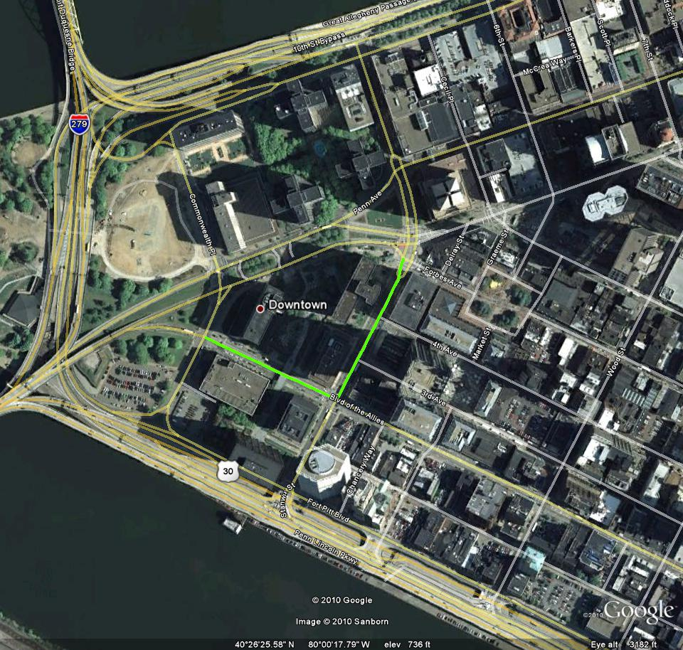
Ground Truth Path

Slide 4
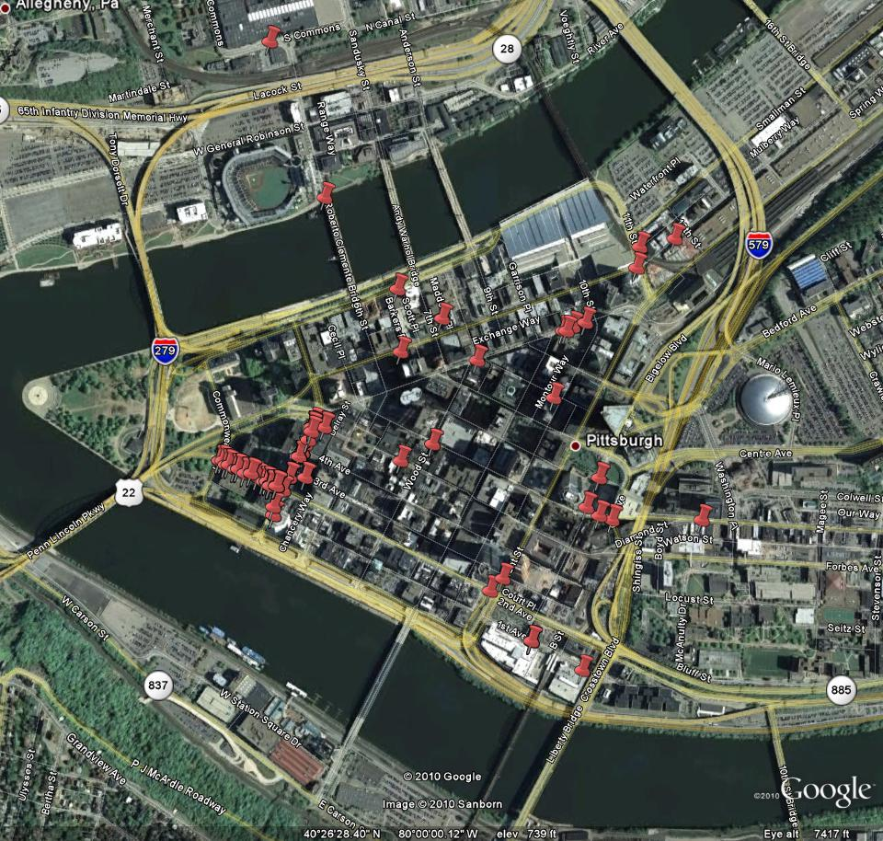
All Frames (2 per second)

Slide 5
Removing incorrect matches with pruning
We chose a proximity radius ‘r’ and a number of points as a threshold
For each point, we check then number of points in that radius and compare with the threshold to find the big group of correct points
r

Slide 6
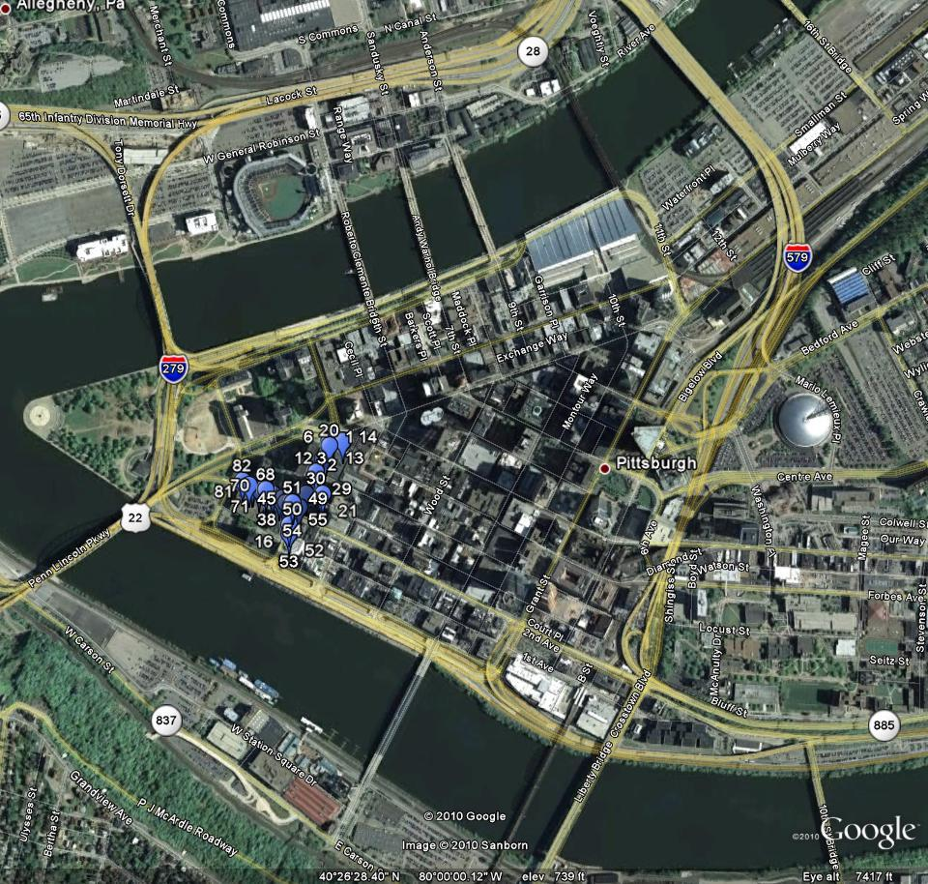
After Pruning

Slide 7
Comparison
Using all frames (2/sec)
After pruning

Slide 8
After Pruning with Ground Truth
Numbering is the sequential ordering of the frames

Slide 9
Driving(2) Video – (0:31 – end)
Video
Video Mac

Slide 10
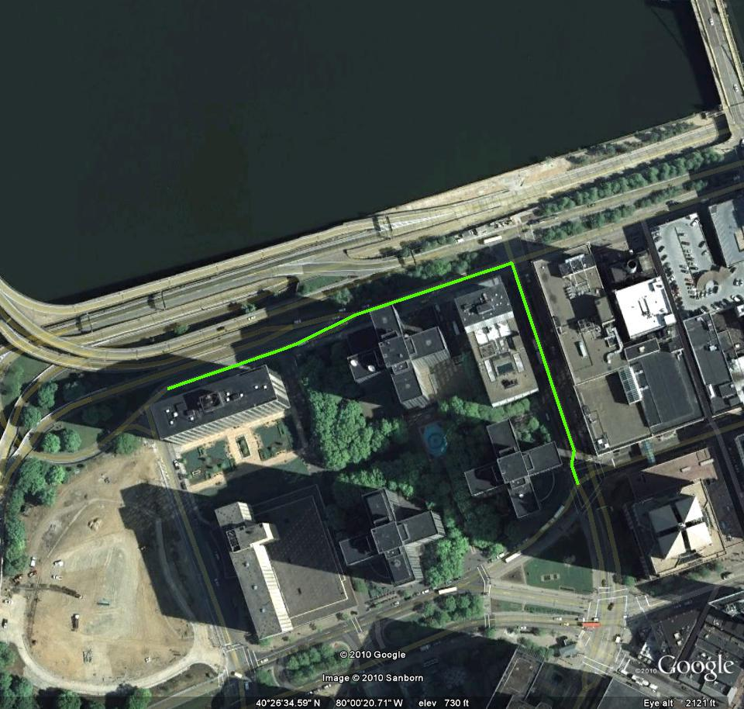
Ground Truth Path

Slide 11
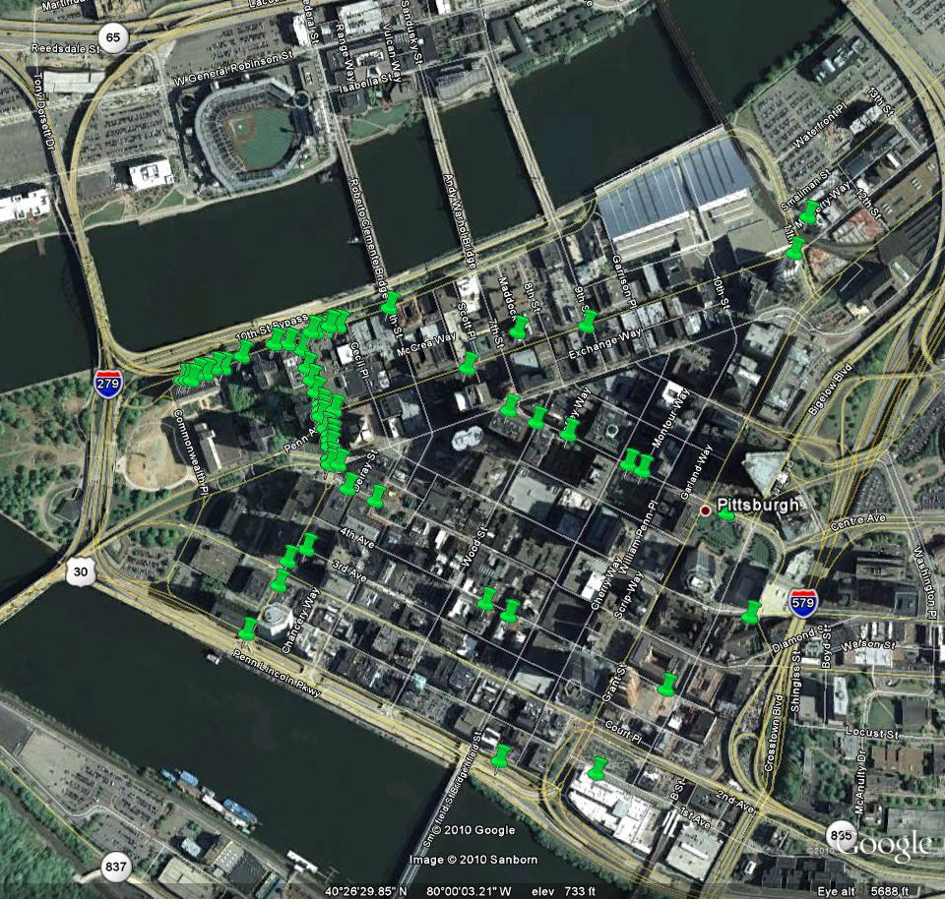
All Frames (2 per second)

Slide 12
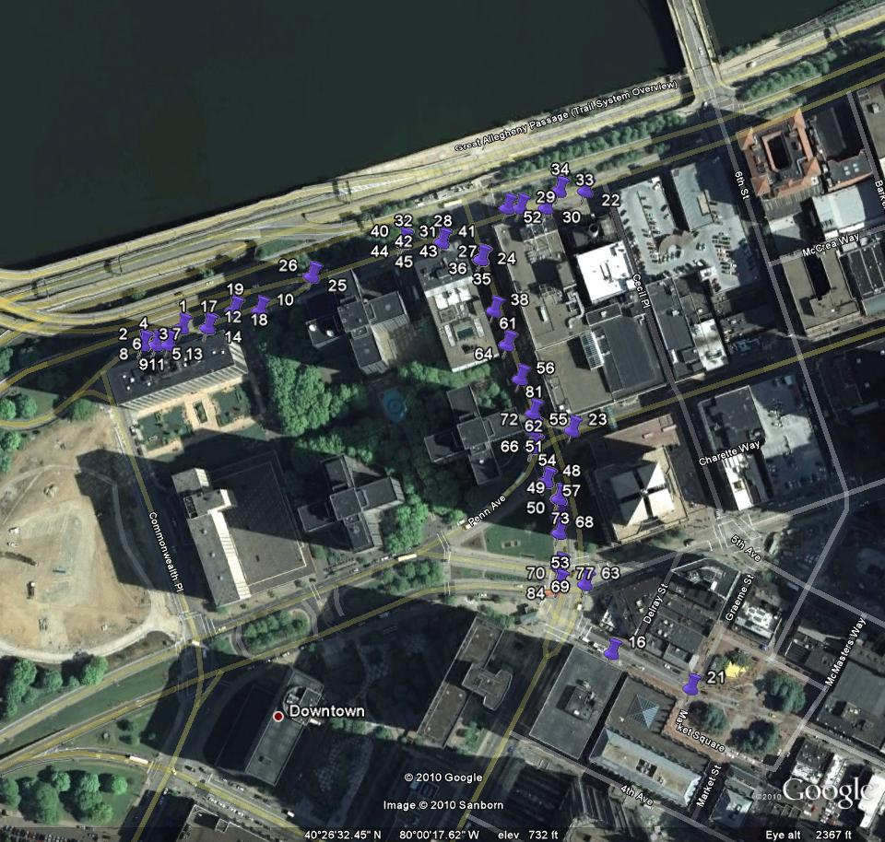
After Pruning

Slide 13
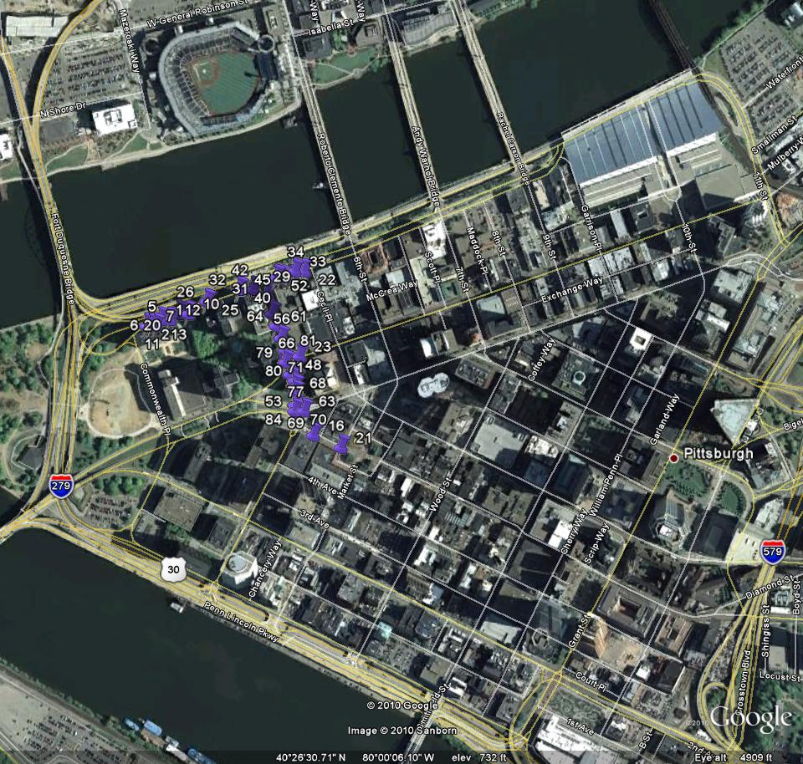
Comparison
The large group of matches was successfully kept. Extreme outliers were removed.
Using all frames (2/sec)
After pruning

Slide 14
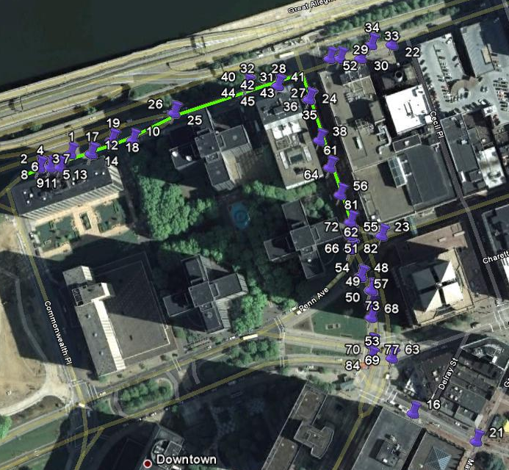
After Pruning with Ground Truth
Numbering is the sequential ordering of the frames

Slide 15
Consecutive pruning
Use a first pruning to find the large group
Because most points have a large number of frame matches, we use a second pruning to refine the results
We choose a radius and threshold but use smaller numbers to eliminate locations with few frame matches
r

Slide 16
After a second round of pruning

Slide 17
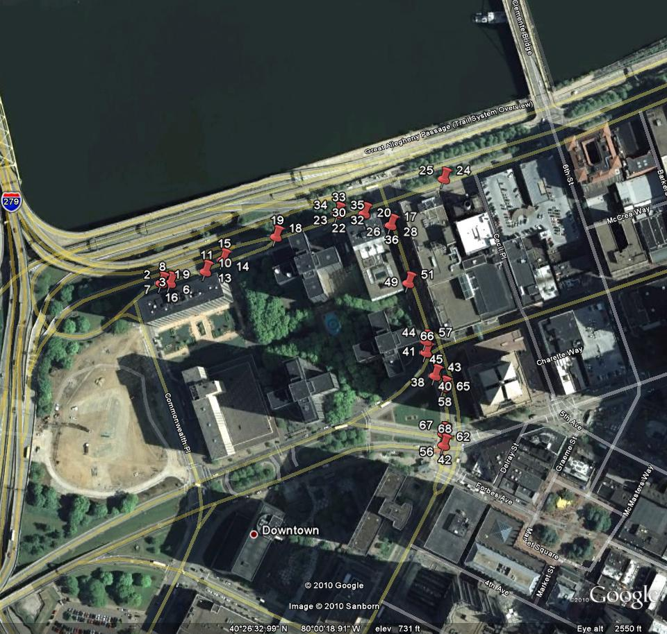
Comparison
First round of pruning
Second round of pruning

Slide 18
After Consecutive Pruning with Ground Truth

Slide 19
Walking(10) Video
Video
Video Mac

Slide 20
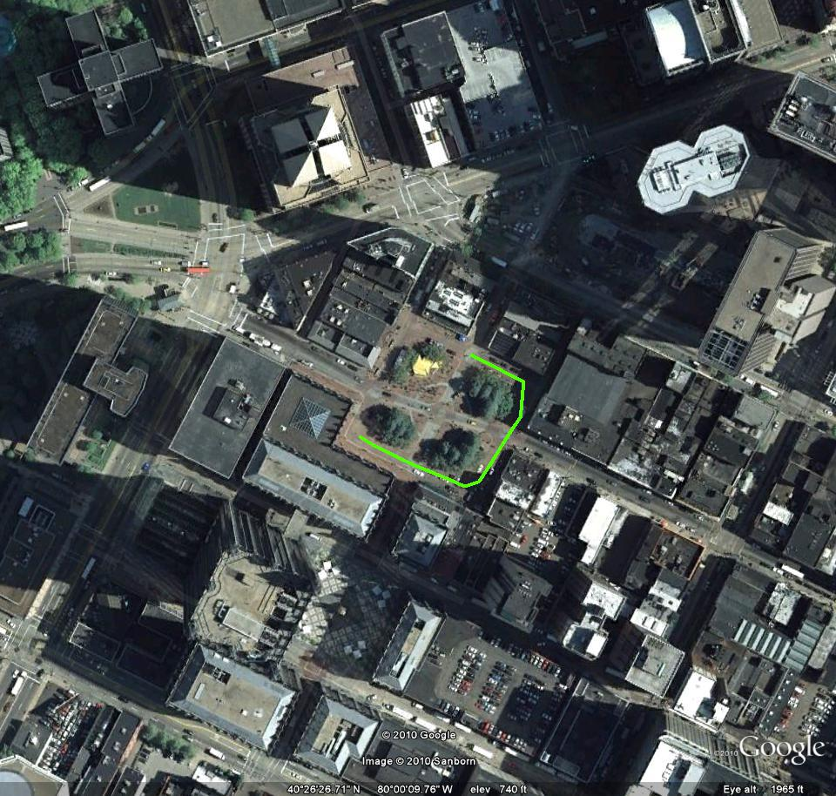
Ground Truth Path

Slide 21
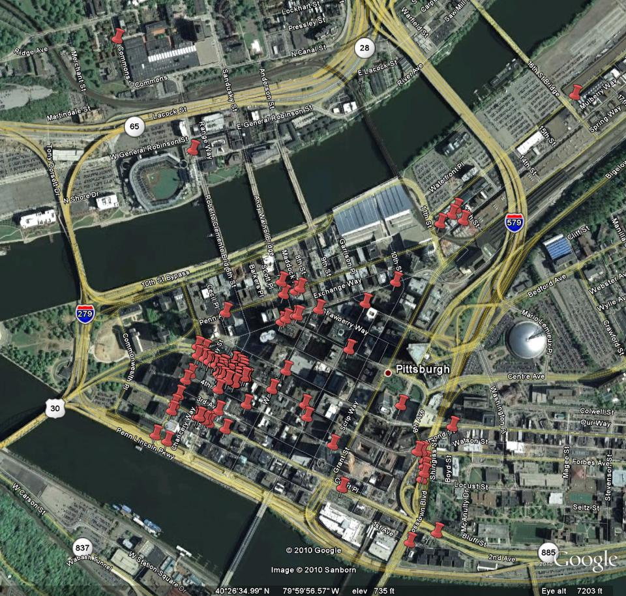
All Frames (2 per second)

Slide 22
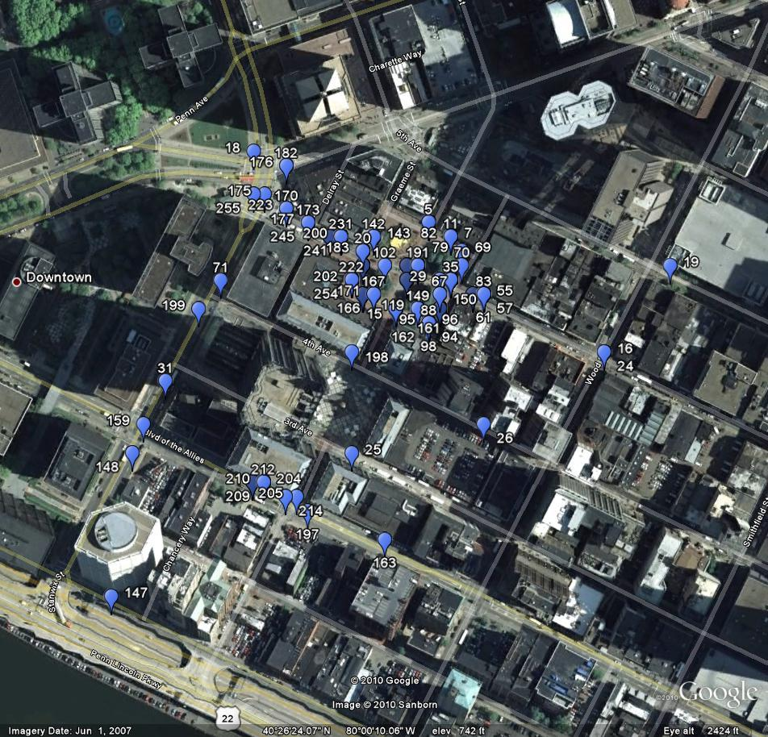
After First Pruning

Slide 23
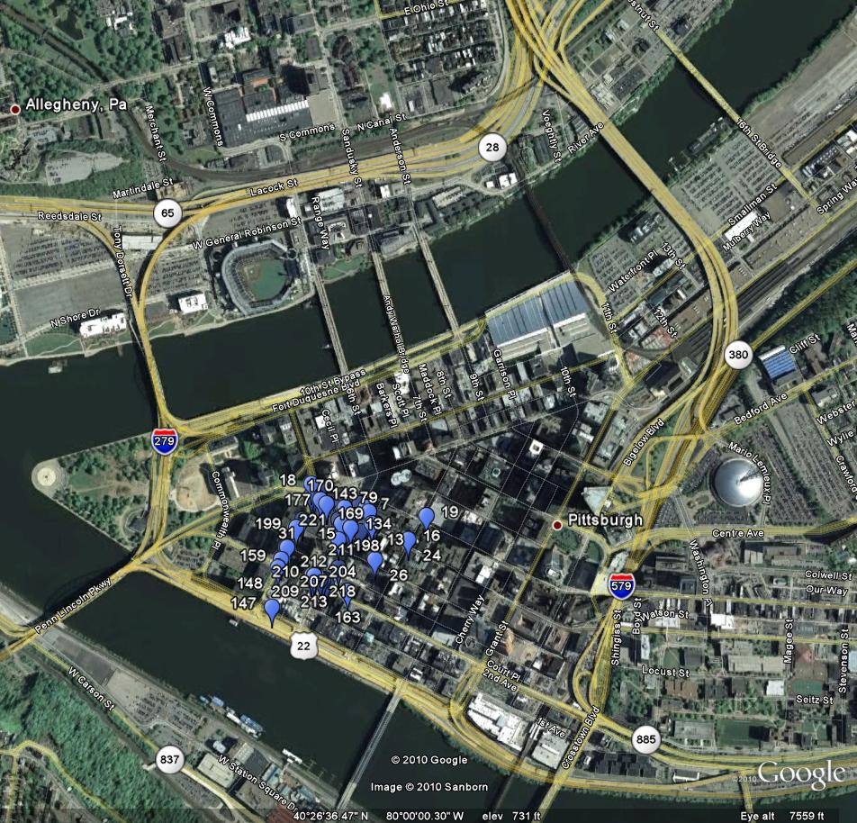
Comparison
Using all frames (2/sec)
After pruning

Slide 24
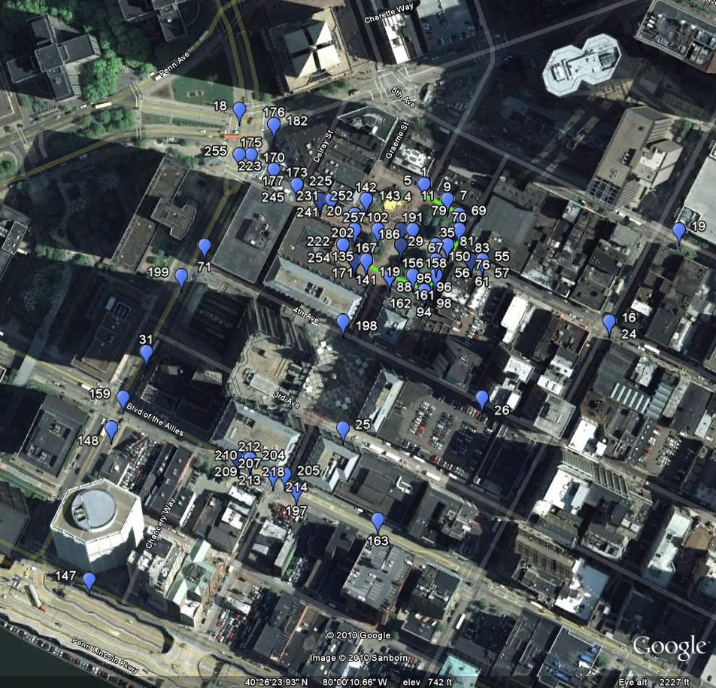
After One Pruning with Ground Truth
Numbering is the sequential ordering of the frames

Slide 25
Consecutive pruning
We again choose a radius and threshold but use smaller numbers
r

Slide 26
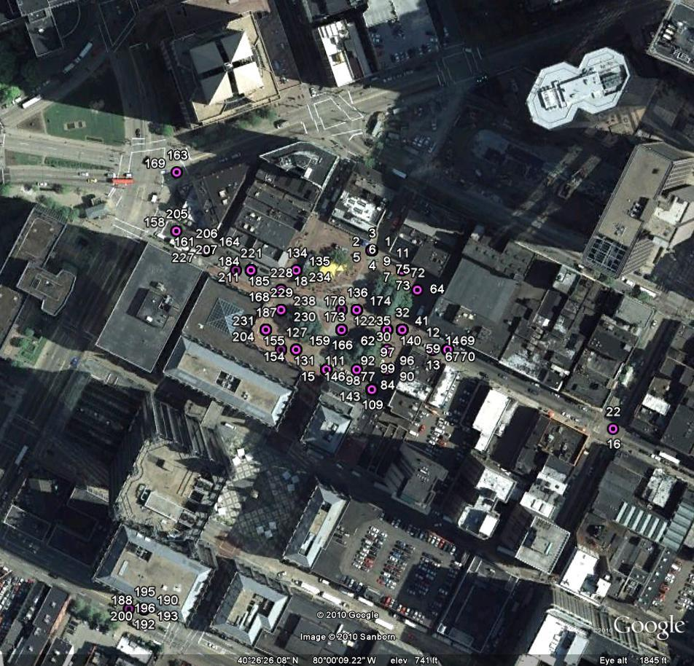
After a second round of pruning

Slide 27
Comparison
First round of pruning
Second round of pruning

Slide 28
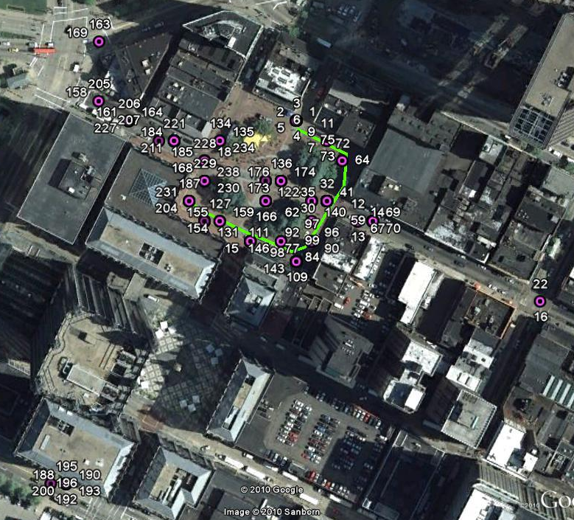
After Consecutive Pruning with Ground Truth

Slide 29
Finding the optimal radius and threshold for each pruning step
Tested
Radii from 10 to 300 incremented by 10
Thresholds from 5 to 50 incremented by 5
Defined a frame as matched if it was within 70 meters of its ground truth
False positive = # incorrect frames after pruning/ #incorrect frames before pruning
True positive = # correct frames after pruning/ #correct frames before pruning

Slide 30
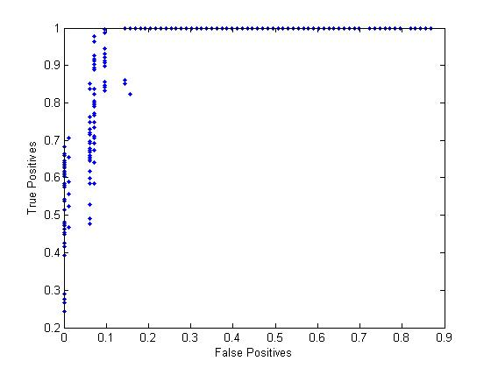
Test Results for Walking(10) Video
Each dot represents one test. Graph shows results for all 90,000 tests.

Slide 31
Test Results for Walking(10) Video
Each dot represents one test. Graph shows results for all 90,000 tests.

Slide 32
Thank You!

