Slide 1
Accurate Video Localization
Neil Gealy
7/20/10

Slide 2
Sequential Pruning

Slide 3
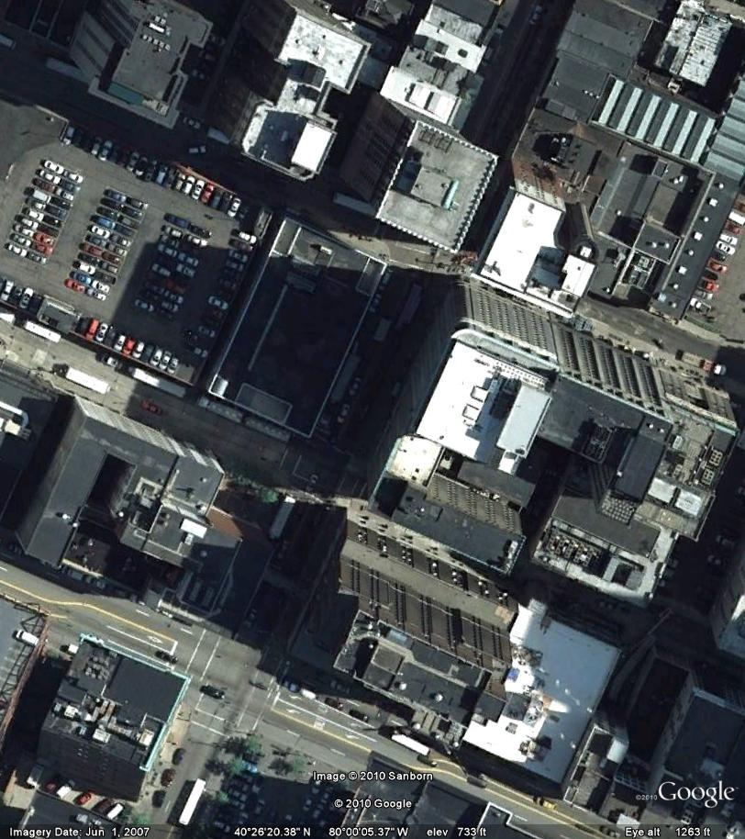
Sequential pruning
Ground Truth in Green
Numbers 1-5 represent frames that are kept after consecutive pruning
5
3
1
2
4

Slide 4
Sequential pruning
Concept
Frames which create a large change in total trajectory are probably out of sequence.
Example: Frame 4 adds a large distance to the total trajectory compared to the other frames
5
3
1
2
4

Slide 5
Sequential pruning
We determine the total length of the proposed trajectory after consecutive clustering
Total Length = 100M for example
5
3
1
2
4

Slide 6
Sequential pruning
Next, we remove one frame and calculate the total trajectory length.
For example, removing frame 2. Total length = 85M
5
3
1
4

Slide 7
Sequential pruning
For example, removing frame 3
Total Length = 80M
5
1
2
4

Slide 8
Sequential pruning
For example, removing frame 4
Total Length = 70M
5
3
1
2

Slide 9
Sequential pruning
We compare the new distances with the total length distance initially calculated.
All frames = 100M
Removing frame 1 = 78M
Removing frame 2 = 85M
Removing frame 3 = 80M
Removing frame 4 = 70M
Removing frame 5 = 72M
By looking at the results, frame 4 has the most effect on the total trajectory length and is probably out of sequence so it is removed.

Slide 10
Sequential pruning
Results after sequential pruning. (we removed frame 4 and renumbered)
4
3
1
2

Slide 11
Results Walking(1)

Slide 12
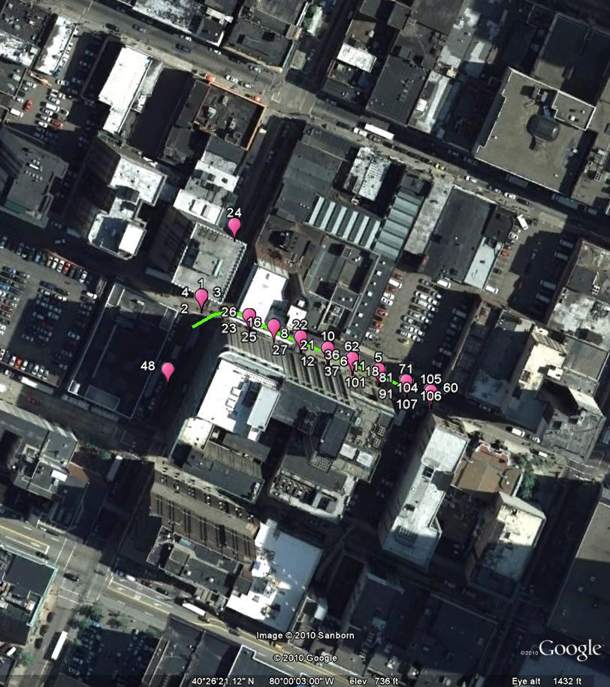
Sequential pruning – real example
Results after consecutive and
sequential pruning.
Results after consecutive pruning.

Slide 13
Sequential pruning – real example
Sequencing
Average the numbers at each location. The average is assigned as the new sequence number for that location.

Slide 14
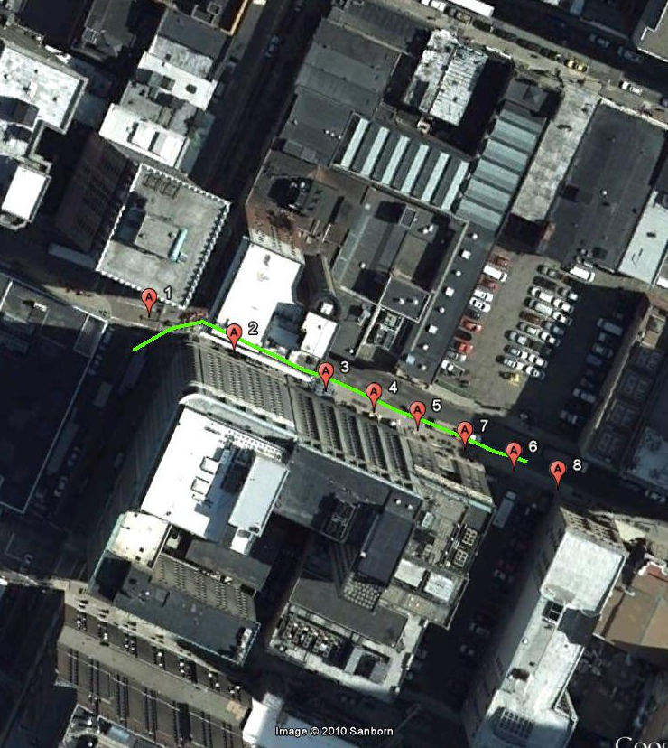
Sequential pruning – real example
Sequencing
To get the actual sequence, we look at each location (there are usually multiple matches for the same GPS location)
We average the numbers at each location which represent the sequential ordering of the points. The average is assigned as the new sequence number for that location.

Slide 15
Results Walking(5)

Slide 16
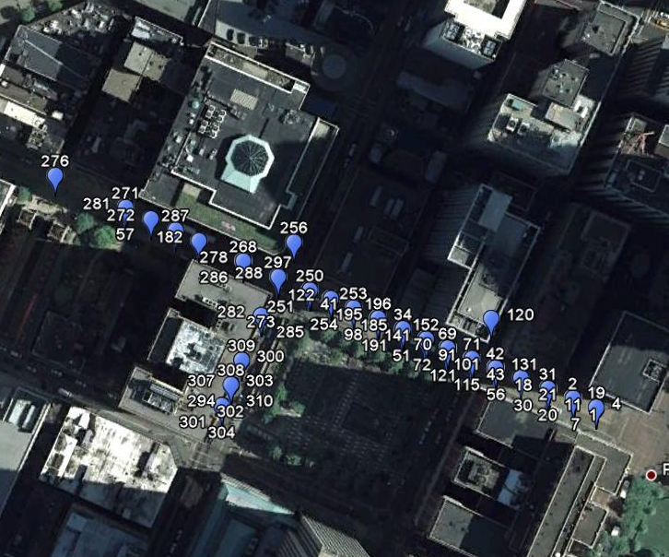
Comparison
Results after consecutive pruning
Results after consecutive and
sequential pruning

Slide 17
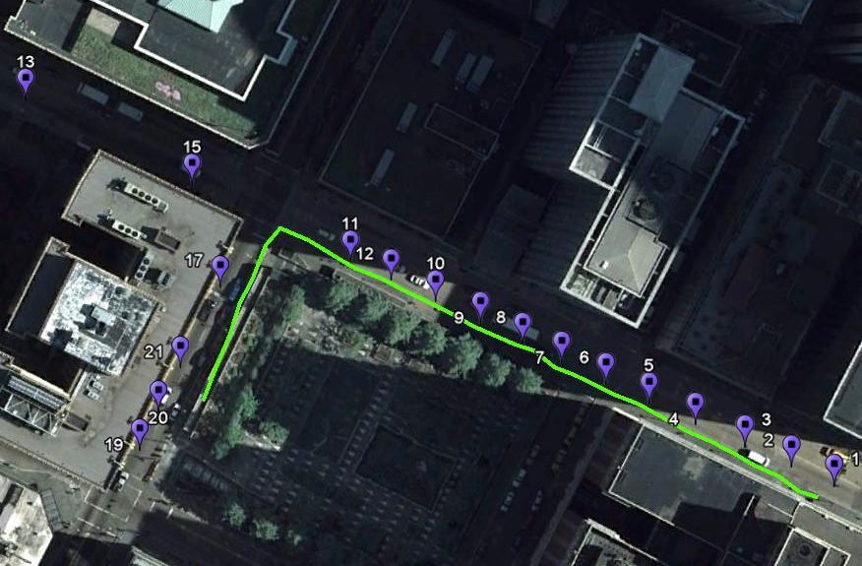
Sequential pruning – real example
Sequencing
Average the numbers at each location. The average is assigned as the new sequence number for that location.

Slide 18
Results Driving(1)

Slide 19
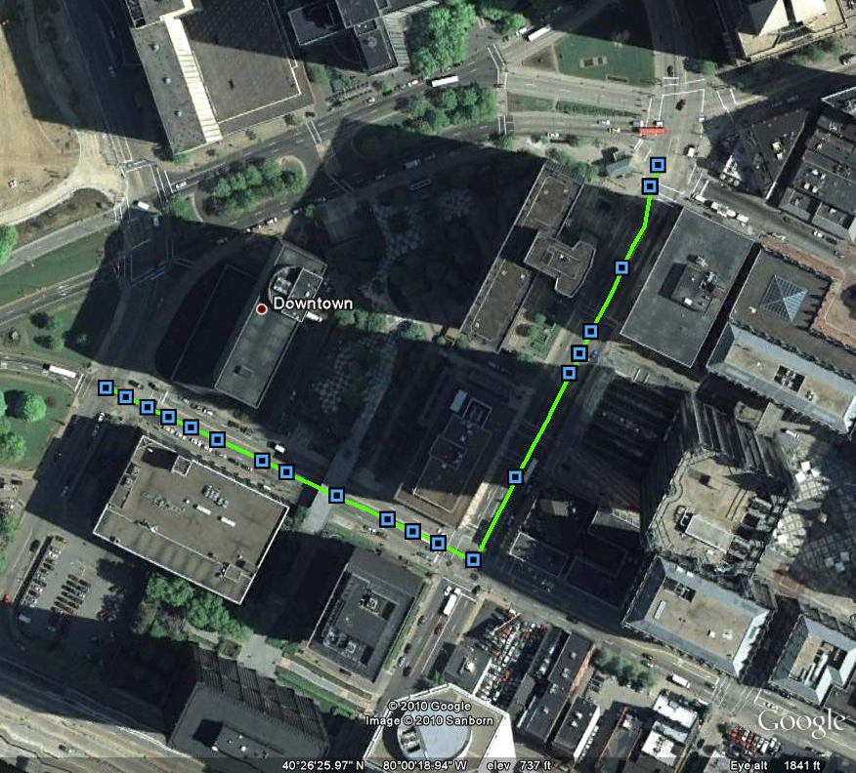
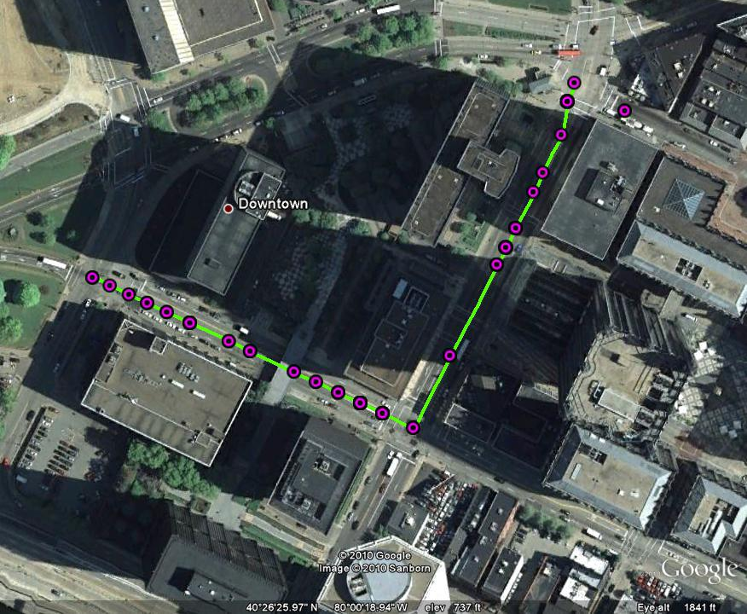
Sequential pruning – real example
Results after consecutive and
sequential pruning.
Results after consecutive pruning.

Slide 20
Sequential pruning – real example
Sequencing
Average the numbers at each location. The average is assigned as the new sequence number for that location.

Slide 21
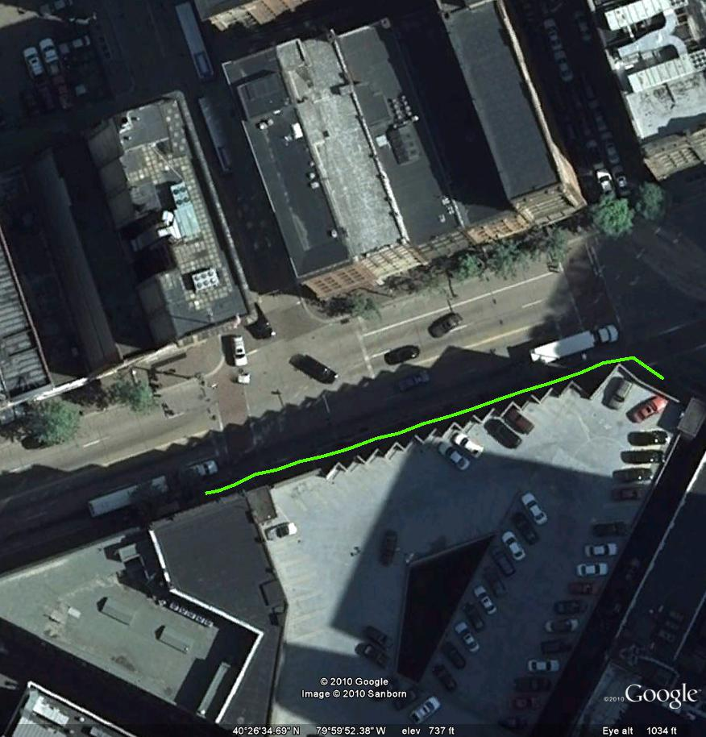
Results Walking(6)

Slide 22
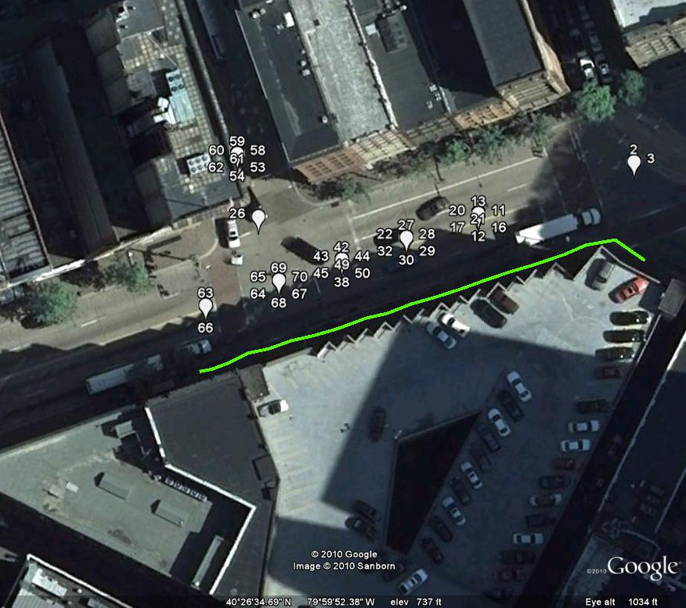
Sequential pruning – real example
Results after consecutive and
sequential pruning.
Results after consecutive pruning.

Slide 23
Sequential pruning – real example
Sequencing
Average the numbers at each location. The average is assigned as the new sequence number for that location.

