Slide 1
Accurate Video Localization
Neil Gealy
7/20/10

Slide 2
Pruning Plots
We need to analyze these plots and try to find optimal pruning parameters.
Single Pruning Results –
Radius: 50m
Threshold: 10
Double Pruning Results –
Radius:
Threshold:

Slide 3
Kalman Filter
Its purpose is to use measurements that are observed over time that contain noise and other inaccuracies, and produce values that tend to be closer to the true values of the measurements
F_{k} is the state transition model which is applied to the previous state x_{k−1}
B_{k} is the control-input model which is applied to the control vector u_{k}
w_{k} is the process noise.
z_{k} is the measurement of the true state
H_{k} is the observation
v_{k} is the observation noise with covariance R_{k}.

Slide 4
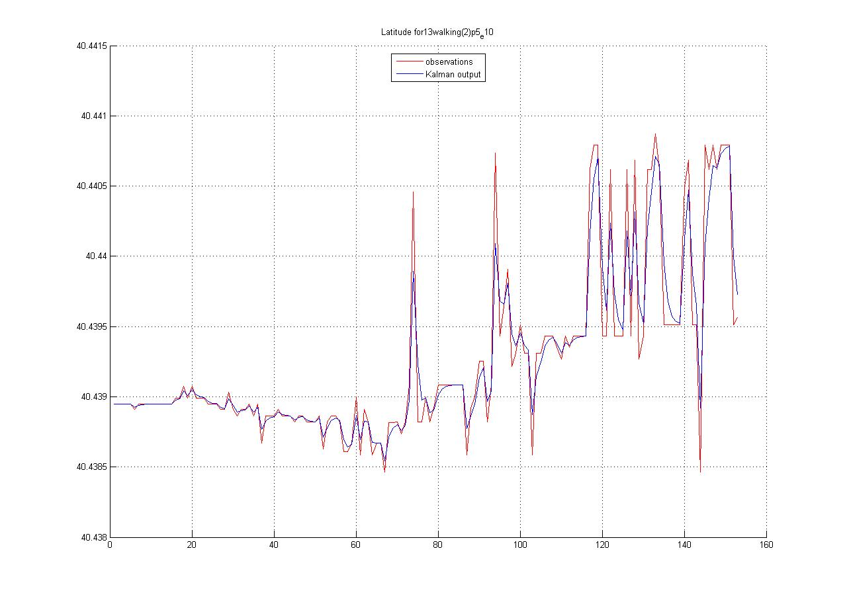
Kalman Filter

Slide 5
Kalman Filter
When the difference between the Kalman output and the observation was greater than a threshold, I removed the frame.
Difference exceeds threshold so remove this frame

Slide 6
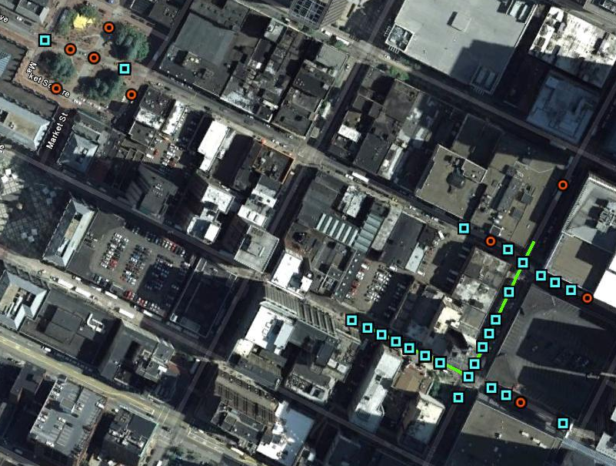
Results of Kalman Filter
Orange dots were removed by Kalman Filter method previously described using .00009 threshold.

