Slide 1
Accurate Video Localization
Neil Gealy
8/6/10

Slide 2
Pruning Plots
What I have found to be the most optimal sequence of pruning:
1. Consecutive pruning based on radius and threshold
2. Sequential pruning based on the change in total trajectory length when removing an individual frame.
3. Sequencing the locations based on an average of the frames located at each location.
4. Repeat step 2.

Slide 3
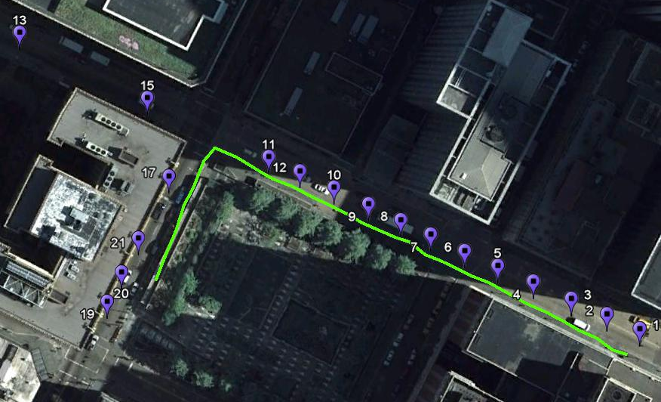
Pruning Plots
Some results:

Slide 4
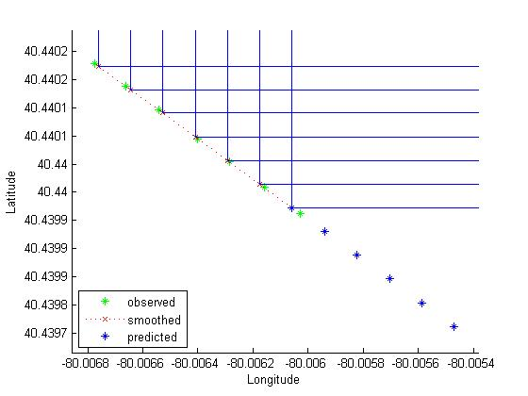
Results of Kalman Filter
Does a good job of fixing parts of the trajectory that are out of sequence!

Slide 5
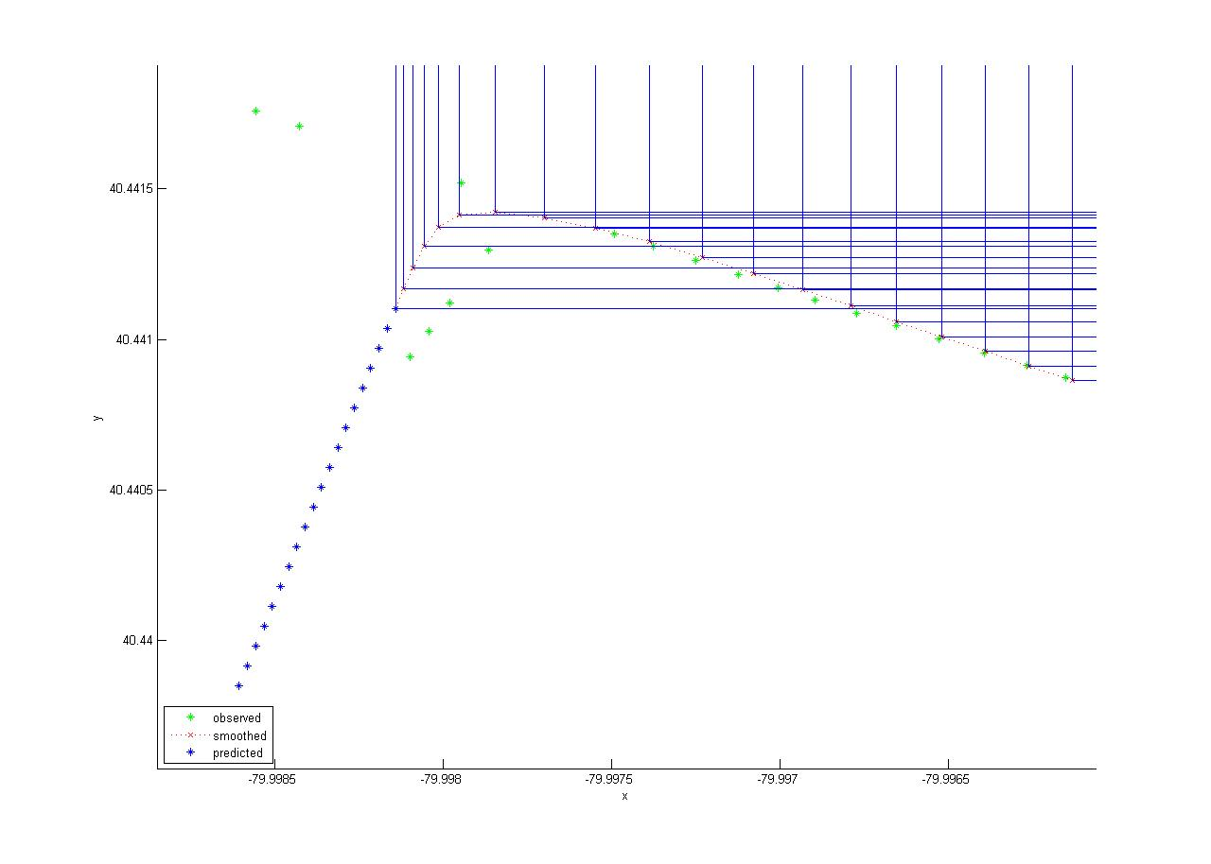
Results of Kalman Filter
Does okay at making turns when misleading points are present.

Slide 6
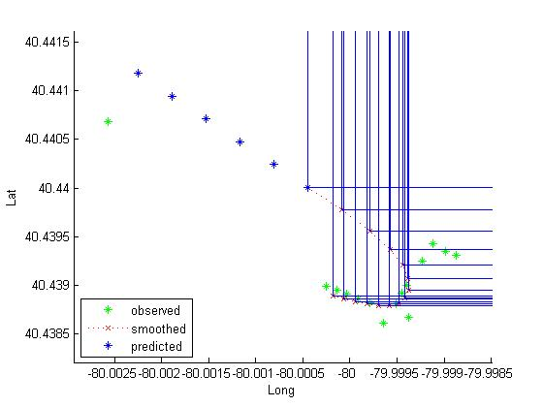
Results of Kalman Filter
Fails when there are major outliers still remaining in the data.

Slide 7
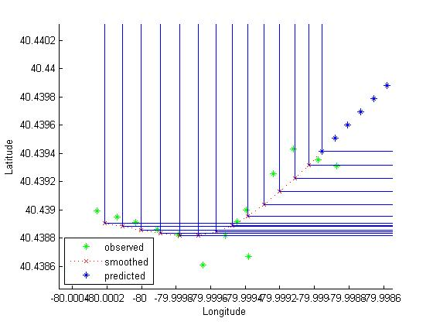
Results of Kalman Filter
The outlier is removed and we compare the results.
Outlier Kept
Outlier Removed

Slide 8
Conclusion
The Kalman Filter can be used to correct errors in sequence or to choose the correct path at intersections. However, results will be negatively affected by major outliers.
Before applying the Kalman Filter, our goal is to make sure all outliers are removed. We will try consecutive pruning as another intermediate step to accomplish this goal.

