Slide 1
Week 1: 5/16 – 5/20
Jeffrey Loppert

Slide 2
Introduction
Computer Science Major & Digital Media Minor @ UCF
Born in California
Two middle names
Roommate and I have siblings with the same name
Transferred Architectural Engineering Major @ UM
Won Audley Webster Award at UM (“Best Freshman Essay”)

Slide 3
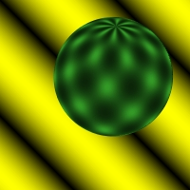
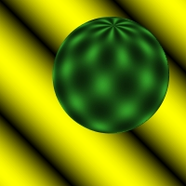
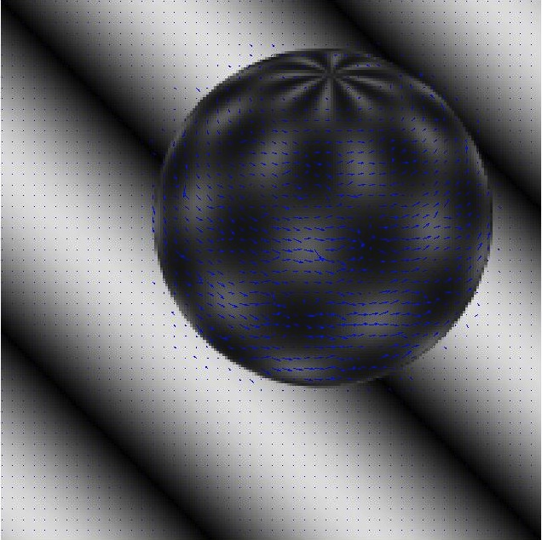
Lucas-Kanade Optical Flow

Slide 4
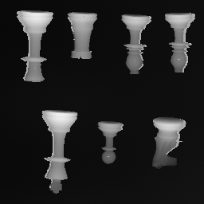
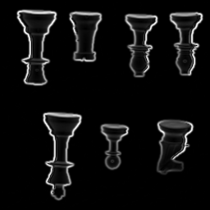
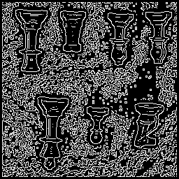
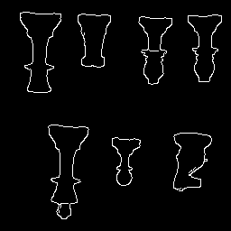
Canny Edge Detection
Sigma = 1, Upper Threshold = 175, Lower Threshold = 25

Slide 5
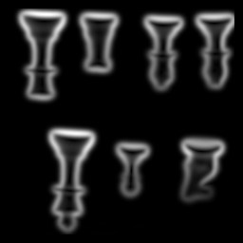
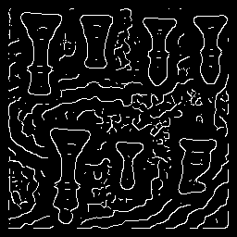
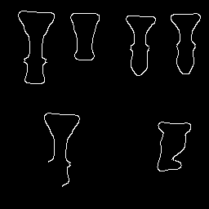
Canny Edge Detection
Sigma = 3, Upper Threshold = 175, Lower Threshold = 25

