Slide 1
Week 2: 5/23 – 5/27
Jeffrey Loppert

Slide 2
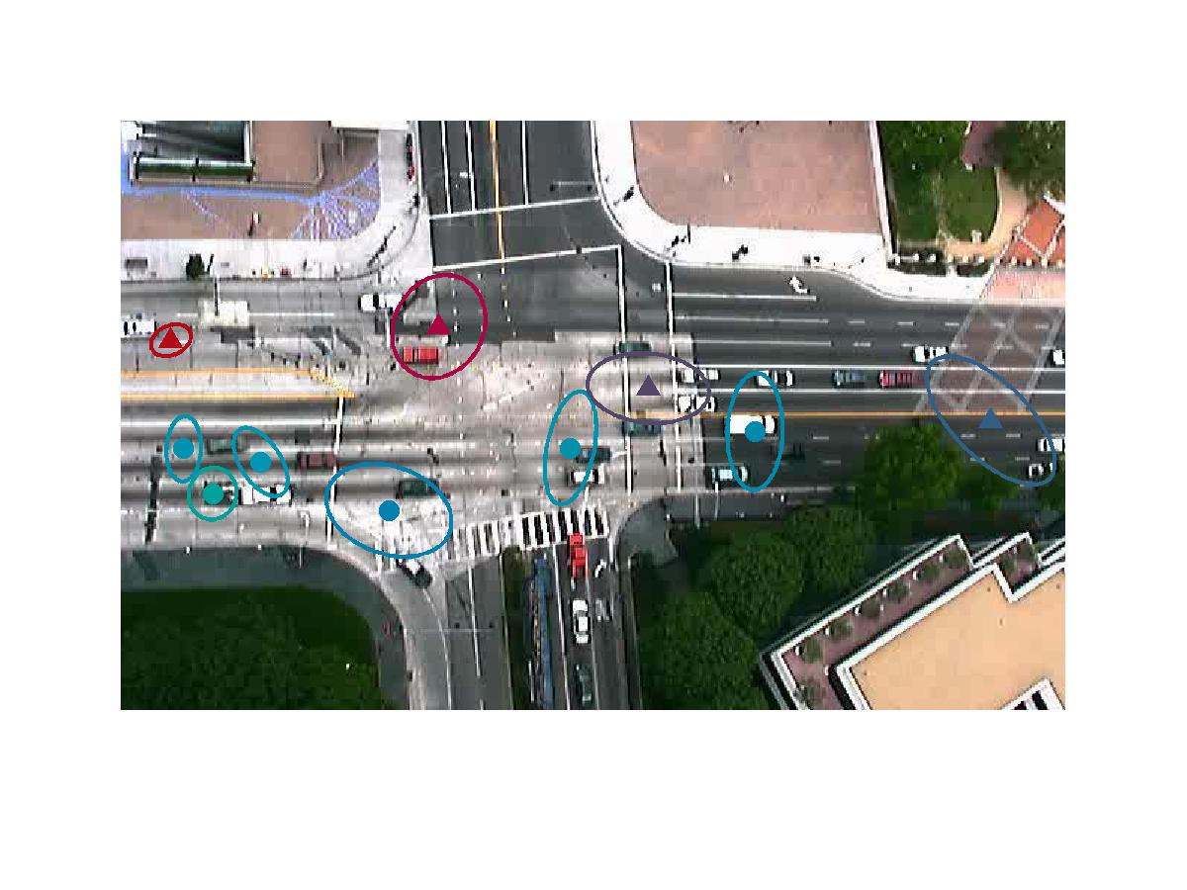
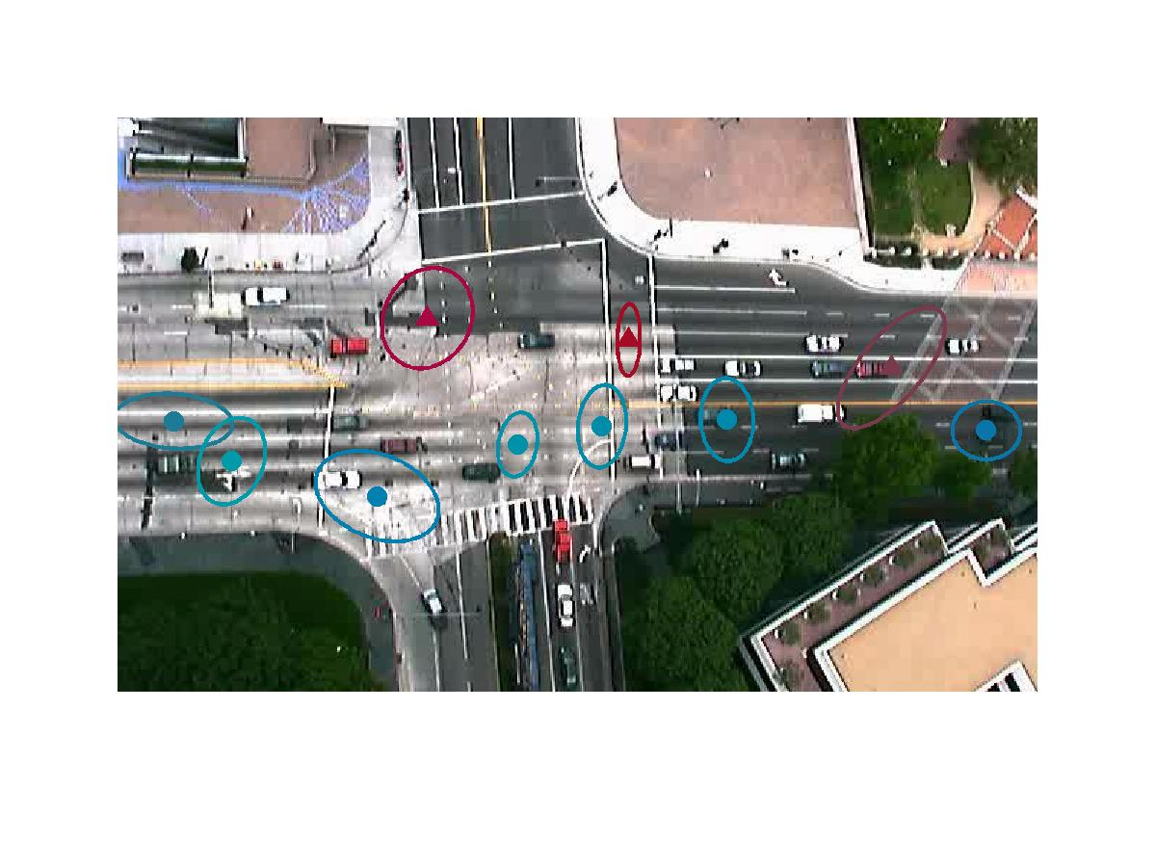
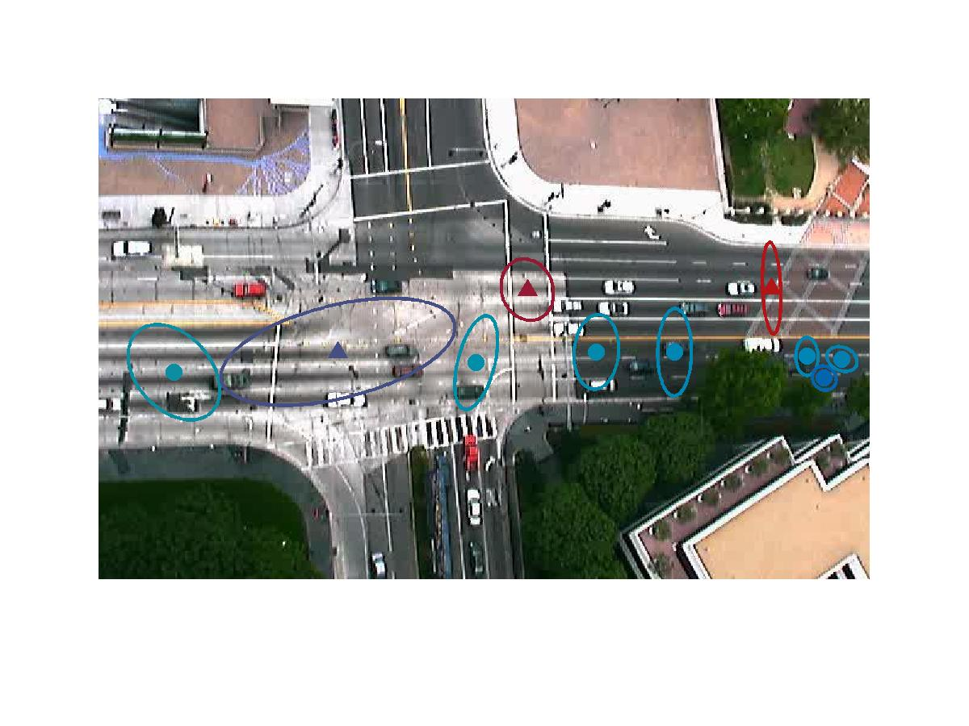
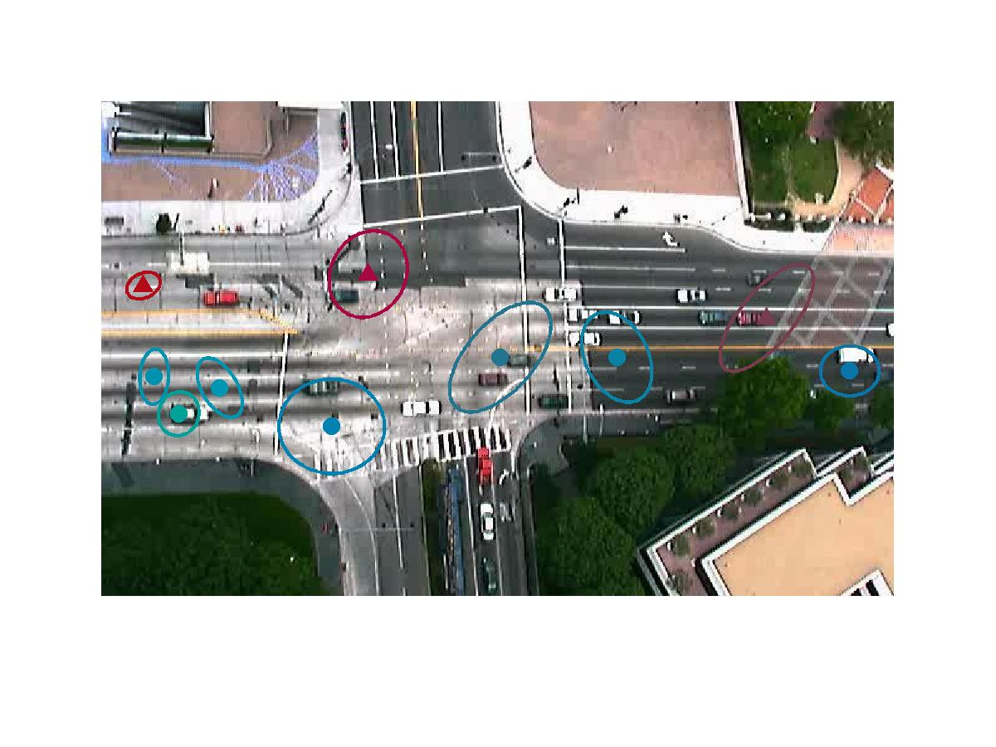
Assignment 3
K = 10

Slide 3
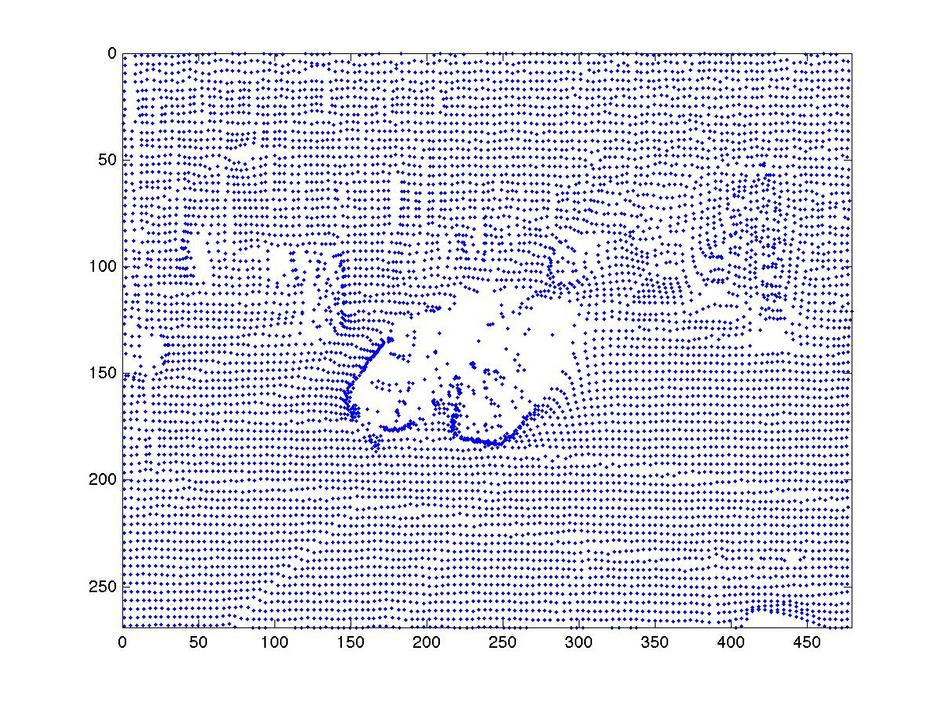
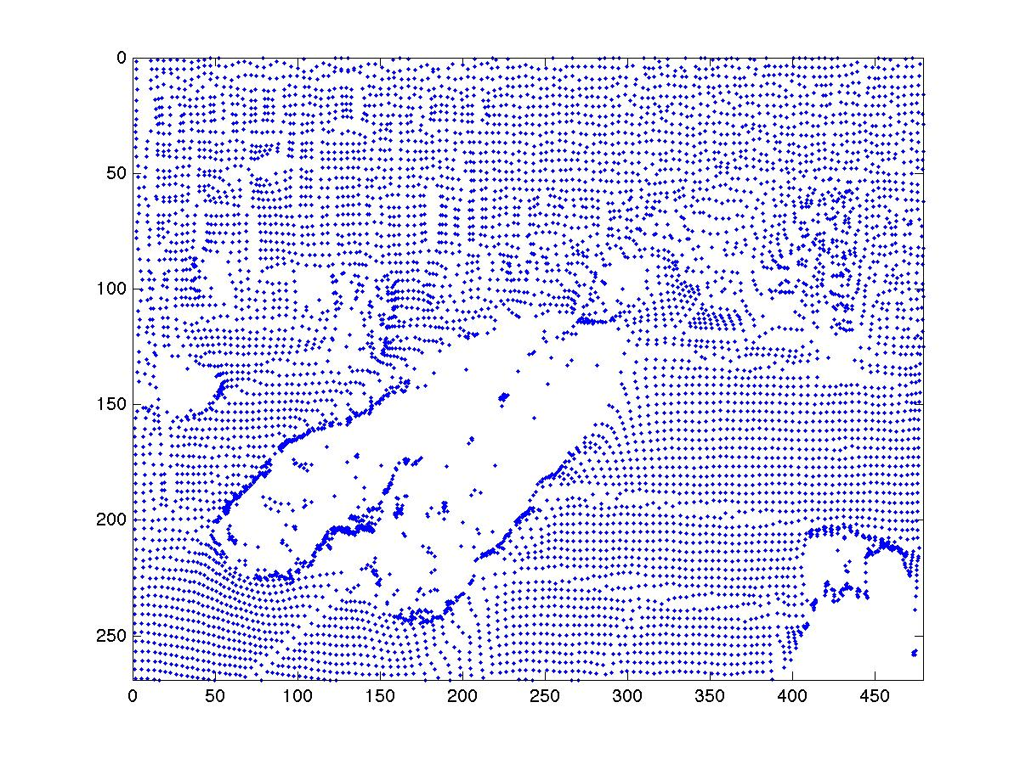
Assignment 4

Slide 4
Projects
Where Am I - GMST
C++ implementation of current MatLab algorithm
C++ implementation of experimental algorithm
Crowd Detection
Armed Person Detection
Face Recognition

