Slide 1
Week 3: 5/30 – 6/3
Jeffrey Loppert

Slide 2
Week 2 Reflections
Construct Presentation incrementally, not all at once
Use Presentation a journal to document progress, successful & failed experiments
If something doesn’t work, ask for help – incompatible software
Efficiently manage time – plan out days in advance

Slide 3
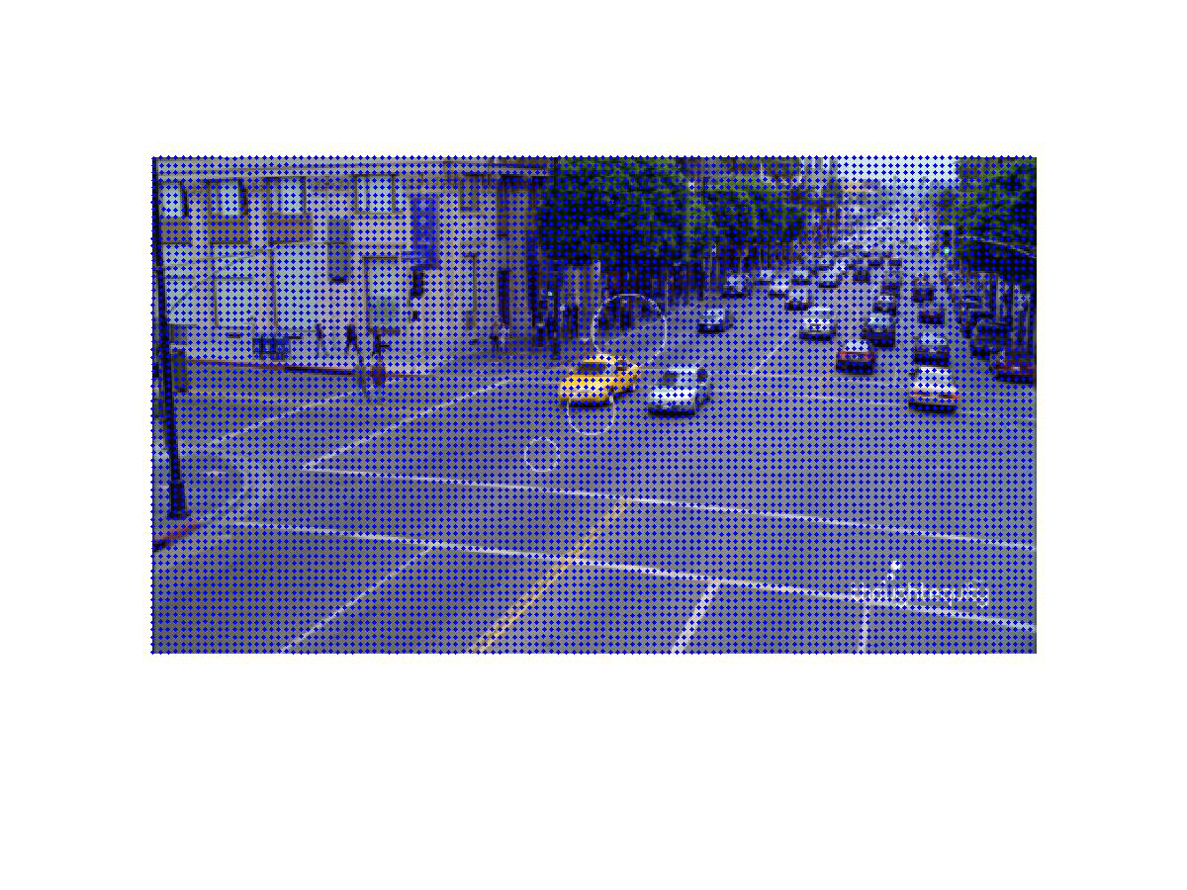
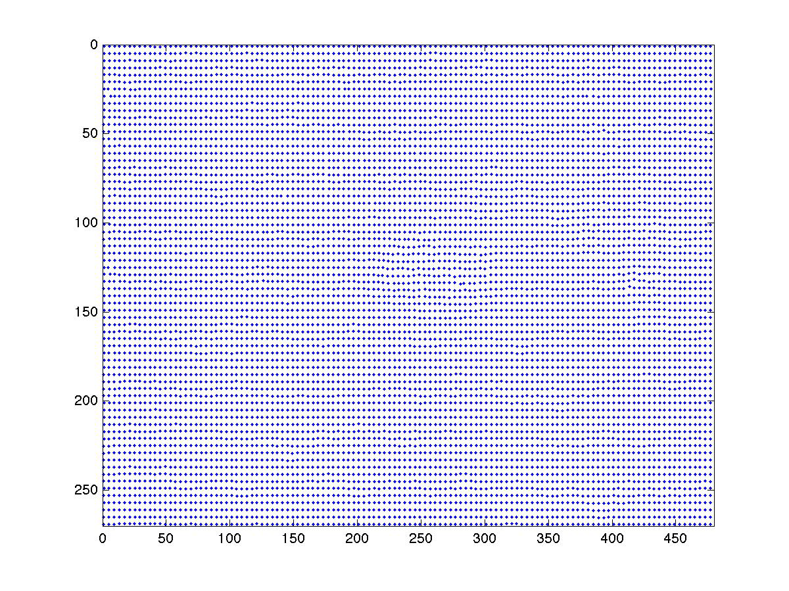
Weekend Progress
Selected research topic - Armed Person Detection
Assignment 4 improvements - added working video demonstration
  Previously, displayed static images
  Using avidemux to create a video from image sequence
Camera to pans towards bottom left - why building appears to move

Slide 4
Week 3 Progress Summary
5/29 - Topic selected, initial contact with Hamid, downloaded suggested research papers
5/30 – Memorial day, my birthday
5/31 – Read initial research papers
    A Discriminatively Trained, Multiscale, Deformable Part Model
    Latent hierarchical structural learning for object detection
6/1 – Meet with Hamid, Pascal Visual Object Class (VOC) Challenge, Dataset, DevKit, Pedro Felzenszwalb’s Discriminatively Trained Deformable Part Models
6/2 – Troubleshoot Matlab, DevKit Example Results, Meet with Hamid

Slide 5
What is Pascal VOC?
The goal of the challenge is to recognize objects from a number of visual object classes in realistic scenes
Three main competitions: classification, detection, and segmentation
Three "taster" competition: person layout, action classification, and ImageNet large scale recognition.
  Detection: Predicting the bounding box and label of each object from the twenty target classes in the test image.
  Where are the instances of a particular object class in the image (if any)

Slide 6
Why use Pascal VOC?
Provides challenging images and high quality annotation, together with a standard evaluation methodology
  a “plug and play” training and testing harness so that performance of algorithms can be compared
Data set investigates the performance of recognition methods on a wide spectrum of natural images.
Datasets contain signiﬁcant variability in terms of object size, orientation, pose, illumination, position and occlusion.
It is also important that the datasets do not exhibit systematic bias, for example, favouring images with centred objects or good illumination.
Similarly, to ensure accurate training and evaluation, it is necessary for the image annotations to be consistent, accurate and exhaustive for the speciﬁed classes.

Slide 7
Pascal VOC Dataset
The training data provided consists of a set of 28,952 images
  each image has an annotation file giving a bounding box and object class label for each object
  multiple objects from multiple classes may be present in the same image.
May 25: the development kit including the training/validation data was released, extends previous years dataset
The test set will be made available for the actual competition June 2011
  No ground truth for the test data will be released.
The VOC2011 data includes images obtained from the "flickr" website

Slide 8
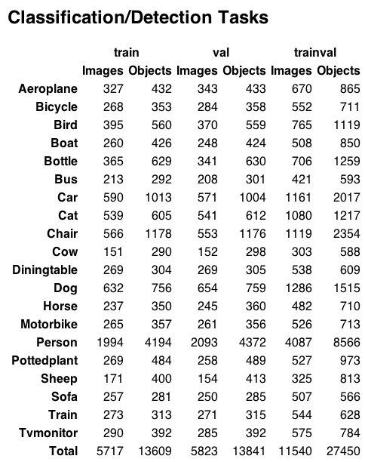
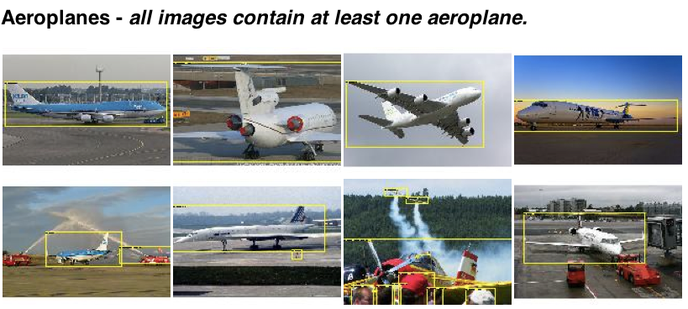
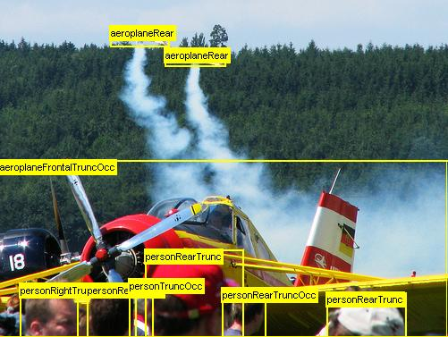
Dataset example

Slide 9
Pascal VOC DevKit
The development kit consists of the training/validation data, MATLAB code for reading the annotation data, support files, and example implementations for each competition
  Example code for
    computing precision/recall curves
    segmentation accuracy
    viewing annotation
The file example_detector.m contains a complete implementation of the detection task.
  For each VOC object class a simple (and not very successful!) detector is trained on the train set;
  the detector is then applied to the val set and the output saved to a results file in the format required by the challenge
  a precision/recall curve is plotted and the `average precision' (AP) measure displayed.

Slide 10
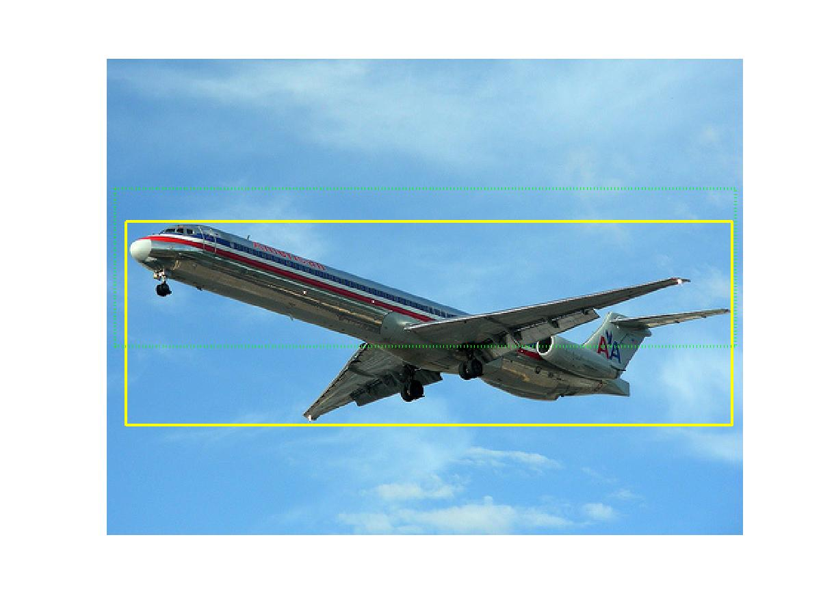
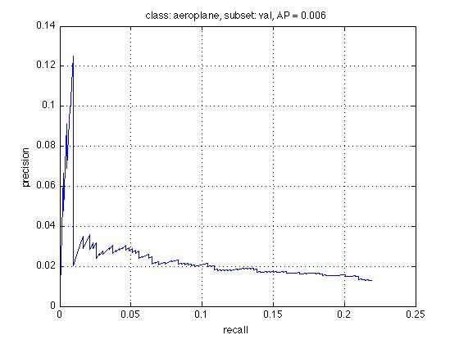
DevKit Results
Creates Detector for the airplane category over 5717 images
Feature Detection, Bounding Box, Ground Truth
  Uses a trivial feature extractor – mean RGB values
Function to run detector versus 5823 test images
Compute confidence of positive classification and bounding boxes
Evaluates using Precision/Recall and Average Precision (AP)

Slide 11
Available code
Discriminatively Trained Deformable Part Models
Pedro Felzenszwalb, Ross Girshick, David McAllester, Deva Ramanan
Learning-based system for detecting and localizing objects in images
System represents objects using mixtures of deformable part models
These models are trained using a discriminative method that only requires bounding boxes for the objects in an image.
  Strong low-level features based on histograms of oriented gradients (HOG)
  Matching algorithms for deformable part-based models (pictorial structures).
  Discriminative learning with latent variables (latent SVM)
The system is implemented in Matlab, with a few helper functions written in C/C++

Slide 12
Armed Person Detection
Current Process
  Take an Image
  Annotate Human and Gun
  Use training images to extract bounding boxes
  Extract image patches from bounding boxes
  Determine Model Size for all image patches
  Resize all image patches to model size
  Generate Negative Samples
  Extract Histogram of Oriented Gradients (HOG) features from each patch
  Train Linear SVM over positive and negative samples
Apply processes to one VOC class for next week
  Many functions included in Devkit and Felzenszwalb’s code

