Slide 1
Week 4: 6/6 – 6/10
Jeffrey Loppert

Slide 2
This week..
Coded a Histogram of Oriented Gradients (HOG) Feature Extractor
Extracted features from positive and negative samples
Used samples to train a linear SVM

Slide 3
Process
Calculate a model size for data set
Generate a negative sample from each image according to model size
Extract the bounding box from a positive sample
Resize the positive sample to model size
Extract HOG features from each sample
Train a linear SVM over positive an negative samples

Slide 4
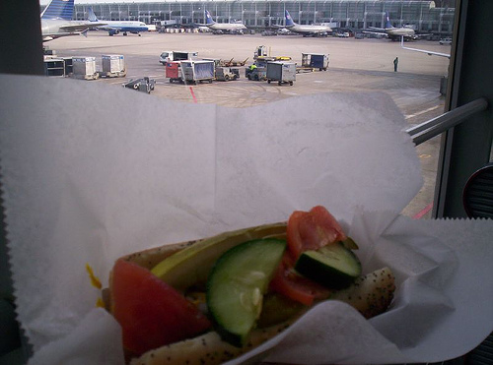
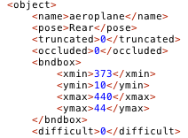
Dataset
Pascal VOC aeroplane training dataset
Consists of 5,717 images of different resolutions
Multiple objects per image, each object can be from a different classes
Each image has a corresponding annotation xml file
Image contains 4 aeroplanes & 1 person

Slide 5
Model Size
Compute ratio of mean width, height for each image to nearest tenth
Calculate number of corresponding 8x8 pixel blocks based on mean width
Example
Block Width = 40 Model Width = 320
Block Height = 17 Model Height = 136

Slide 6
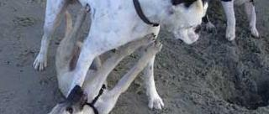
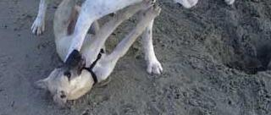
Negative Samples
Generated from each object in each image
Disregarded if image contained object of interest
Negative sample must have less than 50% overlap with bounding box
Randomly selected point within original image to extract sample
Problem – could create an infinite loop – limited to 15 tries
2,949 Negative samples generated from first 1000 images

Slide 7
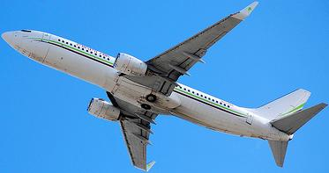

Positive Samples
Extract the bounding box from a positive sample
Resize the positive sample to model size

Slide 8
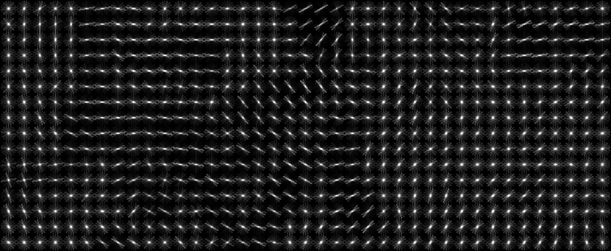

Extract HOG Features
Extract HOG features from each sample

Slide 9
SVM Results
2949 Negative Samples
53 Positive Samples
Train set: 1474 (negative) + 26 (positive)
Test set: 1475 (negative) + 27 (positive)
Accuracy = 100% (1500/1500) (classification)
Accuracy = 98.2024% (1475/1502) (classification)
Test False Positive: 1.7778
Test False Negative: 0.0040678
170
Accuracy = 100% (3066/3066) (classification)
Accuracy = 97.9452% (3003/3066) (classification)
Test False Positive: 1.4353
Test False Negative: 0.0013418

Slide 10
Next Week…
Compute different scales of the image (6 scales)
Slide a window over image in each scale
compute the probability of being the object for each window using the trained model
Determine the peak as object position

Slide 11
Week 4 Reflections
Re-read research papers – won’t fully understand topic first read through
Clear understanding of task at hand
Stay focused, set daily and weekly goals
Ask others for help, not only Hamid

