Slide 1
Week 5: 6/13 – 6/17
Jeffrey Loppert

Slide 2
Object Detection
Pre-processing
  Extract positive/negative samples and compute HOG features
Training
  Used an SVM and Histogram Intersection feature
Testing
  Detect over several different scales
Evaluate
  Use Pascal devkit to compare against example metod
scales
1.0000 0.8710 0.7419 0.6129 0.4839

Slide 3
Object Detection
Pre-processing
  Set of 5717 images
    5717 Negative, 470 Positive samples
  Calculate a model size based on the mean ratio w/h
    Ratio rounded to 2.5
    Empirically decided height 8 (8x8 pixel) blocks
    Width based on ratio – 20 (8x8 pixel) blocks
    Model width = 160 pixels Model height = 64 pixels
  Extract a model sized negative sample from each image
    Less than 50% overlap with object bounding box
    Randomly selecting a point to extract bounding box
      Could infinite loop - keep selecting poor points
      Stopped after 20 tries – returned blank image

Slide 4
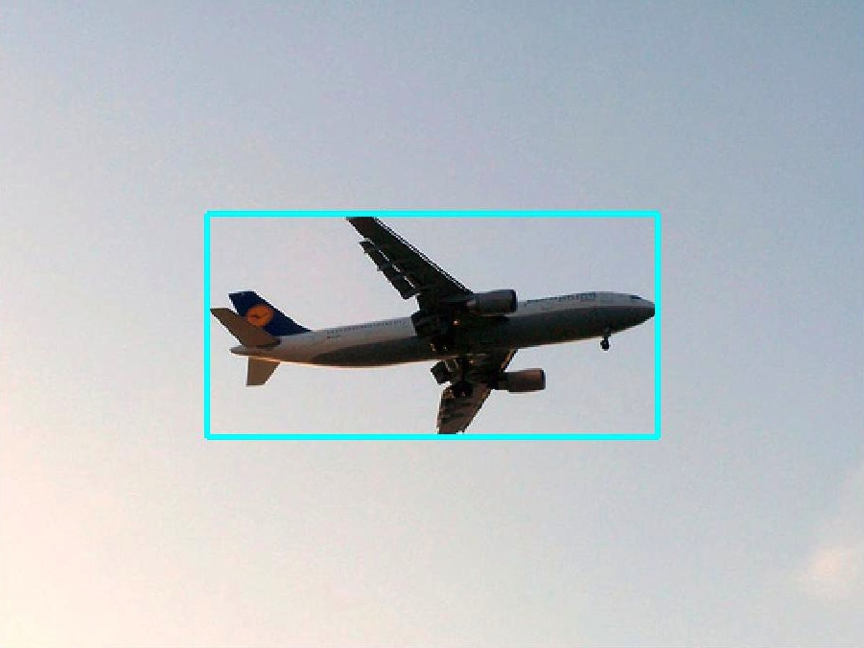

Object Detection

Slide 5
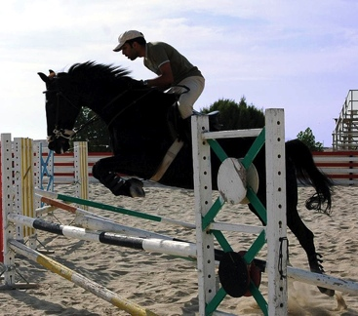
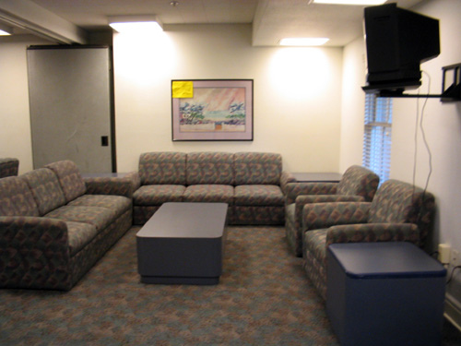


Object Detection

Slide 6
Object Detection
Using different code to generate hog features
  Felzenswalb’s Extended HOG Features
  Believe calculated by averaging a sliding window reference…

Slide 7
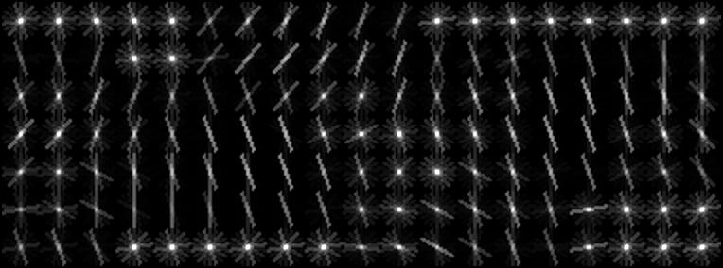
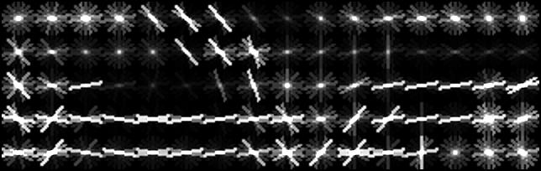
Object Detection
Old - 7x19 Block
New - 5x16 Block

Slide 8
Object Detection
Training
  Used Histogram Intersection with SVM
  Used various scales of the image
  Calculate the probability on each scale.
  Take the highest probability as the object

Slide 9
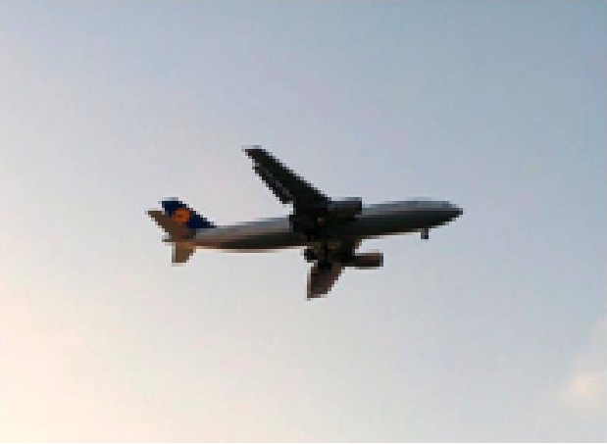
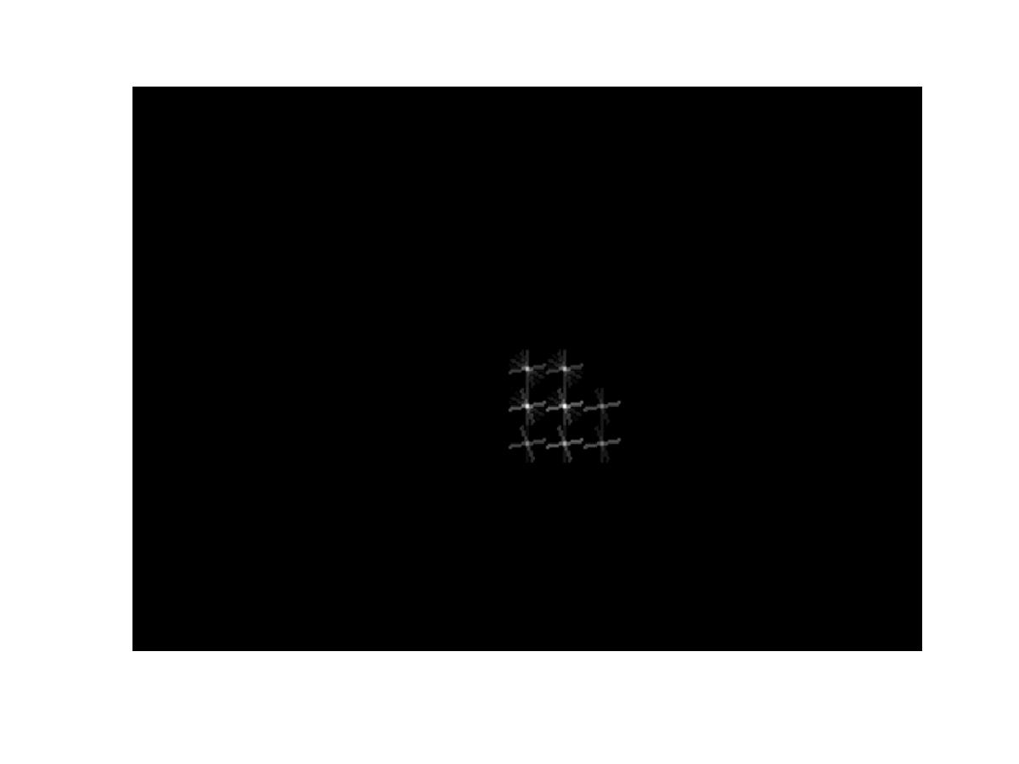
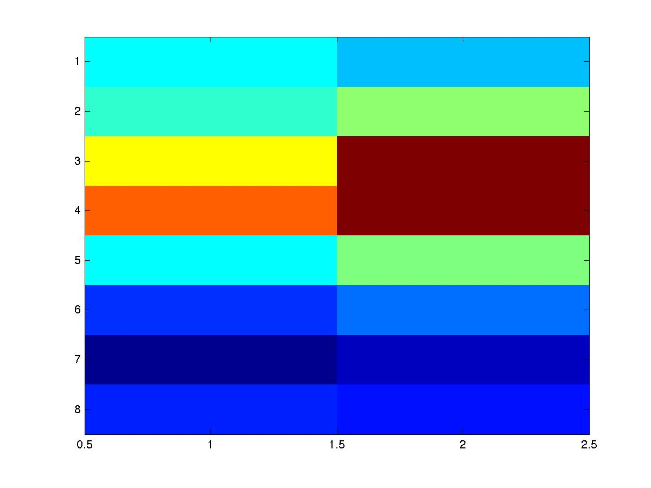


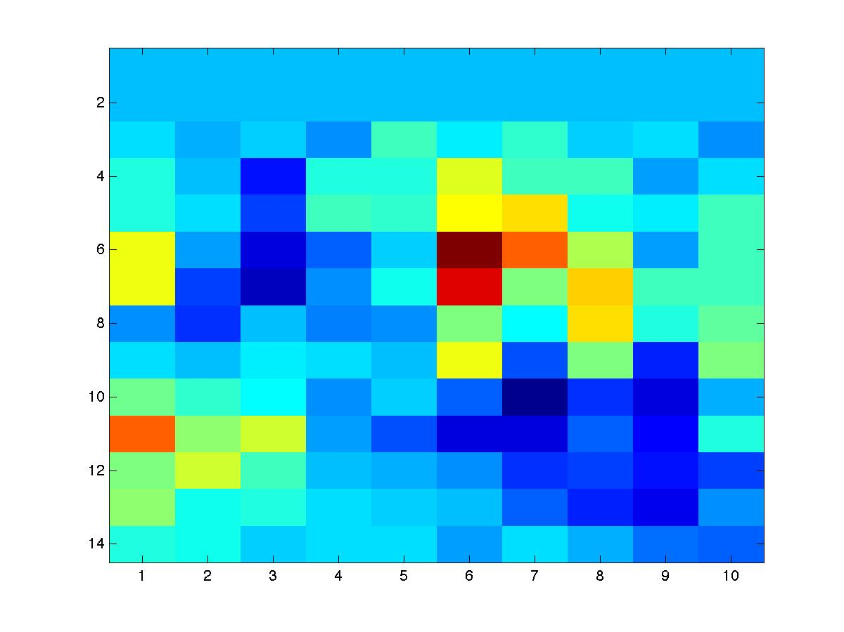
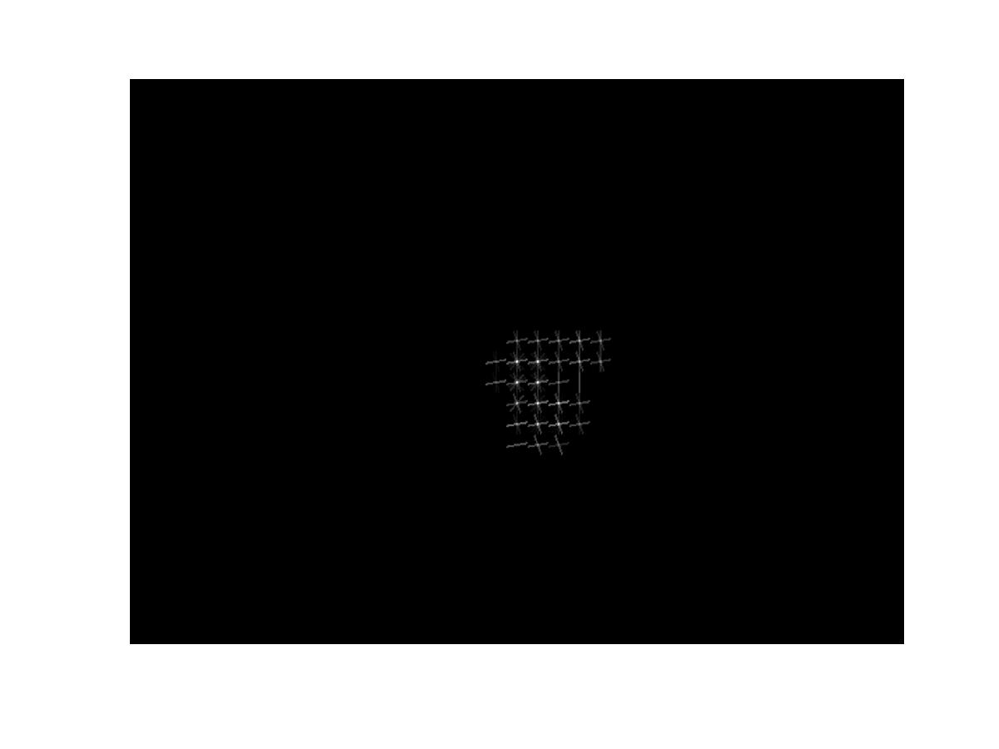
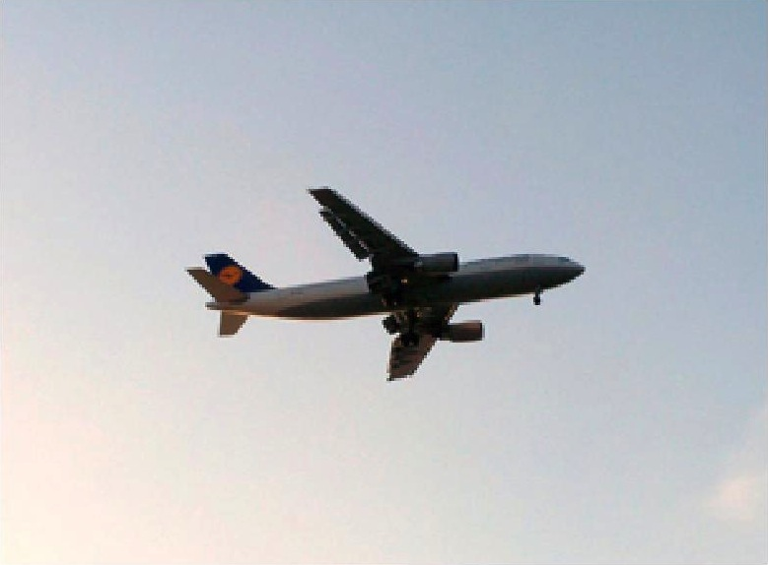
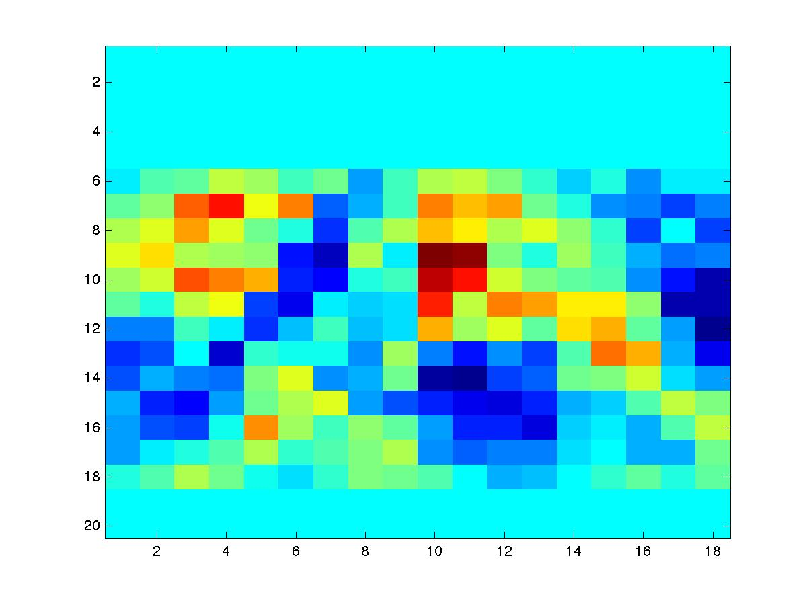


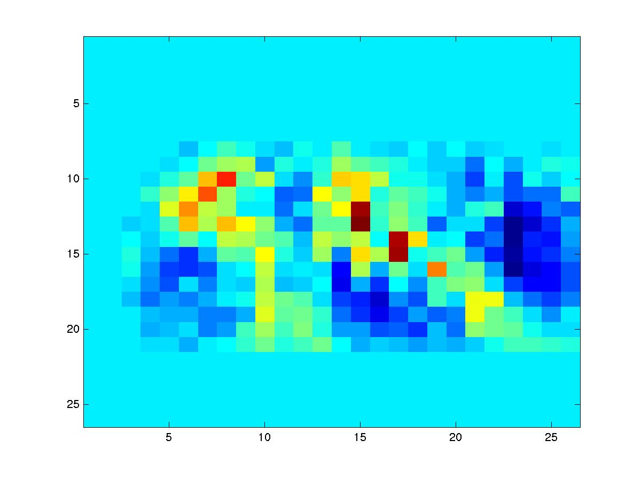
Object Detection
Old

Slide 10
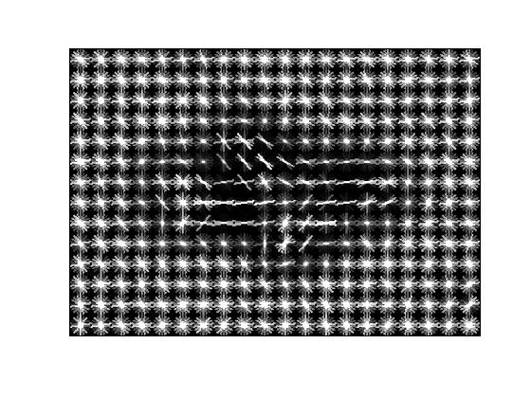
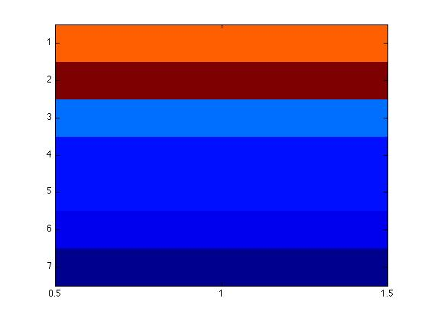
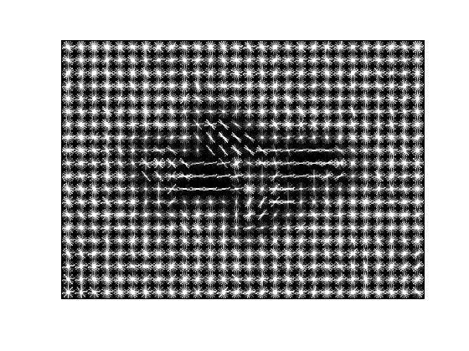
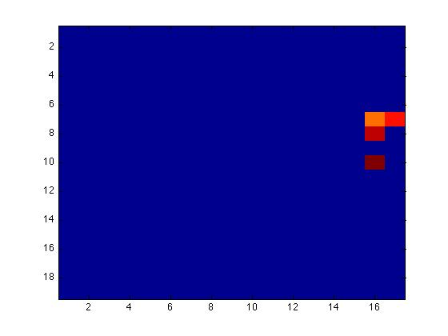
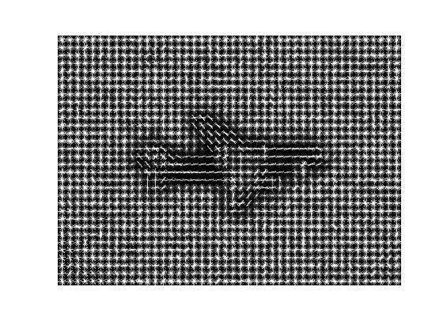
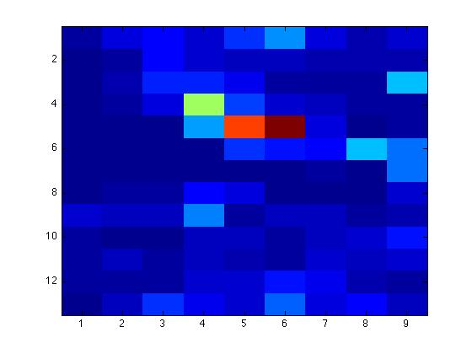
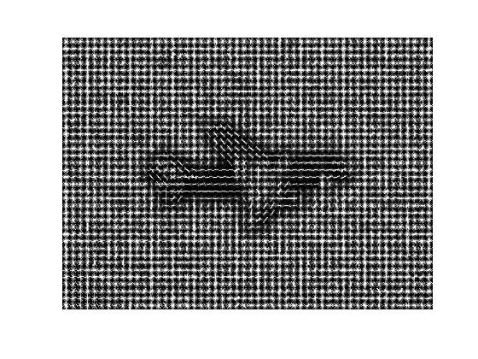
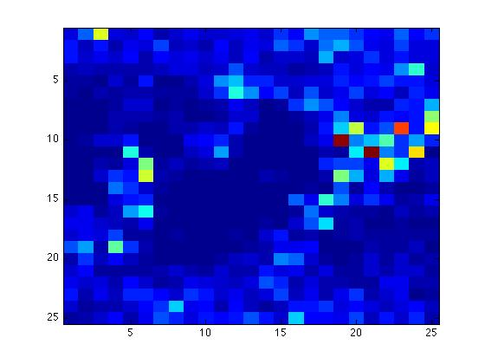
Object Detection
New

Slide 11
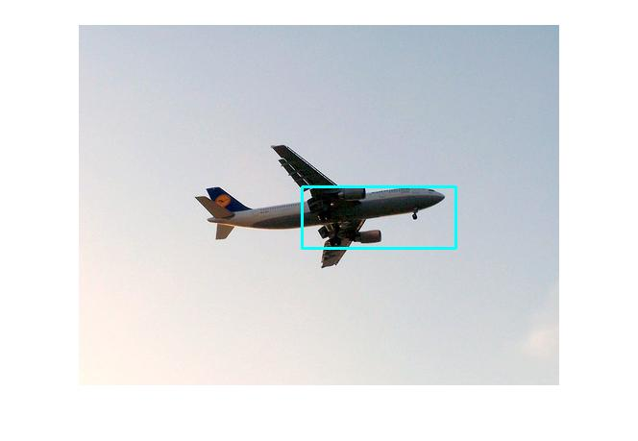
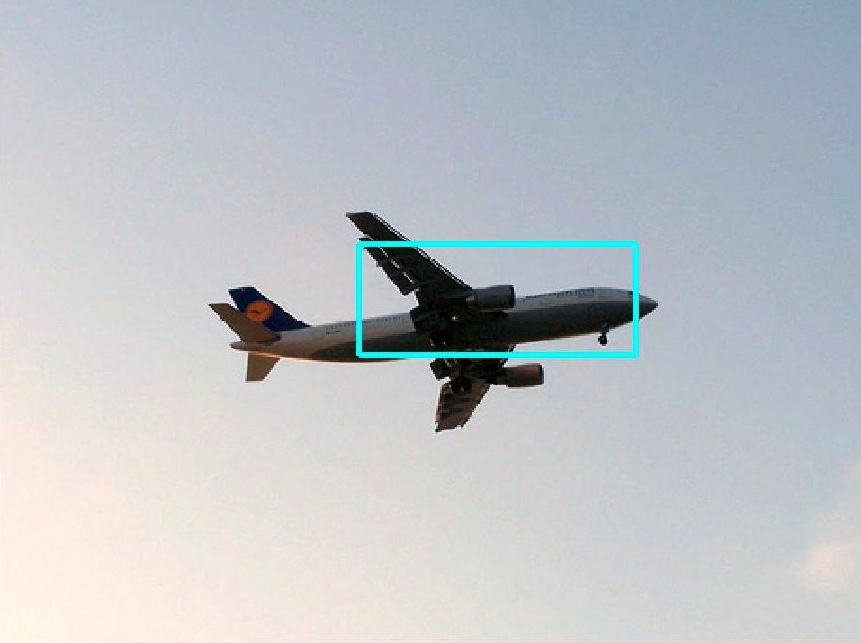
Object Detection
Old
New
New
#### max response is -> prob:0.0035778 h:21 w:21 level:1 scale:1
Elapsed time is 478.760217 seconds.

Slide 12
Object Detection
Evaluation
  Use evaluation tool in devkit to compare results
  Example output for a single image
  File name confidence value bounding box
  2008_000002 0.027039 313.000000 177.000000 160.000000 64.000000
  Using detection method is far too time consuming
  Not practical to run over test set of 5823 validation image
  Elapsed time is 367.663056 seconds.
  Over validation set
  2140901.975088 seconds = 594.694993 hours = 3.53985115 weeks

Slide 13
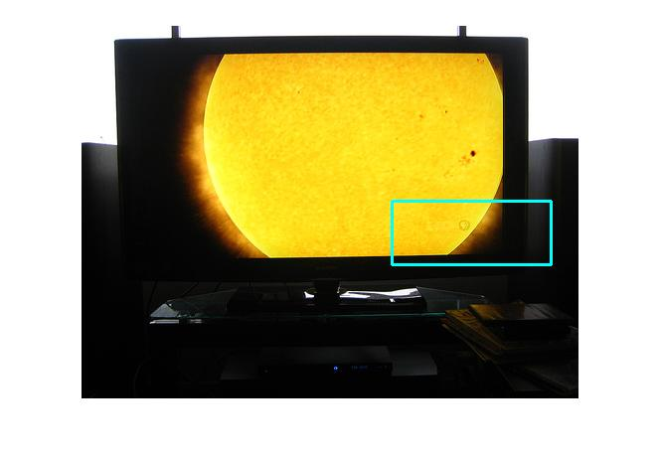
Object Detection
Concern – How we are meant to interpret results
Unsure how to represent images that do not contain an object of interest
  Image where no bounding box was detected
  Current method always detects a region of interest
    but has a low confidence value
#### max response is -> prob:0.027039 h:22 w:22 level:1 scale:1

Slide 14
Object Detection
Planned to use this method as a base line to test a new detection idea
Based on a deformable parts method proposed by Felzenszwalb et al and Poselet Activions by Bourdev et al.
Use a Hidden Markov Model over a Pyramid scheme to model an object

Slide 15
Action Detection
New focus!
Apply this method to action detection in a video sequence
Plan to use the KTH dataset
Starting testing Bourdev et al.’s Poselet Activations and Felzenszwalb et al’s Deformable Parts source code
  Problems
    Poselet source code is based on a different annotation set
    Not all source code may be available, only executables

