Slide 1
Week 6:6/20 – 6/24
Jeffrey Loppert

Slide 2
Action Detection
Tested Bourdev et al.’s Poselet Activation Source code
  Ruled out
    Requires specially trained Poselet models for each image
      Source code and executables not made available
    Long runtime
      one point 90,000² loop – stopped running code
Tested Felzenszwalb et al’s Deformable Parts source code
  Works
    Source code is provided for both detection and model
  Problem – not always accurate
    Consider using ‘star-cascade’ or train a new model
Downloaded KTH dataset
  Focusing on walking

Slide 3
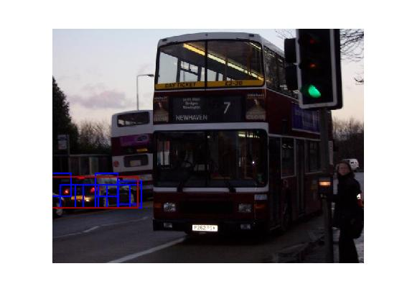
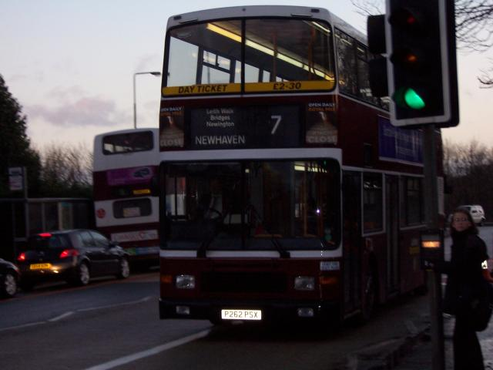
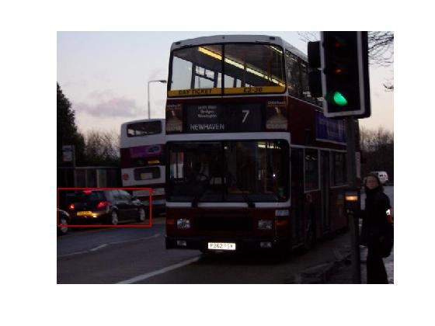
Action Detection
2007 Car Model

Slide 4
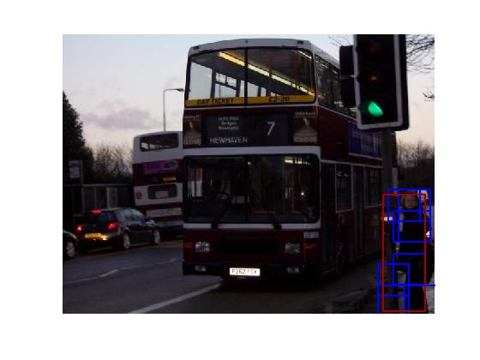
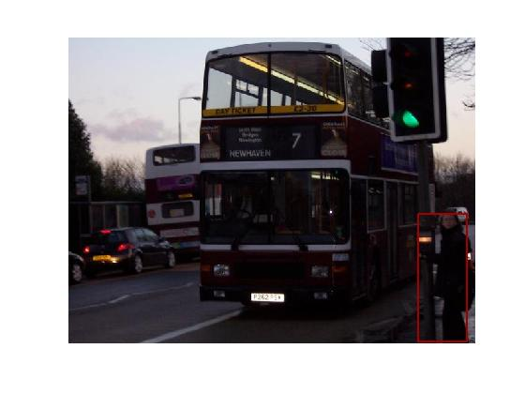
Action Detection
2007 Person Model

Slide 5
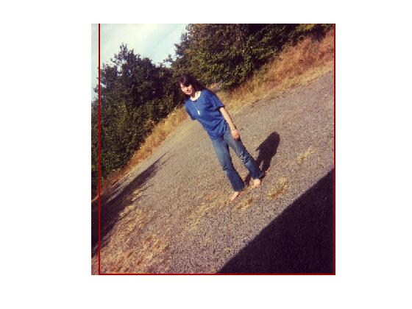
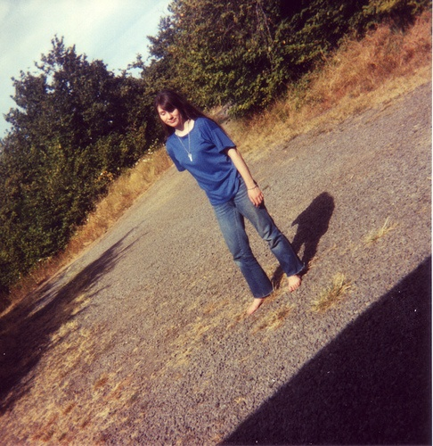
Action Detection
2007 Person Model

Slide 6
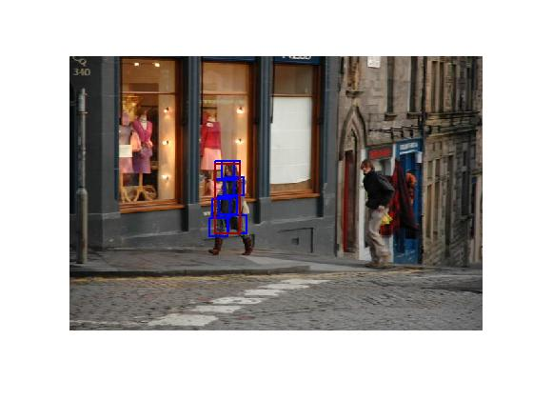
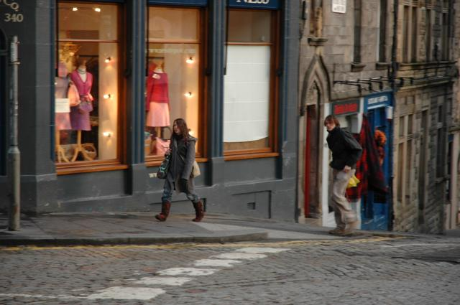

Action Detection
2007 Person Model

Slide 7
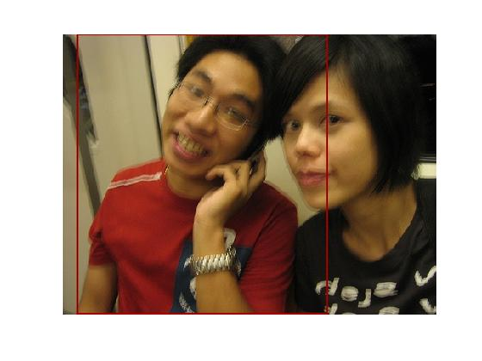
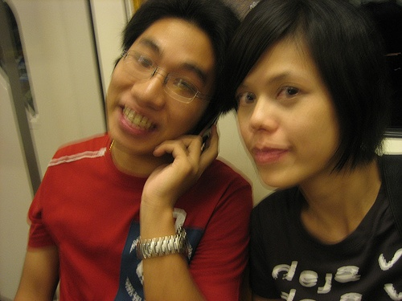
Action Detection
2007 Person Model

Slide 8
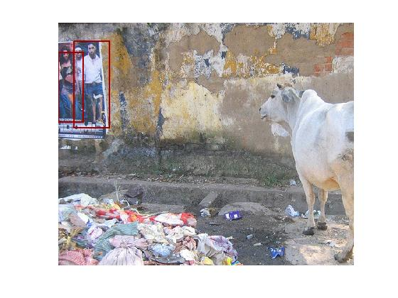
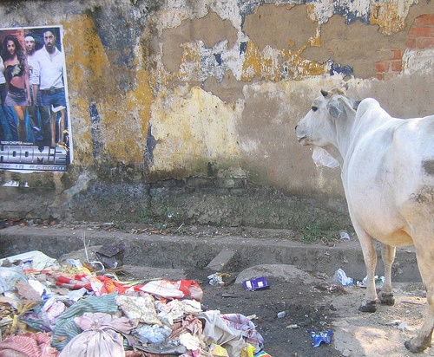
Action Detection
2007 Person Model

Slide 9
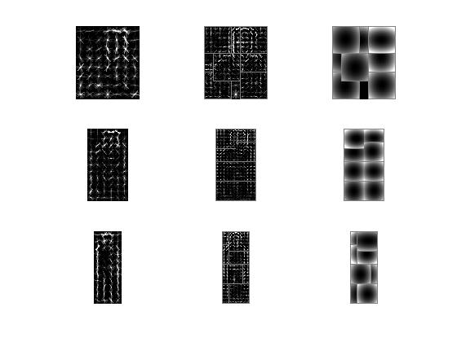
Action Detection
2007 Person Model

Slide 10
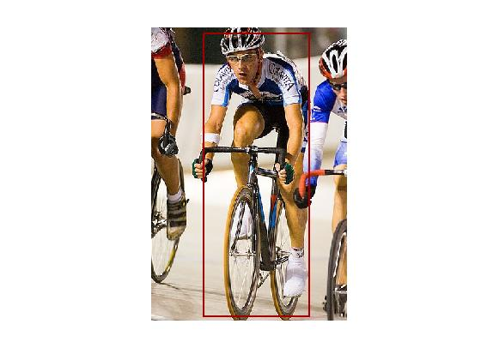
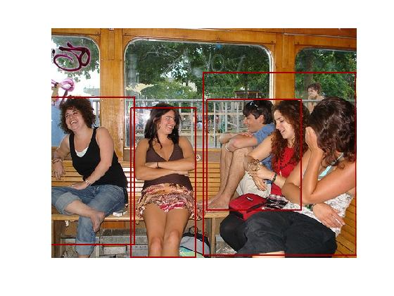
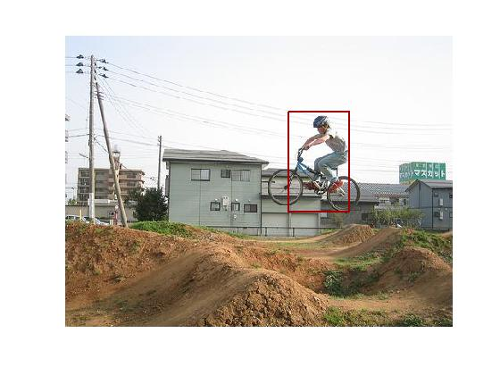
Action Detection
2007 Person Model

Slide 11
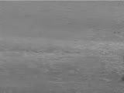
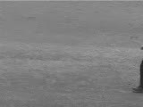
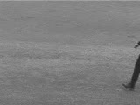

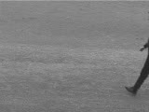
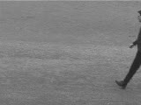
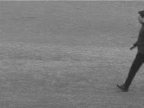
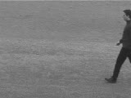
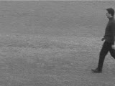
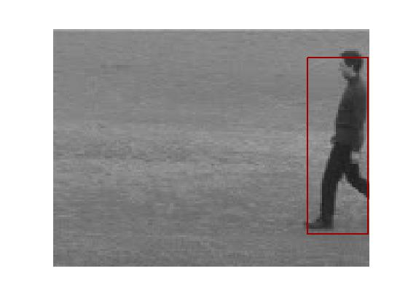
Action Detection
2007 Person Model

Slide 12
Action Detection
Areas for improvement
  Modify code
  Generate new model
    Would require new annotated dataset
      Pascal VOC 2011?

