Slide 1
Research Focus
Human Action Recognition
Taylor Rassmann

Slide 2
Human Action Recognition
Optical flow vectors are obtained from video sequences.
As the optical flow changes over time, it creates a model for which human action recognition can be derived.
Applications
  Youtube video analyzation and tagging
  Detecting abnormal behavior in crowds

Slide 3
Human Action Recognition
Two of the older datasets have become obsolete over time. This is because many approaches are able to attain a 95 percent or higher accuracy.
  Weizmann Action Data Set
  KTH Action Data Set
UCF has proposed a new dataset that has a more robust set of actions to be analyzed.
  UCF50

Slide 4
Human Action Recognition
“Most of the available action recognition datasets are not realistic and are staged by actors. In our dataset, the primary focus is to provide the computer vision community with an action recognition dataset consisting of realistic videos which are taken from youtube.”
“Our dataset is very challenging due to large variations in camera motion, object appearance and pose, object scale, viewpoint, cluttered background, illumination conditions, etc.”

Slide 5
Human Action Recognition
“For all the 50 categories, the videos are grouped into 25 groups, where each group consists of more than 4 action clips.”
“The video clips in the same group may share some common features, such as the same person, similar background, similar viewpoint, and so on.”

Slide 6
Previous Approach
Deriving kinematic features from optical flow and using multiple instance learning

Slide 7
Idea
Set of kinematic features derived from optical flow
Five features:
  Divergence
  Vorticity
  Symmetric and anti-symmetric flow fields
  Second and third principal invariants of flow gradient and rate of strain tensor
  Third principal invariant of rate of rotation tensor

Slide 8
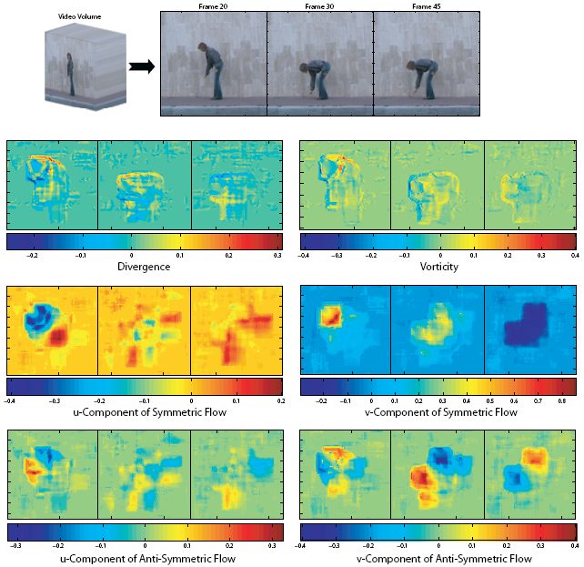

Slide 9
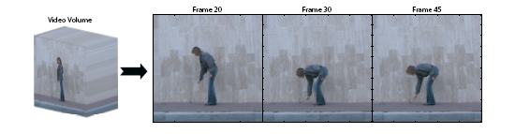
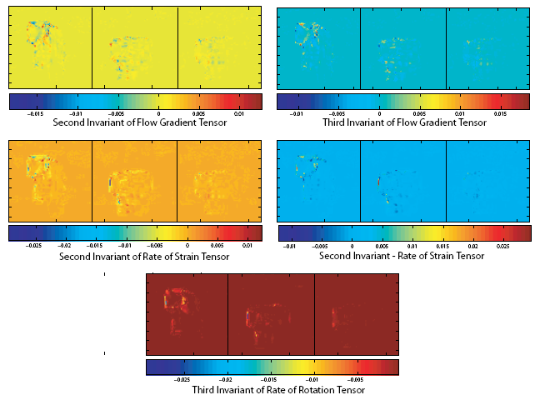

Slide 10
Proposed Approach
New salient regions algorithm found.
This algorithm focuses on “interesting regions” of optical flow during a video.
Combination of salient regions and kinematic features to focus on more “noisy” videos in the UCF50 action dataset

