Slide 1
Human Action Recognition Week 11
Taylor Rassmann

Slide 2
Hierarchical Clustering
Grouping data objects into X tree of clusters and uses distance matrices as clustering criteria
Two Hierarchical Clustering Categories:
Agglomerative (bottom-up): merging clusters iteratively
Divisive (top-down): splitting clusters iteratively

Slide 3
Hierarchical Clustering
AGNES Method:
Merges nodes that have the least dissimilarity
Continues in a non-descending way
All nodes belong to the same cluster at the end
DIANA Method:
Inverse order of AGNES method
All nodes are in separate clusters at the end

Slide 4
Hierarchical Clustering
AGNES and DIANA Weaknesses:
Time complexity of O(N²)
Split or merge decisions are final, and cannot be undone. This may lead to lower quality clusters
New technique proposed:
BIRCH

Slide 5
Hierarchical Clustering
BIRCH: Balanced Iterative Reducing and Clustering using Hierarchies
Incrementally uses a CF tree as a summarized cluster representation, split into multiple phase.
Phase 1: scan the database to build an initial in-memory CF tree
Phase 2: use an arbitrary clustering, such as k-means, to cluster the leaf nodes

Slide 6
Hierarchical Clustering
BIRCH Advantages:
Scales in a linear fashion. This method finds a good cluster with a single run and then can improve with a few additional scans
Time complexity of O(N)
BIRCH Weaknesses:
Only numeric data, and sensitive of order
Favors clusters with a spherical shape

Slide 7
Hierarchical SVMs
Look at a confusion matrix of the UCF50 dataset
Dollar Features
Idea of a structured tree SVM
Different configurations have different paired groupings
Train an SVM specifically on these paired groupings

Slide 8
Hierarchical SVMs
Retrain and test with one less label than the previous iteration
Repeat for multiple levels
50
49
2
48
47
2
46
45

Slide 9
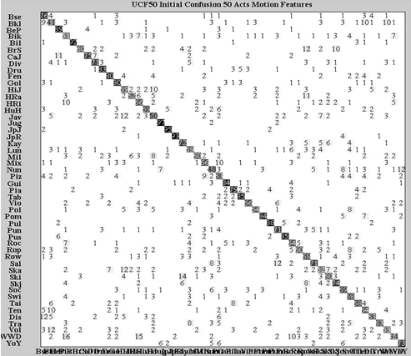
Hierarchical SVMs
Biking | 70 | 30
Horseback Riding | 20 | 80
 | Biking | Horseback Riding

Slide 10
Hierarchical SVMs: Method 1 Results
Configuration: Least confused paired with the most confused
25 levels deep after selection, training, and then testing
Initial Acc = 0.6989
Level 1 Acc | 0.6968
Level 2 Acc | 0.6980
Level 3 Acc | 0.6959
Level 4 Acc | 0.6956
Level 5 Acc | 0.6947
… | …
Level 25 Acc | 0.6418

Slide 11
Hierarchical SVMs: Method 2 Results
Configuration: Most confused pairs grouped together
25 levels deep after selection, training, and then testing
Initial Acc = 0.7019
Level 1 Acc | 0.6983
Level 2 Acc | 0.6980
Level 3 Acc | 0.6968
Level 4 Acc | 0.6962
Level 5 Acc | 0.6983
… | …
Level 25 Acc | 0.6866

Slide 12
Hierarchical SVMs: Method 3 Results
Configuration: Least confused pair with most confused. (Least confused not taken out)
49 levels deep after selection
Training and testing still need to be completed
Level 1 Acc
Level 2 Acc
Level 3 Acc
Level 4 Acc
Level 5 Acc
…
Level 49 Acc
?

Slide 13
Current Work
Continue research into different hierarchical clustering methods
Finish training and testing with method three of hierarchical SVMs
Write final report

