Slide 1
Human Action Recognition Week 12
Taylor Rassmann

Slide 2
Hierarchical SVMs
Look at a confusion matrix of the UCF50 dataset
Dollar Features
Idea of a structured tree SVM
Different configurations have different paired groupings
Train an SVM specifically on these paired groupings

Slide 3
Hierarchical SVMs
Retrain and test with one less label than the previous iteration
Repeat for multiple levels
50
49
2
48
47
2
46
45

Slide 4
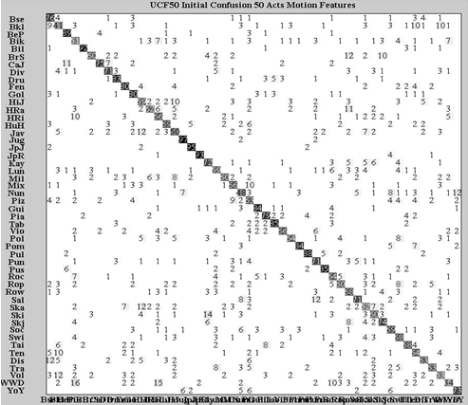
Hierarchical SVMs
Biking | 70 | 30
Horseback Riding | 20 | 80
 | Biking | Horseback Riding

Slide 5
Hierarchical SVMs: Method 1 Results
Configuration: Least confused paired with the most confused
25 levels deep after selection, training, and then testing
Initial Acc = 0.6989
Level 1 Acc | 0.6968
Level 2 Acc | 0.6980
Level 3 Acc | 0.6959
Level 4 Acc | 0.6956
Level 5 Acc | 0.6947
… | …
Level 25 Acc | 0.6418

Slide 6
Hierarchical SVMs: Method 2 Results
Configuration: Most confused pairs grouped together
25 levels deep after selection, training, and then testing
Initial Acc = 0.7019
Level 1 Acc | 0.6983
Level 2 Acc | 0.6980
Level 3 Acc | 0.6968
Level 4 Acc | 0.6962
Level 5 Acc | 0.6983
… | …
Level 25 Acc | 0.6866

Slide 7
Hierarchical SVMs: Method 3 Results
Configuration: Least confused pair with most confused. (Least confused not taken out)
48 levels deep after selection
Initial Acc = 0.7194
Level 1 Acc | 0.7163
Level 2 Acc | 0.7145
Level 3 Acc | 0.7133
Level 4 Acc | 0.7100
Level 5 Acc | 0.7085
…
Level 48 Acc | 0.1653

Slide 8
Conclusion
The method of generating a hierarchical SVM with the least and most confused actions did not give us the expected results.
This may be due to the fact that pairing the least and most confused actions significantly decreases the accuracy of the least confused action, and raises the accuracy of the most confused class an insignificant amount

Slide 9
Conclusion
A more careful selection process, for paired groupings, needs to be done in order to achieve a higher accuracy.

Slide 10
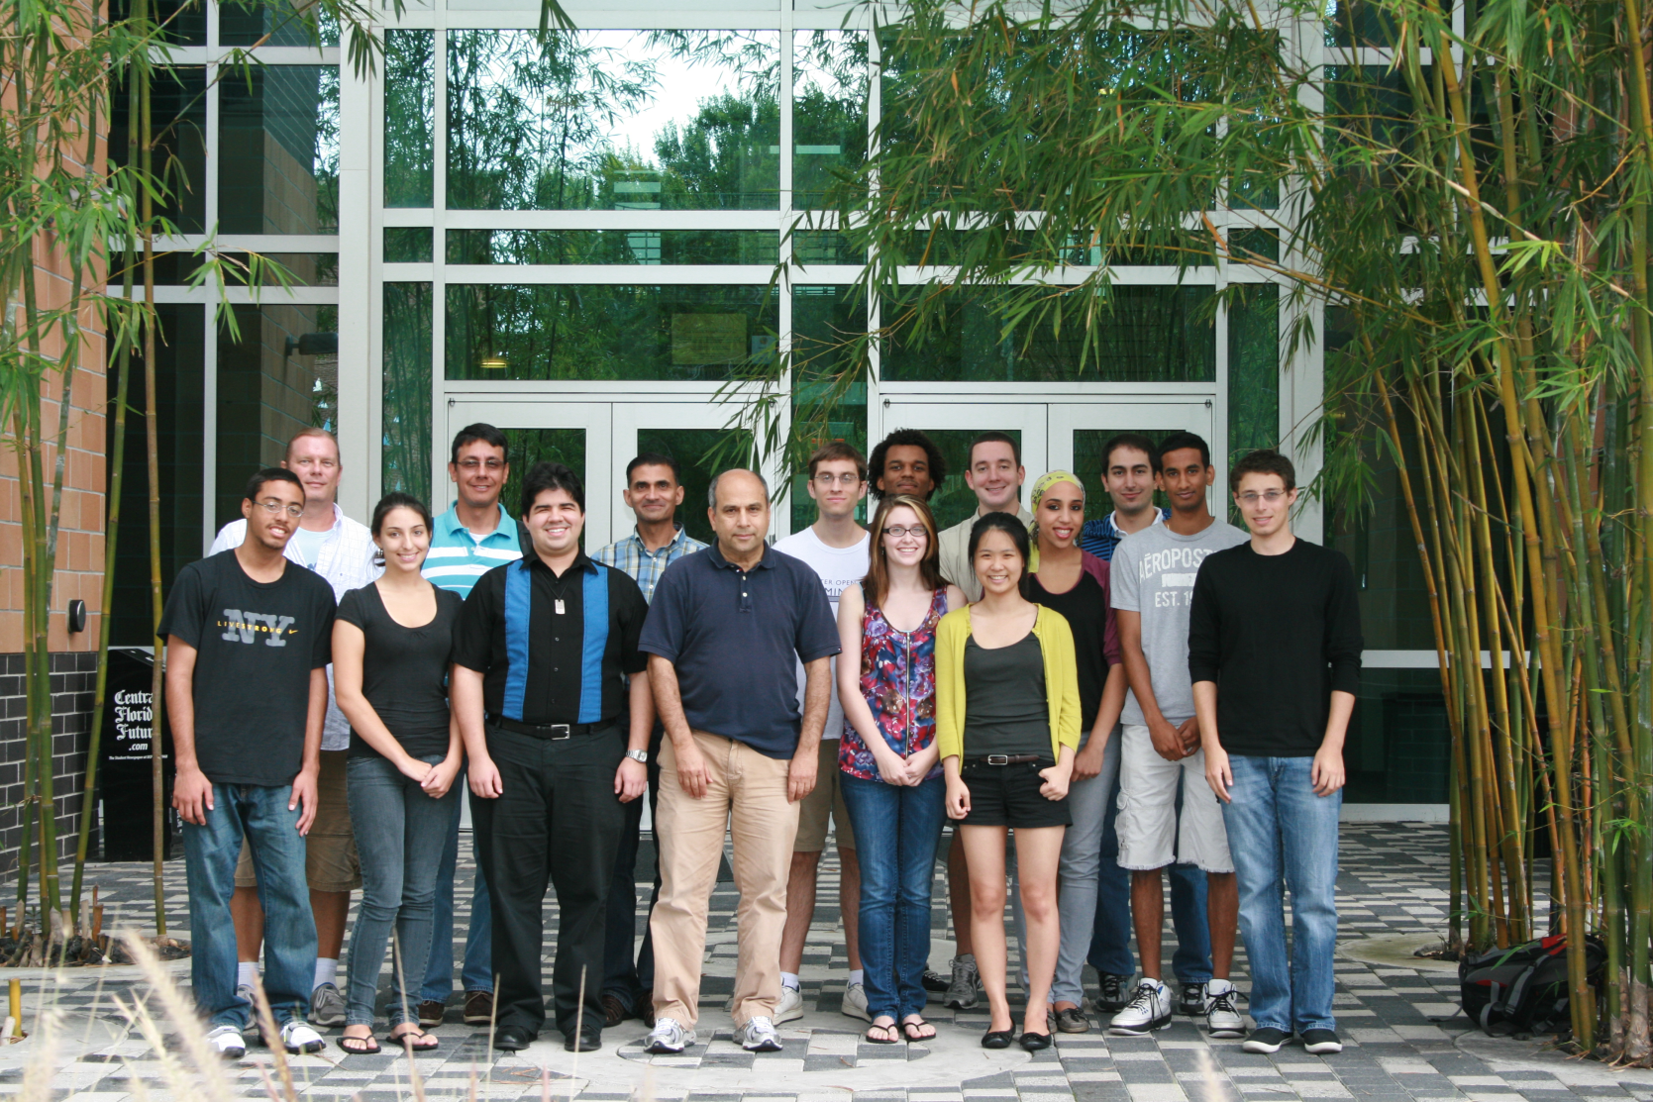
Thank You

