Slide 1
Human Action Recognition Week 5
Taylor Rassmann

Slide 2
Optical Flow
Optical flow is finished on UCF50 dataset
  One week of computation time
  Lucas-Kanade with pyramids method
  1.27 TB of data

Slide 3
Status
Done/In Progress
  Kinematic features extracted on 11 actions
  Generating codebooks of size 20 for different features
    Processing divergence and vorticity
To Do
  Need to generate histograms
  Run SVMs

Slide 4
Center Feature
Idea: When people view actions, their attention is focused on the center of the action that is occurring
If we treat the camera viewpoint as the focus of attention, then the center of the image will be where the most important parts of the action are occurring

Slide 5
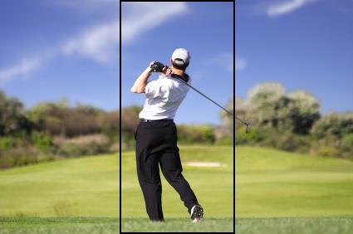
Center Feature Example

Slide 6


Center Feature Baseball
Center Feature U Center Feature V

Slide 7
Current Work
Apply COCOA to entire UCF50 dataset
  Check if improvement in accuracies
Fix center feature error
Apply bag of words to UCF50 dataset
Apply Saad Ali’s bag of kinematic modes
  Compare accuracies between two methods
Research GIST for action recognition
  Paper: Modeling the Shape of the Scene: A Holistic Representation of the Spatial Envelope

