Slide 1
Human Action Recognition Week 6
Taylor Rassmann

Slide 2
Feature Extraction
Almost done extracting six kinematic features from optical flow
Divergence
Vorticity
Symmetric Flow Fields (u and v components)
Asymmetric Flow Fields (u and v components)

Slide 3
KPCA and MIL
Kernel Principal Component Analysis
Generates bag of kinematic modes
Multiple Instance Learning
Action Videos
KPCA
MIL

Slide 4
Multiple Instance Learning
Bags of kinematic modes separated into positive and negative examples for training
Creating of a set of all kinematic modes into one set
Video embedding based on similarity between kinematic modes

Slide 5
KPCA Status
Code integration almost complete
Feature extraction spans over multiple hard-drives
Next Step:
Multiple Instance Learning

Slide 6
Bag of Words
Method tested on first 11 actions of UCF50 dataset
Used built in K-Means
500 Centers

Slide 7
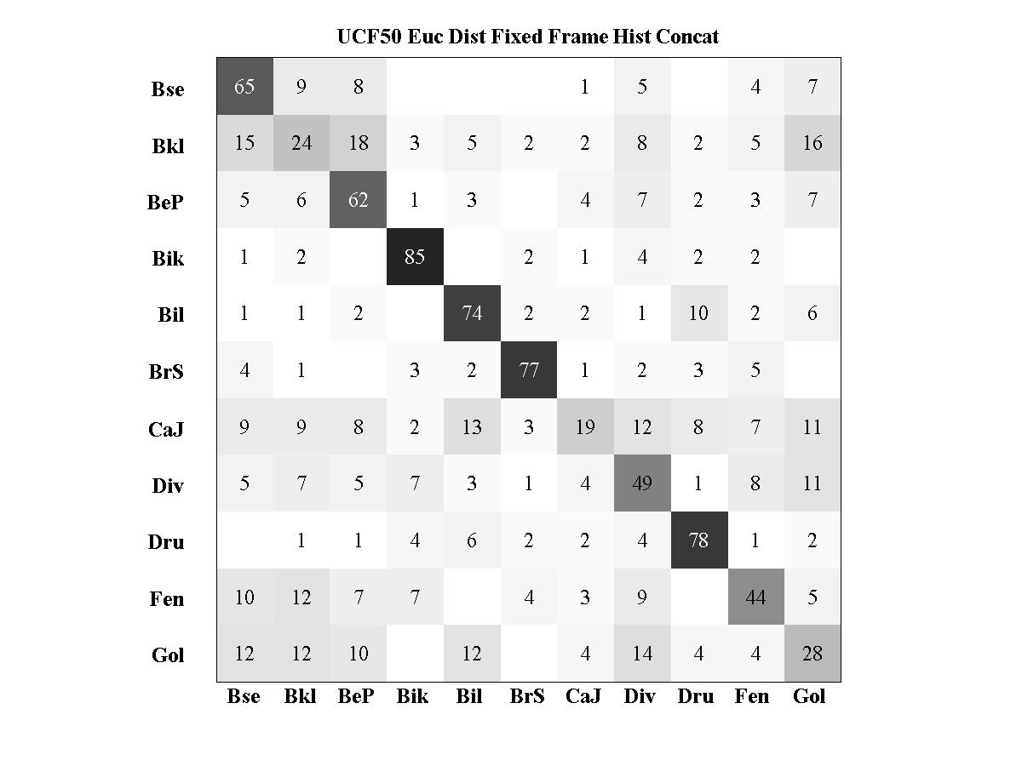
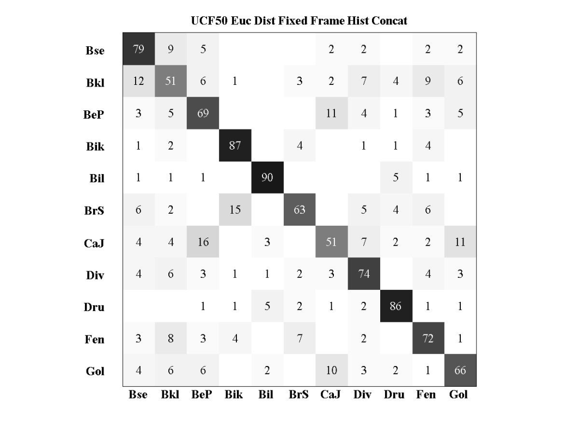
Results
Average accuracies between 70-90 percent
Vorticity Symmetric Flow U

Slide 8
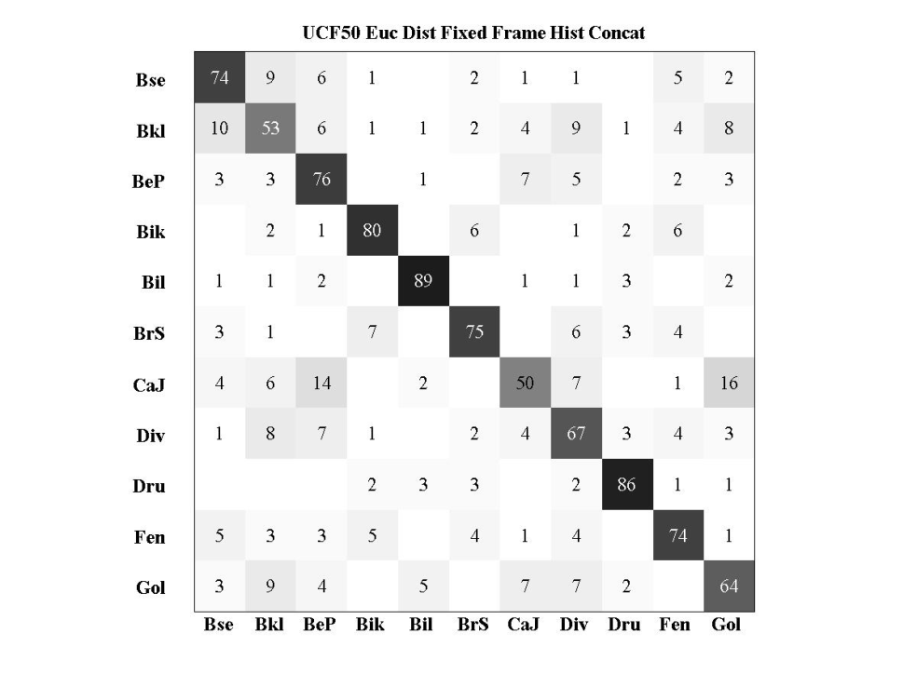
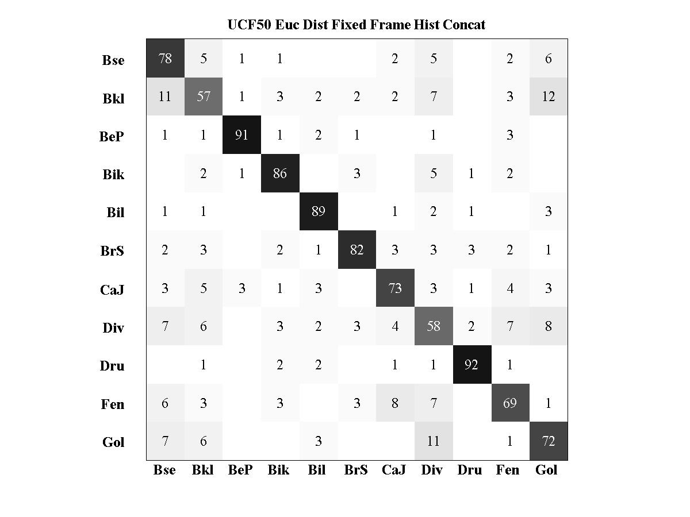
Results
Asymmetric Flow U Asymmetric Flow V

Slide 9
Current Work
Finish KPCA and MIL code integration
Complete Bag of Words over entire UCF50 dataset actions
Each learning method will require careful integration, because feature data spans multiple hard-drives
Start researching GIST and how it can be applied to video sequences

