Slide 1
Human Action Recognition
Week 8
Taylor Rassmann

Slide 2
Bag of Words
Method tested on first 11 actions of UCF50 dataset
  Used built in K-Means
  500 Centers
  Kinematic Features

Slide 3
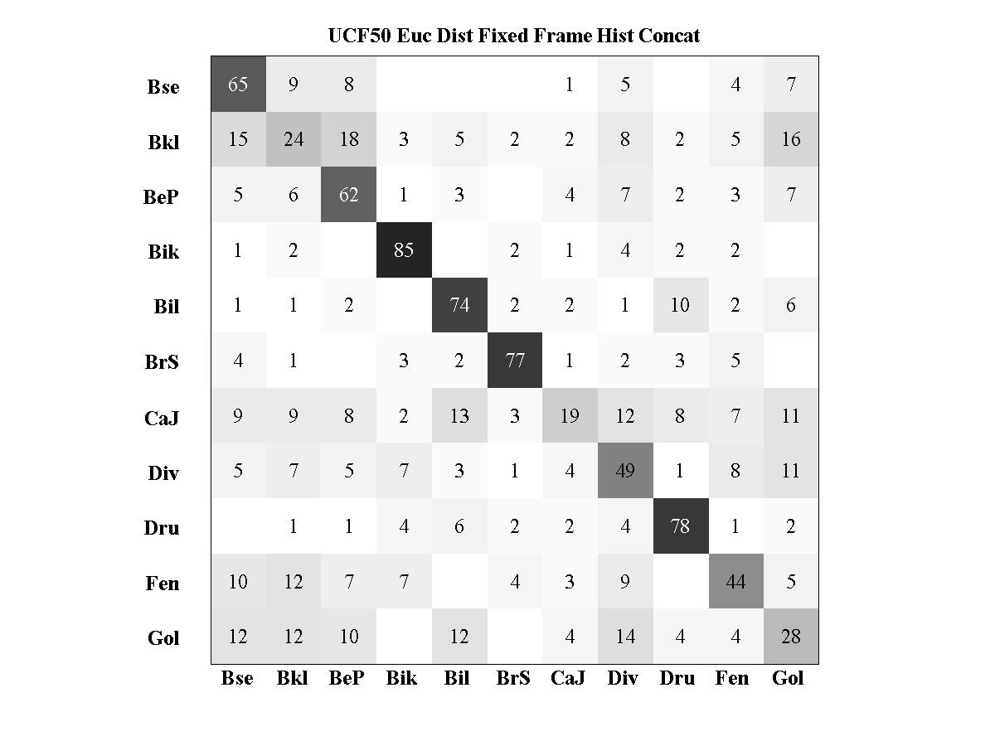
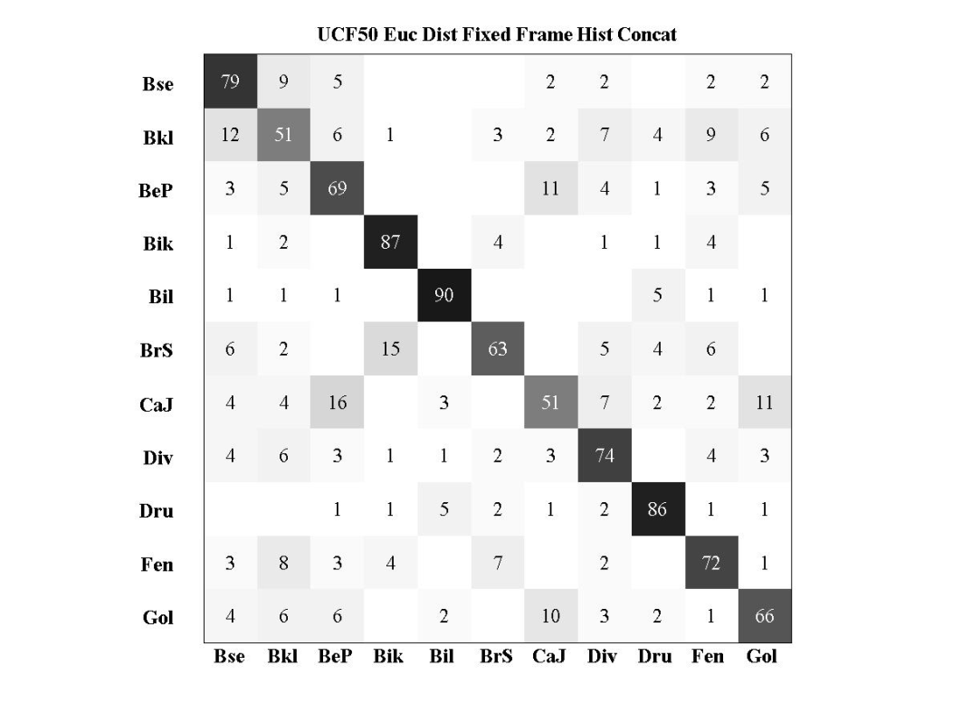
Results: Kinematic Features
Average accuracies between 70-90 percent
Vorticity Symmetric Flow U

Slide 4
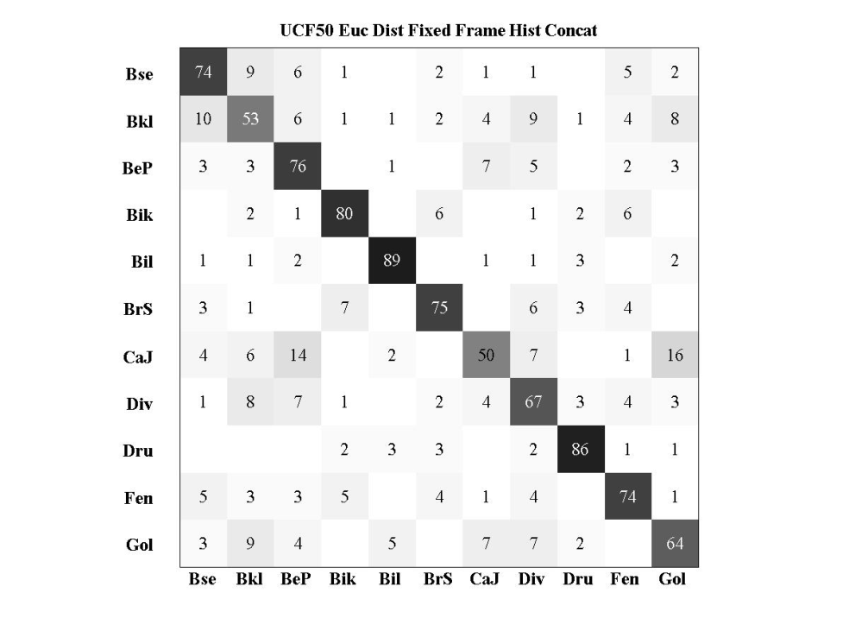
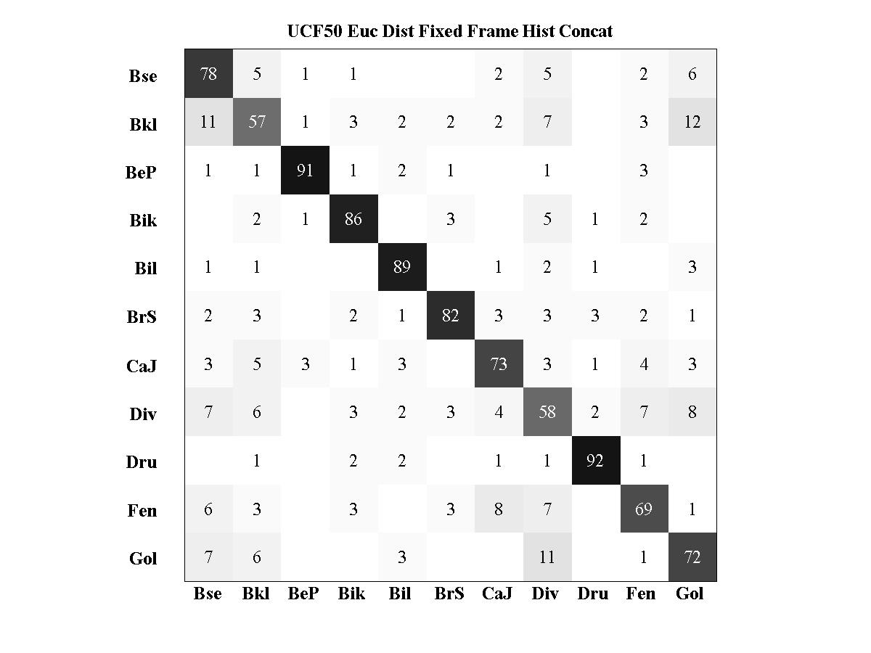
Results: Kinematic Features
Asymmetric Flow U Asymmetric Flow V

Slide 5
Hierarchical SVM
Use K-Means clustering of labels after codebook and histogram generation
Label 1
Label 5
Label 2
Label 3
Label 4
Label 7
Label 8
Label 11
Label 9

Slide 6
Results: Dollar Features 50 Actions
Average Accuracies:
  No centers: 70%
  3 centers: 68%
  5 centers: 66%
  10 centers: 61%

Slide 7
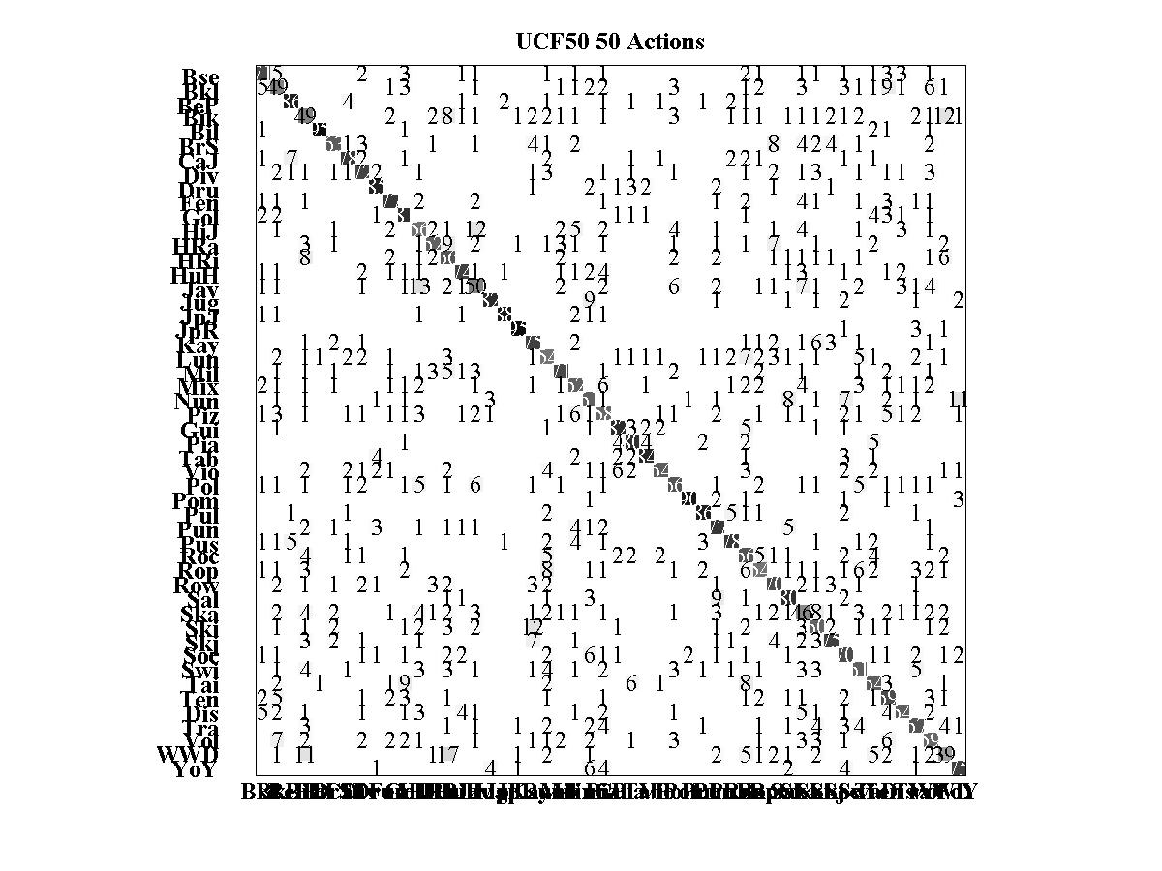

Slide 8
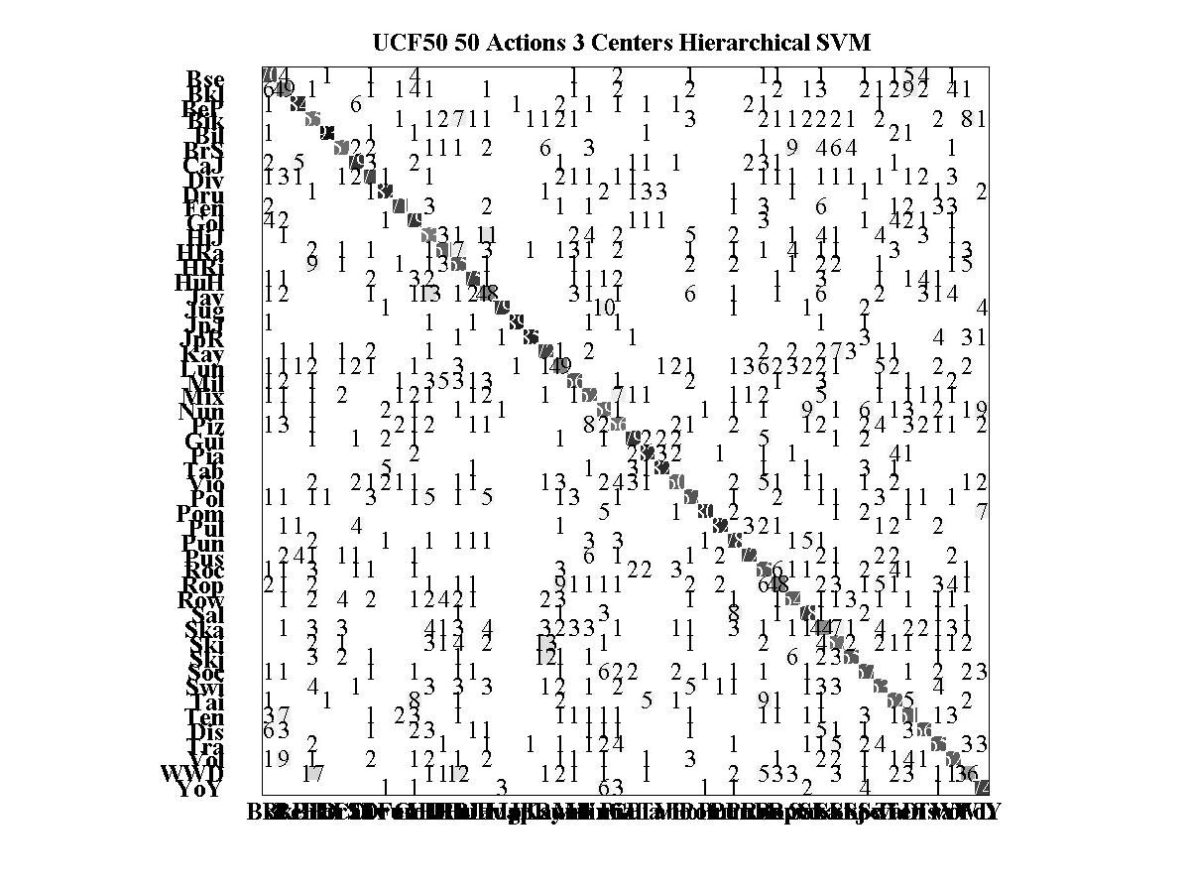

Slide 9
Results: Dollar Features 11 Actions
Average Accuracies:
  No centers: 87%
  3 centers: 85%

Slide 10
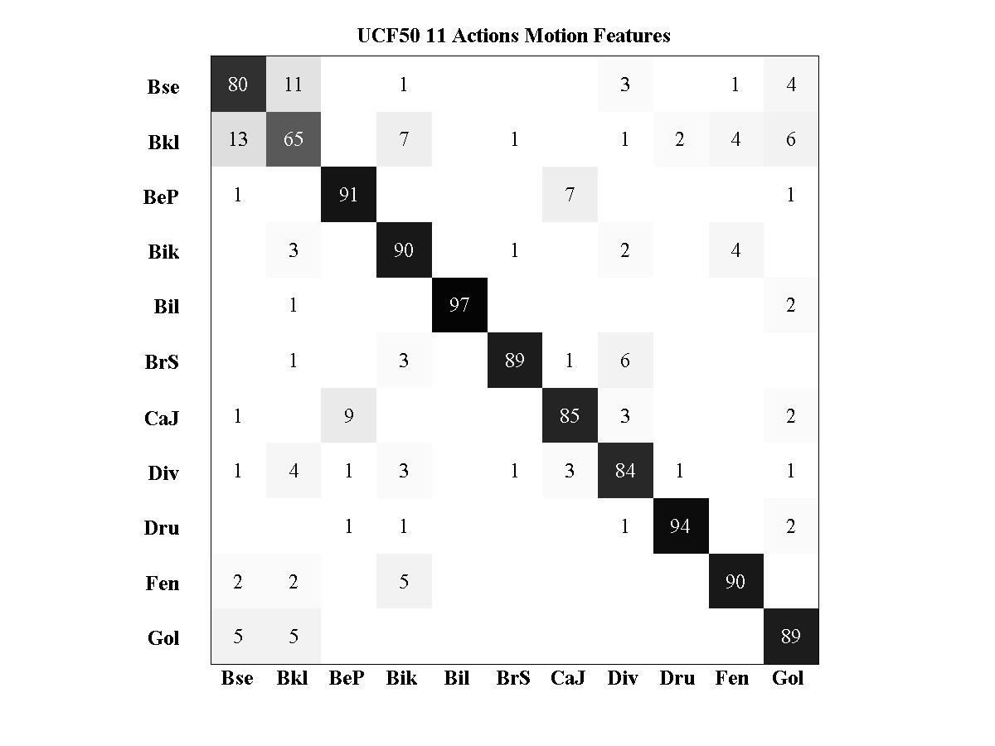

Confusion Matrix Comparison

Slide 11
Results: Divergence 11 Actions
Average Accuracies:
  No centers: 46%
  3 centers: 46%

Slide 12
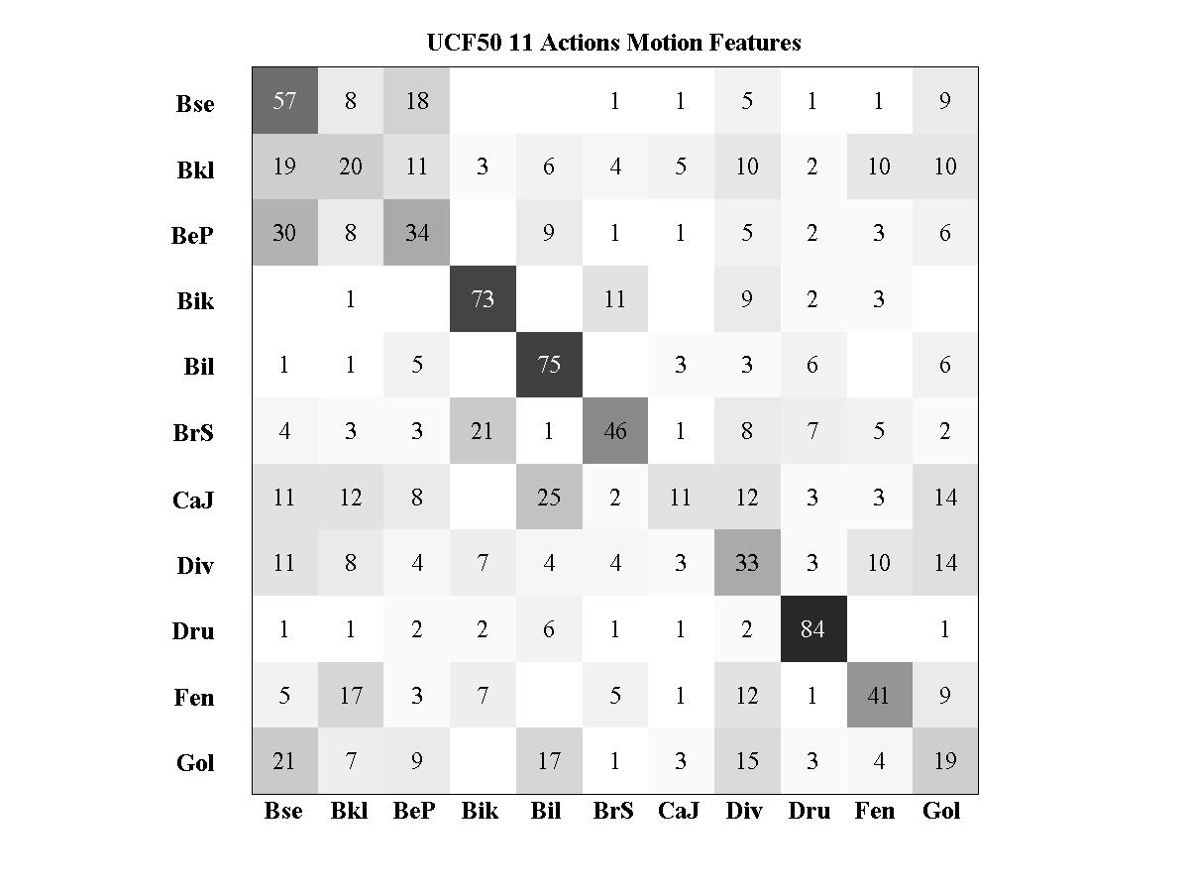
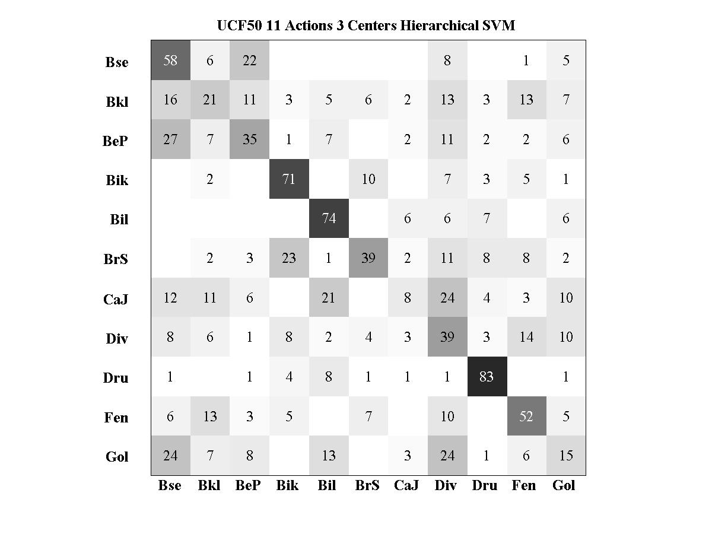
Confusion Matrix Comparison

Slide 13
Hierarchical SVM
Results similar to non-clustering
Labels centers converging on one another
Label 1
Label 5
Label 2
Label 3
Label 4
Label 7
Label 8
Label 11
Label 9

Slide 14
Current Work
Finish K-Means on all 50 kinematic features
Divergence is done
  Make Histograms
  Test average accuracies with SVMs
Find new direction of classification if accuracies are lower than standard SVM

