Slide 1
Human Action Recognition Week 9
Taylor Rassmann

Slide 2
Hierarchical SVMs
Look at a confusion matrix of the UCF50 dataset
Dollar Features
Find the two most confused classes
Train an SVM specifically on these two

Slide 3
Hierarchical SVMs
Retrain and test with one less label than the previous iteration
Repeat for multiple levels
50
2
48

Slide 4
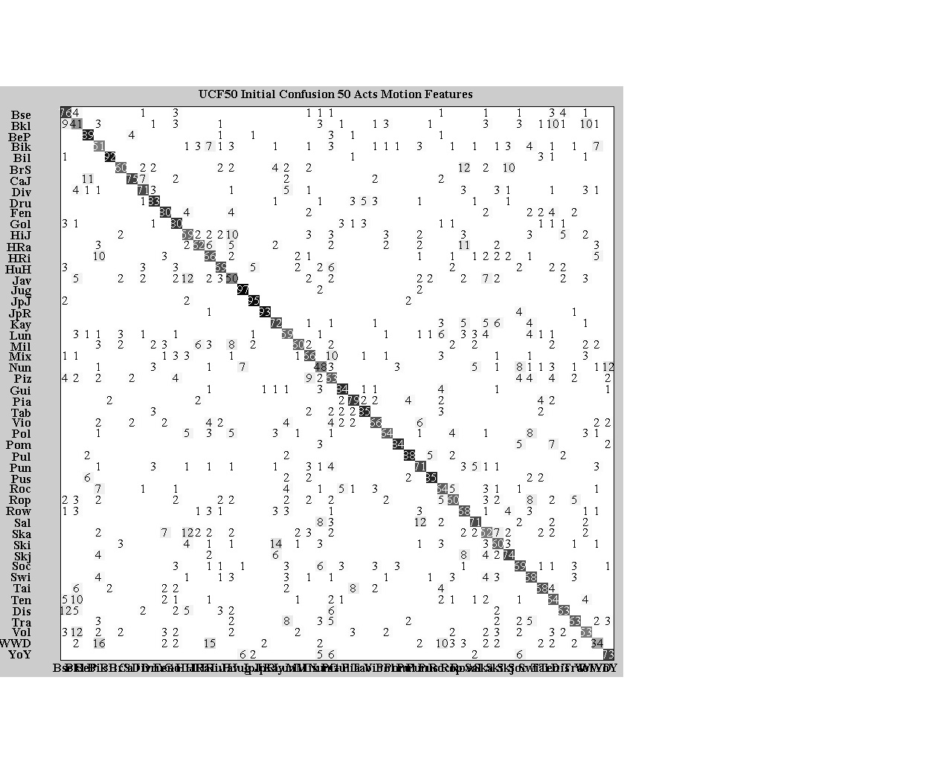
Initial Confusion Matrix

Slide 5
Hierarchical SVMs: Level 1
High jump = +8% improvement
Javelin throw = +7% improvement
High Jump Initial
59%
Javelin Throw Initial
50%
High Jump Final
67%
Javelin Throw Final
57%

Slide 6
Hierarchical SVMs: Level 2
PICTURE
Biking = 0% improvement
Walking with dog = +4% improvement
Biking Initial
51%
Walking With Dog Initial
34%
Biking Final
51%
Walking With Dog Final
38%

Slide 7
Hierarchical SVMs: Level 3
PICTURE
Kayaking = +4% improvement
Skiing = +3% improvement
Kayaking Initial
72%
Skiing Initial
60%
Kayaking Final
76%
Skiing Final
63%

Slide 8
Hierarchical SVMs: Level 4
PICTURE
Basket Ball = +3% improvement
Tennis Swing = -1% improvement
Basket Ball Initial
41%
Tennis Swing Initial
64%
Basket Ball Final
44%
Tennis Swing Final
63%

Slide 9
Hierarchical SVMs: Level 5
PICTURE
Nun chucks = 0% improvement
Yo-yo = +2% improvement
Nun Chucks Initial
48%
Yo-Yo Initial
73%
Nun Chucks Initial
48%
Yo-Yo Initial
75%

Slide 10
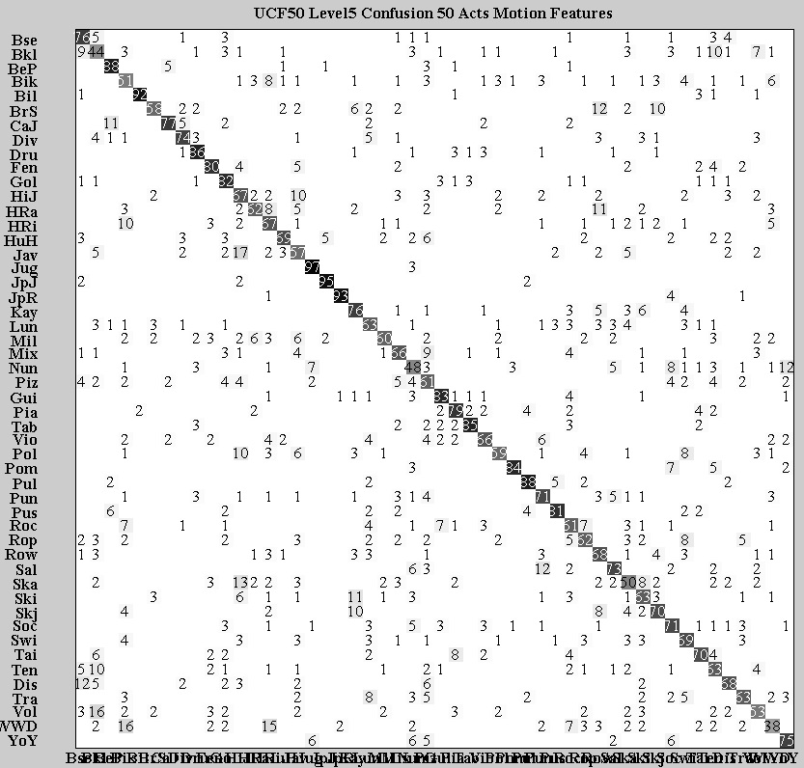
Level 5 Confusion Matrix

Slide 11
Current Work
Continue with more levels of the hierarchical SVM
Instead of using the two most confused actions
Retrain with highest confused and highest accuracy

