Slide 1
Thomas Swift
Week One PowerPoint

Slide 2
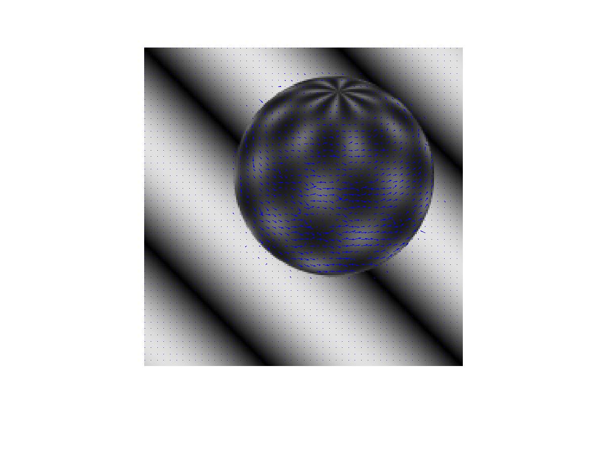
Lucas-Kanade- Optical Flow

Slide 3
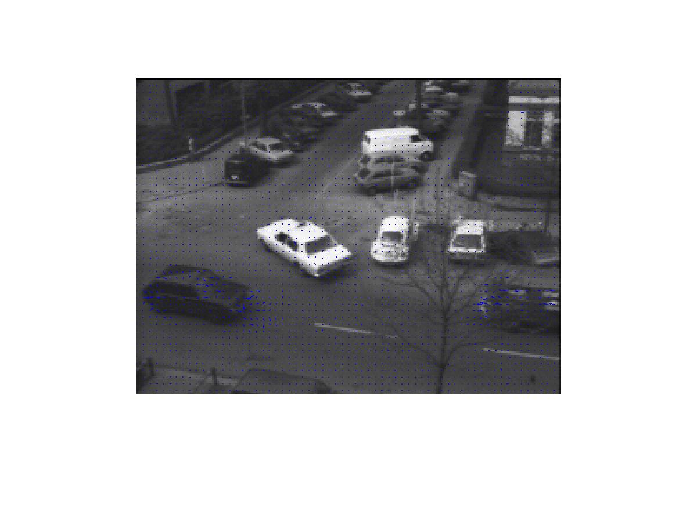

Slide 4
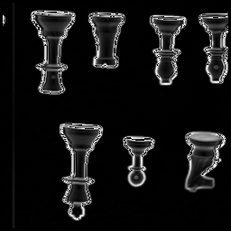
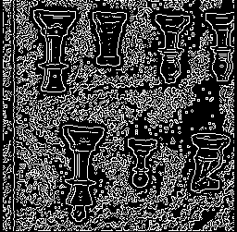
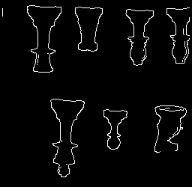
Canny’s Algorithm- Edge Detection
Sample Output (sigma = 1, low = 75, high = 150):
Magnitudes
Peaks
Final Edges

Slide 5

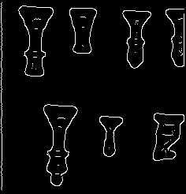
Varying the sigma parameter
Sigma = 1 (Peaks and Edges):
Sigma = 3 (Peaks and Edges):

Slide 6
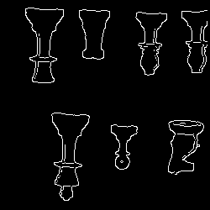
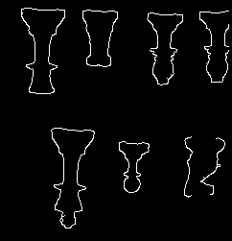
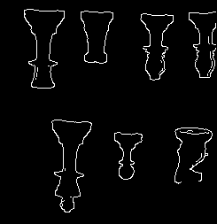
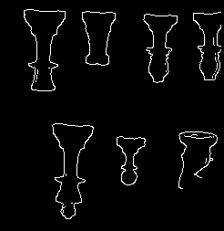
Varying the thresholds
Manipulating the high threshold (low = 75):
Manipulating the low threshold (high = 150):
100
150/200
230
10
75
125

