Slide 1
Thomas Swift
Week 10

Slide 2
Detection of football plays:
A Review
Goal: Given a video clip of a football play, classify the specific play (strategy) employed by the offense in that clip.
Motivation:
  Highly investigated topic in recent years
  At a generic level, is equivalent to analyzing complex behavior of group of people; could have applications to other action recognition scenarios (video surveillance)
Key Steps:
Do video registration pre-processing on clip.
Feature description (tracks, motion patterns, etc) to represent each clip.
Use Directed Information to match input clip to predetermined model of corresponding play.

Slide 3
Directed Information
DI(X^{N} → Y^{N}) = ∑ I(X^{(i)} ; Y_{i} | Y^{(i – 1)})
  Cumulative reduction in uncertainty of frame Y_{i} when the past frames Y^{i-1} of Y are supplemented by information about the past and present frames X^{i} of X.
I(X ; Y) = H(X) – H(X|Y) = H(Y) – H(Y|X) is the mutual information of X and Y.
  Amount of reduction in uncertainty of X after knowing/observing Y
  DI is extension of MI to random processes (random variables that change in value over time)
H(X) = -∑p(x)log(p(x)) is the entropy of X.

Slide 4
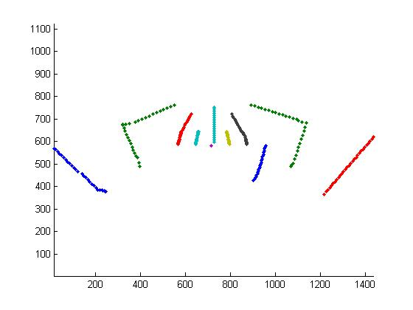
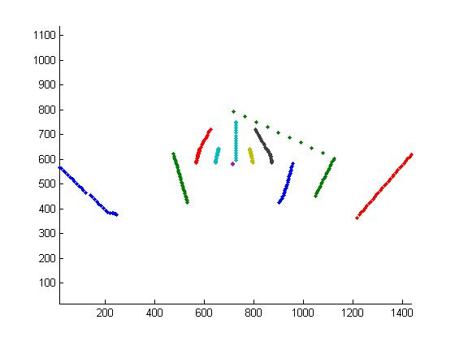

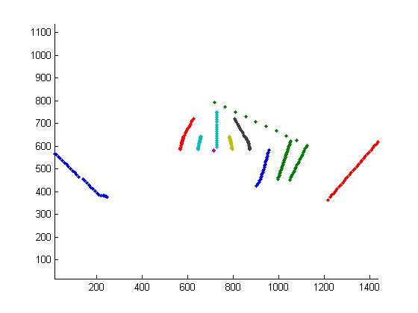
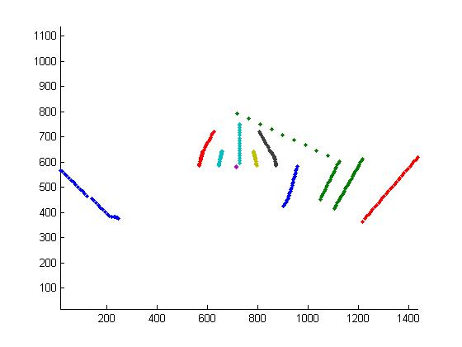
Directed Information on Football Tracks-Variation Within a Play
Post1
Post2
Post5
DI(Post2,Post1) = 6.831; DI(Post2,Post5) = 7.977
DI(Post3,Post1) = 5.914; DI(Post3,Post4) = 6.688
Post3
Post4

Slide 5
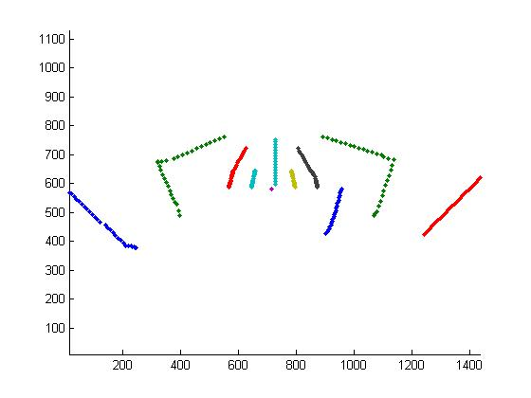
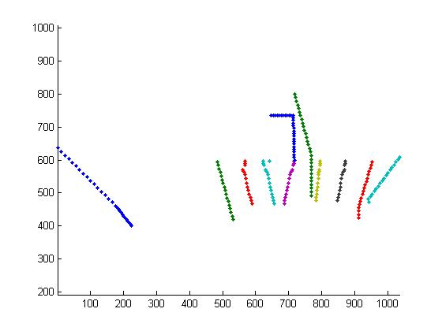
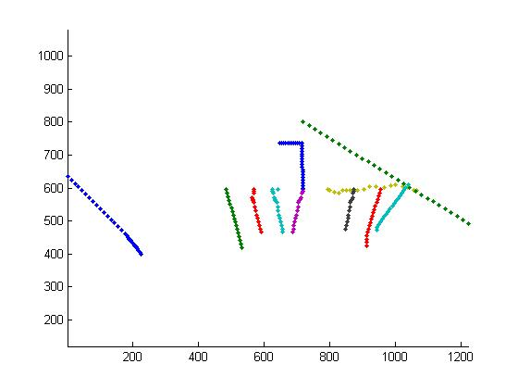
Directed Information on Football Tracks-Variation Among Different Plays
Post1
HM1
HBDraw1
HBSweep1

Slide 6
The Detection Program
Create bag-of-words codebook from tracks of all frames of all examples of all plays (4 plays, 10 examples per play)
Classify model plays and query play according to codebook; creates vector of numbers representation for each
Compute DI score between query and each model (avg DI score btw query and all examples of model)
Select model with highest DI score as the match to the query
Results: around 65% on average

Slide 7
The Problem with Tracks
Tested DI on manual tracks; but not automated tracks
Automated tracks- hard to acquire from football plays
  Heavy Occlusion
  Difficult to separate out tracks for each player
Therefore, tracks are an unreliable feature, and so have been abandoned

Slide 8
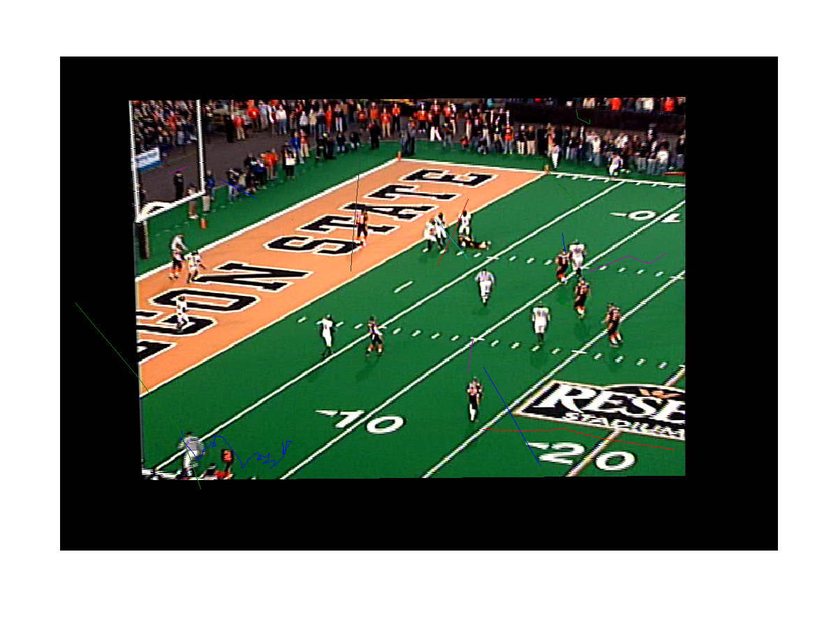
Sample Tracking Output

Slide 9
HOOF Features from Dense 3D Grid
Histograms of Oriented Optical Flow
  Pixels placed into histogram bins based on OF direction, contribute OF magnitude to that bin
HOOF features computed on each partial frame (2D block) in 3D block and concatenated
Codebook classification performed to get one number for each 3D block
Vector of all classified 3D blocks is model for play and is used in DI computation

Slide 10
Oregon State Football Dataset
23 plays split into 5 groundtruth classes (play types)
Using Dense 3D S-T HOOF features and frame registration w.r.t. to first frame, results were: 11/23(21) correct- 47.8%(52.4%)
  Only one example for 2 of 5 classes, which can’t be matched to themself

Slide 11
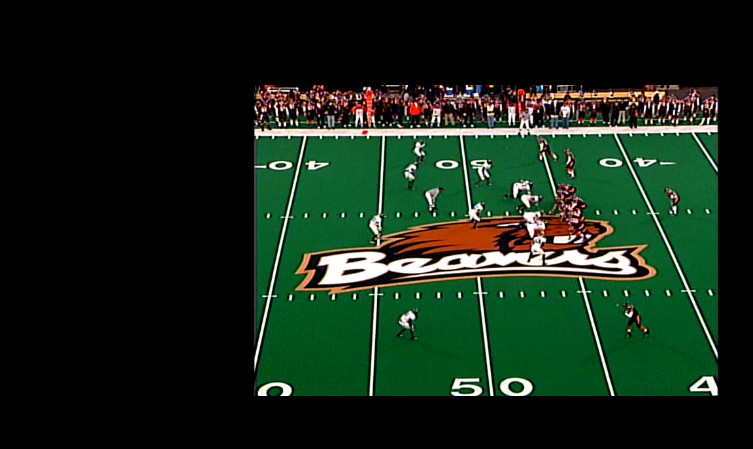
Frame 1

Slide 12
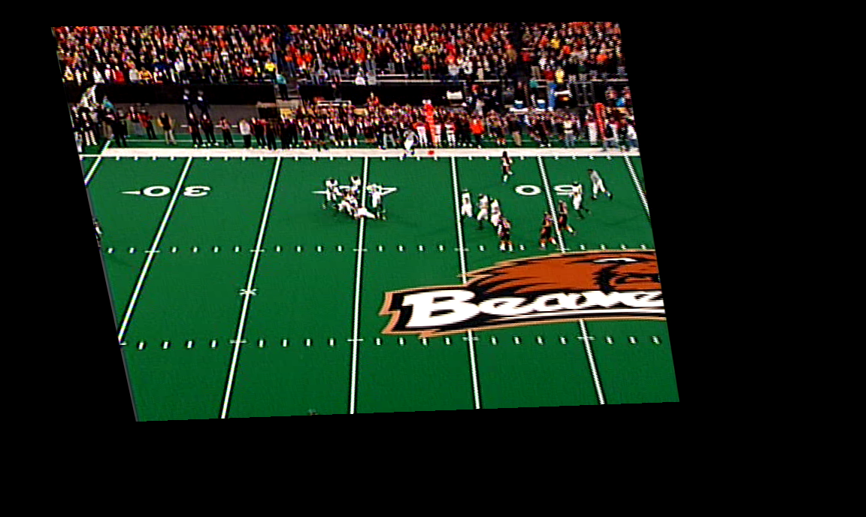
Final Frame (200)

Slide 13
This Past Week

Slide 14
Pre-processing on Optical Flow
Manipulate optical flow prior to computing HOOF features
  Clean flow boundaries (eliminate false flow)
  Make direction of flow consistent among all plays (have all plays run right or all run left, flip plays to conform with most common direction)
  a) Extract non-trivial (non-zero) flow from larger flow matrix
  (3b) translate non-trivial flow by centering non-trivial flow of first frame of each play

Slide 15
Results with Pre-processing
Without pre-processing: 11/23(21) correct- 47.8%(52.4%)
Through (2) [standardize direction]: 13/23(21) correct- 56.5%(61.9%)
Through (3a) [segment flow]: 5/23(21) correct- 21.7%(23.8%)
  BAD!!
Through (3b) [center flow]: 8/23(21) correct- 34.8%(38.1%)
  Classified everything as play type 2

Slide 16
Current work
Acquiring a better dataset
  OSU dataset is inadequate- only contains 25 plays and only 5 classes of plays (with uneven distribution)
  Trying to acquire Georgia Tech Dataset; is standard dataset with previously published results
  Are on the verge of acquiring set of plays from UCF football team; hopefully can form good dataset from this
Completing registration to static field model, and then retesting

