Slide 1
Thomas Swift
Week 11

Slide 2
Registration to field model
Complete!!
Not perfect- slight tilt/rotation of field at times
Possibly due to error in original registration
Causes noise in OF, which is weeded out through thresholding

Slide 3

Original Video Frames

Slide 4
Registration wrt First Frame

Slide 5
Registration wrt Field Model

Slide 6
Manipulation of Optical Flow
Starting with OF obtained from registered frames, do the following:
Zero out flow from blackened regions (false flow)
Threshold real flow
Rotate flow so that flow of all plays run in same direction (direction determined manually)
Align scrimmage lines to center of field model (centers of scrimmage lines determined manually)

Slide 7
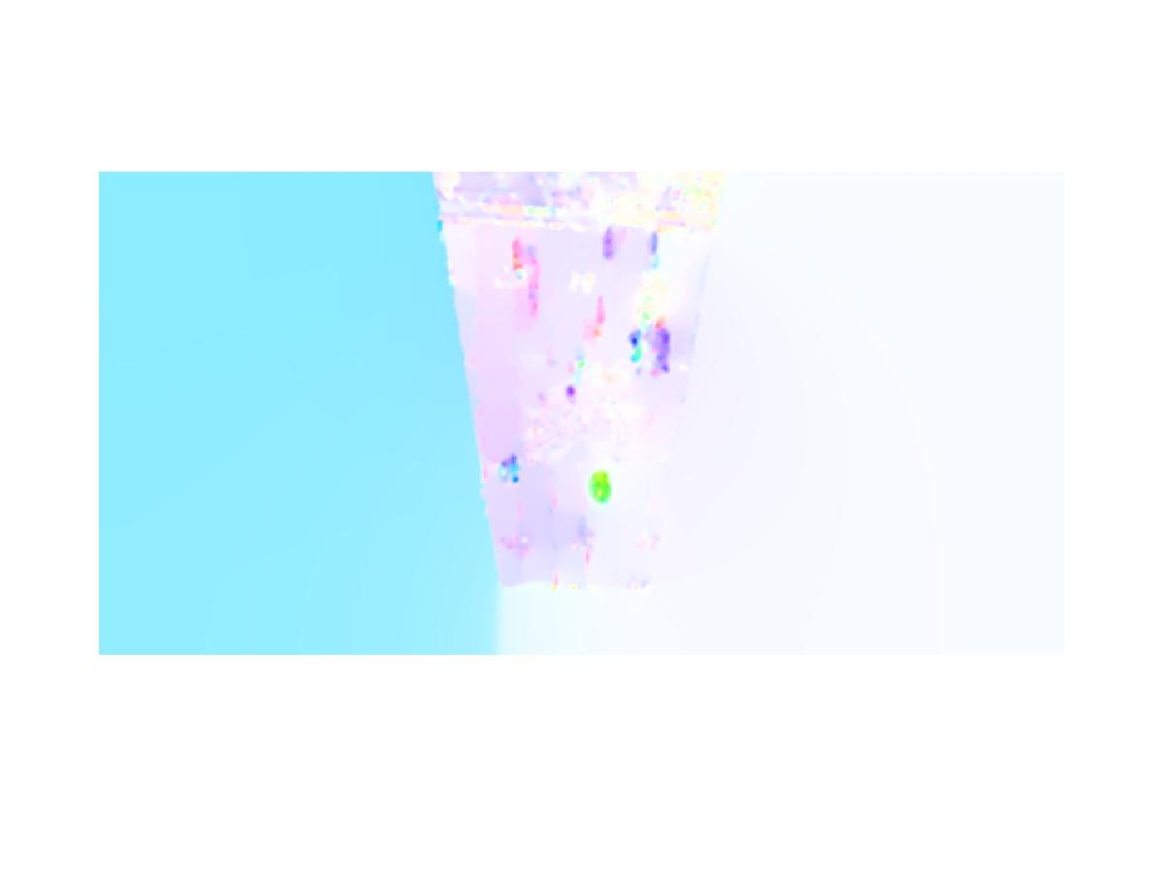
Optical Flow- Original

Slide 8
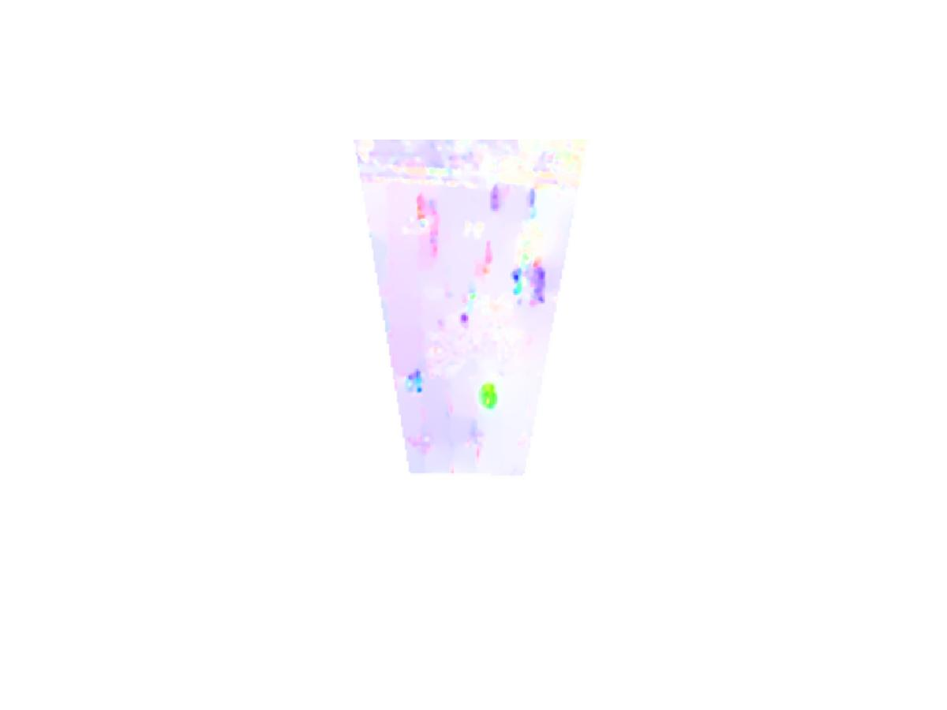
Optical Flow- Stage 1

Slide 9

Optical Flow- Stage 2

Slide 10

Optical Flow- Stage 3

Slide 11

Optical Flow- Stage 4

Slide 12
Results
Old registration (first frame)
From original OF: 11/23- 47.8%
Through stage 3: 13/23- 56.5%
Through stage 4a: 5/23- 21.7%
Through stage 4b: 8/23- 34.8%
New registration (field model)
From original OF: 7/23- 30.4%
Through stage 2: 5/23- 21.7%
Through stage 3: 4/23- 17.4%
Through stage 4: 3/23- 13.0%

Slide 13
Current Work
Redoing the original first frame registration using COCOA
Appears to be better
If results are better, redo field model registration for plays which previously were poorly registered
Applying PCA to Aladdin dataset to make testing feasible

