Slide 1
Thomas Swift
Week 12

Slide 2
Information from Camera Motion
Analyze masks for play’s frames following registration
Look at following data from masks:
Center of each mask (displacement)
Gradient between each mask
Area of each mask
Total area covered by all masks joined together
Observations:
Maximum/mean gradient higher for left/right runs than middle runs
Pass plays have greater maximum/total areas
Problems:
Field positioning (plays near endzone)
If runner breaks tackles and goes down field

Slide 3
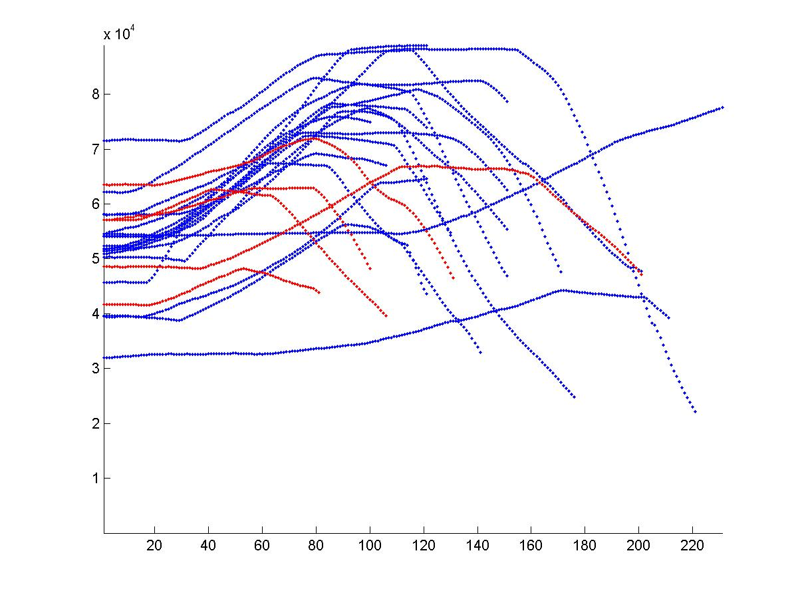
Areas

Slide 4
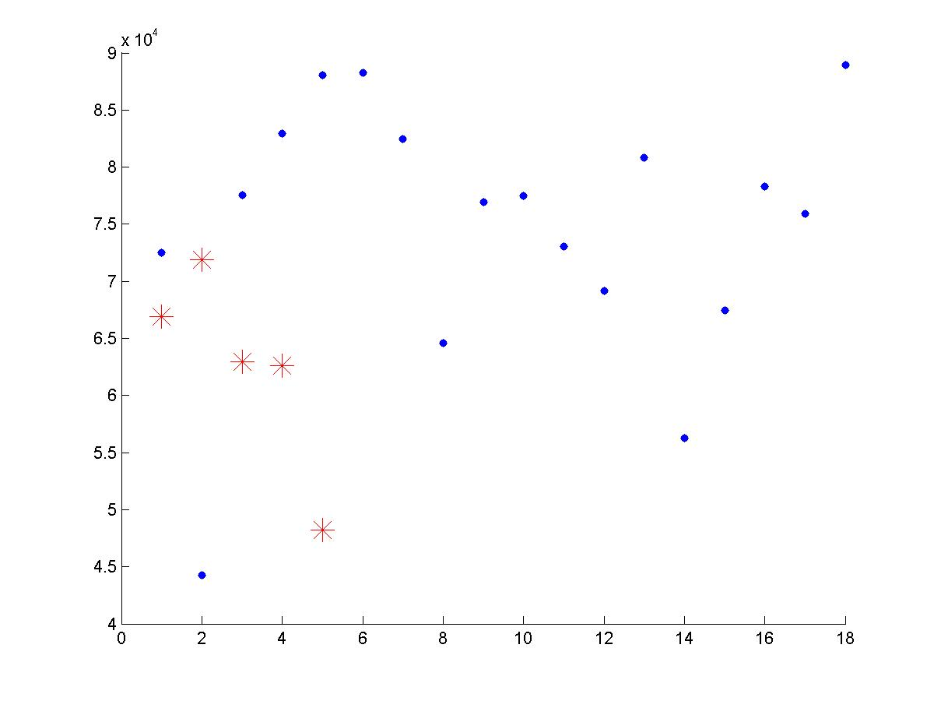
Maximum Area

Slide 5
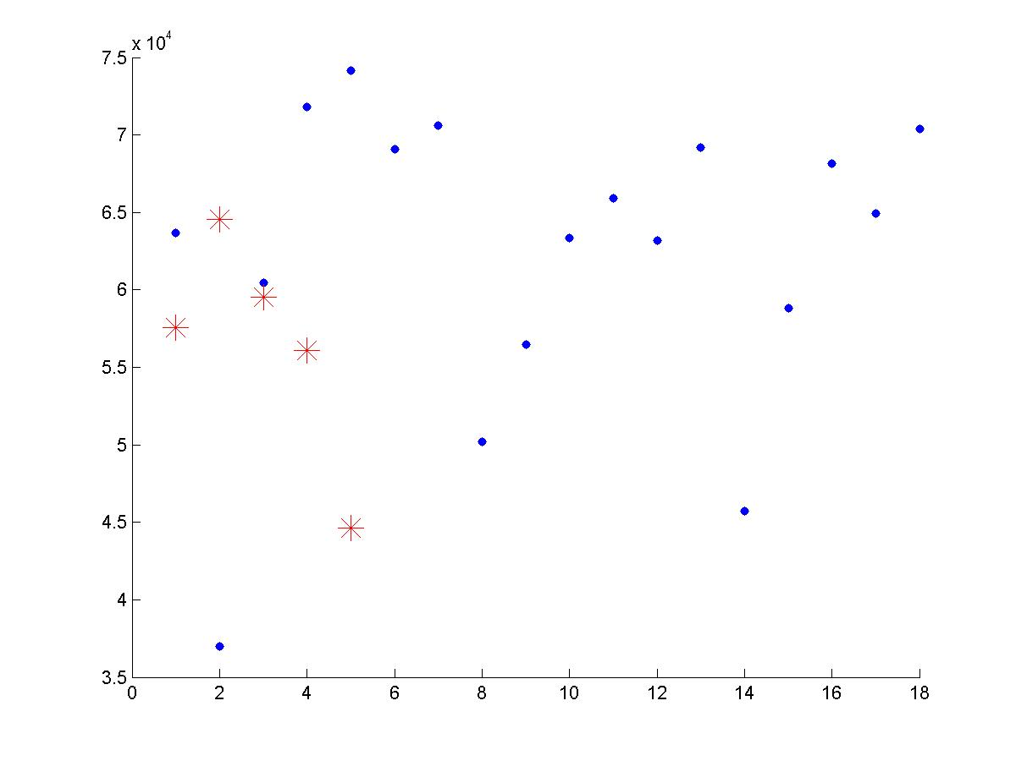
Mean Area

Slide 6
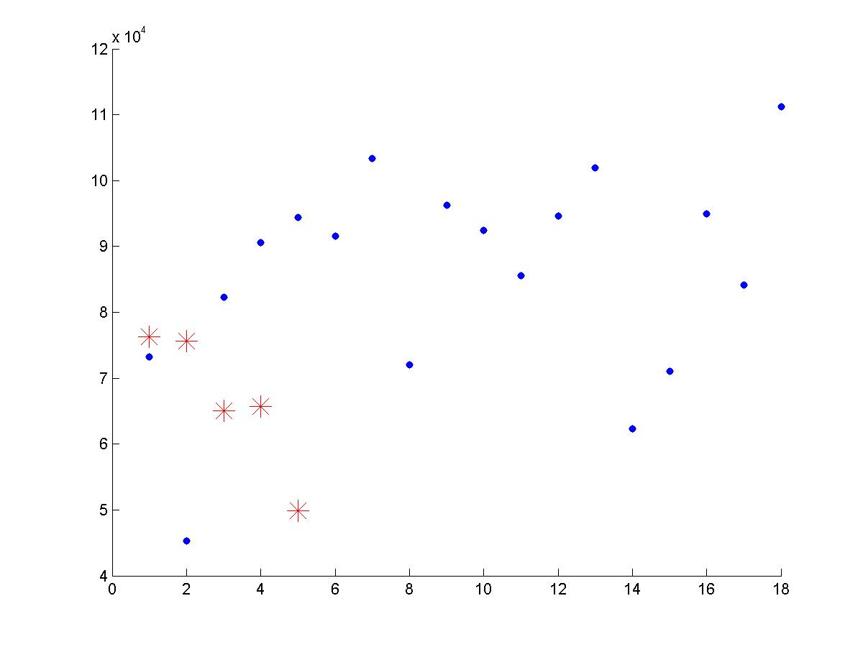
Total Area

Slide 7
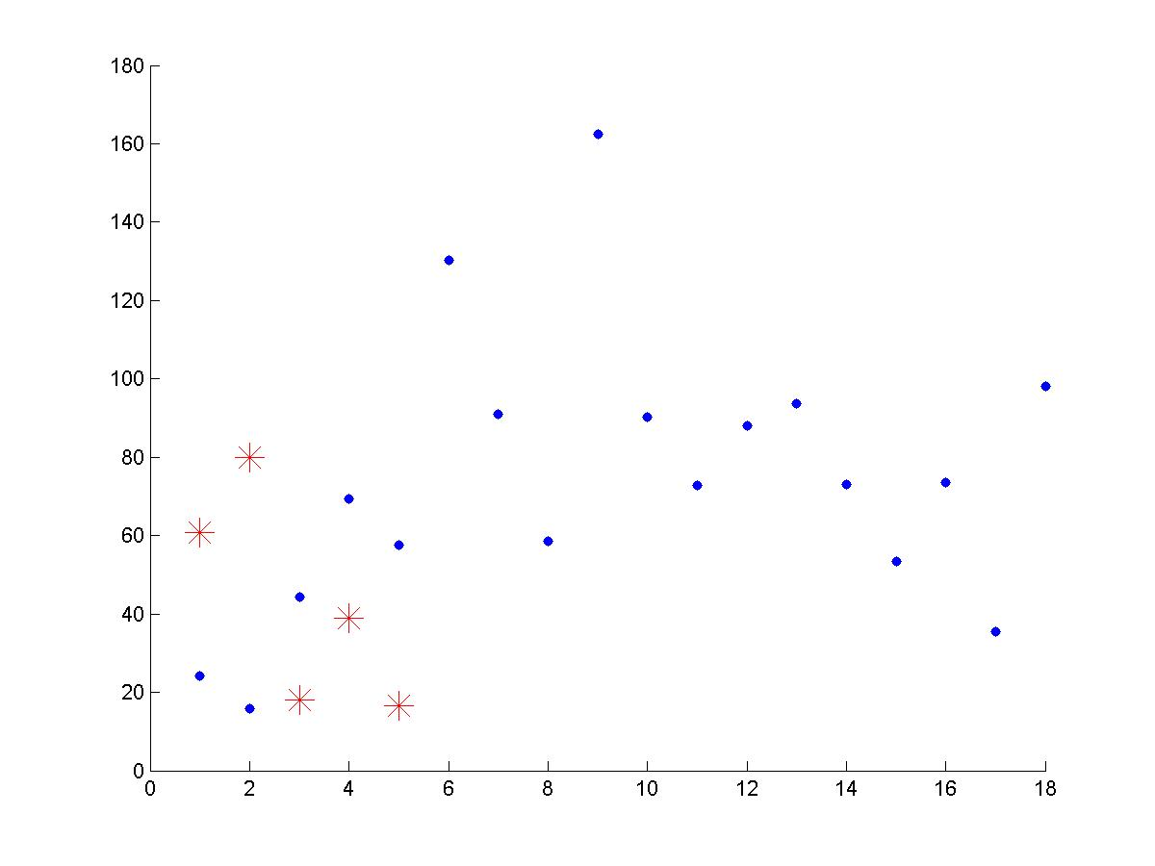
Maximum Displacement

Slide 8
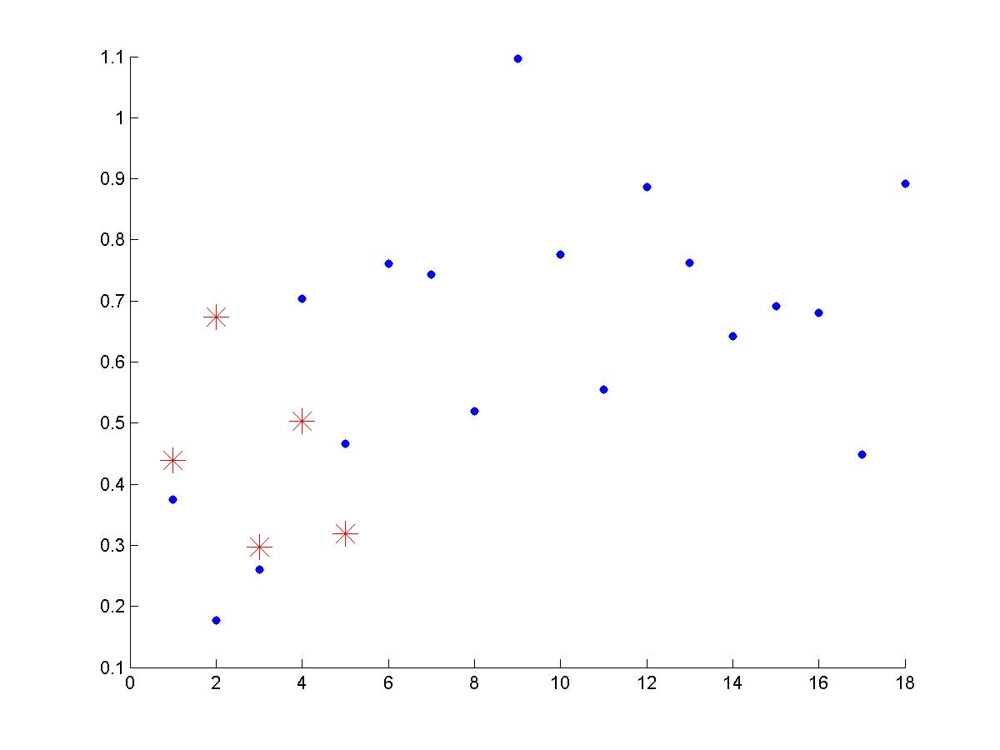
Mean Gradient

Slide 9
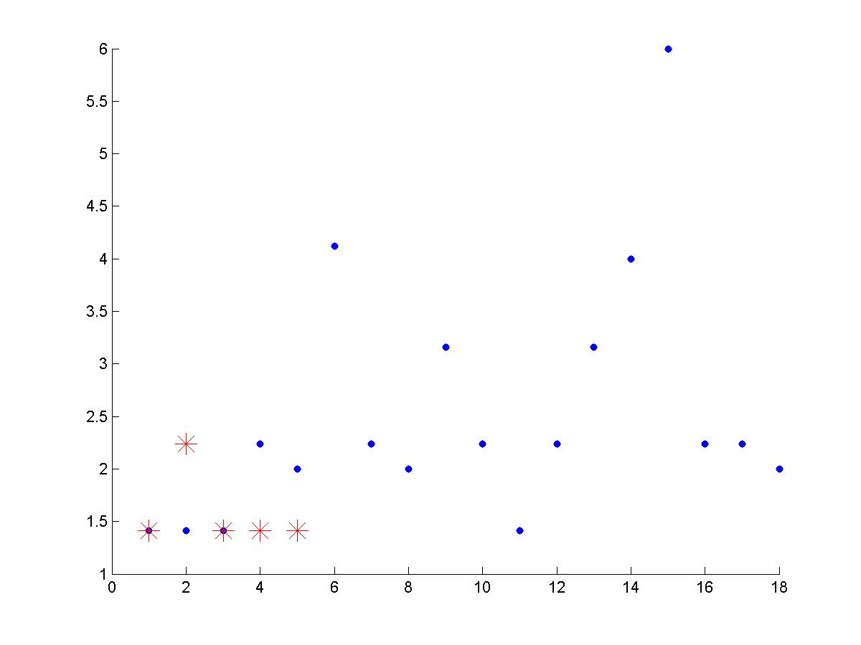
Maximum Gradient

Slide 10
Warping the Optical Flow
Registration methods:
First: respect to first frame
Little noise, but no uniform coordinate system between all plays
Second: respect to field model
Lots of noise, needs to be thresholded out
New approach: warp flow from first method to field model from second
Achieves uniform coordinate system with much less noise

Slide 11
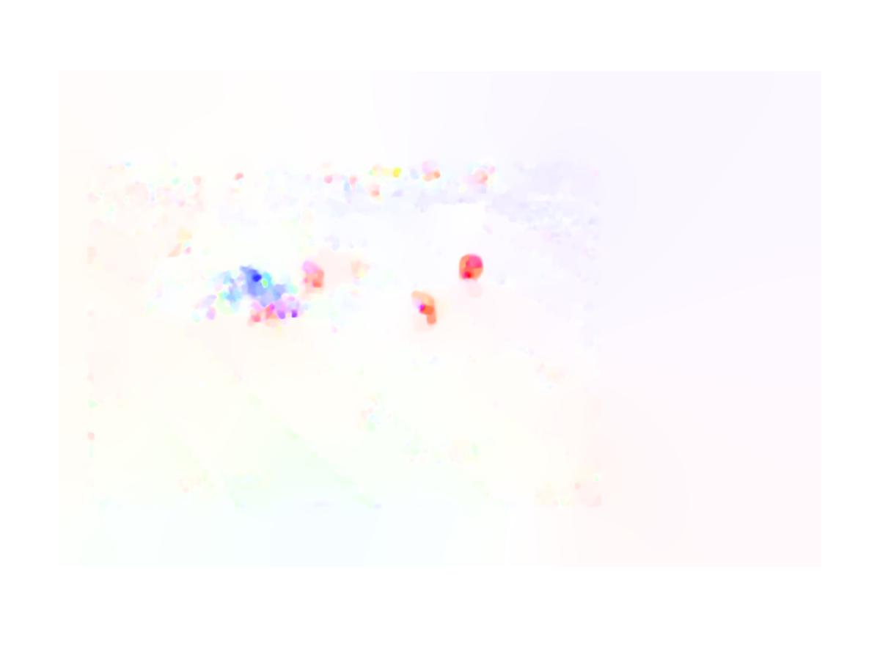
First method

Slide 12

Second Method

Slide 13

New Method

Slide 14
New Results
With unmodified flow- 39.1%
After thresholding- 34.8%
After flow rotation- 43.5%
Difficulty aligning scrimmage lines, no results yet
Reasons for optimism
Better than method 2
Doesn’t classify every play as same couple of plays
Doesn’t classify every play as pass play

Slide 15
Ways to improve in Future
Differentiate run/pass plays
10 plays which were classified incorrectly were classified as wrong play type (run vs pass)
Use camera clues
Look at consistent number of frames among all plays
Currently only looking at first 80 frames for all plays; lose lots of information for longer plays
Better recogniton for short passes than deep passes; probably because deep passes take longer to develop
Use fewer bins in HOOF histograms

