Slide 1
Thomas Swift
Week Two PowerPoint

Slide 2
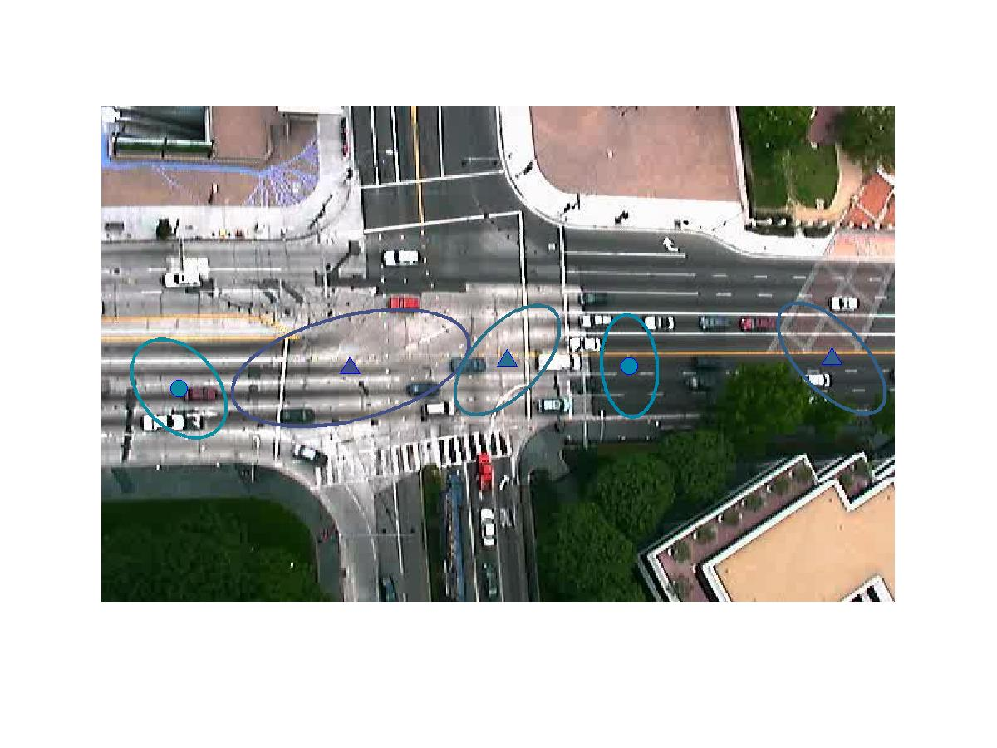
Gaussian Mixture Modeling
K = 5

Slide 3
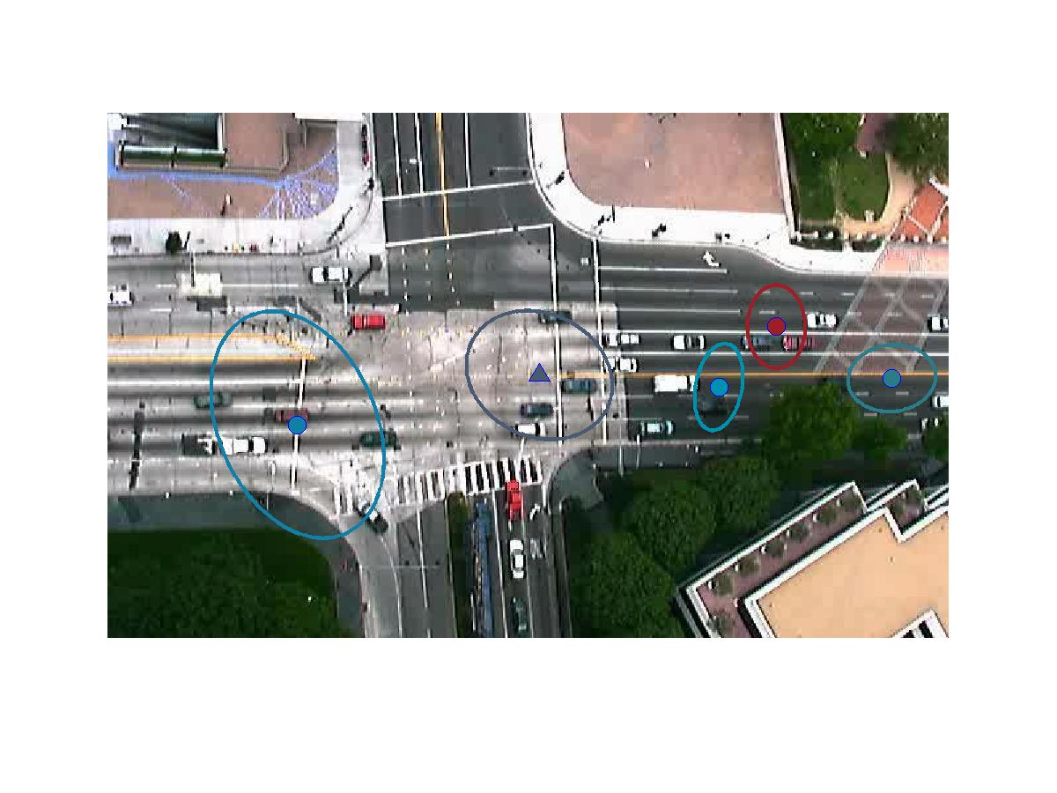

Slide 4
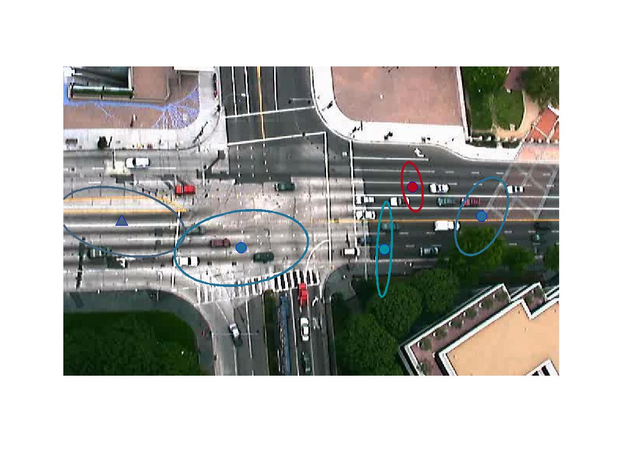

Slide 5

K = 10

Slide 6


Slide 7
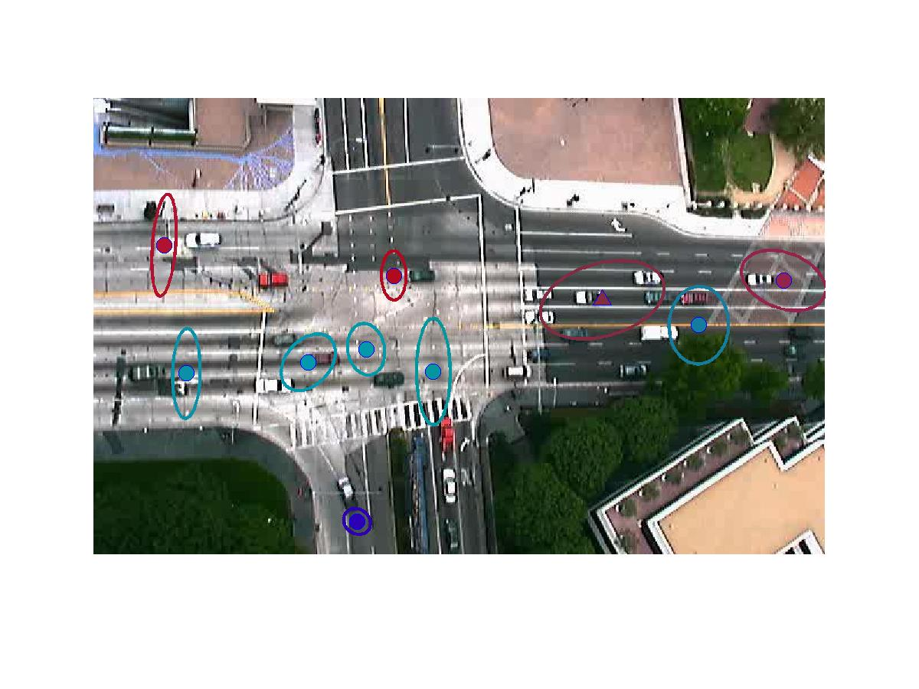

Slide 8
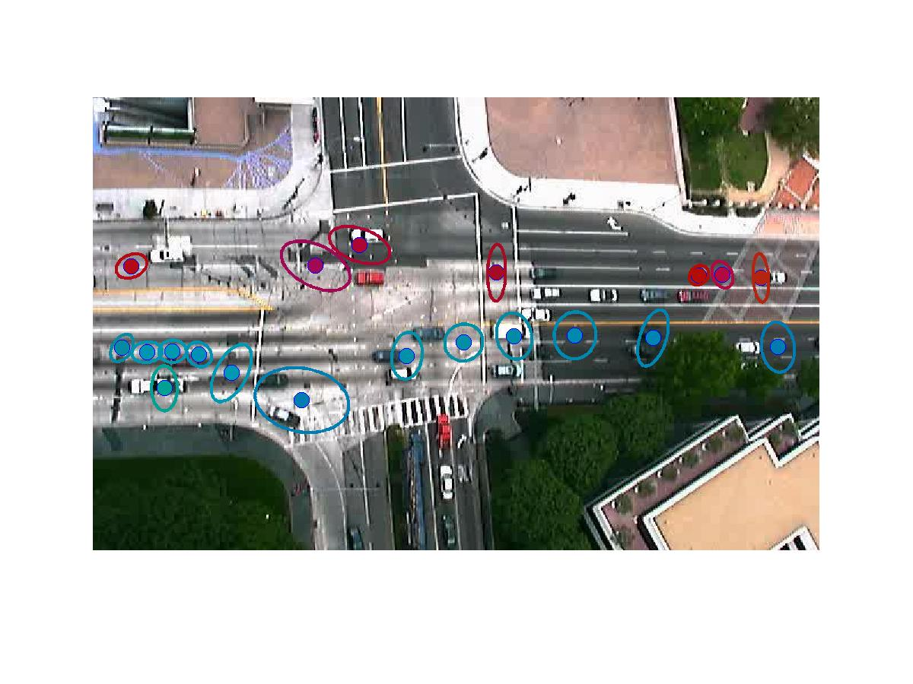
K = 20

Slide 9


Slide 10
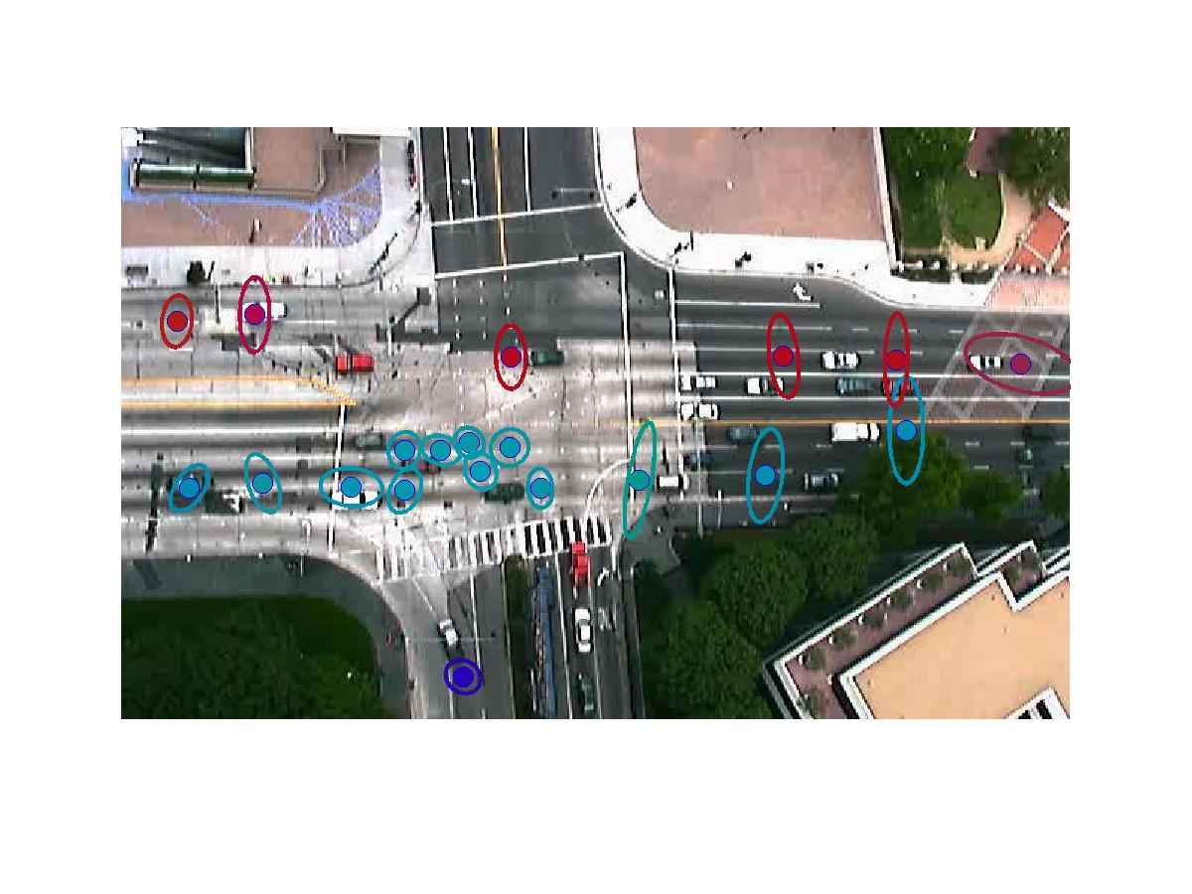

Slide 11
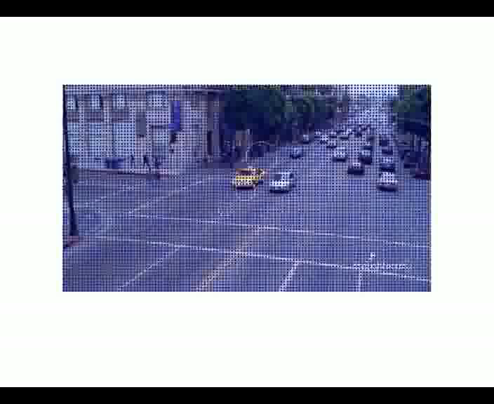
Particle Trajectories

Slide 12
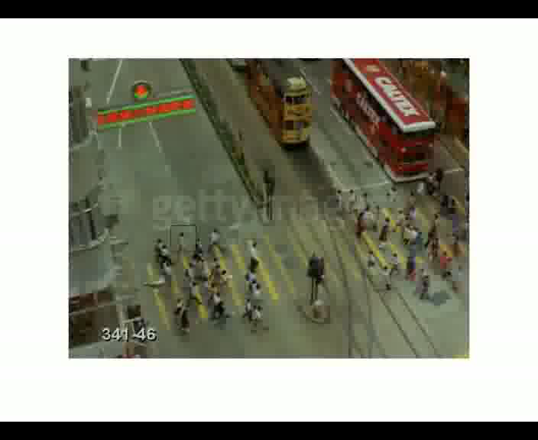
Object Tracking
Without Gaussian Filter

Slide 13
With Gaussian Filter (sigma = 1.5)

Slide 14
With Gaussian Filter (sigma = 2)

Slide 15
Potential Projects
Where am I?
Detection of Football Plays

