Slide 1
Thomas Swift
Week 3

Slide 2
Detection of Football Plays
Goal: Given a video clip of a football play, classify the specific play (strategy) employed by the offense in that clip.
Key Steps:
Do video registration pre-processing on clip.
Feature detection/description (tracks, motion patterns, etc) to represent clip.
Use Directed Information to match input clip to predetermined model of corresponding play.

Slide 3
Video Registration
Concept: Want to be able to refer to player trajectories in terms of static coordinate system (field). This makes comparison of trajectories among different clips much easier.
Why necessary?
Plays are filmed from different camera views and zoom lengths among video clips.
Within same clip, camera is constantly panning and zooming, resulting in constant coordinate changing.

Slide 4
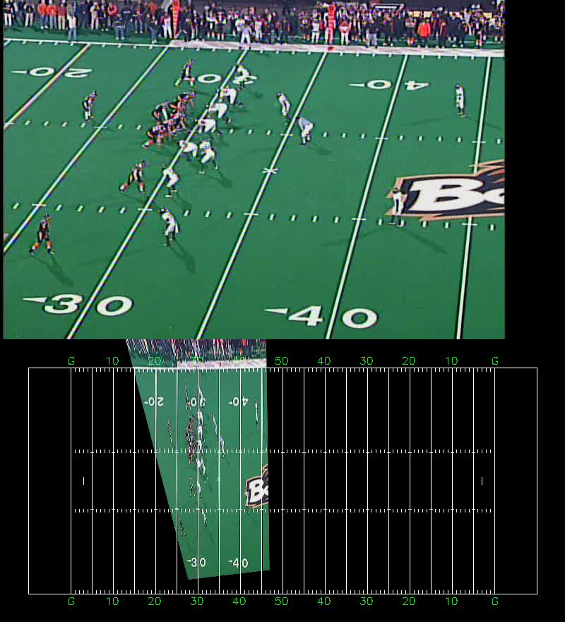

Slide 5
Directed Information
Builds off of Mutual Information
I(X;Y) = H(X) – H(X|Y)
Amount of reduction in uncertainty of X after knowing/observing Y
Extends MI to random processes (sequences of random variables)
Allows us to compare features accumulated through many frames of video clips, instead of just individual frames.

Slide 6
Papers
Universal Estimation of Directed Information
On Directed Information and Gambling
Recognizing Offensive Strategies From Football Videos
Improved Video Registration using Non-Distinctive Local Image Features

