Slide 1
Thomas Swift
Week 5

Slide 2
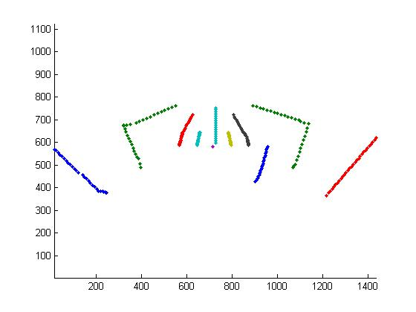
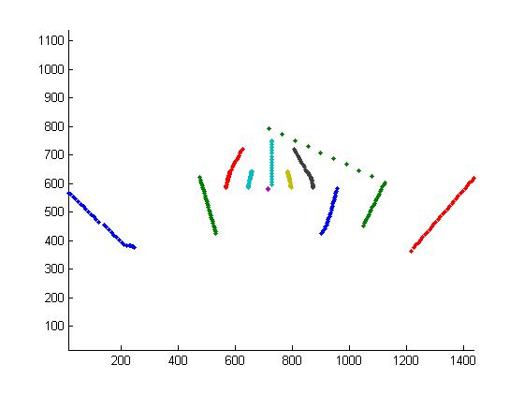

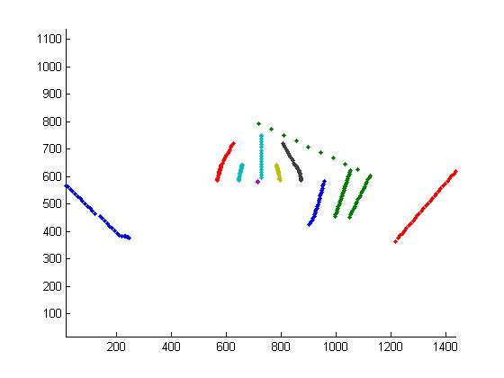
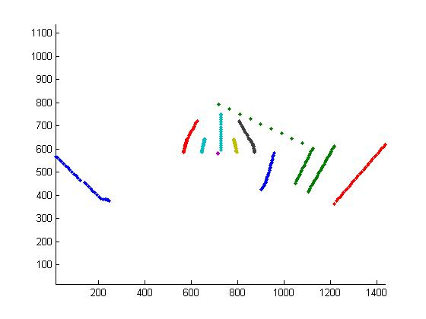
Directed Information on Football Tracks-Variation Within a Play
Post1
Post2
Post5
DI(Post2,Post1) = 6.831; DI(Post2,Post5) = 7.977
DI(Post3,Post1) = 5.914; DI(Post3,Post4) = 6.688
Post3
Post4

Slide 3
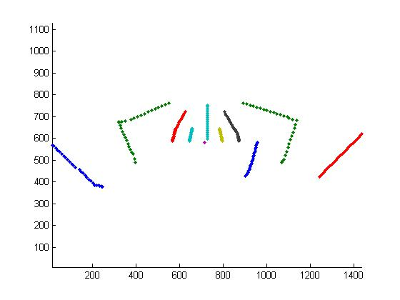
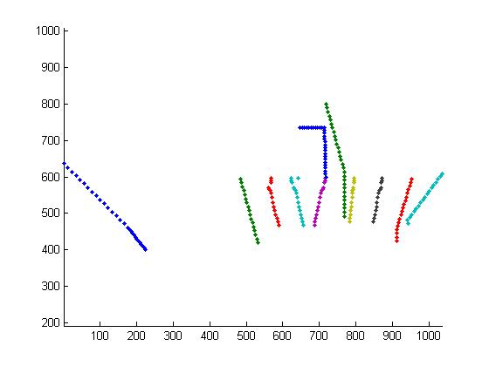
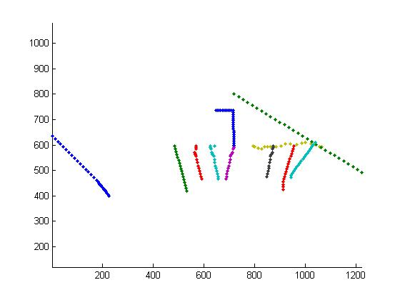
Directed Information on Football Tracks-Variation Among Different Plays
Post1
HM1
HBDraw1
HBSweep1

Slide 4
Results
Queries: [Post1; HM1; HBDraw1; HBSweep1]
HM1: [7.069; 7.325; 4.610; 5.583]
HBDraw1: [5.673; 5.703; 7.967; 7.729]
Post5: [5.531; 5.428; 3.785; 4.403]
HBSweep5: [4.724; 4.568; 4.716; 4.968]

Slide 5
The Detection Program
Create bag-of-words codebook from tracks of all frames of all examples of all plays (4 plays, 10 examples per play)
Classify model plays and query play according to codebook; creates vector of numbers representation for each
Compute DI score between query and each model
Select model with highest DI score as the match to the query

Slide 6
Results
1st Method- Model plays represented by just one of their examples
Initial Run: 40%
Min: 30%, Max: 50%, Mean: 39% (10 runs)
2nd Method- DI score btw query and model is average of DI scores btw query and all examples of the model play
Initial Run: 72.5%
Min: 52.5%, Max: 87.5%, Mean: 66% (10 runs)
MUCH better

Slide 7
Things to Do
Lower variance in DI values (and hence results)
Obtain better data
Get correct HM tracks
Get tracks for full length of each clip, not just first 29 frames; could lead to better track variation & hence results
Experiment with codebook size to see if better/more consistent results can be obtained

