Slide 1
Thomas Swift
Week 8

Slide 2
The Problem with Tracks
We have tested DI on manual tracks; but not automated tracks
Automated tracks- hard to acquire from football plays
Heavy Occlusion
Difficult to separate out tracks for each player
Therefore, tracks are an unreliable feature, and so have been abandoned

Slide 3
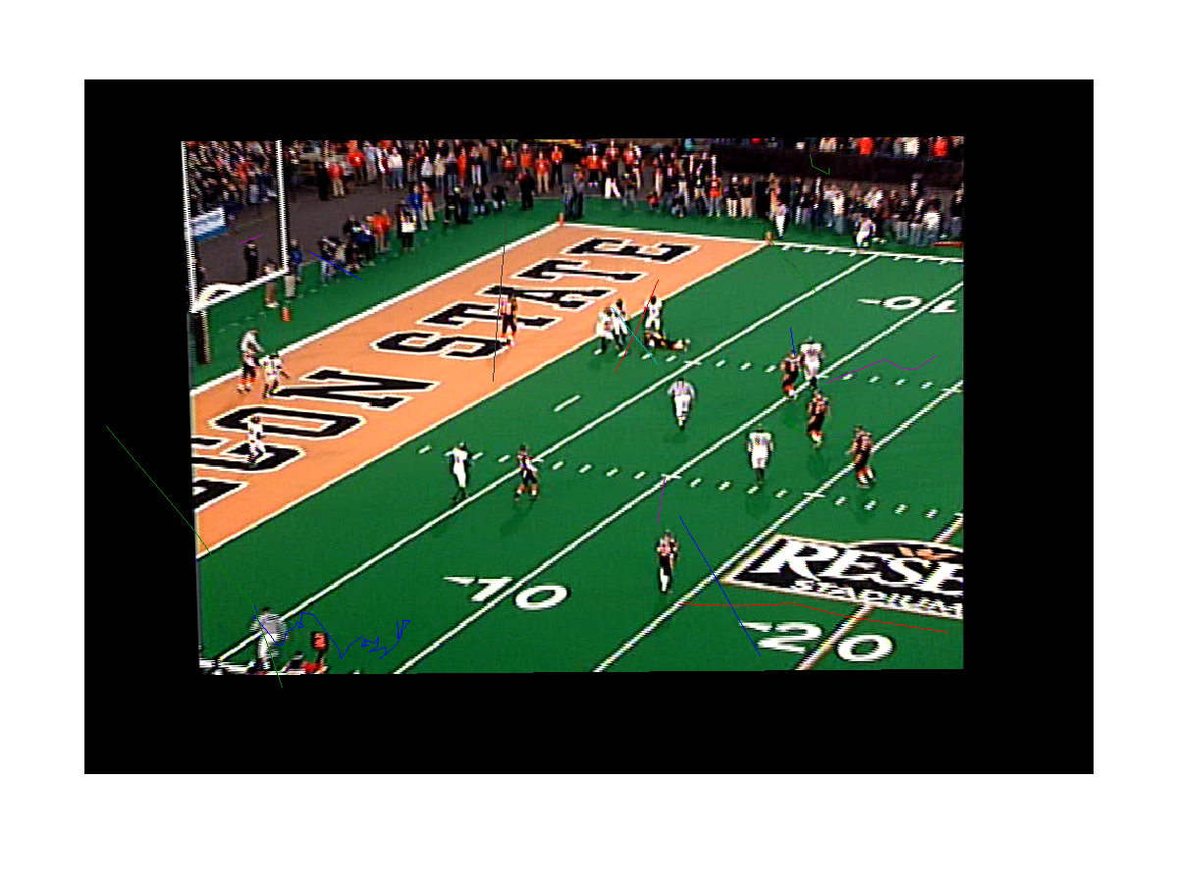
Sample Tracking Output

Slide 4
HOOF Features from Dense 3D Grid
Histograms of Oriented Optical Flow
Pixels placed into histogram bins based on OF direction, contribute OF magnitude to that bin
HOOF features computed on each partial frame (2D block) in 3D block and concatenated
Codebook classification performed to get one number for each 3D block
Vector of all classified 3D blocks is model for play and is used in DI computation

Slide 5
DI on ALADDIN Dataset
ALADDIN Dataset- 15 actions; about 120 videos per action
Received motion feature (Dollar spatio-temporal) histograms computed on all videos in dataset from Subh
Have histograms for varying codebook sizes (100,200,500,1000,2000)
Best prior results have been obtained on codebook of size 1000 (about 45%)

Slide 6
Results- In Progress
HOOF features on OSU Football Dataset
Still need to register all frames of all plays (25 plays) to static field model prior to computing optical flow- Salman is coding registration program
ALADDIN Dataset
Divided data into 80% training and 20% testing
On codebook of size 100 and with only testing half of test queries, results from one run are: 16/196
Results are for only one training/testing division

Slide 7
Ways to Improve ALADDIN Results
Determine why program is constantly outputting same wrong answers (8,13) and (14,12) [10/17 on action 8 correct, 6/7 on action 14 correct]
Check that features are represented in appropriate way for DI calculations
Need order sensitive representation
Try larger codebook size (1000)
Run program over all K testing/training divisions (account for anomalies)

